Slide 1
Scott Dynes^{1,2}
Hans Brechbühl¹
M. Eric Johnson¹
¹Center for Digital Strategies, Tuck School of Business
²Institute for Security Technology Studies
Dartmouth College
Information Security in the Extended Enterprise:
Some Initial Results From a Field Study of an Industrial Firm

Slide 2
Why this study?
- Tighter integration of supply chains might mean increased risk for firms due to cyber event.
- What role does the market play of adoption of information security? What are the drivers?
- Much talk (Clark’s Digital Pearl Harbor etc.), little data.
Notes:
Firms starting to use internet for core functions
3PLP example
Is InfoSec a consideration when considering vendors or business partners? Is it a competitive advantage to be better at InfoSec? If not, what are drivers of InfoSec adoption?
A lot of noise

Slide 3
Research Questions:
-How do firms make InfoSec investment decisions? How explicitly are they managing risk?
- Are firms exposed to risk through their use of the information infrastructure to manage their supply chain?
- Are big companies better at managing InfoSec risk than small companies?

Slide 4
Methods
Investigate a ‘host’ firm and a few suppliers of different sizes.
At each firm conduct interviews to determine:
- How InfoSec investment decisions are made.
- How reliant the firm is on the information infrastructure for its ability to produce product.
Understand the means by which the host and suppliers communicate to gauge the internal IT risk due to integration.
Supplier
Supplier
Host
Su
Supplier

Slide 5
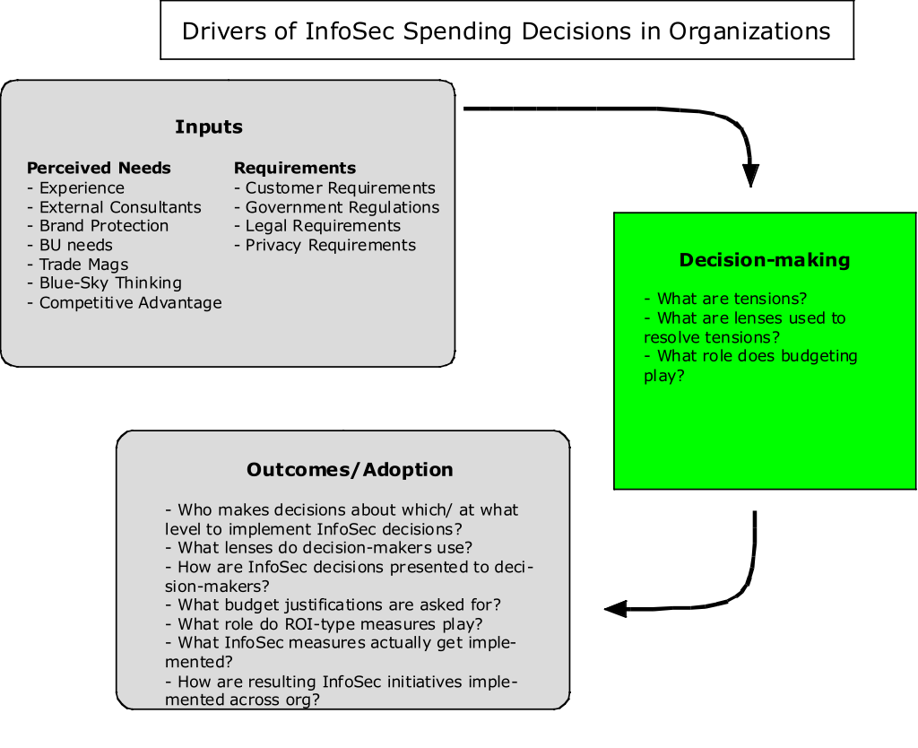
How Do Companies Make Investment Decisions?

Slide 6
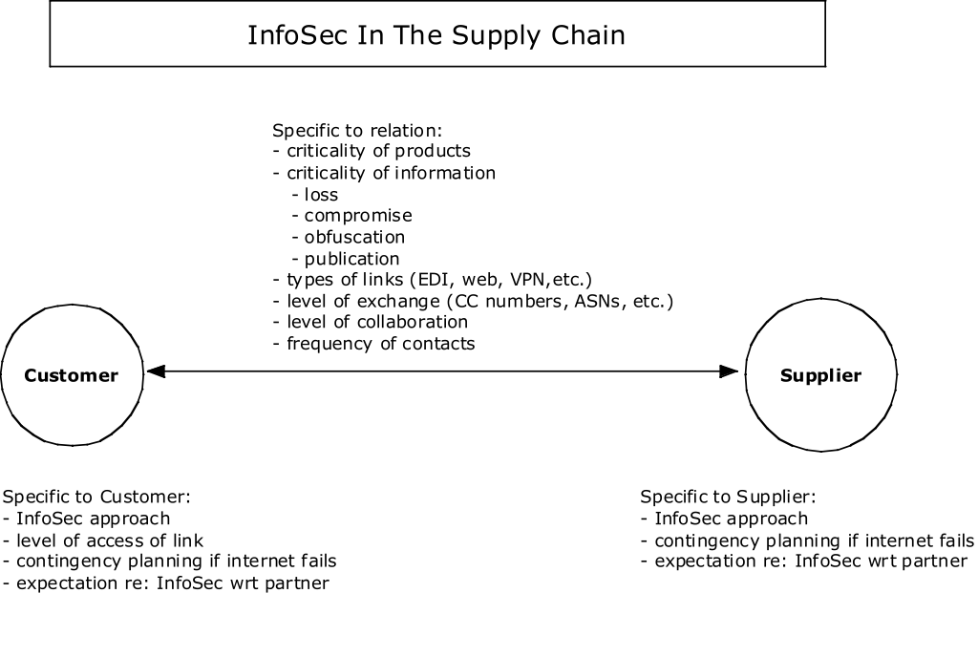
What are the Interdependencies Among Firms?

Slide 7
Results
Host is a Fortune 500 manufacturing firm; were able to engage 2 business units at which we interviewed 13 executives and managers of InfoSec and supply chain management.
Have interviewed 9 executives and managers at four suppliers.

Slide 8
Results: Study Participants
Product
Number of locations
Annual Revenues
Subsidiary?
Host
Conglomerate
many
several billions
No
Supplier A
Metal
many
few billion
Yes
Supplier B
Logistics Services
many
few 100 millions
Yes
Supplier C
Printing/Design
few
few 10 millions
Yes
Supplier D
Metal parts
one
few millions
Yes

Slide 9
Results - Drivers of Adoption of InfoSec
Baseline level of InfoSec to secure internal network and data (InfoSec “needs”). This level is based on:
  - Experience
  - Input from trusted colleagues
  - External Consultants
  - Trade mags/ other press
Above and beyond that, firms respond mainly in response to:
  - Customer requests/questionnaires
  - Government regulation
Notes:
Smaller companies tend to outsource their InfoSec responsibilities to consultants or SMB InfoSec specialists.
Talk about Jack’s industry group - “best money I spend”

Slide 10
Results - Drivers of Adoption of InfoSec
How were InfoSec recommendations prioritized, and received by decision-makers? (Two firms talked about this process in detail)
At InfoSec manager’s level, InfoSec “wants” prioritized by:
- Cost
- Exposure
At decision-maker level, InfoSec “wants” are not a priority at one firm; other firm has discussion of downside, probability, and cost to mitigate.
Notes:
Story of Host and closing of quarter and virus

Slide 11
Results - Drivers of Adoption of InfoSec
Risk analysis - no quantitative risk analysis in this group; some believe it impossible. Some did qualitative analysis.
Info on costs of attacks came from:
-Gut
Info on probabilities came from:
- History
- Industry pubs
- Gartner/Meta/etc.
- Gut
- “Al”
- Tech Republic
Notes:
Those most clueful spoke of managing outcomes rather than vulnerabilities through redundancies - paper given yesterday

Slide 12
Results - Drivers of Adoption of InfoSec
All firms thought of InfoSec as an expense
Most thought of InfoSec as a qualifier, even though none had any InfoSec requirements of their business partners
Few gave examples of InfoSec as a competitive advantage
Notes:
Bring up Quality analogy
Mention that is a competitive advantage to some oil firms

Slide 13
Results - Risks Due To Integration
Two types of risk were examined:
- Risk to firm’s internal IT infrastructure
- Risk to firm’s ability to produce product due to use of information infrastructure to manage supply chain

Slide 14
Results - Internal Risks Due To Integration
Communication Channels between Host and Suppliers
Web App
VPN
Electronic Data Interchange (EDI)
Email
Host*
Y
Few
Y
Y
Supplier A
N
N
Y
Y
Supplier B
N
N
Y
Y
Supplier C
N
N
N
Y
Supplier D
Y
N
N
Y
Risks (according to host InfoSec manager):
- Web apps most risky
- VPN not so risky
- email/EDI least risk
* One Host BU to integrate tightly with a third-party logistics provider

Slide 15
Results - Supply Chain Risks Due To Integration
Communication channels with suppliers
Web App
EDI
email
Phone/Fax
Host BU #1
(20% -> 100%)
(40%)
0%
12%
Host BU #2
0%
50-60%
0%
40-50%
Supplier A
0%
0%
0%
100%
Supplier B
0%
60%
0%
40%
Supplier C
0%
0%
80%
20%
Supplier D
0%
?
?
?
All Firms say that if internet were to fail they would revert to the 3 F’s: phone, fax and FedEx

Slide 16
Results - Supply Chain Risks Due To Integration
Effects on ability to produce product from an Internet outage of:
 | An afternoon | 1 day | 3 days | A week
Host BU #1 | none | Low volume plants: pain | Hi volume plants OK | Hi volume plants: shipping issues
Host BU #2 | ASN disruptions | Stock available | Customers would see slack | Unable to produce all items
Supplier A | none | none | none | none
Supplier B | [confident there would be no impact on delivering products]
Supplier C | none | none | none | none
Supplier D | none | none | none | none
All Firms say that they would do whatever it takes to move product; biggest hassle would be in processing invoicing/payment paperwork.
Notes:
Relate lo-hi volume story
Talk about fax insufficiency at Host BU #2
Talk about few/many customers

Slide 17
Results - Are Bigger Companies Better?
Reported Incidents in Past Year (2004)
 | Virus/Worm | Break-In | Web Site Defacement | # of InfoSec methods used (out of 16)
Host | N (Y in 2003) | N | Y | 10
Supplier A | N | N | N | ?
Supplier B | N (Y in 2003) | N | N | 12
Supplier C | N | N | N | 6
Supplier D | N | N | n.a. | 8
Notes:
Talk about firms not titrating, but investing to see zero events; talk in superficial way about maintaining brand.

Slide 18
Key Take-Aways
Drivers of Adoption:
- InfoSec becoming a qualification in manufacturing.
- Customer demands are the key driver of additional InfoSec methods.
Risks to Firms Due to Use of Internet to Manage Supply Chain:
- Manufacturing sector largely reactive wrt InfoSec Needs.
- Risk to internal IT systems low, but increasing.
- Risks to supply chain low for internet outages of 3 days or less.
Are Big Firms Better at InfoSec?
- Big firms devote more resources.
- All interviewed firms have appropriate or better levels of InfoSec.
And...
- Firms are looking to share information in appropriate forums
- Firms are investing to experience zero successful attacks (no titration)

Slide 19
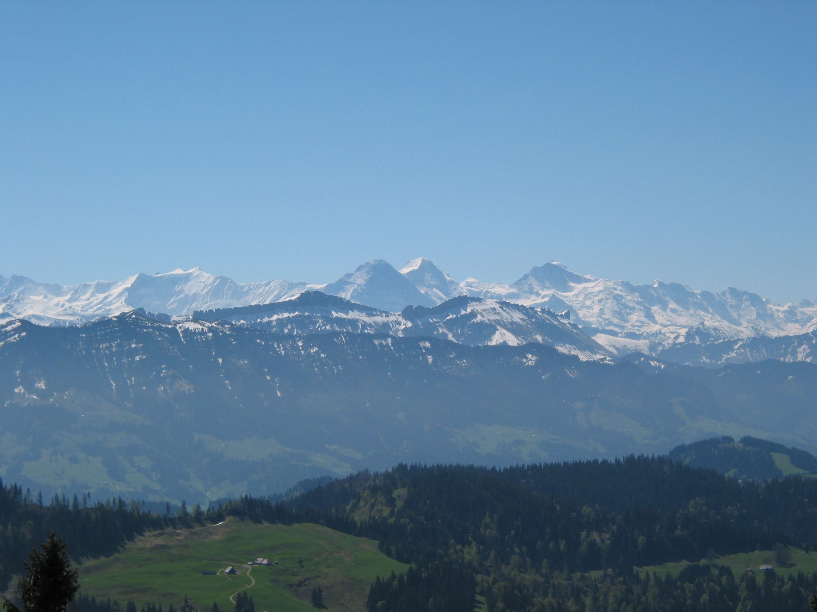

Slide 20
Discussion: Drivers of Adoption of InfoSec
- Every firm adopted a just-do-it base level of information security that is effective for current threats.
- Customer demands and government regulations are the main drivers for additional InfoSec (but didn’t result in increased security).
- Interviewed firms mainly reactive wrt InfoSec.
- Market forces are active but incomplete.
- Interviewed firms take narrow view of what they are protecting.

Slide 21
Discussion: Internal Risks Due To Integration
- Small, as most interviewed firms do not integrate tightly
- Exception: outsourcing of logistics likely means tight integration

Slide 22
Discussion: Supply Chain Risks Due To Integration
- For short outages, pain will mainly be in customer relations
- Firms that supply a lot of things to a lot of customers unlikely to be able to revert to the 3 F’s: phone, fax, FedEx
- Logistics is likely the limiting factor

Slide 23
Discussion: Risk Management
- In manufacturing, risk management is implied at best; no firm uses a risk management methodology; some say explicitly can’t manage threats, only outcomes.
- Interviewed firms adopt a narrow definition of risk: only things that happen within my perimeter.
- How to know the threats and the probabilities?

Slide 24
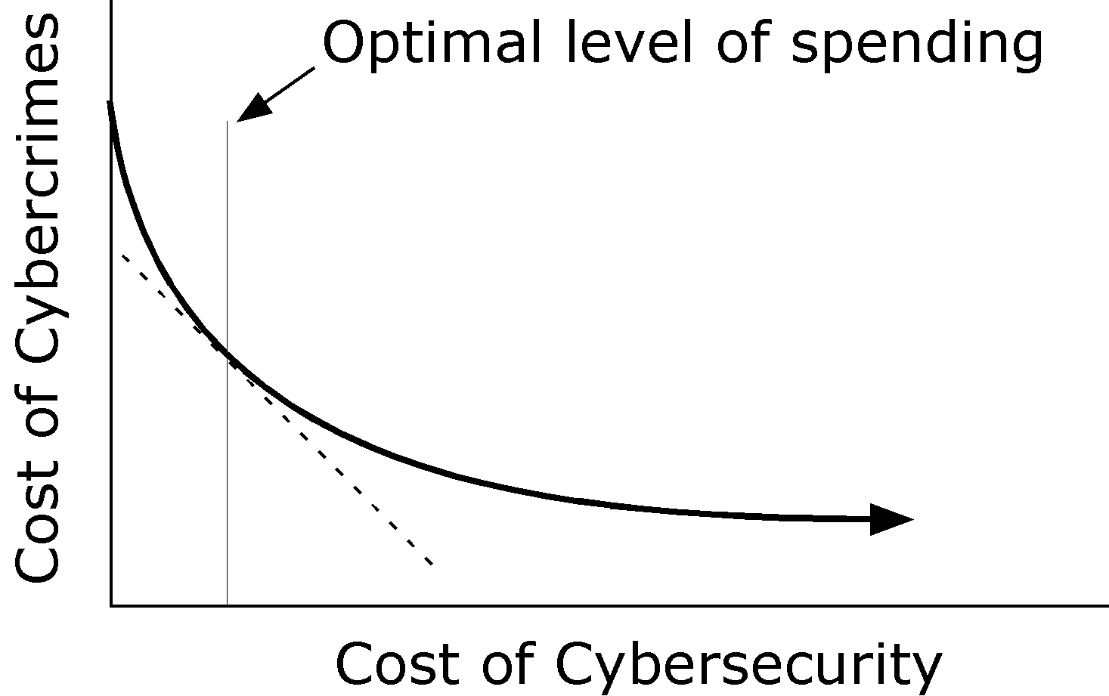
Assumes you know:
-Level of InfoSec spending
-Costs of lack of InfoSec spending
Implicit: a definition of what is important to protect
Implicit: you are managing risk

Slide 25
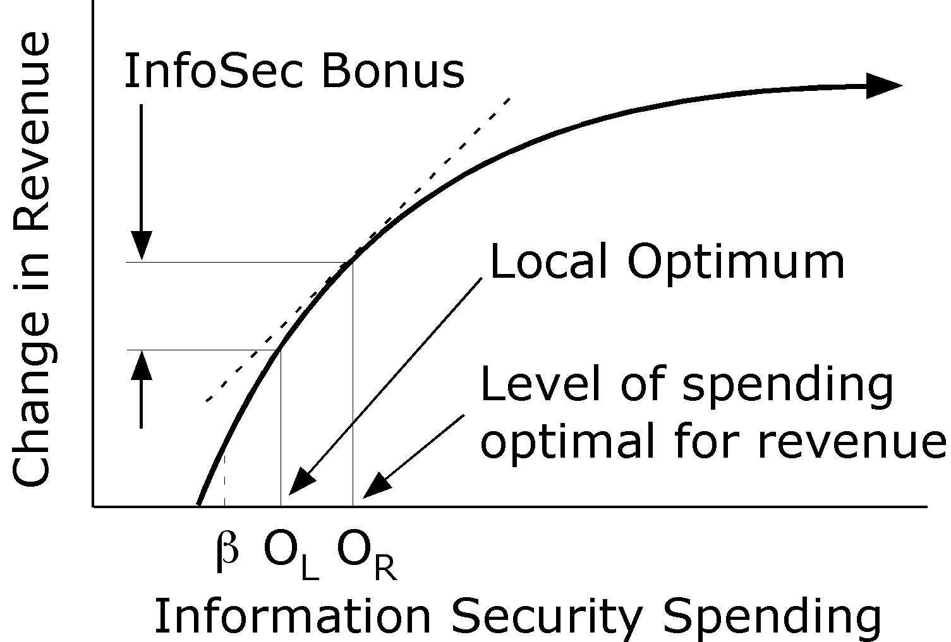
What market forces would look like:
Making more money

Slide 26
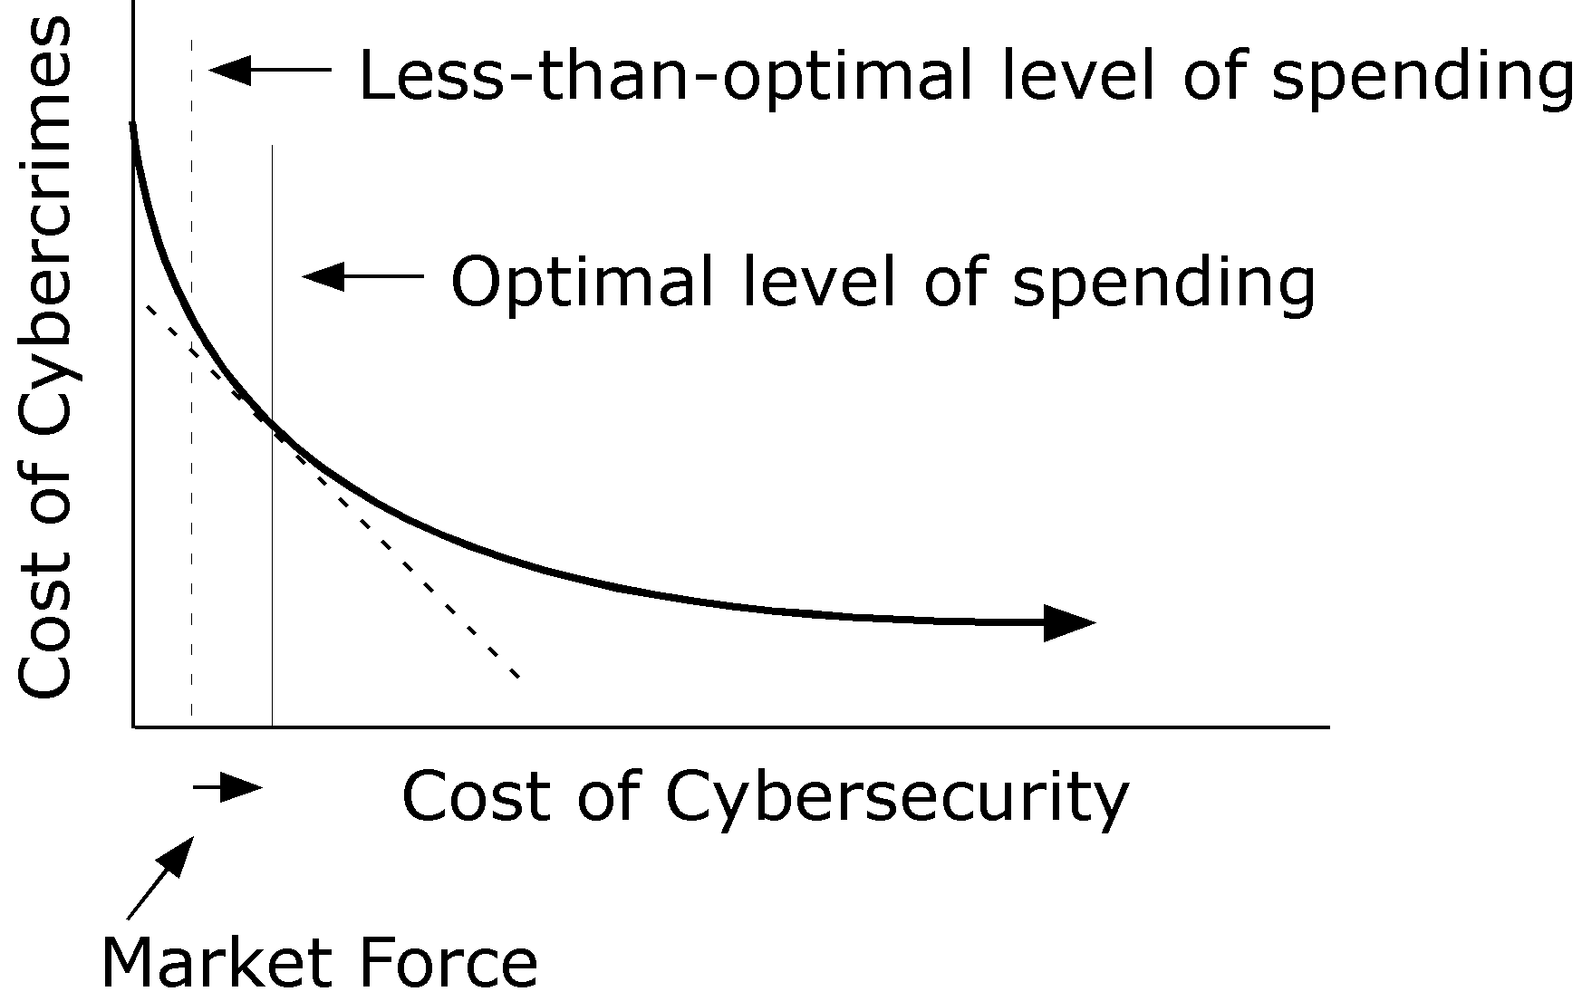
What market forces would look like:
Lowering costs

Slide 27
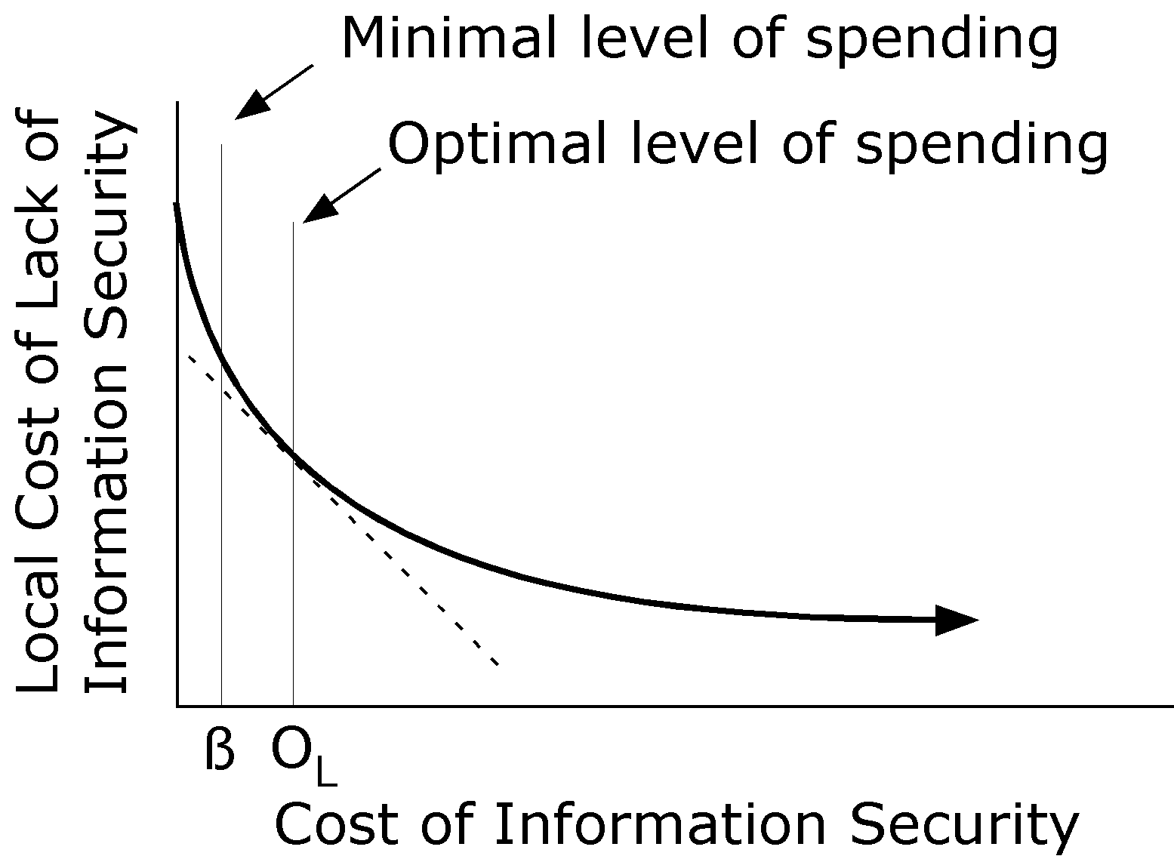
Corporate Level

Slide 28
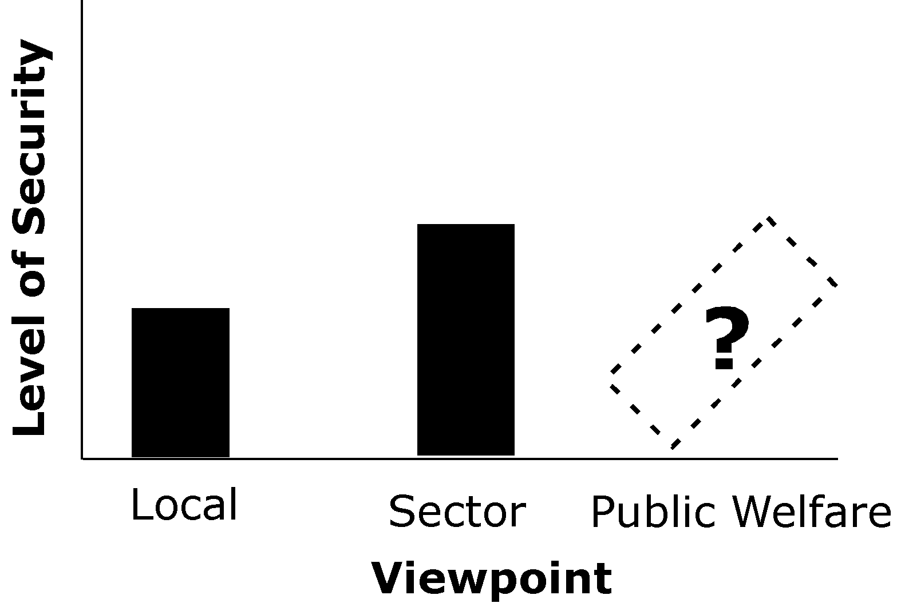
Government

