Slide 1
An empirical approach to valuing privacy
Luc Wathieu
Harvard Business School
Harvard University
Allan Friedman
Kennedy School of Government
Harvard University

Slide 2
Outline
Privacy, utility and complex models
Hypotheses for the sophisticated consumer
A controlled experiment to measure privacy sentiment
Results
Implications

Slide 3
Defining privacy
Privacy is important for many reasons
Resistant to simple definitions
We can use economic concepts of utility to avoid conceptual quagmires
BUT: Are model utilities rooted in real consumer sentiment, or just microeconomics textbooks?
  I.e. Do consumers have sophisticated views on privacy that mirror theoretical economic models?

Slide 4


Simple utility of informational privacy
Personal Data
Harms
(e. g. Unwanted Marketing)

Slide 5

More complex models of harms from privacy
Personal Data
Harms
Data
(e. g. Price Discrimination)
Third party

Slide 6
More complex models of harms from privacy
Personal Data
(Multiple sources)
Harms
Data
(e. g. Price Discrimination)
Third party

Slide 7
Can privacy concerns exist when the connection from data release to data use is less clear?
?
Personal Data
(Multiple sources)
Harms
Data
(e. g. Price Discrimination)
Third party

Slide 8
General Hypothesis
Consumers are capable of expressing differentiated levels of concerns in the presence of changes that suggest indirect consequences of information transmission

Slide 9
General Hypothesis
Consumers are capable of expressing differentiated levels of concerns in the presence of changes that suggest indirect consequences of information transmission
“Indirect consequences” is not formally defined
  Subtle price discrimination
  Costs from market segmentation
  General fear of information collection

Slide 10
Specific Hypotheses
H1 Indifference Towards Mere Dissemination: Data dissemination alone has no disutility in privacy terms.
H2 Sensitivity to Relevance: Situational relevance for a self-interested party increases the privacy concern.
H3 Spontaneous Concern: Consumers have a privacy concern that stems from indirect effects even in the absence of additional warnings or priming.
H4 Privacy Externality: Individuals may have personal privacy concerns in situations where they do not have a personal stake to directly gain or lose.
H5 Limited Personal Control: Opt-in and opt-out preferences do not completely enact privacy concerns when indirect consequences are perceived.
H6 Demand for Intermediation: When indirect threats are associated with the privacy concern, consumers are more likely to call for a collective intervention to limit data transmission.

Slide 11
Specific Hypotheses
H1 Indifference Towards Mere Dissemination: Data dissemination alone has no disutility in privacy terms.
H2 Sensitivity to Relevance: Situational relevance for a self-interested party increases the privacy concern.
H3 Spontaneous Concern: Consumers have a privacy concern that stems from indirect effects even in the absence of additional warnings or priming.
H4 Privacy Externality: Individuals may have personal privacy concerns in situations where they do not have a personal stake to directly gain or lose.
H5 Limited Personal Control: Opt-in and opt-out preferences do not completely enact privacy concerns when indirect consequences are perceived.
H6 Demand for Intermediation: When indirect threats are associated with the privacy concern, consumers are more likely to call for a collective intervention to limit data transmission.

Slide 12
Specific Hypotheses
H1 Indifference Towards Mere Dissemination: Data dissemination alone has no disutility in privacy terms.
H2 Sensitivity to Relevance: Situational relevance for a self-interested party increases the privacy concern.
H3 Spontaneous Concern: Consumers have a privacy concern that stems from indirect effects even in the absence of additional warnings or priming.
H4 Privacy Externality: Individuals may have personal privacy concerns in situations where they do not have a personal stake to directly gain or lose.
H5 Limited Personal Control: Opt-in and opt-out preferences do not completely enact privacy concerns when indirect consequences are perceived.
H6 Demand for Intermediation: When indirect threats are associated with the privacy concern, consumers are more likely to call for a collective intervention to limit data transmission.

Slide 13
Specific Hypotheses
H1 Indifference Towards Mere Dissemination: Data dissemination alone has no disutility in privacy terms.
H2 Sensitivity to Relevance: Situational relevance for a self-interested party increases the privacy concern.
H3 Spontaneous Concern: Consumers have a privacy concern that stems from indirect effects even in the absence of additional warnings or priming.
H4 Privacy Externality: Individuals may have personal privacy concerns in situations where they do not have a personal stake to directly gain or lose.
H5 Limited Personal Control: Opt-in and opt-out preferences do not completely enact privacy concerns when indirect consequences are perceived.
H6 Demand for Intermediation: When indirect threats are associated with the privacy concern, consumers are more likely to call for a collective intervention to limit data transmission.

Slide 14
Specific Hypotheses
H1 Indifference Towards Mere Dissemination: Data dissemination alone has no disutility in privacy terms.
H2 Sensitivity to Relevance: Situational relevance for a self-interested party increases the privacy concern.
H3 Spontaneous Concern: Consumers have a privacy concern that stems from indirect effects even in the absence of additional warnings or priming.
H4 Privacy Externality: Individuals may have personal privacy concerns in situations where they do not have a personal stake to directly gain or lose.
H5 Limited Personal Control: Opt-in and opt-out preferences do not completely enact privacy concerns when indirect consequences are perceived.
H6 Demand for Intermediation: When indirect threats are associated with the privacy concern, consumers are more likely to call for a collective intervention to limit data transmission.

Slide 15
Specific Hypotheses
H1 Indifference Towards Mere Dissemination: Data dissemination alone has no disutility in privacy terms.
H2 Sensitivity to Relevance: Situational relevance for a self-interested party increases the privacy concern.
H3 Spontaneous Concern: Consumers have a privacy concern that stems from indirect effects even in the absence of additional warnings or priming.
H4 Privacy Externality: Individuals may have personal privacy concerns in situations where they do not have a personal stake to directly gain or lose.
H5 Limited Personal Control: Opt-in and opt-out preferences do not completely enact privacy concerns when indirect consequences are perceived.
H6 Demand for Intermediation: When indirect threats are associated with the privacy concern, consumers are more likely to call for a collective intervention to limit data transmission.

Slide 16
Desired features of the experiment
Familiar, likely situation
Control for expected harms
No explicit focus on privacy
Measure sentiment, not revealed behavior
Alumni association offering insurance
(based on Wathieu & Morris (2004))

Slide 17
Experimental design
As a service to its members your college alumni association has negotiated a special deal with a well-known car insurance company.
The insurance company will use data (including members’ name and contact information) on a one-time basis to offer alumni (via a mail and phone marketing campaign) an alumni association-endorsed deal featuring first-class service levels and a 30% discount on annual insurance premiums.
Based on certain parameters specified by the insurance company, data for 20% of the alumni have been transmitted to the insurance company and all these alumni are about to be offered the deal. At this point it is still unknown whether you are among the beneficiaries of this deal.

Slide 18
Response questions (Likert)
How happy are you that this deal was struck between your alumni association and the car insurance company?
In this instance, how fairly do you feel your alumni association is treating you?
Are you fearful that this kind of activity in the insurance market might ultimately reduce your access to a low-premium contract?
This is an example of a situation in which I am concerned about privacy.
Alumni should be given an opportunity to opt-out (withdraw) from this program before their data is transmitted.
Alumni should be included in this program only if they specifically sign up before their data is transmitted.
I would like this kind of initiative to be reviewed and voted on (either banned or explicitly authorized by the Board of Alumni)
Notes:
Also asked: optout, opt in, vote to authorize

Slide 19
Experimental Conditions
Dissemination (everyone’s data shared)
More data
  Relevant (GPA, occupation, etc)
  Irrelevant (City of birth, college activities)
Priming
  “Some have wondered whether the premium paid by ordinary drivers can stay low if car insurance companies continue to use databases to offer special deals to consumers predicted to be ‘safe drivers.’”
No Personal Benefit
12 experimental groups in all

Slide 20
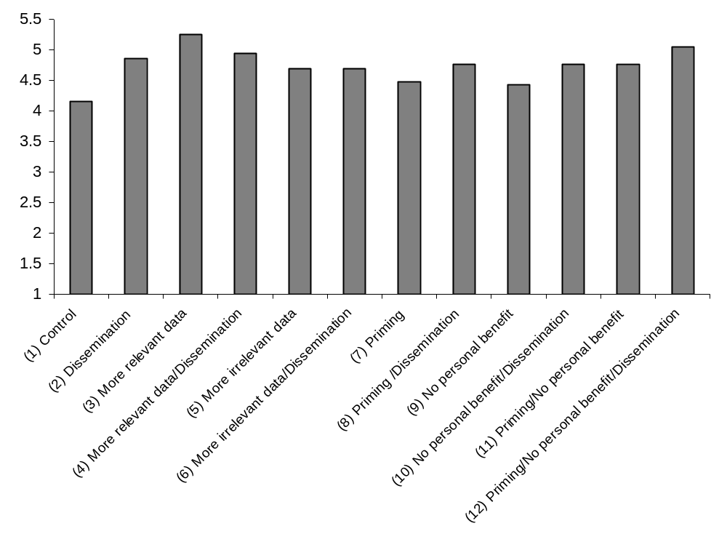
Raw response data
Mean of privacy sentiment by group
Control
Likert
Sentiment
647 paid participants

Slide 21
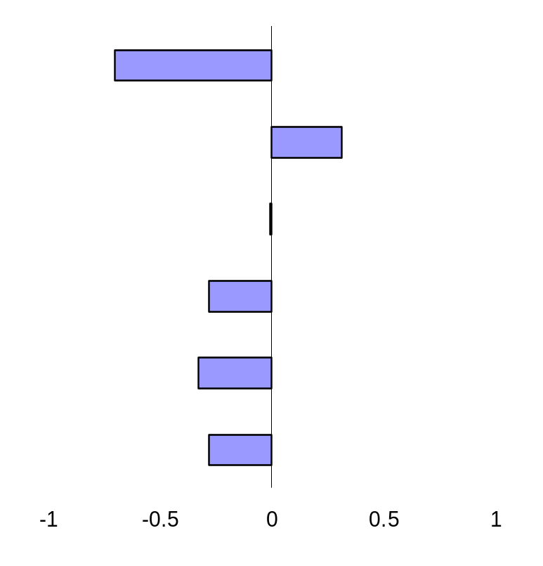
Result 1: Mere data dissemination does not change privacy concern
Change in Privacy concern
With dissemination
Control
(P = 0.0516)
More relevant data
More irrelevant data
Priming
No personal benefit
Priming/no pers. benefit
Support for Dissemination hypothesis

Slide 22
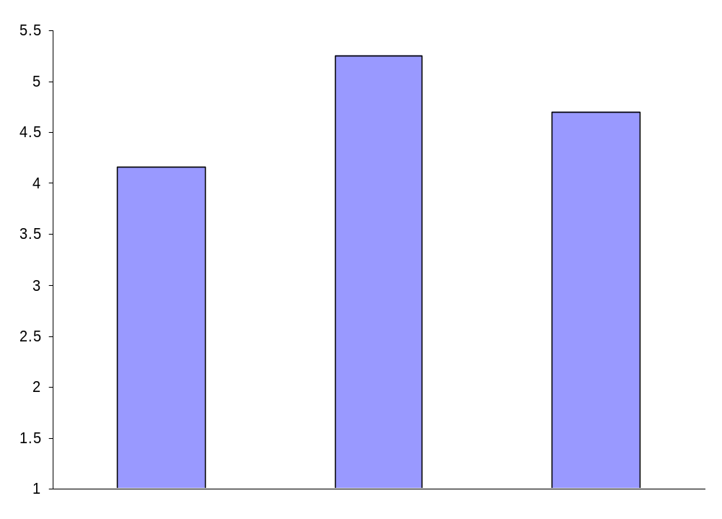
Result 2: Privacy concern is a function of amount and relevance of data
P < 0.05
P < 0.10
Likert
Sentiment
Control
Relevant data
Irrelevant data
Support for Relevance hypothesis

Slide 23
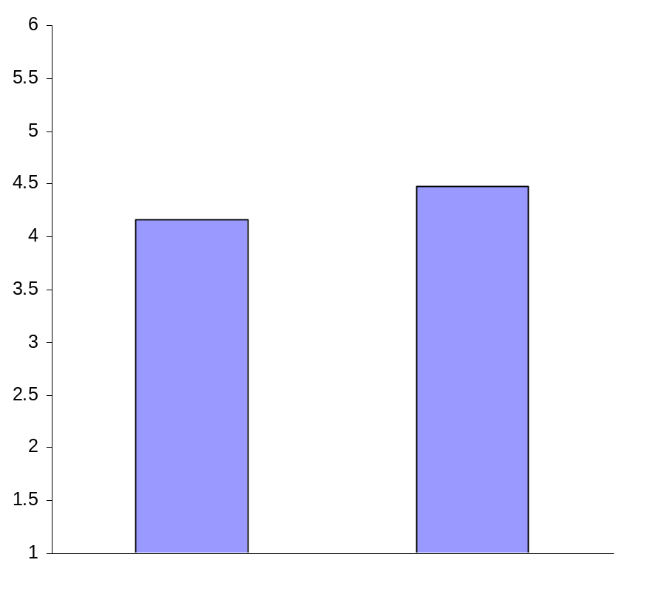
Result 3: Participants are aware of non-obvious issues with respect to privacy
“Some have wondered whether the premium paid by ordinary drivers can stay low if car
insurance companies continue to use databases to offer special deals to consumers predicted to
be ‘safe drivers.’”
Not significant
Control
Primed
Support for Spontaneous Concern hypothesis

Slide 24
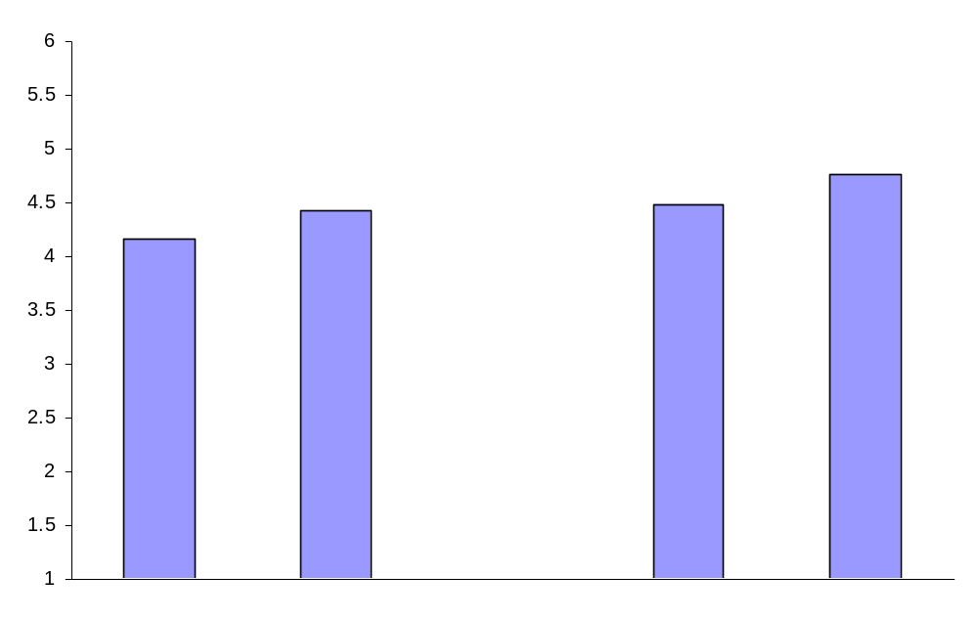
Result 4: Privacy concern exists, even when the users personal information is not at stake
Not significant
Not significant
Control
Not a
participant
Primed
Primed, not a
participant
Support for Externality hypothesis

Slide 25
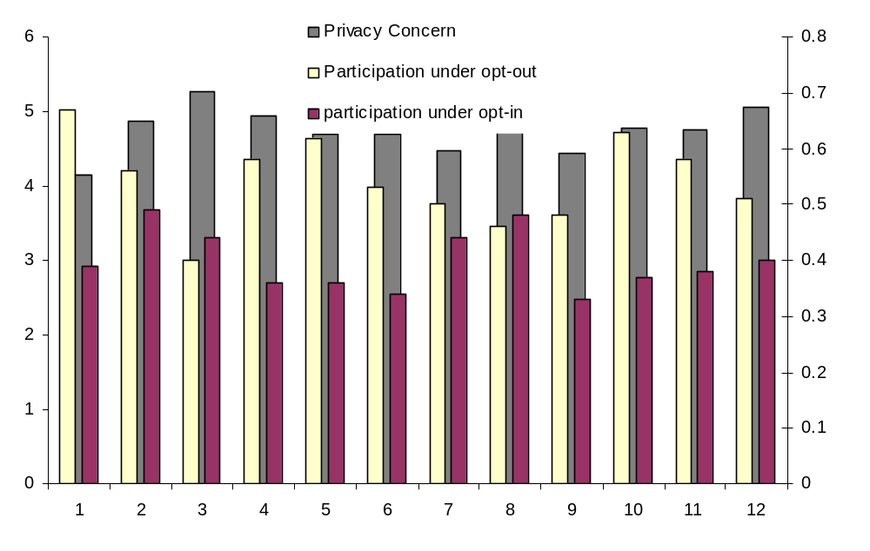
Result 5: Opt-out intentions reflect privacy concerns, while opt-in does not
Privacy
concern
% opting
in/out
Very weak support for personal control hypothesis

Slide 26
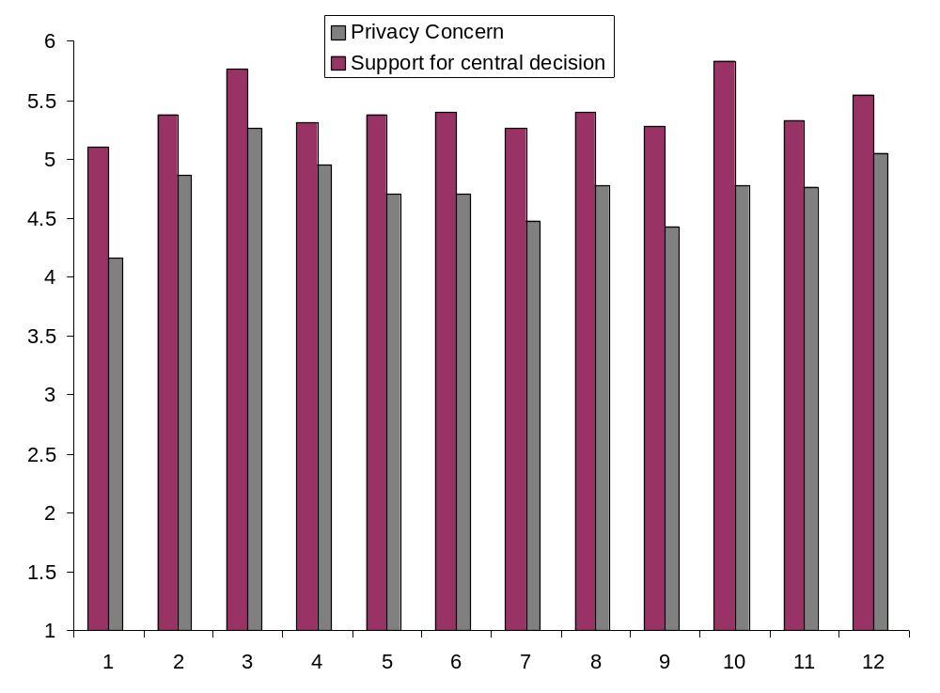
Result 6: Mixed determinants for approval of social planner
Privacy
concern
Weak support for intermediation hypothesis

Slide 27
Caveats
Analysis rests on the fact that treatment means don’t change.
  Treatments too subtle?
  Treatments didn’t trigger privacy issues?
Have not explained some of the interaction effects

Slide 28
Implications of results
Consumers exhibit signs of understanding context and indirect effects
  We should feel more comfortable about building complex models.
Privacy isn’t about atomic personal data transactions
Privacy regimes should focus on use, not individual data transactions

