Slide 1
Protecting Online Privacy:
Self Regulation, Mandatory Standards, or Caveat Emptor
Zhulei Tang, Carnegie Mellon University
Yu (Jeffrey) Hu, MIT
Michael D. Smith, Carnegie Mellon University
Notes:
Good afternoon. Thanks for coming.
The title is of our paper is…
This is the work I did jointly with Yu Hu and Michael Smith.
The growth of information technology has given marketers the power to collect vast quantities of consumer information, to assimilate this information across different DBs, and to use this information in new ways, that possibly consumers wouldn’t authorize or otherwise participated.
In this paper, we study three commonly used regimes to protect online privacy: industry self-regulation, mandatory standards, and caveat emptor. Caveat emptor means “let the buyer beware”. We use an analytical model of asymmetric information to compare the optimality of the three regimes.
What we found is that each of the three regimes can be optimal depending on the number of individuals who face a loss from privacy violations and the size of the loss they face.

Slide 2
Consumers’ Privacy Concerns
“Almost 95% of Web users have declined to provide personal information to web sites at one time or another when asked” (Hoffman 1999).
RealNetworks Inc., DoubleClick cases
The degree of concern depends on consumer, type of information, and context.
Notes:
There are many definitions of privacy. We are going to adopt a fairly broad notion of it. Violating privacy means that any personally identifiable information is used in a way that leads to a loss of utility to the consumer. But consumer can be compensated through lower prices, as is consistent with findings in some paper that we will mention later.
In a survey shown in Hoffman 1999,….So at least in some context, consumers care about their privacy online
And you might imaging that they have a reason to care. For the interest of time, I will not go into details of these two cases. However, in both of the cases, the companies inappropriately used their customers’ information.
Of course, not every consumer would care. Last week, VeriSign Inc. revealed a survey results, saying that 85% of survey participants compromised their actual password, or revealed hints about their password, for a cup of coffee. According to the company, one executive who was too busy to respond to questions but still wanted a gift card sent his administrative assistant back to complete the survey. The assistant promptly revealed both the executive's password and her own.
Strictly speaking, the survey was not conducted online (San Francisco's Market Street). The point is, different consumers care about different types of private information in a different way. For example, more consumers would care much more about their health information than their transaction information with Amazon.com.
We would wholeheartedly agree and we capture this hetero. In consumers preferences in our model, and we will explain in just a second.

Slide 3


Different Approaches to Protecting Consumer Information Online
Caveat Emptor
  “Let the buyers beware”
  e.g., FTC’s attitude towards general online information
Mandatory Standards
  e.g., European Union’s Data Protection Directive
  Children’s Online Privacy Protection Act (COPPA)
Seal-of-Approval
  TRUSTe, BBBOnline
Notes:
The concerns over unfair use of consumer information have led to different proposals of protecting consumer information. As we know, there is quite a debate of which form of regulation should be adopted to protect consumer information.
In this paper, we abstract different proposals into three regimes:
CE: Buyers are responsible to protect their own privacy. An example of this is FTC’s general approach to protect online privacy. FTC requires that if a website says that it’s going to protect, it should protect. If it doesn’t say it, it doesn’t. But doesn’t tell you how to protect privacy in general
And in most cases it doesn’t require that you post a privacy policy.
MS: EU Comprehensive, prohibit the processing of personal data unless special conditions.
COPPA: The Children’s Online Privacy Protection Act of 1998. <13 from the online collection of personal data.
SOA:Self-regulation is a system made up of voluntary compliance with industry guidelines, membership in privacy seal-of-approval programs, and other practices that facilitate the protection of personal information. This method gained some popularity recently. E.g. TRUSTe, Yahoo and AOL are members.

Slide 4
Research Questions
Under what conditions will each regime dominate?
  Consumer surplus
  Producer surplus
  Total welfare
Notes:
The existence of the different approaches raises two obvious questions:

Slide 5
Literature Review
Hann et al. (2002)—benefit and cost
Vila et al. (2003)—lemons market
Greenstadt and Smith (2005)—obstacles and directions
Chellappa and Shivendu (2003)—privacy as commodity
Magat and Viscusi (1992), Sunstein (1999)—information regulation
Milgrom and Roberts (JPE 1986)
Notes:
Our paper relates to several other papers…
Within the IT lit.
Hann: conjoint analysis to study the tradeoffs revealing personal info. to websites and consumers’ privacy concerns. And they found that monetary incentives do affect individuals’ privacy concerns.
The one by Rachel and her coauthors show that asymmetric information about whether websites will sell private information or not leads to a lemons market for privacy.
Rachel and Michael’s 2005: go into details of pros and cons of each approach; in purely descriptive way[??]
We are different from the first three papers in that we explore different privacy regimes.[***?]
Milgrom and Roberts studies advertising and price as signals of product quality. We apply this literature in a different context.

Slide 6
The Model—Basic Setting
The Monopolistic Retailer
  Different costs of protecting privacy: c_{L} & c_{H}
  Choose optimal price p_{L} & p_{H}
  A: binary action—protect or not
Consumers (two segments)
  S sensitive
    Incur a loss L if privacy not protected
    proportion ρ
  I insensitive
    Proportion 1-ρ
  Willingness to pay v~U[0,1]
Notes:
Now, I’d like to talk about our model.
These are the settings that are common to the three regimes. In the next slide,
On Ci…You might just imagine they have different cost of installing.. Hiring....or In either case, we will just capture the difference using
Firms have two decisions to make, if they decide to protect, they incur cost Ci.(The opportunity cost of protecting consumer privacy in terms of not selling the consumer’s informa-tion to outside marketing companies vary significantly across firms based on the nature of firms’ products, the natures of the firms’ consumers, the value of branding and trust to a firm’s consumers, and the amount of information the firm is able to observe about customers. The operational cost of protecting consumer privacy can be quite heterogeneous as well. For example, firms may employ different privacy protection infrastructure, which will lead to significant variation in cost.)
The price is important in our model because it “strengthen” the signal.
Without loss of generality
Explain protection: fair information practice.
We will first present the basic components of the model that are common to CE, MS, and SOA. We then present components of the model specific to each regime along with the timing of the game.

Slide 7
The model—Setting (cont’d)
Seal-of-approval programs (SOA)
  Retailer decides whether to join seal program: J=1 join; J=0 not join.
  Pays membership fee t
  Violators incur penalty cost M with probability α
Caveat Emptor (CE)
  Consumers incur R, which is the cost of reading and understanding privacy policy, if they read.
Mandatory Standards (MS)
Notes:
License fee: unit cost; the higher the demand, the total membership fees paid.
Explain the penalty cost:
M could come from a variety of different ways. Incur a fee that is forfeited…A risk being prosecuted by an outside CPA firm or being sued..(in the paper, we have a detailed discussion of the enforcement mechanisms under each regime)
Certainly, there is some parallel between SOA in our paper, and the current industry seal programs (e.g.,TRUSTe). But we’re not necessarily assigning them a one-to-one relationship.
In our paper, from the SOA’s point of view, two necessary conditions to guarantee the seals’ effectiveness are: first, there ought to be unambiguous privacy protection standards for the licensees to include in their privacy policies; second, the mechanism of enforcement and redress has to be in place.
Caveat Emptor:The retailer gets to choose R
Claim protection in privacy policy?
Follow its privacy policy?—High punishment Pu if not follow
Mandatory Standards:
The retailer has to protect consumers’ privacy.
Without loss of generality, assume the protection cost is Ci, i={H, L}

Slide 8
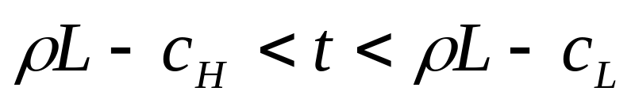
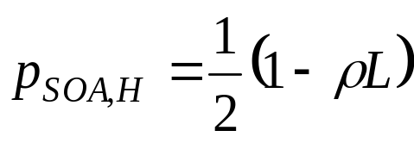
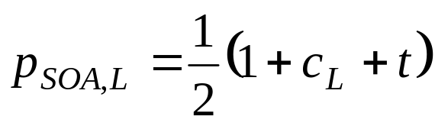
Solution—Seal-of-approval
A unique separating equilibrium exists when membership fee t satisfies:
In this equilibrium, L-type retailer joins and protects privacy, while the H-type retailer doesn’t.
H-type retailer charges a lower price to compensate consumers:
Notes:
Now let’s..
The details of the solutions are in the paper, for the sake of time, we will just mention the findings.
Separating equilibrium exists and is unique for specific value of t, it makes sense for the seal granting authority to choose t
The high type firm charges a lower price to compensate the sensitive consumers, while the L-type firm charges a price premium, including the protection cost and the membership fee.

Slide 9
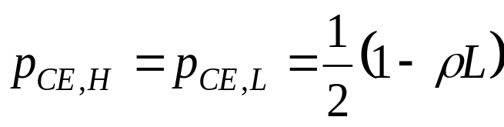
Solution—Caveat Emptor
Pooling equilibrium is obtained, where retailer sets high R, consumers don’t read privacy policy.
In this equilibrium, no retailer will protect consumers’ privacy.
Both types of retailers charge the same price:
Notes:
This assumption is consistent with available anecdotal evidence that very few consumers actually read privacy policies. For example, Regan (2001) reports that less than 1 percent of the visitors to six major online travel sites during April 2001 read privacy policies. We also sampled 20 top shopping sites’ privacy policies and found them lengthy and hard to read, which approximates a high R.
Privacy policy doesn’t contain much information as joining SOA.
..protection costs are irrelevant . And since they face the same demand, the charge the same price.

Slide 10
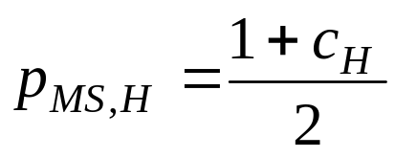
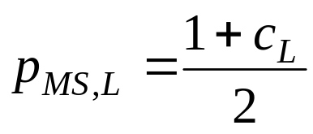
Solution—Mandatory Standards
Both types of retailers protect consumers’ privacy.
L-type retailer incurs protection cost c_{L}
H-type retailer incurs protection cost c_{H}
Both types of retailers charge prices higher than the price under caveat emptor:
Notes:
As a requirement, both types of retailers have to protect.
(don’t include the gov’t regulation cost)
Society may incur a cost, which may or may not be compensated by the sensitive consumers’ gain from being protected.

Slide 11
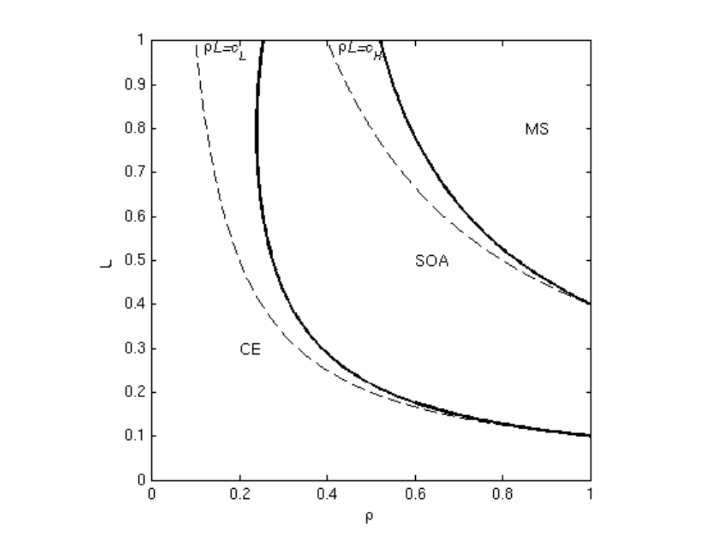
Welfare Implications—Consumer and Producer Surplus
Notes:
In this picture, we show the optimality of each regime under rho-L space, where rho is.. L is…
As you would expect, for low rho or low L, CE is the one that generates the most consumer and producer surplus. This is the region shown on the lower left corner of this graph. And this is consistent with what we see with many types of privacy data on the Internet. The passwd info. Of the VeriSign survey we mentioned earlier may fall into this region. In this case, CE is the optimal regime.
Conversely, for sufficiently high rho and L, it’s socially optimal for the MS to be in place. And this is consistent with the U.S. regulatory approach with protecting a particular type of consumer information online, such as health care information or consumer credit information.
And finally, for intermediate level of rho and L, we find SOA can lead to social optimality. Again, it’s consistent with what we see in the market with the emergence of firms, like TRUSTe for protecting some type of consumer information online.

Slide 12
Conclusions
Joining seal-of-approval programs can serve as a credible signal of privacy protection, when membership fee is set appropriately.
In general, caveat emptor is optimal under low privacy sensitivity;
Seal-of-approval is optimal under moderate privacy sensitivity;
Mandated standards are optimal under high privacy sensitivity .
Notes:
To summarize…we looked at these two questions using an analytical model of asymmetric information.
what we found that…SOA can set a membership fee in such a way that separating equilibrium exists. That is, under reasonable assumptions, joining SOA is a credible signal that the retailer will protect consumers’ private information.
The second thing, maybe the more interesting finding is that depending on how many people care about privacy and how they perceive their loss if their privacy is violated, each of the regime can be optimal.

Slide 13
Future Directions
Explore different privacy enhancing technologies, e.g., P3P.
Explore different ways of signaling privacy protection, e.g., branding.
Explore the effect of competition and dynamics.
Notes:
P3P basically….lower the cost of processing the privacy policy. Retailers get to choose whether to parse their privacy policies in this way or not….
Basic level includes a standardized set of multiple choice questions.
Enable browser to “read” and compare to consumers' preferences.
Lower “reading cost” compared to the caveat emptor case.
Certainly introducing competition among retailers and time dynamics make our model more realistic. But both will complicate our model without adding further insights within the current model’s framework.
That’s what we had for you today.

Slide 15
Timeline
Nature chooses the retailer’s type.
The retailer sends signals.
Consumers decide whether to purchase.
The retailer decides whether to protect privacy.
Check if the retailer’s action is consistent with its messages.
Consumers’ utility and the retailer’s profit are realized.

Slide 16
Sometimes, privacy policy is hard to understand
“You hereby consent to, and expressly waive such rights as you may have under the Cable Act or otherwise to limit or prohibit the collection by, and sharing between, MediaOne and ServiceCo and other MediaOne entities of such information.” MediaOne User Agreement

Slide 17
Privacy?
“Ask 100 people if they care [about privacy] and 85 will say yes. Ask those same 100 people if they'll give you a DNA sample just to get a free Big Mac, and 85 will say yes.”
  Austin Hill, president of Zero-Knowledge Systems (WSJ 2002/06/12)

Slide 18
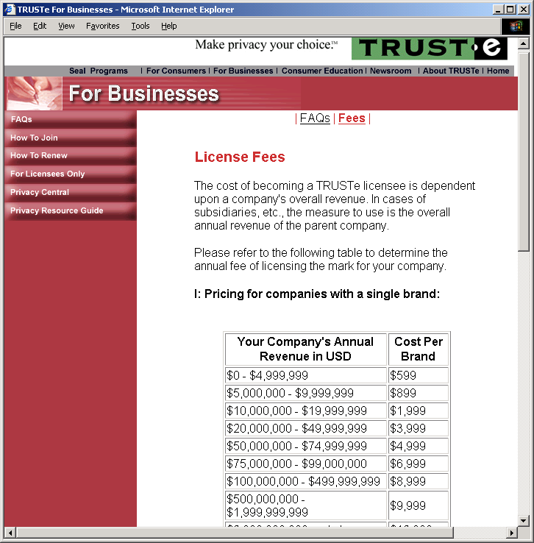

Slide 19
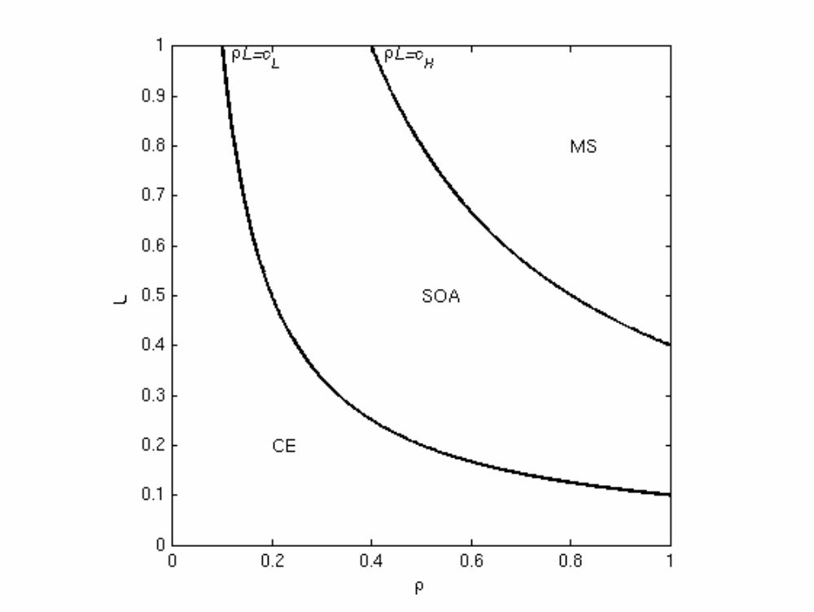
Welfare Implications—Producer Surplus

Slide 20
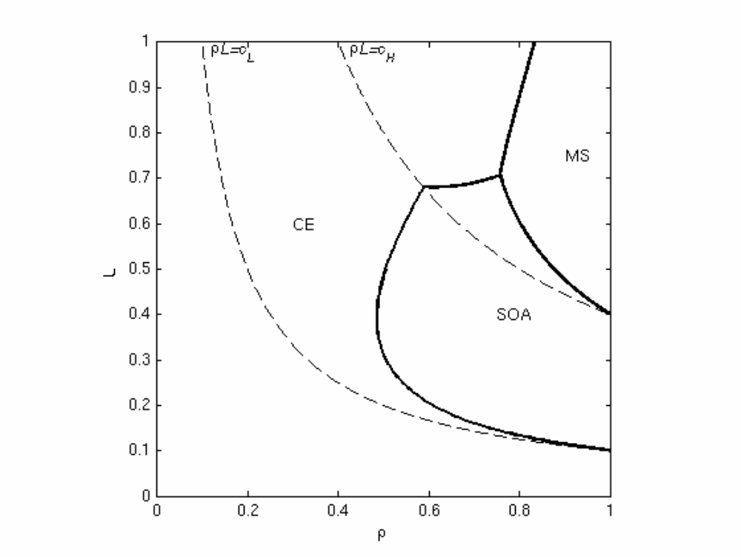
Welfare Implications—Consumer Surplus

