Slide 2
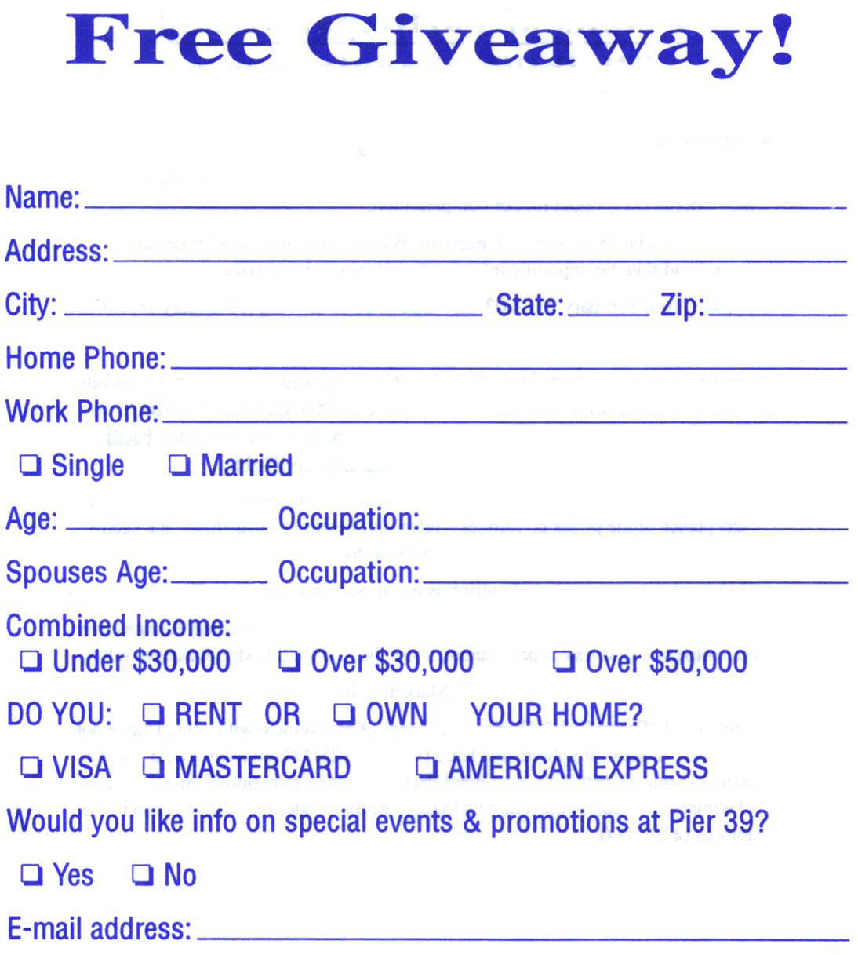
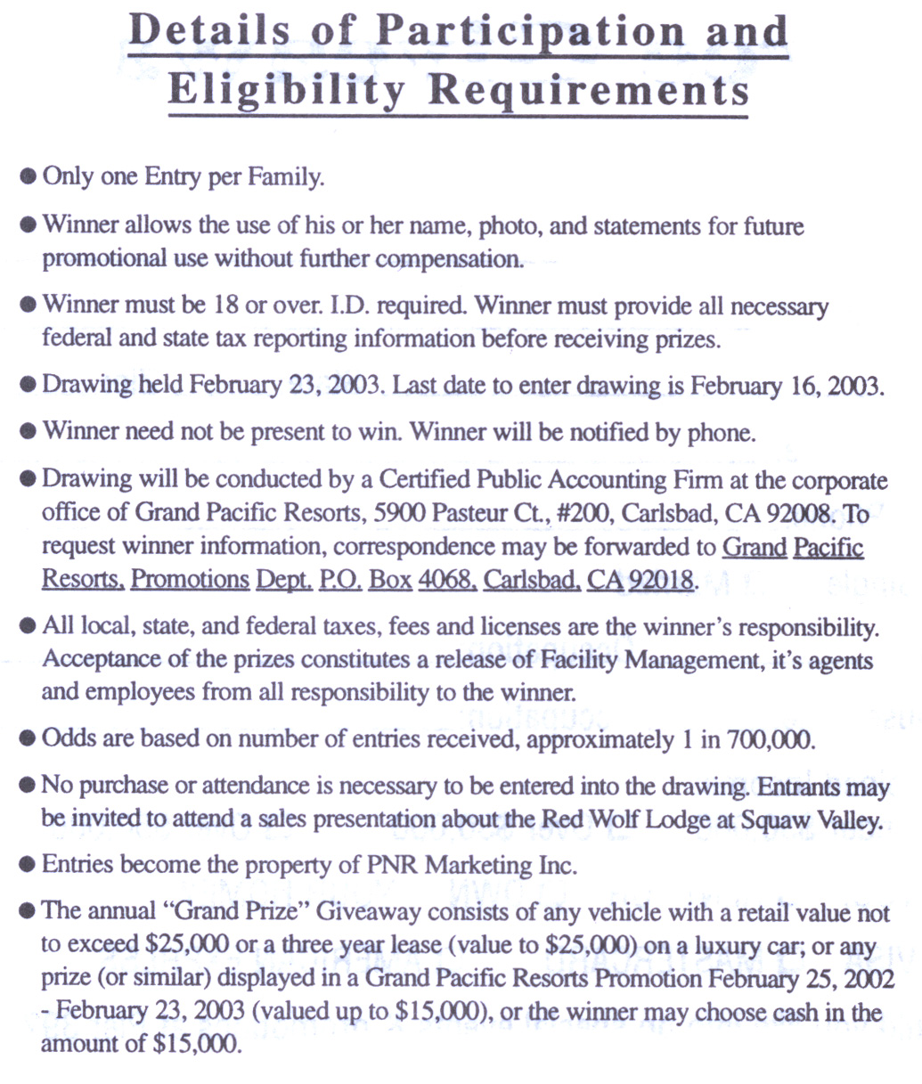

Slide 3
What can the individual infer?
Benefits:
  Non-monetary benefit (e.g., excitement of participation)
  Expected monetary benefit:
    1/700000 * $15000 = 2 cent
Costs:
  Promotions, unsolicited mailing, sales contacts (cannot exclude further use and consequences)
  Expected monetary cost:
    ?
Notes:
Benefit: easy to calculate, but few people do it
Cost: calculation is entirely subjective and based on idiosyncratic personal ideas about the practices of comapnies involved

Slide 4
Agenda
Risk, uncertainty, and ambiguity
Risk vs. ambiguity in privacy
Survey results
Notes:
Marketing, psychology, and economic lietrare
How amiguity can affect prvacy decision making

Slide 5
Risk, uncertainty, and ambiguity
Distinction between risk and uncertainty (or ambiguity) dates back (at least) to Bernoulli (1738)
Application to economics: Menger (1871), then Knight (1921)
  Risk: possible random outcomes of a certain event have known associated probabilities
  Uncertainty (or ambiguity): randomness cannot be expressed in terms of mathematical probabilities, and/or probabilities are unknown
  (Ignorance: states/events are unknown)
Notes:
Say that ambiguity is synomym for uncertainty (or almost so!)
We use ambiguity because, unfortunately, many economists have lost the difference between uncertainty and risk
Some also talk about “ignorance”

Slide 6
Risk, ambiguity, and expected utility
Expected utility theory (Von Neumann and Morgenstern [1944]) is based on objectively knowable probabilities (i.e., Knight’s “risk”)
  Probabilities may objectively exist in the world
  Or, probabilities may be subjective (Savage [1954])
However: in complex scenarios, it may be unreasonable to assume existence of known or knowable probabilities, or complete beliefs about all possible outcomes and probabilities over all possible outcomes
  So, what model of individual decision-making is more appropriate?

Slide 7
Ambiguity and utility maximization
Prescriptively:
  Under prescriptive decision theory, ambiguity about probabilities can be collapsed down into “one level" of uncertainty
  Mainstream economic theory of expected utility incorporates this idea (transforms uncertainty into risk)
Descriptively:
  Empirically, individuals react differently to risk and ambiguity
  Even if individuals had sufficient data about outcomes and associated probabilities, they may still use data in ways which are different from that of expected utility maximization (see Kahneman and Tversky [2000] and Ellsberg [2001])
    E.g., given the choice between a certain outcome (e.g., $10) and a lottery over outcomes (e.g., $0 with 50% likelihood and $X with 50% likelihood), individuals prefer the certain choice unless they are offered a premium in the lottery so that the expected value of the lottery is greater than the certain outcome (e.g., X strictly greater than $20): individuals are ambiguity averse (see Camerer and Weber [1992])
    E.g., Nunes and Park (2003) on incommensurate resources
    E.g., Dreze and Nunes (2004) on combined-currency prices
Notes:
So economic models of privacy that represent risk but refer to uncertain situations do not accuately represent individual behavior and should be treated carefully as a base for policy decisions
INCOMMENSURATE: define two different carriers of wealth or resources that difficult to convert into any meaningful unit of measurement as “incommensurate” → value of a premium may be less likely than a comparable monetary discount to be viewed in a relatice sense and thus less likely suffer from diminishing marginal returns → marketer avoids paying premium
COMBINED: conditions under which a price that comprises payments delivered in different currencies can be superior from company’s perspective to a standard, single-currency price, either by lowering the psychological or perceived cost associated with a particular revenue objective (i.e., price) or by raising the amount of revenue collected given a particular perceived cost.

Slide 8
Privacy: risk or ambiguity?
Two forms of incomplete information in privacy decision making:
  First and obvious: privacy as “concealment” (e.g. Posner [1978], and most subsequent formal economic models)
    Data subject has some control on the level of access that other entities can gain on her personal sphere
  Second and less obvious: incomplete information affects data subject whenever her control on her personal sphere is limited and/or ambiguous
    E.g., data subject may not know if and when another entity (data holder) has gained access to or used her personal information, nor may she be aware of the potential personal consequences of such intrusions

Slide 9
“Reversing” information asymmetry
Data subject
Data subject
Data subject
(Future) data holder
Data holder
Data holder
t₀
t₁
t₂
Private information
Transaction
Data usage
...Alice visits merchantsite.com...
...transaction with merchantsite.com reveals set of data, including Alice’s wtp...
... merchantsite.com uses wtp for price discrimination, email address for marketing, credit card information for profiling...
Notes:
Most economic models focus on left box; we focus on right one

Slide 10
Information asymmetry in privacy
In t₀ data subject has advantage: knows future data holder and has private information
  E.g., can manipulate behavior for her own interest
    Acquisti and Varian (2005): dynamic behavioral based price discrimination not optimal because high valuation consumers can act as low valuation ones
But: after t₁, incomplete information affects data subject and may favor data holder:
  …data usage
  …data holder
  …t₂
  …t₁ !
Notes:
T1: subject may not even know when information is revealed
T2: time when data is used - CHANGES THE NATURE OF THE GAME

Slide 11
Ambiguity and privacy
Models of privacy decision-making face:
  Incomplete information of structure of the game
    Identification of other entities
    Possible strategies/actions of other entities
    Not only due to complexity, but intentional information barriers
  Incomplete information of probabilities associated with known outcomes
  Incomplete information of possible outcomes
    Payoff structure of other entities is unknown (gains from selling/reselling/utilizing of information)
Hence…
Notes:
More detail on problem in consideration

Slide 12
Hypotheses
Privacy decision making is more about uncertainty and ambiguity than risk
  Knight (1921)’s distinction of risk and uncertainty necessary in privacy modeling
  Without that distinction, expected utility theory may lead to incorrect descriptive assumptions about individual behavior, and misleading policy advices
    E.g., subjective privacy valuation vs. objective privacy costs
Behavioral economists and psychologists have worked on modifications of the theories of risk and uncertainty
  E.g., “subjective weights” (Hogarth and Kunreuther [1992])
  Initial value anchoring can be subject to substantial manipulation (Ariely, Loewenstein, and Prelec [2003])
How is individual privacy decision-making
affected by ambiguity and risk?
Notes:
More detail on problem in consideration

Slide 13
This paper’s approach
Focus on how re-framing of ambiguous offers affects individual privacy valuations
  Marketing literature approach – e.g., Nunes and Park (2003) and Dreze and Nunes (2004)
Empirical approach:
  Use Acquisti and Grossklags (2005)
    119 individuals, CMU (after pilot)
    Online, anonymous
    Used to study: incomplete information, bounded rationality, and hyperbolic discounting
  Two questions: baseline and treatment
    Statistical tests to verify internal consistency of answers

Slide 14
Scenario
Marketer’s offer
  Monetary benefit
  Privacy cost (uncertain and ambiguous)
  Different data items

Slide 15
Baseline question
“Suppose a marketing company wants to buy your personal information. You do not know and you cannot control how the company will use that information. You know that the company will effectively own that information and that information can be linked to your identity. For how much money (in U.S. dollars) would you reveal the following data items to this company: (if you would never reveal that information, write ‘never’).”
→ Subjects specify WTA or reject

Slide 16
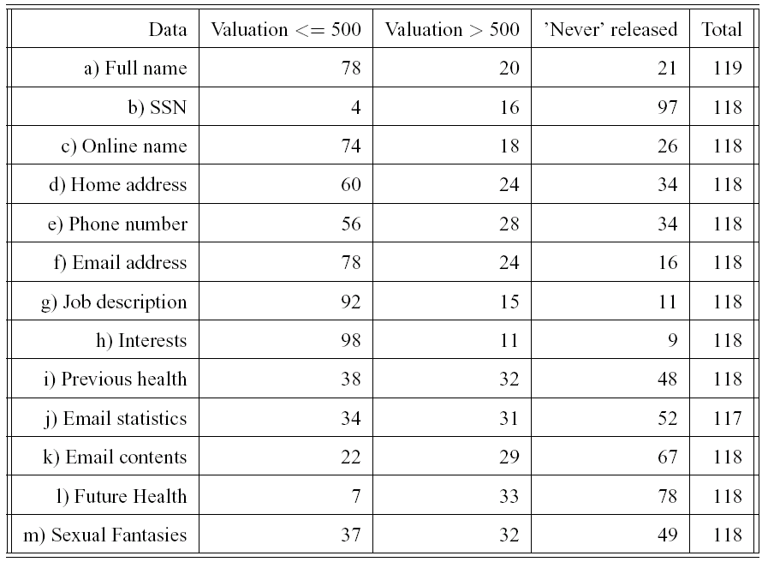
How do subjects value information?
Data on ‘rejection rate’ due probably to low self-selection of subjects wrt to privacy preferences (compare to, for example, Danezis et al., 2005)
Notes:
Introduce data categories: not that Allan considered activities as irrelevant (not entirely!!! → careful when there are small groups)
→ Allan’s presentation: just data dissemination???? In some sense our question only hints to data dissemination but yields strong reactions from the subject pool
Jennifer Granick: Turning over irrelevant data should trigger privacy concerns → relevant shoul dbe ok; BUT Allan’s study has economic data → fear of economic discrimination

Slide 17
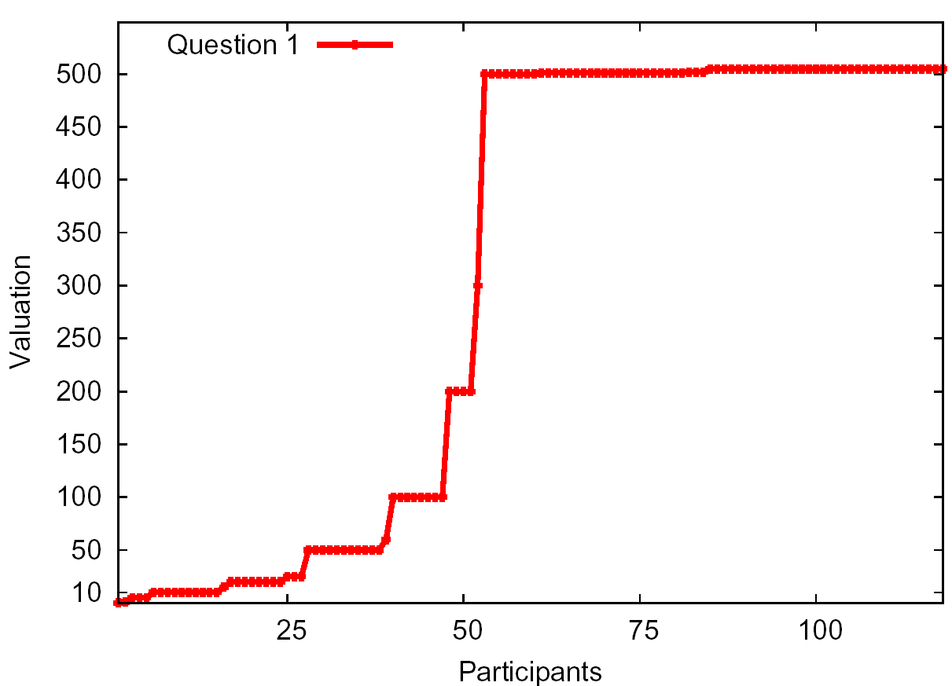
Home address data
Flat region
Dispersed
region
Valuation
> 500
Rejection
zone

Slide 18
High valuation vs. rejection
Valuation > 500: MIN = 11 (for Interests)
MAX = 33 (for Future Health)
Rejection: MIN = 9 (for Interests)
MAX = 97 (for SSN)

Slide 19
More on rejection
Do rejection frequencies differ statistically from each other (McNemar’s non-parametric test)?
  (interests and job [and favorite online name])
  < ([favorite online name and] email and full name)
  < (home address and phone number)
  < (Previous health history, sexual fantasies, and Email statistics)
  < (Email contents)
  < (Future health history)
  < (SSN)
Notes:
Interesting for future experiments

Slide 20
Discussion of valuation results
Immediate gratification (O’Donoghue and Rabin 2000)
  Suggests higher acceptance rate
  High valuation?
Coherent arbitrariness (Ariely et al. 2001)
  No experimentally induced anchor in our study
Independent private values (Vickrey 1961)
  Private signals such as fairness considerations, prior experience, knowledge of risks and protections
Impact of deviance & desirable vs. undesirable characteristics
  Weight, Age (Huberman et al. 2005)
  Traveling off-campus (Danezis et al. 2005)
Notes:
Should come later ---ALEX WHAT ABOUT BUY SELL DICHOTOMY

Slide 21
Discussion (2) Is there a premium?
WTA compared to expected financial loss
  People expect premium
  93% SSN
  90% Email address
  100% Content Email
  89% Sexual Fantasies
  95% Future Health History
Resale price/Market value
  E.g., for large set of email addresses in the order of a few $

Slide 22
Treatment question
“Would you provide this information for a discount on an item you want to purchase or service you want to use? The items value is $500. If yes, what discount (in US dollars) would you expect? If you would not provide this information please enter ‘no’.”
→ Subjects specify discount-WTA or reject
Notes:
Should come later

Slide 23
Descriptive analysis of differences
 |  | Baseline higher valuation | Treatment higher valuation | Difference
 | a) Full name | 45 | 22 | 23
 | b) SSN | 13 | 1 | 12
 | c) Online name | 36 | 21 | 15
 | d) Home address | 46 | 14 | 32
 | e) Phone number | 53 | 6 | 47
 | f) Email address | 56 | 21 | 35
 | g) Job description | 51 | 18 | 33
 | h) Interests | 52 | 23 | 29
 | i) Previous health | 35 | 8 | 27
 | j) Email statistics | 31 | 9 | 22
 | k) Email contents | 25 | 4 | 21
 | l) Future Health | 20 | 2 | 18
 | m) Sexual Fantasies | 44 | 6 | 38
Notes:
Should come later

Slide 24
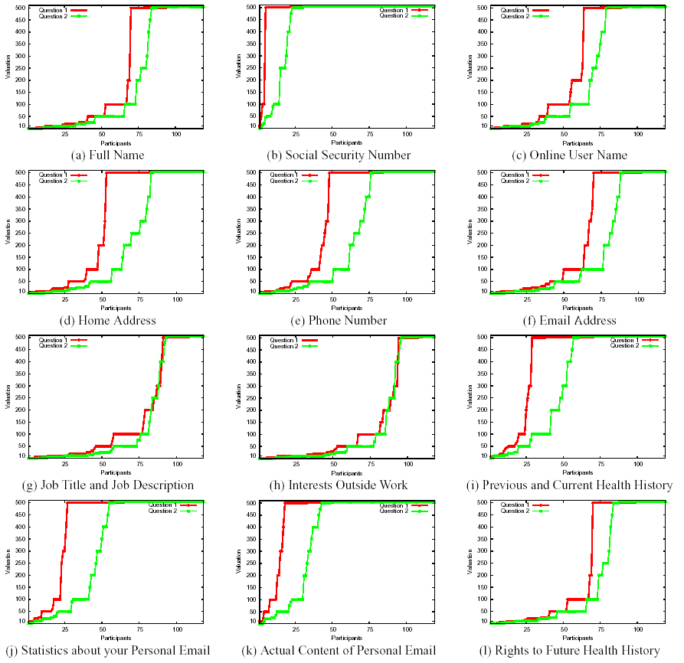
Notes:
Should come later

Slide 25
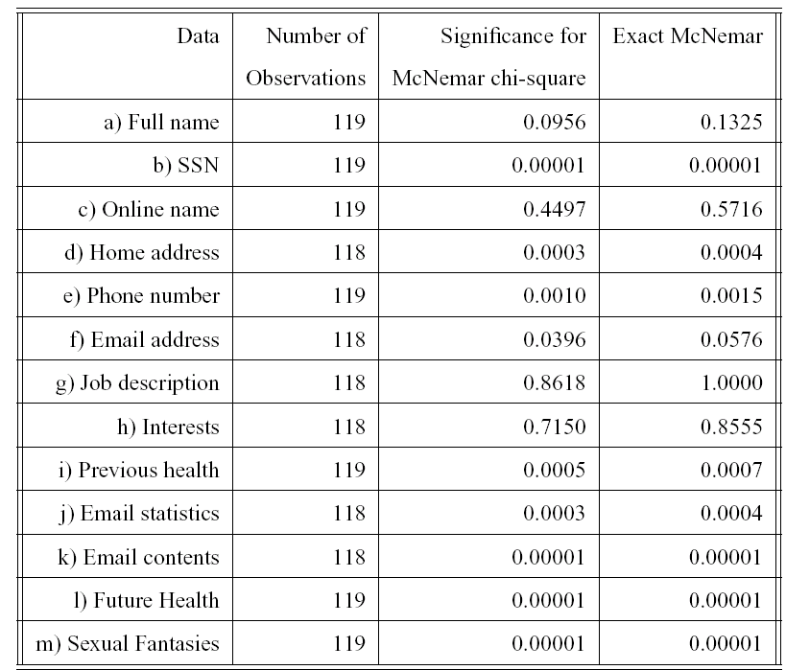
Treatment effect
*
***
***
***
***
***
***
**
*
}
Very low
rejection
rate
***
***
***
***
***
***
***
***
***
***
McNemar non-parametric test; test for acceptance levels (measured as values below $500) between treatments; accept lower rejection levels
Notes:
Should come later

Slide 26
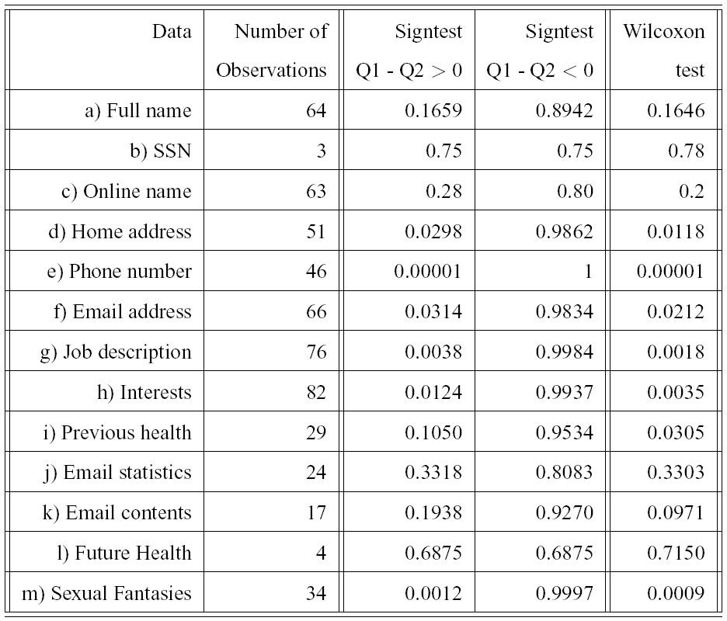
Treatment effect
**
**
***
***
**
**
***
***
**
***
**
*
**
**
Wilcoxon Match-Pairs Signed Ranks Test and Signtest; test for valuation differences; firmly reject valuation (treatment) > valuation (baseline)
Notes:
Should come later

Slide 27
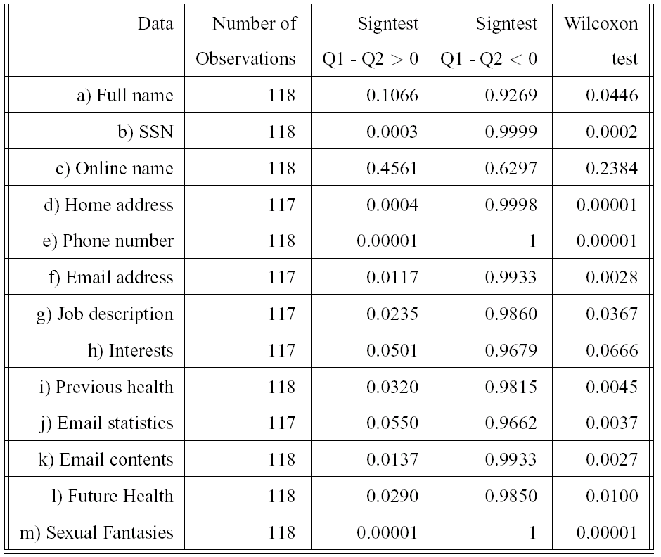
**
***
***
**
***
***
***
**
***
***
**
**
*
**
***
*
***
**
***
**
**
**
***
Wilcoxon Match-Pairs Signed Ranks Test and Signtest; test for valuation differences; accept valuation (treatment) < valuation (baseline)
Notes:
Should come later

Slide 28
Discussion
Two findings wrt treatment condition:
  Lower Valuation
  Lower Rejection rate
Psychological difference between discount-WTA and WTA
  Private information and Incommensurate resources
  → Impact on evaluability (Hsee 1996)
  → Impact on relativistic processing (Kahneman and Tversky 1984)
Notes:
Should come later

Slide 29
Discussion (2) What about the premium
Discount-WTA compared to expected financial loss
  People still expect premium, but less often
  41% SSN [52% less]
  79% Email address [11% less]
  93% Content Email [7% less]
  67% Sexual Fantasies [22% less]
  50% Future Health History [45% less]
Notes:
Should come later

Slide 30
Conclusions
Because analysis of consequences is so ambiguous, individuals are very susceptible to small variations in simple marketing methods, even when underlying trade-offs stay the same
  So, watch out also in privacy surveys and experiments!
  Methodology for privacy research:
    Between vs. within subjects design
    Work with independent private values
    Experiment vs. survey
Not a random effect (marketing instruments likely to work with independent private values)
  How to choose appropriate discount?
Notes:
Should come later
Experiment vs. survey: people try to game experiment (e.g., reveal fake GPA) ← be careful with control

