Slide 1
Quantifying Privacy Choices with
Experimental Economics
Julia B. Earp
Associate Professor
of IT
David L. Baumer
Professor
of Law
J.C. Poindexter
Associate Professor
of Finance
College of Management
North Carolina State University
WEIS
Harvard University
June 2-3, 2005

Slide 2
Privacy Values of Consumers
Many studies have addressed consumer privacy concerns
Why are these endeavors important?
  Company policies
  Enforcement
  Auditing
  Legislation

Slide 3
Privacy Values of Consumers
For Example, Earp et al.
  Worldwide survey of over
  1000 respondents
  36 scale items
  Consumers are most
  concerned with (in order):
    Information Transfer
    Notice / Awareness
    Information Storage
“Examining Internet Privacy Policies within the Context of User Privacy Values.”
IEEE Transactions on Engineering Management,
May 2005.

Slide 4
Survey Limitations
There are no consequences to choices
Responses tend to make respondents look good
Sizeable disparities between what respondents say and what they do

Slide 5
The Continuing Question
» How can we accurately determine the value that consumers place on privacy?

Slide 6
Uses of Experimental Economics
To test game-theoretic hypotheses (interactive behavior experiments)
To perform investigations into industrial organization issues
To test theories of individual choice
  Decision-making under uncertainty

Slide 7
Individual Choice
Subjects participate in a game
  opportunities for certain gambles or risks
  real money
Construct a utility curve
Predict individual behavior

Slide 8
Privacy Related Objectives
Develop an economic model of consumer privacy concerns
  General
  Financial
  Healthcare
Economic model that relates benefits/risk to access choices

Slide 9
Why Experimental Economics?
Unreliability of surveys
All external factors can be controlled and the system can be agitated by single influences
  Passage of privacy legislation
  Increased outbreaks of identity theft
  New technologies

Slide 10
The General Experiment: Assumptions
Assume more intensive Internet usage can bring increased benefits, but can also bring additional risks
Rely on a “money account” measure for tracking net benefit from Internet usage choices

Slide 11
The General Experiment:
Process
Participants choose a usage level
Outcomes are announced
News stories of exceptional outcomes are revealed
Sensitivity to the introduction of privacy changes
  Legislation
  Technology protection
  Education
  Hacker innovations
Participant with the highest net value in his/her account wins

Slide 12
Payoff Matrix
Payoff Matrix will reflect possible benefits and possible risks/burdens to using the Internet
The possible benefits of using the Internet
The possible risks of using the Internet

Slide 13
Pilot Experiment #1:
Online Job Search
Two pilot groups
Four week time period where participants submitted resumes in an experimental setting
Grade incentive (using a money account)

Slide 14
Pilot Experiment #1:
Online Job Search Choices
General employment websites
  50% chance of being hired in the first three months
  Average starting salary = $30,000.
Employer websites
  Requires more information
  50% probability of being hired in the first three months
  Average starting salary = $40,000
Headhunter websites
  Requires much more information
  25% probability of being hired in the first 3 months
  Average starting salary of $60,000
Family and friend contacts
  Average starting salary = $20,000

Slide 15
Group A: 27 Undergrad Students
 |  | GEW | EW | HW | None
Week1 | Freq. Prot. | 2 2 | 21 19 | 1 | 3
Week2 | Freq. Prot. | 1 1 | 22 22 | 2 | 2
Week3 | Freq. Prot. | 0 0 | 17 14 | 8 | 1
Week4 | Freq. Prot. | 3 2 | 10 10 | 3 | 11

Slide 16
Group B: 32 Graduate Students
 |  | GEW | EW | HW | None
Week1 | Freq. Prot. | 2 1 | 22 14 | 6 | 2
Week2 | Freq. Prot. | 0 0 | 15 11 | 10 | 2
Week3 | Freq. Prot. | 1 1 | 10 6 | 15 | 1
Week4 | Freq. Prot. | 1 0 | 13 11 | 9 | 7

Slide 17
Pilot Experiment #2:
Automated Process
Proof-of-Concept
General Pilot Experiment
12 participants
No indication of probabilities presented
5 Scenarios with 5 iterations each

Slide 18
Pilot Experiment #2:
Scenarios
Moderate amount of spam / viruses
Increased amount of spam / viruses. Legislation and law enforcement to combat increased malicious activity
Moderate amount of spam / viruses
Participants can purchase protection against spam / viruses
Participants can purchase additional protection against spam / viruses

Slide 19
Pilot Experiment #2:
Usage and Risk Levels
Scenario | Grand Avg. | Risk Avg. | Usage Avg.
1 | 12.6 | 10.8 | 14.4
2 | 9.5 | 8.9 | 10.0
3 | 11.5 | 10.2 | 12.9
4 | 13.4 | 11.7 | 15.2
5 | 14.9 | 14.3 | 15.6
Low is 3, Moderate is 10, and High is 20. No use is 0.

Slide 20
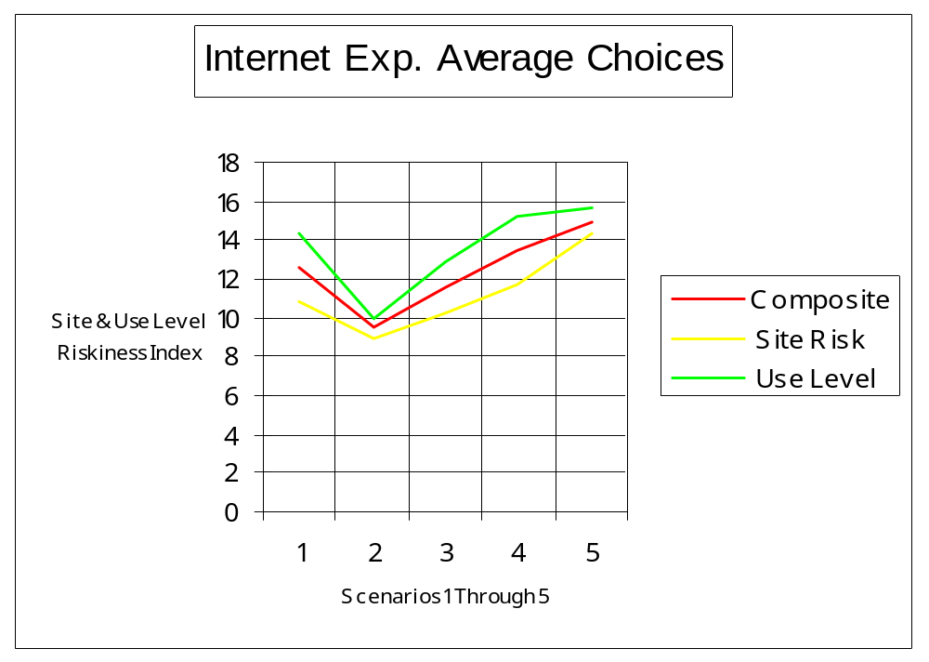

Slide 21
The Next Steps
A more sophisticated simulation environment
Several experiments
  General experiment
  Financial experiment
  Health care experiment
Augment with survey results
In the end, determine what consumers truly value and when they are willing to compromise

Slide 22
For Information on Privacy Research
at NCSU:
http://theprivacyplace.org/
and
http://www4.ncsu.edu/~jbearp/

