Slide 1
Economic Analysis of Incentives
to Disclose Software Vulnerabilities
Dmitri Nizovtsev
Washburn University
Marie Thursby
Georgia Institute of Technology

Slide 2
Full
Public
Disclosure:

Slide 3
Why the controversy?
Full
Public
Disclosure:

Slide 4
Why the controversy?
Full
Public
Disclosure:
Why do benign discoverers disclose?

Slide 5
Why the controversy?
Full
Public
Disclosure:
Why do benign discoverers disclose?
What is socially optimal?

Slide 6
Why the controversy?
Full
Public
Disclosure:
Why do benign discoverers disclose?
What is socially optimal?
How to get there?

Slide 7
The existing body of economic research on information security focuses on

Slide 8
The existing body of economic research on information security focuses on
- decisions made by vendors

Slide 9
The existing body of economic research on information security focuses on
- decisions made by vendors
the “coordinator” (the opt. disclosure policy issue)

Slide 10
The existing body of economic research on information security focuses on
- decisions made by vendors
the “coordinator” (the opt. disclosure policy issue)
information sharing (ISACs)

Slide 11
The existing body of economic research on information security focuses on
- decisions made by vendors
the “coordinator” (the opt. disclosure policy issue)
information sharing (ISACs)
users’ decision to patch

Slide 12
The existing body of economic research on information security focuses on
- decisions made by vendors
the “coordinator” (the opt. disclosure policy issue)
information sharing (ISACs)
users’ decision to patch
- viability of a market for vulnerabilities…

Slide 13
The existing body of economic research on information security focuses on
- decisions made by vendors
the “coordinator” (the opt. disclosure policy issue)
information sharing (ISACs)
users’ decision to patch
- viability of a market for vulnerabilities…
…but not on individual decisions to disclose.
Our research is an attempt to close this gap.

Slide 14
Commonly believed motives for full public disclosure:

Slide 15
Commonly believed motives for full public disclosure:
Signaling one’s abilities;

Slide 16
Commonly believed motives for full public disclosure:
Signaling one’s abilities;
Warning other users;

Slide 17
Commonly believed motives for full public disclosure:
Signaling one’s abilities;
Warning other users;
Putting pressure on the vendor.

Slide 18
Commonly believed motives for full public disclosure:
Signaling one’s abilities;
Warning other users;
Putting pressure on the vendor.
Our alternative explanation:
Benign users are
minimizing their expected loss

Slide 19
The Model

Slide 20
The Model
Three types of “agents”:

Slide 21
The Model
Three types of “agents”:
Black Hats attack other users when they can

Slide 22
The Model
Three types of “agents”:
Black Hats attack other users when they can
White Hats inform the vendor,
decide whether and how to disclose

Slide 23
The Model
Three types of “agents”:
Black Hats attack other users when they can
White Hats inform the vendor,
decide whether and how to disclose
Vendors issue a fix once attacks reach
a certain intensity level

Slide 24
The Model
Three types of “agents”:
Black Hats attack other users when they can
White Hats inform the vendor,
decide whether and how to disclose
Vendors issue a fix once attacks reach
a certain intensity level
Independent discoveries of the same bug are possible.

Slide 25
Bug discovered by a benign user
Y
Disclose?
N
Massive
attack
No attack
Fix provided by vendor
Next
discoverer?
WH
Game
ends
Disclose?
BH
N
Single attack
Y
Game continues…

Slide 26
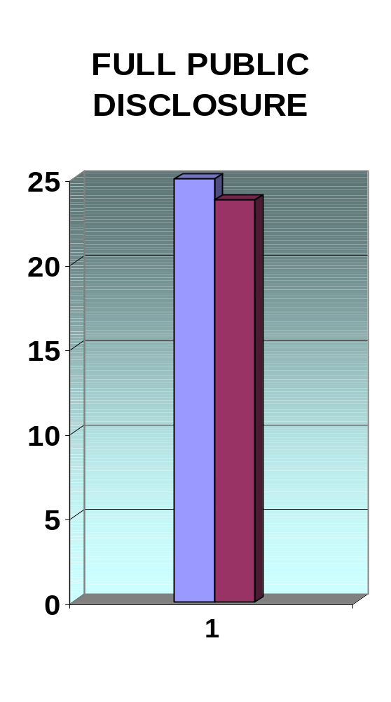
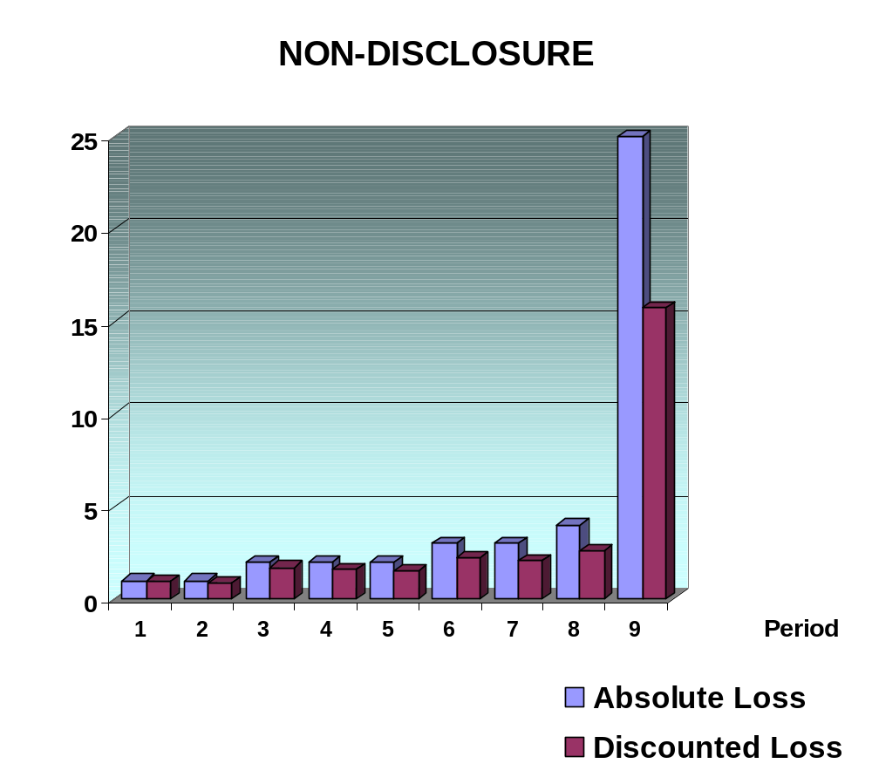
Loss Structure

Slide 27
Expected loss
LN
N1
N2
Proportion of
white hats disclosing
LN – expected loss of white hats who don’t disclose
N1 – expected loss from a massive attack (result of FPD)
N2 – exp. loss from ‘covert’ attacks (result of independent discoveries)

Slide 28
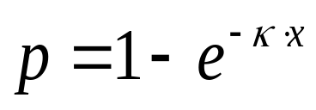
Exogenous parameters
Population
(B black hats + W white hats)
Transparency of the bug, r (affects the chances of independent discoveries)
Potential damage from each attack, C
The ease of exploiting the published vulnerability, ε
The discoverer’s “impatience factor”, ρ
Users’ knowledge of software, κ
(affects the probability of a fix developed by
the user, )

Slide 29
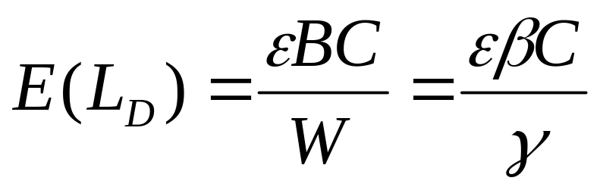
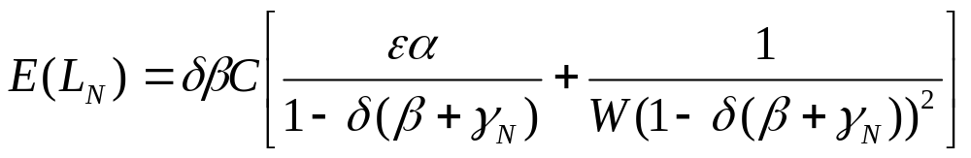

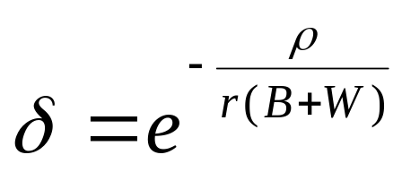
Expected Loss
Disclosing agent:
Non-Disclosing agent:
where is the probability that a white hat plays “disclose”
and is the discounting factor .
.

Slide 30
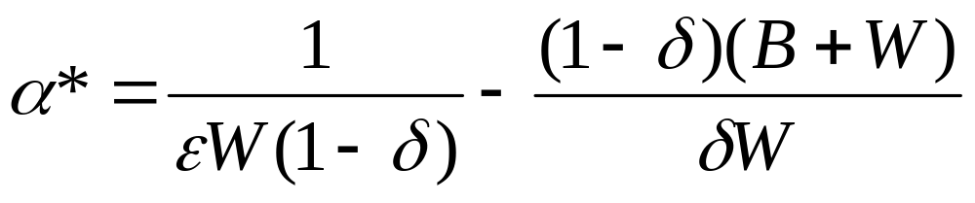
The equilibrium proportion of white hats who choose full public disclosure (FPD):

Slide 31
Possible equilibria:
Expected loss
E(L_{D})
E(L_{N})
Proportion of white hats choosing FPD
0
1
1. Pure no-disclosure (ND) equilibrium, α*<0
None of benign discoverers discloses

Slide 32
Possible equilibria:
Expected loss
E(L_{N})
E(L_{D})
Proportion of white hats choosing FPD
0
1
2. Pure full disclosure (FD) equilibrium, α*>1
All benign discoverers disclose

Slide 33
Possible equilibria:
Expected loss
E(L_{D})
E(L_{N})
Proportion of white hats choosing FPD
0
1
3. Mixed strategy equilibrium, 0<α*<1
Some benign discoverers disclose,
others don’t

Slide 34
FPD tends to occur more often as…

Slide 35
FPD tends to occur more often as…
Bugs become easier to discover

Slide 36
FPD tends to occur more often as…
Bugs become easier to discover
Users get more patient (less myopic)

Slide 37
FPD tends to occur more often as…
Bugs become easier to discover
Users get more patient (less myopic)
The number of black hats increases

Slide 38
FPD tends to occur more often as…
Bugs become easier to discover
Users get more patient (less myopic)
The number of black hats increases
It gets more difficult to develop an exploit based on the disclosed information

Slide 39
FPD tends to occur more often as…
Bugs become easier to discover
Users get more patient (less myopic)
The number of black hats increases
It gets more difficult to develop an exploit based on the disclosed information
The effect of the population size is ambiguous

Slide 40
FPD tends to occur more often as…
Bugs become easier to discover
Users get more patient (less myopic)
The number of black hats increases
It gets more difficult to develop an exploit based on the disclosed information
The effect of the population size is ambiguous
If the social loss function equals the aggregate damage from attacks…

Slide 41
FPD tends to occur more often as…
Bugs become easier to discover
Users get more patient (less myopic)
The number of black hats increases
It gets more difficult to develop an exploit based on the disclosed information
The effect of the population size is ambiguous
If the social loss function equals the aggregate damage from attacks, then full public disclosure can be socially optimal

Slide 42
FPD tends to occur more often as…
Bugs become easier to discover
Users get more patient (less myopic)
The number of black hats increases
It gets more difficult to develop an exploit based on the disclosed information
The effect of the population size is ambiguous
If the social loss function equals the aggregate damage from attacks, then full public disclosure can be socially optimal
Whenever that is the case, it is the equilibrium strategy of individual benign discoverers

Slide 43
Bug discovered by a benign user
Y
Disclose?
N
Massive
attack
No attack
Fix provided by vendor
Next
discoverer?
WH
Game
ends
Disclose?
BH
N
Single attack
Y
Game continues…

Slide 44
Bug discovered by a benign user
Y
Disclose?
N
Choice of effort, X_{Y}
Choice of effort, X_{N}
Patch
installed?
Y
Y
Patch
installed?
N
Game ends
(no loss)
N
Massive
attack
No attack
Fix provided by vendor
Next
discoverer?
WH
Game
ends
Disclose?
BH
N
Single attack
Y
Game continues…

Slide 45
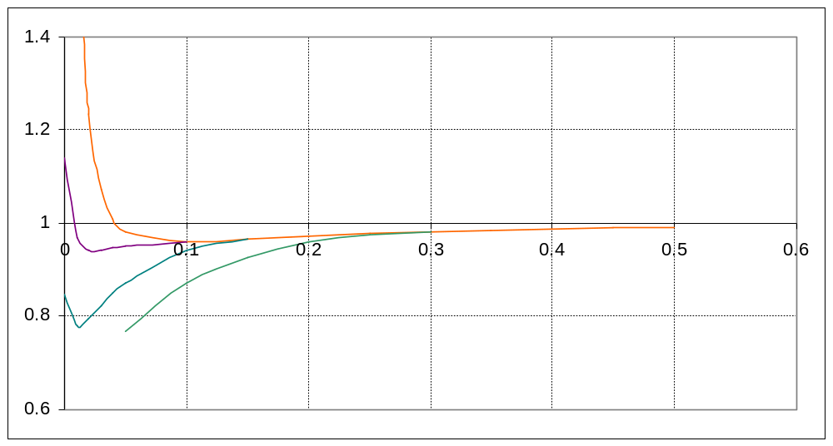
More transparent code leads to more effort put into finding a fix and less FPD.
E(L_{WN})/E(L_{WD})
Κ=0
α
Κ>0
So does a greater potential damage from an attack

Slide 46
Suppose we have a coalition of agents anyone can disclose information to.
The composition of the coalition population is assumed the same as for the rest of the world.
Does it change the incentive structure?
What happens to the aggregate damage from attacks?

Slide 47
Bug discovered
W
Disclose?
N
C
Choice of effort
Choice of effort
Choice of effort
X_{W}
X_{C}
X_{N}
Patch
installed?
Y
Y
Patch
installed?
Y
Patch
installed?
N
N
N
Massive
attack
No attack
Moderate
size attack
Game
ends
Game ends
(no loss)
Next
discoverer?

Slide 48
Such a coalition improves social welfare only if
Software is not too complex
Coalition members are willing to work on a patch
AND
Otherwise,
a coalition has no effect!

Slide 49
Punishing those who choose full public disclosure…
Policy alternatives
Loss
New
Old
% FD
…is not a good idea

Slide 50
Punishing those who choose full public disclosure…
Policy alternatives
Loss
New
Old
% FD
…is not a good idea
Let them disclose!

Slide 51
Better security of existing systems
(a decrease in C, the loss from an attack)
Policy alternatives
Exp. Loss
Old
New
% FD
Aggregate loss decreases
More frequent disclosure along the way

Slide 52
Punishing black hats
Policy alternatives
Exp. Loss
Old
New
% FD
Aggregate loss decreases
More FPD along the way
Costly but not hopeless

Slide 53
Software quality improvement
Policy alternatives
Loss
Old
New
% FD
Fewer bugs discovered

Slide 54
Software quality improvement
Policy alternatives
Loss
Old
New
% FD
Fewer bugs discovered
Weaker incentives to disclose
+
Both effects have to be taken into account when
discussing the effects of software quality improvement!!!

Slide 55
Making vendors issue patches faster
Policy alternatives
Loss
Old
New
% FD
Less disclosure
Smaller aggregate loss

Slide 56
Making vendors issue patches faster
(One of the roles for the coordinator?)
Policy alternatives
Loss
Old
New
% FD
Less disclosure
Smaller aggregate loss

Slide 57
Making the source code transparent
Policy alternatives
Loss
Old
New
% FD
Bugs are patched faster (not necessarily by vendors)
Less disclosure
Smaller aggregate loss

Slide 58
Making the source code transparent
Policy alternatives
Loss
Old
New
% FD
Bugs are patched faster (not necessarily by vendors)
Less disclosure
Smaller aggregate loss
Would this be a threat to intellectual property rights?

Slide 59
Future modifications and extensions
Endogenizing vendors’ decisions and users’ decision to patch
Role of the coordinator
Testing the results empirically

