Slide 1
The Likelihood of Vulnerability Rediscovery and the Social Utility of Vulnerability Hunting
Andy Ozment
Computer Security Group
Computer Laboratory
University of Cambridge

Slide 2
Overview
Overview of previous work: Eric Rescorla. “Is finding security holes a good idea?” WEIS 2004
Security growth modeling: using reliability growth models on a carefully collected data set
Real-world examples of vulnerability rediscovery

Slide 3
Value Proposition for Vuln Hunting
Vulnerability hunting: looking for vulnerabilities without the intent to exploit them in an attack
Possible social benefits
  Motivate vendors to produce more secure software
  Improve the security of existing software
  Find vulnerabilities and repair them before the bad guys (attackers) can find and exploit them
Rescorla dismisses 1 and argues that 2 and 3 are also not achieved

Slide 4
Is finding security holes a good idea? (Rescorla 2004)
Vulnerability data from the ICAT database of all CVE labeled vulnerabilities
Employs reliability growth modeling literature
Tests whether the vulnerability data can be characterized by linear, exponential, or Weibull distributions

Slide 5
Rescorla’s results
Looks at data from three perspectives
Software:
  Four operating systems
  Linear and exponential models do not fit
Vulnerability age cohorts
  Four years: 1997-2000, inclusive
  Only 1999 shows trend
All vulnerabilities
  Half life of 2.5 years

Slide 6
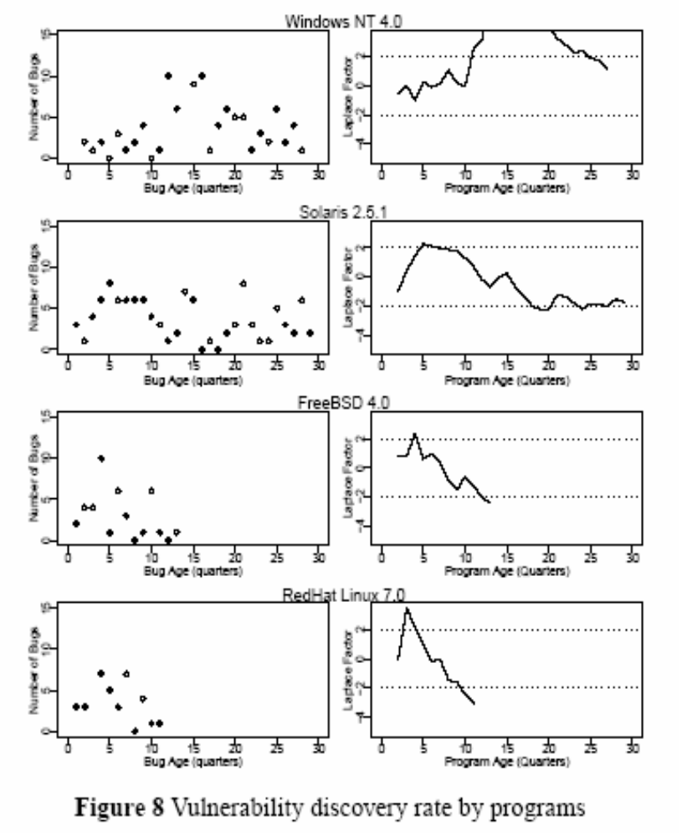
(Rescorla 2004)

Slide 7
Rescorla concludes
Vuln hunting does not significantly increase product quality
  The pool of vulns in products is so large that it is not diminished during the product’s life span
Therefore, the likelihood that multiple individuals will independently discover the same vuln is slight
Vulnerability hunting is thus not socially beneficial
  Good guys do not find vulns that would later be identified by bad guys
  Patch releases inform the bad guys of vulns, and they exploit the unpatched systems
Caveat: Rescorla notes that his data is noisy

Slide 8
Problems with ICAT data
Inaccurate birth dates
Inaccurate death dates
Not comprehensive
So… the OpenBSD 2.2 data set
Use CVS to obtain birth and death dates
Consider any vuln listed by OpenBSD, ICAT, or Bugtraq

Slide 9
Results of OpenBSD 2.2 analysis
44 vulns in a 30 month period encompassing the release of 5 versions
39 of those vulns originated in, or prior to, version 2.2
Two models work
  Acceptable fit (Chi square)
  Good accuracy (prequential likelihood)
Brooke’s & Motley’s Discrete SR Model (Binomial)
  Estimates 49.63 total vulns
Yamada’s S-Shaped Reliability Growth Model
  Estimates 43.08 (lower 95%: 39.0 and upper 95%: 57.31)
Suggestive, but not conclusive
  Other distributions that do not show increasing security could also fit

Slide 10
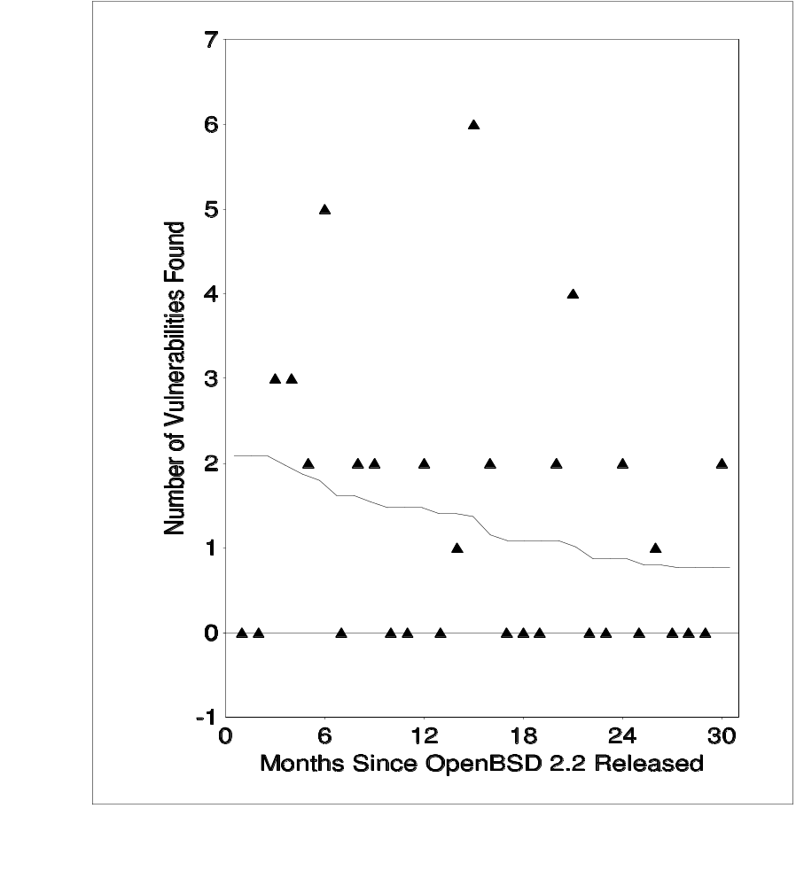
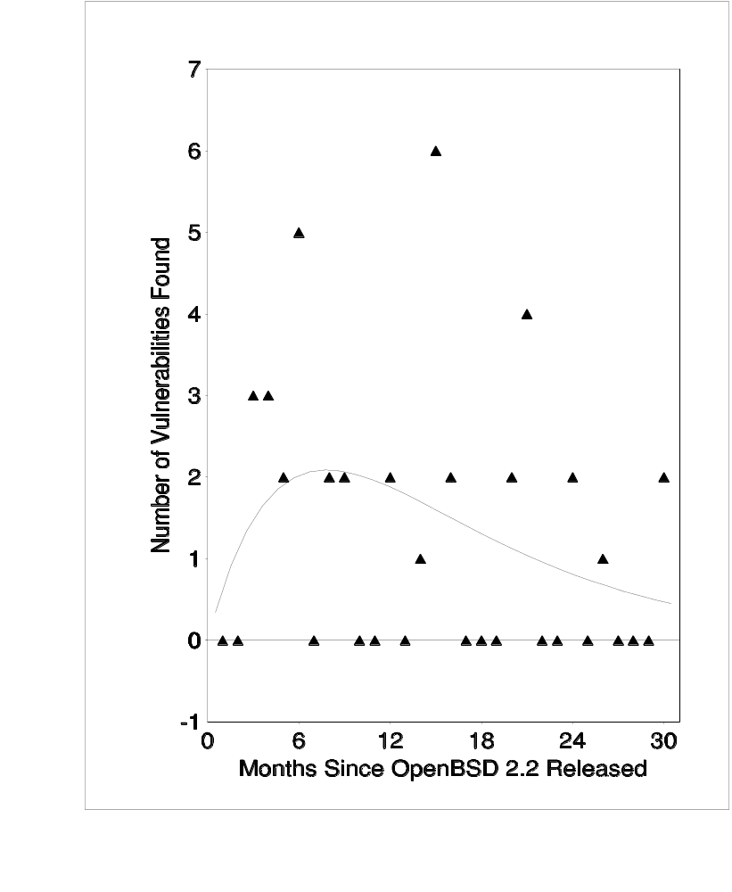
Brooke’s & Motley Model
Yamada’s S-Shaped Model

Slide 11
Key concern: independent rediscovery
Real world experience and intuition suggest that it should not be ruled out
MS security bulletins (patch announcements) provide coarse info
Often credit multiple entities for reporting the same vuln
  But is this credit for ind. rediscovery or collaboration?
Small window of time for rediscovery

Slide 12
Data set
Examine those vulns for which multiple entities are credited in MS bulletins
  Individual reporters’ security bulletins
  Contact individuals credited by MS
Considered the vuln to have been ind. rediscovered
  If confirmed by 1 of the 2 entities listed
  If confirmed by 2 of the 3 entities listed
When are two closely related vulns considered the same vuln?
  I let MS decide
Not scientifically rigorous, but it provides info to feed an intuitive understanding
Likely to be an undercount

Slide 13
Independent Rediscovery of Vulns
Year
No Credit
1
2 Ind.
3 Ind.
% of credited
2002
62
71
4
0
6.58 %
2003
22
43
4
0
8.51 %
2004
22
54
3
2
8.47 %
Total
106
168
12
2
7.69 %

Slide 14
Future work
Major shortcoming of security growth modeling: data is not normalized for effort
  Number of people hunting for vulns
  Skill of vuln hunters
Security growth modeling as a measurement tool
  Comparison between different products
  Comparison of different portions of code base
Is there an ROI on secure coding training?
How does the likelihood of ind. rediscovery change over time?

Slide 15
Conclusion
Success (fit and accuracy) in using reliability growth models for security growth modeling
  In contrast to prior work, vuln depletion cannot be ruled out
Non-trivial real-world evidence of ind. rediscovery
  Undercounts the real occurrences
The evidence of independent rediscovery
  Suggests a more complicated value case for vulnerability hunting than shown in previous work
  Should be considered when modeling vulnerability disclosure policies
  Even using the rough 8% rediscovery figure might alter the models’ calculations of how rapidly patches should be released (or if at all)

