Slide 1

Evaluating Information Security Investments from Attackers Perspective: the Return-On-Attack (ROA)
Marco Cremonini
Dept. of Information Technology
University of Milan, Italy
Patrizia Martini
Zucchetti.com, Italy

Slide 2
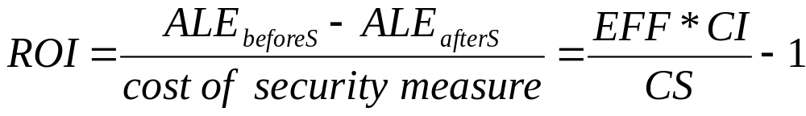
Assumption
ROI: typical metric for many evaluations
The attackers behavior is not explicitly modeled

Slide 3
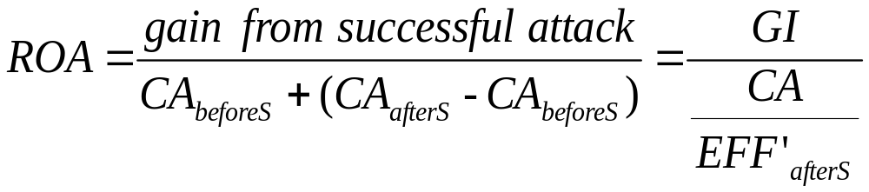
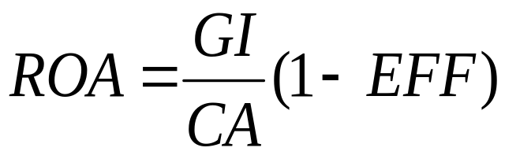
Return-On-Attack
A defender’s evaluation of the way attackers will react to the new security technology
Assuming the efficiency EFF’ of the attacker equal to (1-EFF)

Slide 4

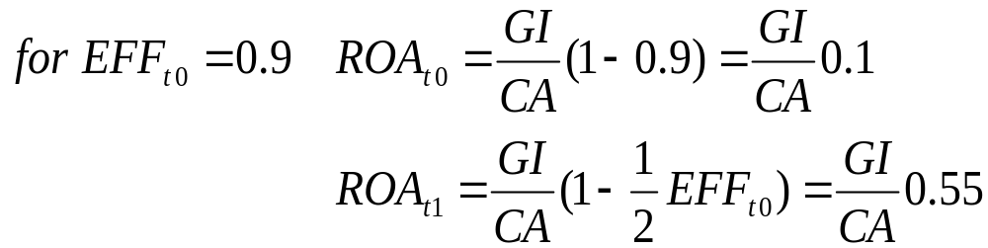
Example: cost reduction
At time t₀: a solution (e.g., a firewall) was chosen with a given ROI_{t0}
IF at time t₁: EFF_{t1} = 1/2 EFF_{t0} and CS_{t1} = 1/2 CS_{t0}

Slide 5
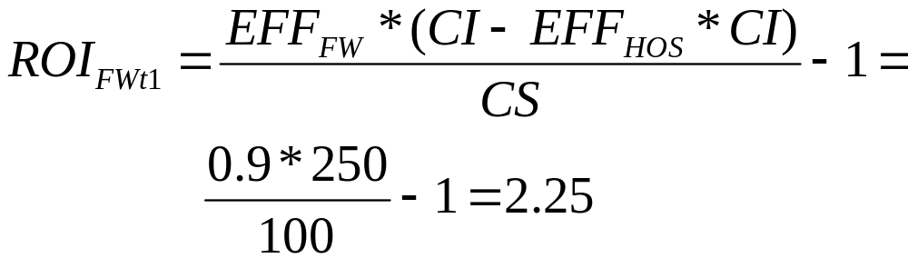
Example: layered solution
At time t₀: two solutions were evaluated (e.g. a NIDS and an HOS) and the latter was chosen with a given ROI_{HOSt0}
At time t₁: a firewall is evaluated to be added to the current architecture

Slide 6
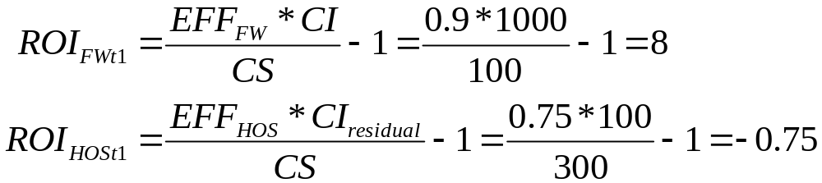
Example: layered solution (cont.)
Problem: the FW is the 1st line of defense and the HOS the 2nd
HOS no longer convenient? Only the FW in place?

Slide 7
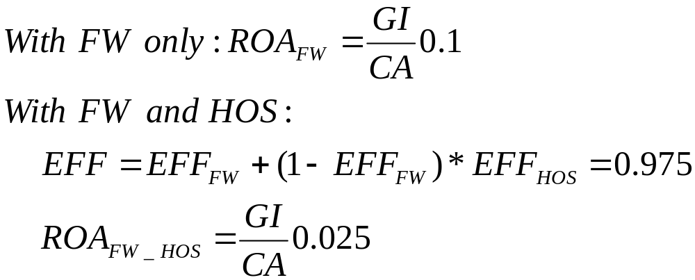
Example: layered solution (cont.)
Calculate ROA:
HOS provides few benefits, the ROA confirms the ROI evaluation.

Slide 8
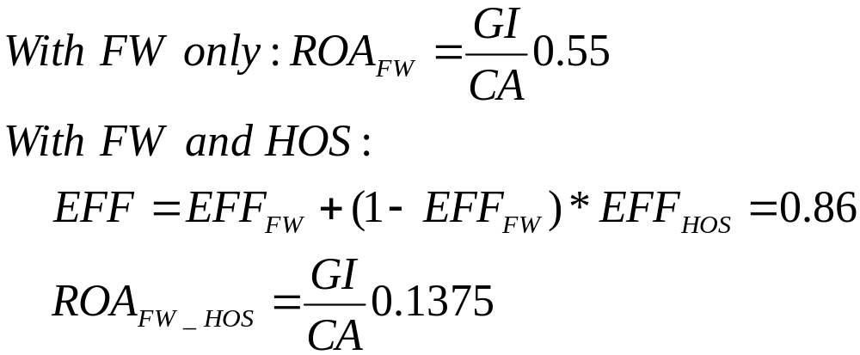
Example: layered solution (cont.)
Take into account the cost reduction scenario
With HOS as the 2nd layer of defense the overall ROA has a little degradation only

Slide 9
Conclusions and future work
The ROI alone provides a partial evaluation of the convenience of a solution
The impact of a solution on attackers behavior should be evaluated as well as possible efficiency degradation over time or cost reduction strategies affecting current solutions
Next steps: Modeling attackers behavior:
⇒ live experiments and reports (e.g. honeynet)
⇒ game theory

