Slide 1
How Much is Location Privacy Worth?
George Danezis, Stephen Lewis and Ross Anderson
Cambridge University

Slide 2
Location Privacy
Location data on people collected by mobile phones etc (cell, triangulation, GPS,…)
Supplied to employers, police and others – dreams of ‘m-commerce’
Some horror stories of affairs being discovered etc
But technical privacy proposals, such as home proxies, haven’t taken off
How much do people value their location privacy?

Slide 3
Experimental Design
Asked 300 CS undergrads to bid to participate in location study
Their mobile phone location would be collected for 28 days
We’d invite the N students with the lowest bids
3rd year students, at least, should understand auction incentive-compatibility
Didn’t say we just wanted valuation; cleared this with ethics procedures

Slide 4
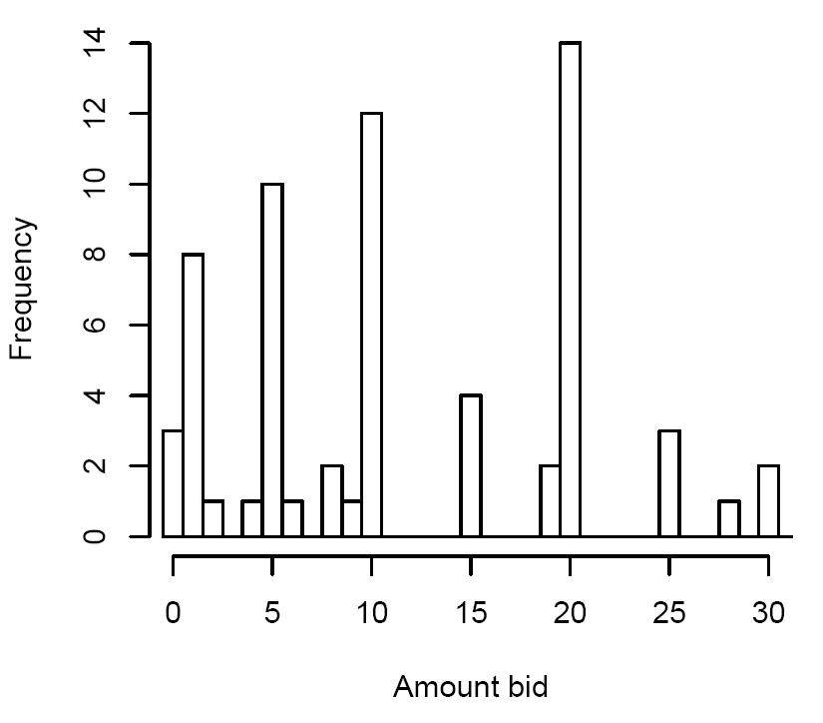
Amounts Bid
3 bid £0, and peaks at £1, £5, £10, £20
Nine bid above £30 (highest was £400)
Median was £10, mean was £27.40
74 people filled out the full form

Slide 5
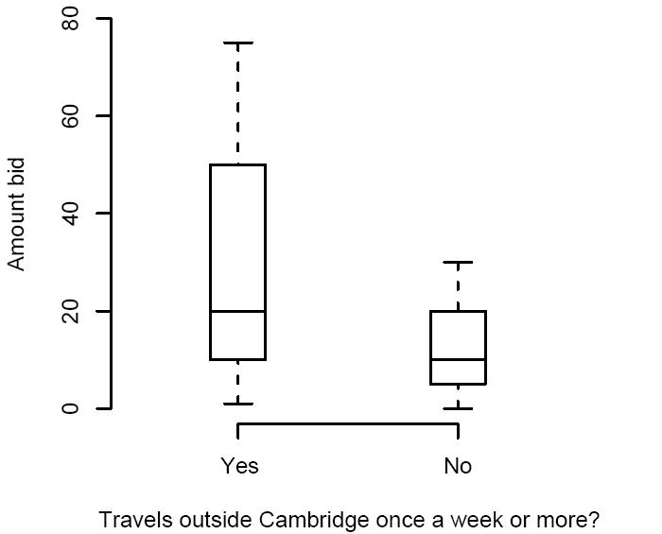
Correlations
People who travel out of town at least once a week have a higher median bid
Mann-Whitney U test significant at 5%
Also a longer tail on the distribution

Slide 6
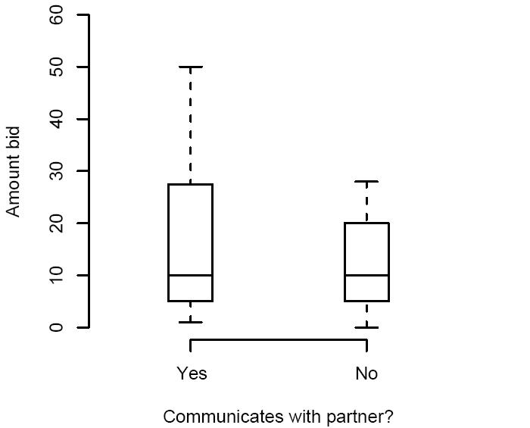
Correlations (2)
Students who use their mobile phone to communicate with a partner have a longer tailed distribution
Difference in medians not significant though

Slide 7
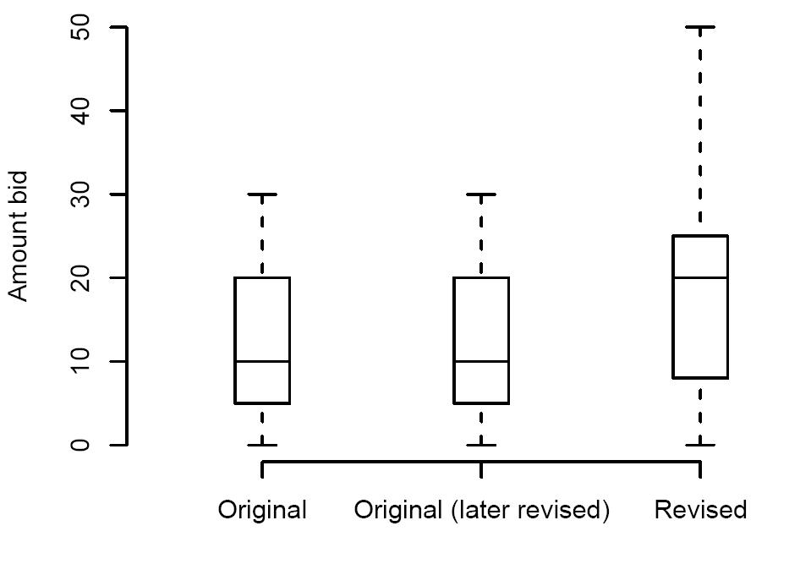
Second Pass
Told students of commercial interest in data
Invited revised bids
The median bid doubled
Yet over half chose not to revise

Slide 8
Conclusions
Stated preferences for location privacy are as one might expect from other stated privacy studies plus social intuition
It remains to be seen if the gulf between stated and revealed preferences is as large here as elsewhere (but why not?!)
What’s novel is our methodology – using a second-price auction to elicit truth

