Slide 1

Private Information Shielding Service for Overcoming Privacy Risk in Recommender System
Choong Hee Lee, Junseok Hwang

Slide 2

목차
Introduction
Benefits of the Recommender System in ECommerce
Privacy Risks in Recommender System
Analysis about Consumer’s Decision Making in RS
The Weakness of Recommender System in ECommerce market
PRINSS – Private Information Shield Service
Conclusion

Slide 3
Necessity of Personalized Information Service
It has been only 25 years when we started to experience varieties of web applications and World Wide Web systems, but there already existed more than 7,700 terabytes of information on the web and more than 5 billion people got connected to this enormous amount of information by year 2000 – Lyman, P. and Varian, H.

Slide 4
Trends of online B2C Trade
The rapid increment of internet subscribers cause the broadening of B2C online transaction
Internet Subscribers –
(million)
Online B2C Market Revenue –
(million$)
US
135
28%
90%`
39
268K
10,652
Europe
82
40%
123%
17
55K
1K
Asia
37
56%
148
197%
4
26K
Japan
22
25%
407
130%
5
26K
Others
43
54%
182
196%
5
41K
World Wide
320
36%
104%
69
425K
12
(%=growth rate per year)
1997 2002
<Anderson Consulting, 2000,2>

Slide 5
Recommender System
Recommender system is
  defined as the personalized information providing system through explicit or implicit data collection about all the system users.
The developers of the first recommender system, Tapestry, coined the phrase “collaborative filtering”
Collaborative filtering is operated by looking for patterns of agreement among the ratings of groups of people
The rating includes both users’ explicit indication of preferences about items and implicit indication, such as purchases or click-throughs
The collaborative filtering functions to predict and inform the user about specific items, which are more probable to prefer by analyzing the patterns
Notes:
People have wanted systems, which can provide valuable information for each individual, and the representative system to satisfy these requests is recommender system

Slide 6
Benefits of RS in eCommerce
Viewpoint of sellers
  Converting browsers into buyers
  Increasing Cross-sell
  Building Loyalty
Viewpoint of buyers
  Decreasing the uncertainty of outcome with product purchasing
  Decreasing the searching cost for the product

Slide 7
Privacy Risk in RS
The correctness of recommender system depends on how much information has been provided
The performance of recommender system shows positive correlation with privacy risk in general cases.
  The major constraints in the promotion of eCommerce adoption is customers’ concerning about private information out-flow – Acquisiti
RS researchers have developed several solutions to keep the efficiency of the recommender system
  However, each solution has its own shortcoming and it is like followings pages

Slide 8
Former Researches (1)
Pseudonymous Profiles
  Anonymous identity is provided
  Privacy risk can be reduced because aggregated pseudonymous profiles are hard to match with real identities
  However, during the process which should be related with real identity like payment and delivery, the risk of revealing real owner of anonymous profile exists
Client-Side Profiles
  Personal information is stored on the end-user devices
  Privacy can be protected by forbidding recommender system operator to aggregate personal profiles
  This solution increases the privacy risk by viruses or other malicious programs which targets personal devices, and needs operating overhead comes from distributed ad-hoc end-user devices.

Slide 9
Former Researches (2)
Task-based Personalization
  The temporary information, which is obtained by activated session or task, is utilized for the input of recommender system to produce real time personalized recommendation
  This solution has clear limitation in the services which need permanent information or history of purchasing
Putting users in Control
  This is the method to build a system which needs to receive the approval of owner of personal information for the application of all source of personal information
  However, recommender system operator has incentive to utilize shared personal information to unauthorized purposes because it can enhance the performance comparing to competing systems

Slide 10
Assumptions
Decision model in RS
Assumption 1. The uncertain outcome(X) from purchasing product is a uniformly distributed random variable which exists on [μ₀-σ₀, μ₀+σ₀]
Assumption 2. In case of sharing personal information, recommendation which is provided by recommender system decreases product uncertainty. The changed uncertain outcome(Xw/r) is a uniformly distributed random variable on [μ₀-σ₀, μ₀+σ₀]. ( σ₁ ≤ σ₀)
Assumption 3. As the rate(k) of the users who share their information in the recommender system increases, the correctness of recommender system increases. (a>1, 1≥k≥0)
Assumption 4. As k increases, it decreases the value(C) of disutility from item searching process. (b>1)
Assumption 5. Consumer utility function is assumed to CARA (Constant Absolute Risk Aversion), and consumer utility function of certain outcome(x) is as following. It is assumed to Von-Neumann Morgenstern utility function.
Assumption 6. Negative outcome which can be made by sharing the personal information is uniformly distributed random variable on [-2σ₂, 0].
Assumption 7. Each user recognizes the privacy risk differently. For the total user set, the individual value of σ₂ is distributed uniformly on [-2σ₂, 0].
Assumption 8. The value of C, σ₁ and σ₂ are independent.

Slide 11
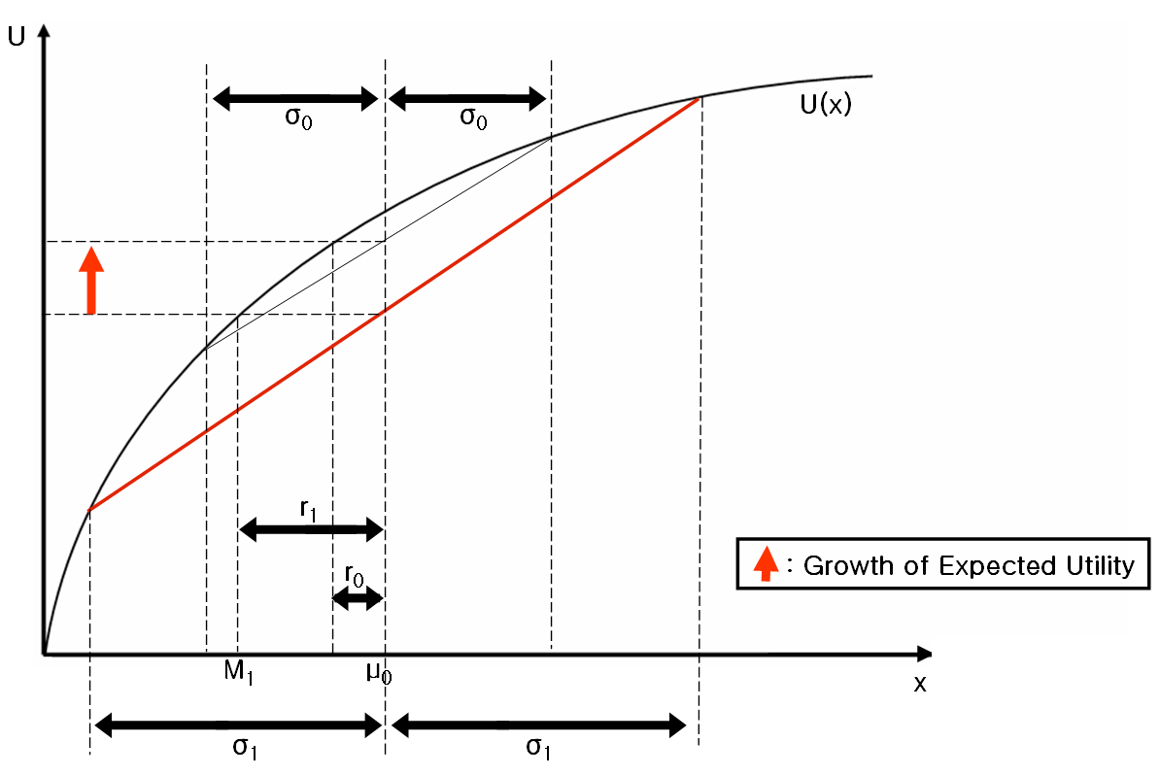
Without Privacy concerning
Decision model in RS
Fig. 1. Growth of expected utility caused by recommendation, according to the decrement of uncertainty in product purchasing

Slide 12
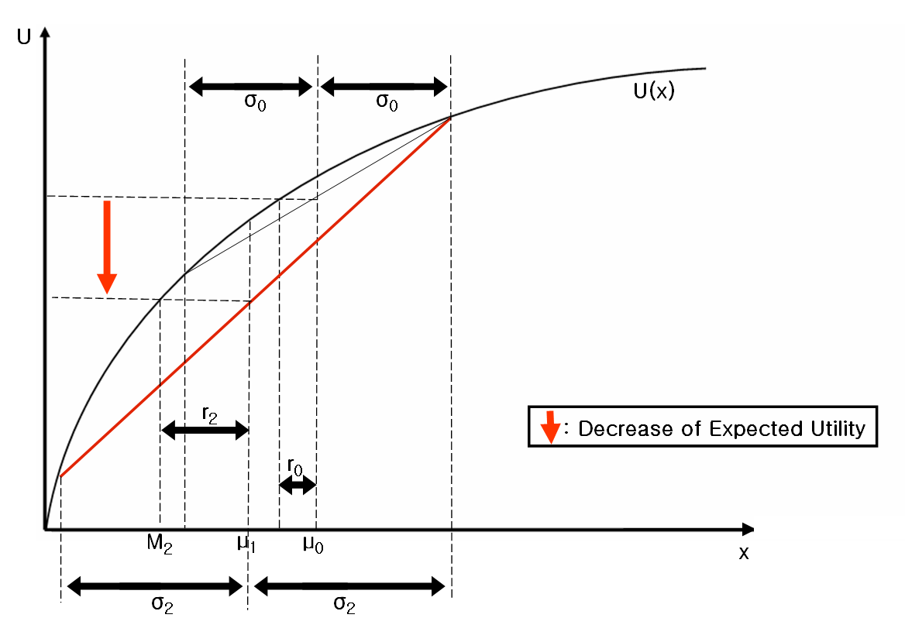
With privacy concerning
Decision model in RS
Fig.2. Decrease of expected utility caused by privacy risk, according to the increment of negative uncertainty which comes from privacy risk

Slide 13
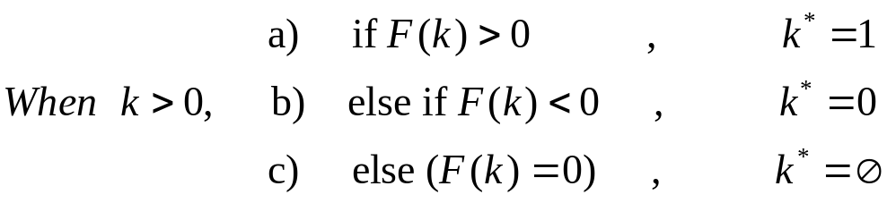



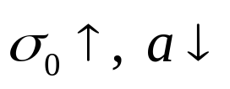
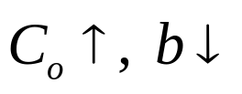
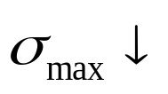
Evolutionary Stable Equilibrium(k*) in RS
When the decrement of uncertainty increases by recommender system:
When the decrement of searching cost increases by recommender system:
When the negative uncertainty of sharing personal information decreases:

Slide 14
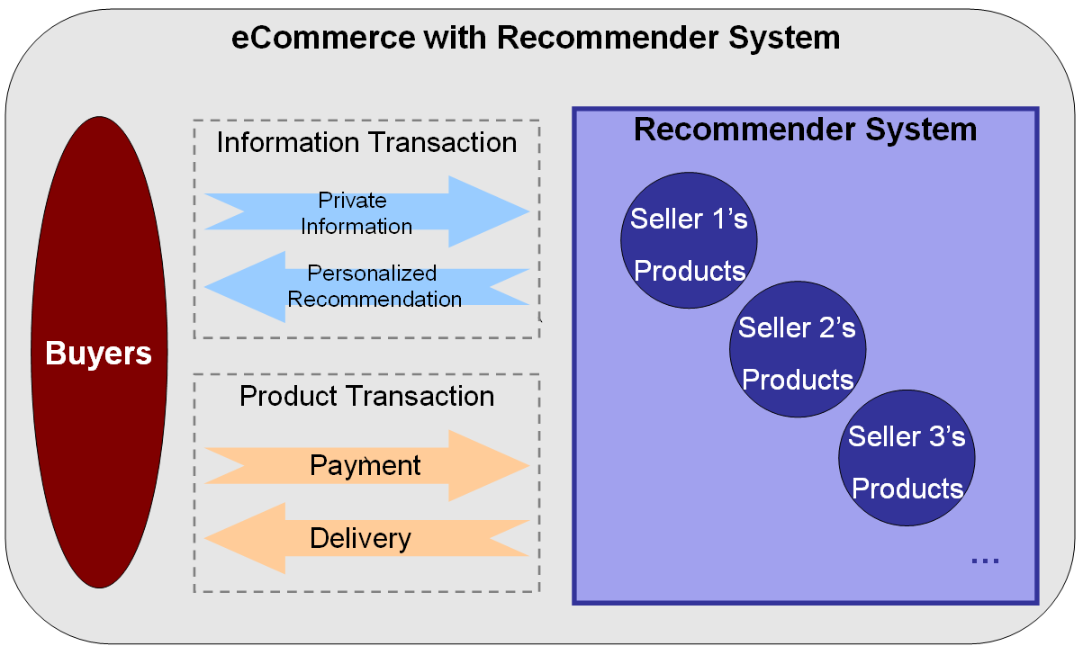
ECommerce with RS

Slide 15
Trust Problems in RS
`
Can I Trust My Partner ?
Will my private information be protected properly ?
Can I trust the recommender system not to generate false recommendation for the profit of itself ?
Can I trust the provided information from buyers?
Personal privacy concern
Product sellers’ shilling attack
Information Transaction
`
Private
Information
Personalized
Recommendation

Slide 16
Weakness of RS without Trust
Attack by reputation system operator
Attack by product seller
Attack by product buyer
Notes:
Attack by reputation system operator
In June 2001, Sony pictures quoted non-existing movie critic’s review for marketing of a new movie, and in case of Amazon it was pointed out that there would be high possibility of the misuse of the recommender system.
When the recommender system operator gets high profit by making false recommendation, it is likely to happen that the system operator uses the recommender system for malicious purposes.
Especially, when it is difficult to distinguish the false recommendation or when the punishment for the false statement does not have compelling power, these problems become more serious.
Also the recommender system operator has incentive to sell or share personal information, which was provided for the recommendation, to the companies which are closely related to their own profits.
Attack by reputation system operator
When the recommender system operator is not the product seller, it is not possible that the product seller makes the false recommendation in order to motivate consumers’ purchase.
However, the product seller who knows the management algorithm of the recommender system can fabricate the recommendation. It can be one of marketing strategy to generate the false personal information or product preference information for increasing recommendations about their own products.
It can also be used for building distrust between the user and the competitive companies. Especially, when there are many substituting products, which have not much difference in the price and quality, these strategies can distort the market permanently by lock-in effect caused by network externality.
Attack by product buyer
The product buyer can reject to provide their personal information or provide false information. This attack will drop the efficiency of whole information transaction, and decrease the amount of product transaction by increasing the uncertainty of item selection at last.
Moreover, it is almost impossible to distinguish the false statement from the users. If some part of consumers uses others’ personal information to get their necessary information and provide the false information, it will destroy the fairness and generate cross-subsidization among consumers.
Consequently, moral hazard and free riding problem will become important in information transaction market. In other words, these attacks from some proportion of users can result in the distrust of all the users because the users who provide true information become to get lower utility from eCommerce than the users provide false. Accordingly, the increment of these attacks can bring out “information lemon market,” and this will be serious disaster to recommender systems

Slide 17
PRrivate INformation Shielding Service - PRINSS
Private Info Shield Service
Recommender System
Wolf’s Credit Insurance
Jun
Security #
Credit Info
Address
Age
Preference
…
Purchased
Product A
Wolf
Choong’s identity proxy
Private Information
Choong
Personalized
Recommendation
Product B
…
…
Transaction Amount
Record per Product
Proxy
Address
: Authorized Private Info
: Cash Transfer
: Product Transfer

Slide 18
Subsidiary Mechanism for PRINSS
By limiting the sharing of different information for the specific fact of personal information, proxy identity management software can constrain the false information input of users
PRINSS provider can generate the reference for the discrimination of attacks, when the attack is suspicious, from recommender system by recording total amount of product sales
PRINSS can increase the cost of generating false information by collecting the product preference or satisfaction only from real product buyers
PRINSS can motivate the explicit report such as product preference or satisfaction by giving the direct incentive to the user. The more incentive(cyber money, mileage, etc) is supplied to the reporters who contribute more to the improvement of recommendation fitness.

Slide 19
Advantages of Financial Institutes as PRINSS Provider
Financial institutes have already accumulated the credit information and the information related with real identity. Accordingly, we need not increase the distribution of personal information.
In case of financial institutes, we already have strong regulatory agency about their financial activities. This means that we can monitor the PRINSS provider more easily for prohibiting colluding with sellers or recommender systems.
Financial service institutes have been including customer security as their service quality. Therefore, they have incentive to adopt PRINSS for supplementary service of existing financial services when there are enough demands for PRINSS.

Slide 20
Suggestion for Future Information Market
Providing the incentive of participating information transaction with trust
Increasing the cost of attack against recommender system
Distinguishing the attack and enforcing proper punishment
Developing the technology or regulatory system for securing the information owner’s right
Inducing the competition on trust as one of the component of service quality

