Slide 1

Could IPv6 Improve Network Security? And, If So, at What Cost?
Presented at
Workshop on the Economics of Information Security
Boston, MA
June 2, 2005
Presented by
Brent Rowe and Mike Gallaher
3040 Cornwallis Road · Research Triangle Park, NC 27709 · www.rti.org
Phone: 919-485-2626 · Fax: 919-541-6683 · browe@rti.org
RTI International is a trade name of Research Triangle Institute.
Notes:
My name is Brent Rowe, and this is Dr. Mike Gallaher, and we are both economists at RTI International…
In the next 5 minutes, I’m going to talk to you briefly about a project we’ve been working on looking at Internet Protocol version 6, or IPv6

Slide 2

IPv6 Technical and Economic Impact Analysis
RTI was funded by NTIA and NIST to conduct a technical and economic impact analysis of IPv6
Information gathering activities included
  DoC Request for Comments
  DoC Public Forum
  Literature review
  Industry interviews by RTI
Notes:
In September 2003…
The information gathering included
22 respondents to the RFC, including over 400 pages of text back in March 2004
Over 30 panelists at the Public Forum held in July 2004
Additionally, we interviewed over 60 experts and industry stakeholders
During the time we have today…
First, I’m going to tell you about the potential benefits of IPv6, focusing on the security benefits AND…
Then, I’m going to tell you about the likely transition costs of IPv6

Slide 3
Internet Protocol Version 6 (IPv6): Benefits
Cost reductions resulting from increased efficiency
Value of remote access to existing products/services
Innovation in communications and online products/services
Cost reductions resulting from improved security
  IPSec inclusion
  Flow labels and priority differentiation added
Notes:
IPv6 was developed in the early 1990’s by the Internet Engineering Task Force, IETF, to replace IPv4. The intention was to improve and enhance the capabilities of the Internet Protocol in several ways…
In our study, we looked at the major potential benefits of IPv6 and developed qualitative estimates of the impacts based on our research and interviews…

Slide 4
Internet Protocol Version 6 (IPv6): Benefits
Cost reductions resulting from increased efficiency
Value of remote access to existing products/services
Innovation in communications and online products/services
Cost reductions resulting from improved security
  IPSec inclusion
  Flow labels and priority differentiation added
Notes:
For this group, I’m going to focus on the potential security benefits…

Slide 5
Security Effects: Overview
Long-term benefits
  Motivate the development of new security model to be adopted
      Increase utilization of E2E security
      Differentiated levels of security
  Cost savings for users and IT staff
Notes:
Although in the short-term, there will probably be additional vulnerabilities from IPv6 adoption rather than benefits, the long-term benefits could be substantial
Many experts have stated that IPv6 will help motivate and subsequently support the development and adoption of a more End-to-End Internet architecture…
Through IPSec use and expanded header options possible in IPv6, security could be significantly improved resulting in time savings for users and IT staff…

Slide 6
Cost of Transitioning to IPv6
Likely Deployment Strategies
  Many IPv6 capabilities could be added as part of routine upgrades
  Transition will likely be gradual
Likely Implementation Costs
  Hardware, software, labor, and indirect costs (i.e., productivity losses)
  Labor costs predicted to dominate
Notes:
Based on our conversations, deployment will likely be gradual… no “flip switch” date…
IPv6 “capabilities” can be added at minimal incremental costs during normal replacement cycles. Experts expect that over the next 5 or 6 years, most major hardware and software will be replaced during organizational routine upgrade cycles.
Once the infrastructure is present, various transition techniques (i.e., dual-stack, tunneling, translation) could be used to support a gradual transition from IPv4 to IPv6.
In addition to the Hardware and Software, transition costs include incremental expenditures and activities associated with the IPv6 deployment. They reflect costs above and beyond routine costs…
Largest deployment costs will be to “enable” IPv6 capabilities in HW and SW
These costs include:
(1) staff training,
(2) upgrading network-specific applications and network management software, and
(3) enabling IPv6 capabilities.

Slide 7
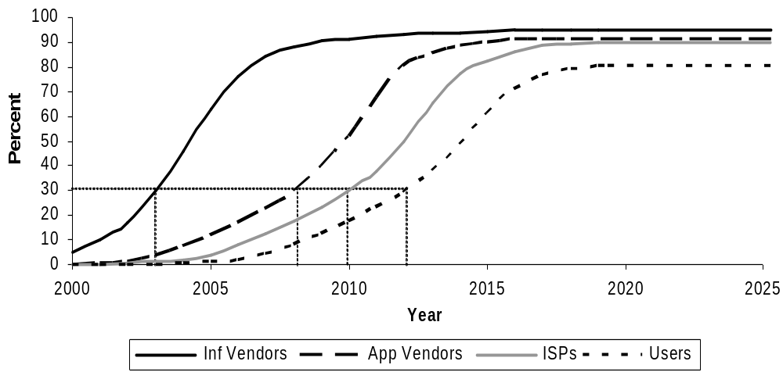
Penetration Estimates of IPv6 in the United States
Notes:
We developed these curves based on information provided in our interviews with experts and industry stakeholders, including…
Infrastructure vendors,
Application vendors,
Internet Service Providers, and
Users (public and private).
These curves, however, have different interpretations…
For Vendors – they indicate when capabilities are being offered in X% of available products
For ISPs – the curve indicates when X% of service provider provisioning networks are able to provide IPv6 service to customers
For Users – the curve indicates when X% of users are using IPv6…

Slide 8
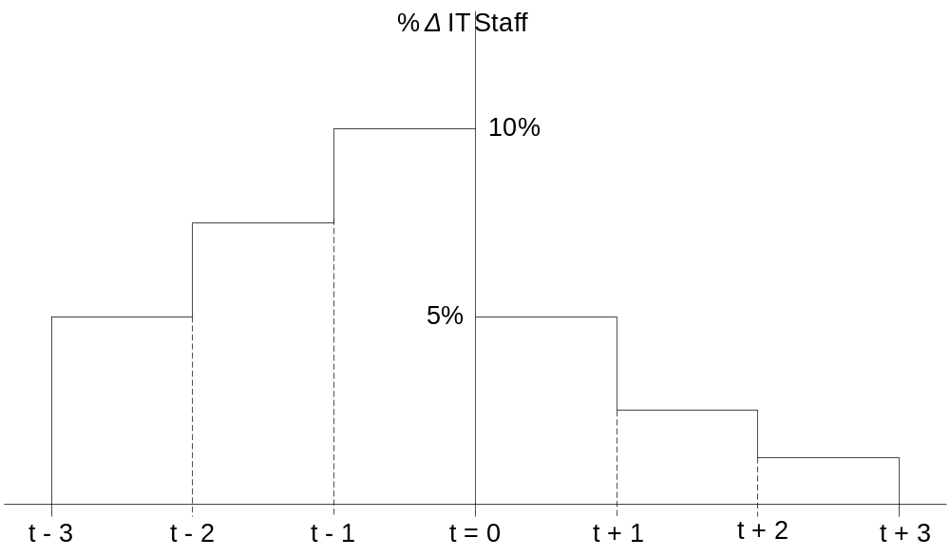
Percentage of IT Staff Dedicated to IPv6 Transition for Internet Users
Notes:
Then, we asked for time series distribution of costs, where
t = 0: is the date IPv6 is enabled
t – 3: is the first year of spending on training for, planning for, and testing of IPv6
t + 3: is the last year of “additional spending” related to IPv6
The percentages represent either the increase in annual total IT spending (for users), annual R&D spending (for vendors), and provisioning (for ISPs)…

Slide 9
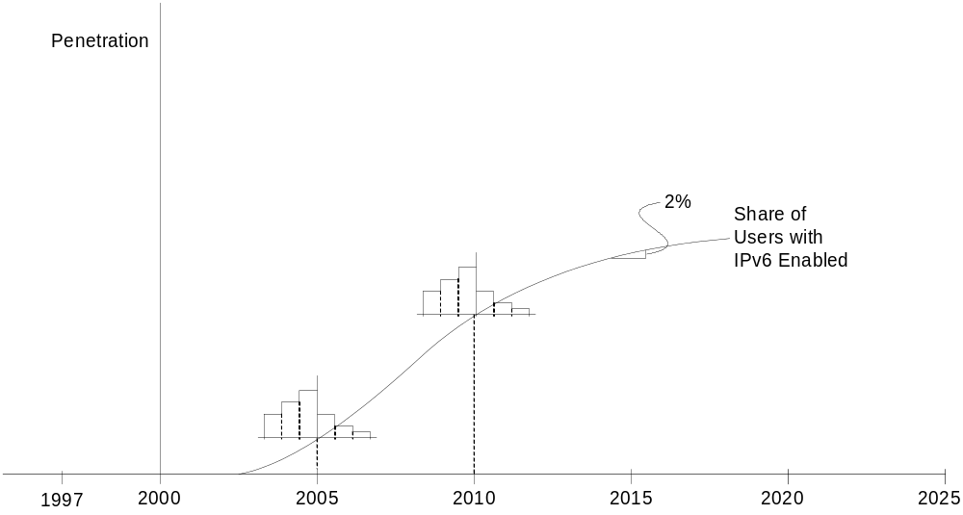
Example of U.S. User Enablement Over Time
Notes:
Here we combined the penetration and time series costs to eventually get a curve showing when costs will be borne
We used figures from the U.S. Census Bureau, the National Science Foundation, and Gartner to estimate annual R&D expenditures for vendors and IT costs for users and ISPs…

Slide 10
Annual Spending by U.S. Users to Become IPv6 Enabled
$ Millions
0
2000
Year
Notes:
Our calculations resulted in this preliminary distribution of costs over the next several decades from U.S. users…
We cannot show the actual dates and costs because the Department of Commerce’s IPv6 Task Force has not yet released their Final Report…

Slide 11
Timeline of Costs for Base Case and Accelerated Deployment Scenarios
$ Millions
0
2000
Year
Base Case
Accel Scenario 1
Accel Scenario 2
3 year acceleration of deployment in existing HW/SW
Early replacement of HW/SW
Notes:
Further, we estimated changes in the magnitude and timing of the transition costs based on two scenarios…
Case #1 – users enable IPv6 at the same time as their purchase products with the capabilities, but these purchases are still through routine upgrades (additional training costs were estimated to occur)
Case #2 – users purchase products with IPv6 capabilities one year ahead of schedule and enable at the same time; we used annual IT spending figures to estimate the effects…

Slide 12
Summary of Transition Costs from IPv4 to IPv6
Stakeholder Group | Costs (Present Value [PV] Millions $2003)ª
Infrastructure vendors | $$$
Application vendors | $$$
ISPs | $$$
Users | $$$
Total | $$$
ª Calculated using a 7 percent real social discount rate.
Notes:
In our report, we breakdown the transition costs by stakeholder group, with users, having the biggest stake by far…
Please keep an eye out for the Dept. of Commerce to release their report, which will include our analysis
If you let me know, I can send you the link to the report when it’s made public
We’ll post the paper we planned to submit to this conference as soon as possible
Any questions???

