Slide 1
My Dishonest
Benchmark
How to Manufacture a 100x PostgreSQL Performance Claim
Mayur@Veeam
01

Slide 2
AGENDA
This is not a “look at my TPS” talk.
The goal: recognize where benchmarking ends and benchmarketing begins.
BENCHMARKING
BENCHMARKETING
Measure to learn
Measure to sell
Where is the line?
MY DISHONEST BENCHMARK
02

Slide 3
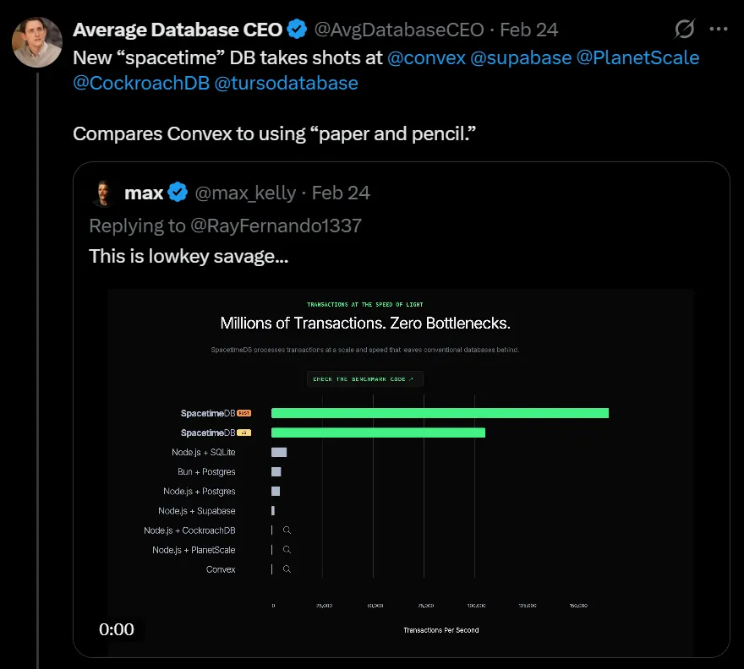
INSPIRATION
MY DISHONEST BENCHMARK

Slide 4
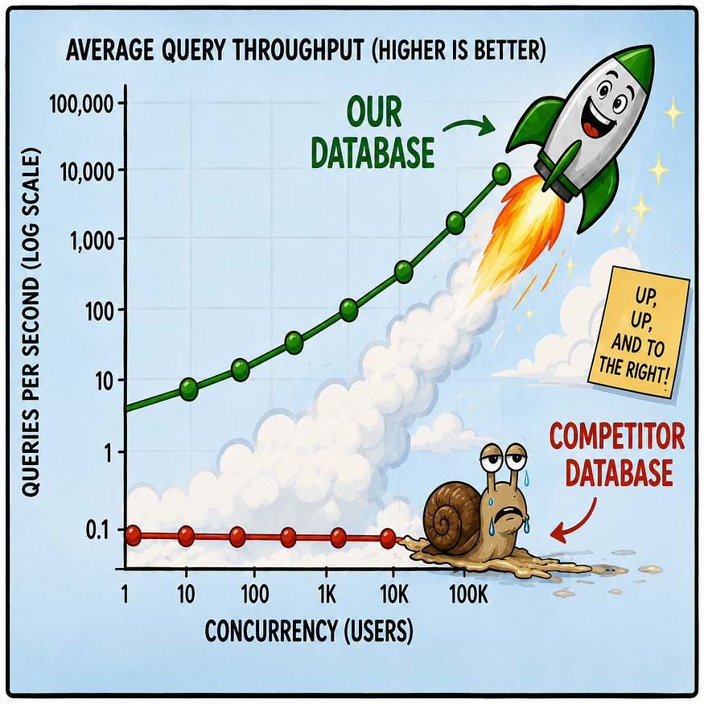
MODERN DAY BENCHMARKING
MY DISHONEST BENCHMARK

Slide 5
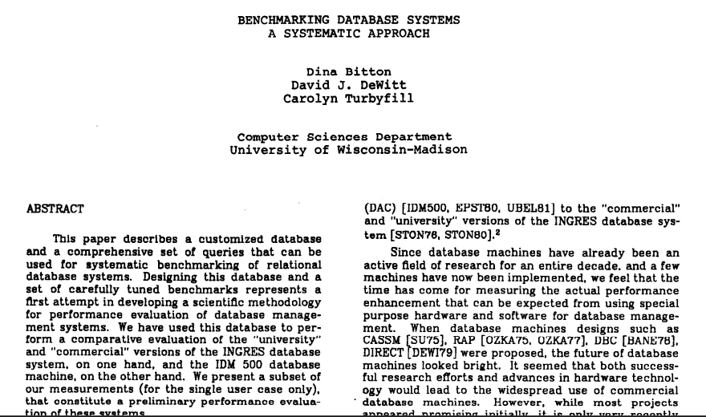
HISTORY
MY DISHONEST BENCHMARK
04
Notes:
Forty-three years ago, Bitton, DeWitt and Turbyfill had a radical idea: instead of every database vendor telling us how fast their database was, perhaps we could run the same tests.

Slide 6

There was
one small
problem.
MY DISHONEST BENCHMARK
05
Notes:
Oracle performed poorly in the Wisconsin benchmarking and Larry Ellison objected strongly. Ellison even contacted the department chair demanding that DeWitt be fired. Oracle had temporary ban on hiring Wisconsin graduates.

Slide 7
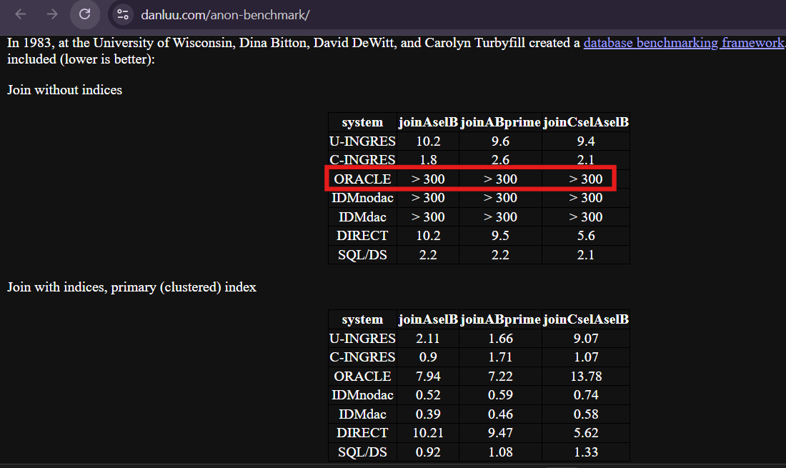

Slide 8
THE DEWITT CLAUSE
The DeWitt Clause changed the battlefield
1980S
Wisconsin Benchmark
Independent academic DBMS benchmarking
VENDOR PRESSURE
Commercial conflict
Poor results trigger fights
DEWITT CLAUSE
License restriction
Publishing results can require approval
RESULT
Benchmarketing
Loss of academic interest
MY DISHONEST BENCHMARK
05
Notes:
In direct response to the Wisconsin Benchmark results, Oracle added a license provision (the original “DeWitt Clause”) that prohibits publishing benchmark results of Oracle software without prior written permission.

Slide 9
CONSEQUENCE
The DeWitt Clause helped change who controlled the benchmark narrative
INDEPENDENT RESEARCHERS
Pulled back
Became less willing to publish comparative results
VENDORS
Stepped in
Increasingly published their own benchmark results
MY DISHONEST BENCHMARK
06

Slide 10
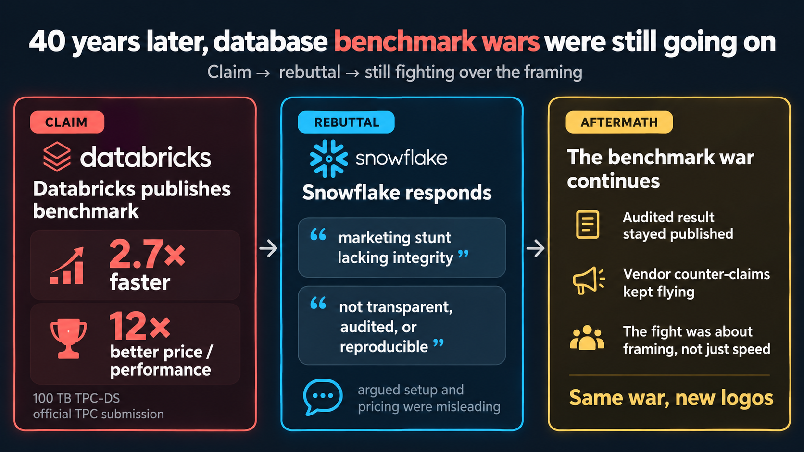
The benchmark wars, 40 years later
Notes:
You would think that after 40 years, the database industry might have learned to behave itself.
Well... not quite.
Fast-forward to 2021.
“Same war, new logos.”
Databricks' official TPC-DS result was audited, whereas Snowflake disputed the separate comparative measurements attributed to Snowflake.

Slide 11
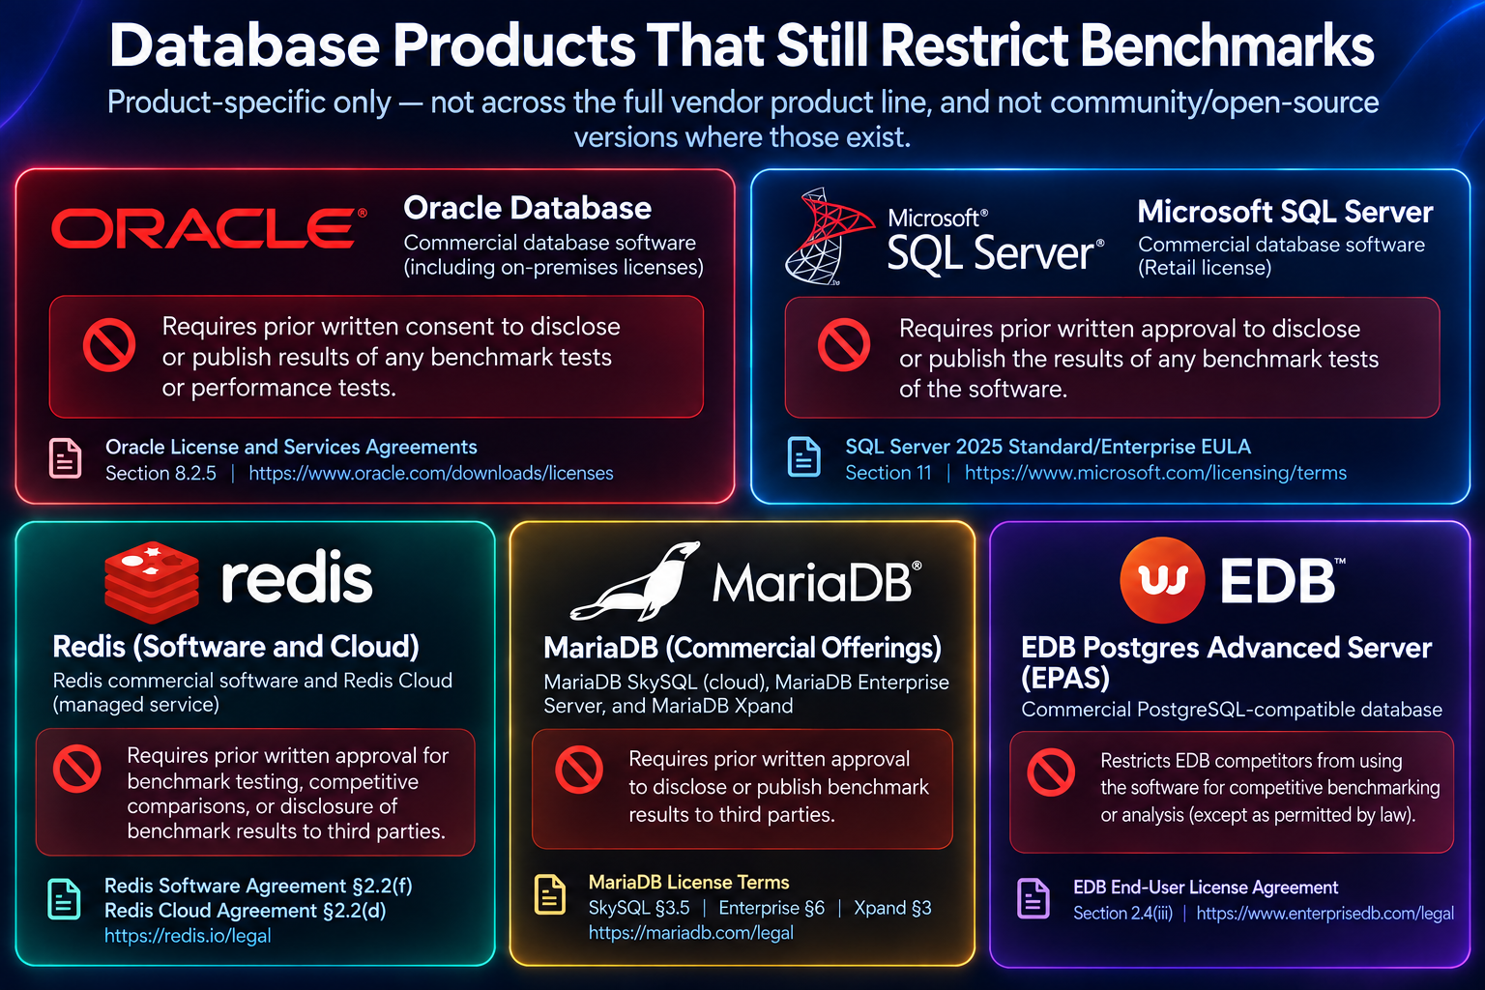

Slide 12
What is a DeWitt Embrace Clause?
Open benchmarking, with one catch: the vendor can test you back
01
02
03
Benchmark us
Show your work
We test you back
You test the vendor’s product
Publish results with full setup details
The vendor can test your product in return
Open benchmarking, not a gag order
Not proof that a benchmark is fair

Slide 13
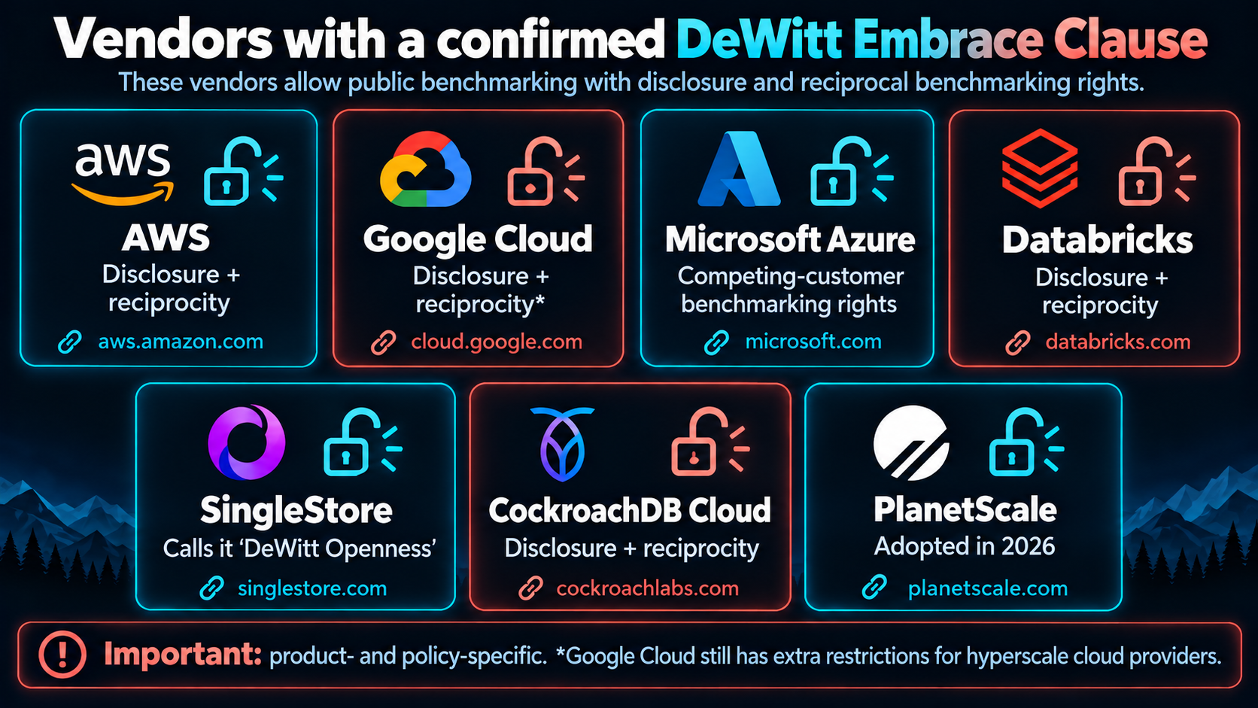

Slide 14
BENCHMARK ANARCHY
Six ways to tilt a benchmark favorably towards your database
01
02
03
Tune
Default
Choose
your own database carefully
the comparison database
a workload your architecture loves
04
05
06
Ignore
Ignore
Publish
cost + tail latency
write amplification + crash behavior
the one graph where you win
MY DISHONEST BENCHMARK
07

Slide 15
TRANSPARENCY
A better fight: publish everything
01
02
03
04
CODE
CONFIG
COST
WORKLOAD
Exact harness + implementation
Settings on every system
Hardware + spend
What each side actually did
MY DISHONEST BENCHMARK
08

Slide 16
ENTER POSTGRES
PostgreSQL has a marketing problem.
No owner. No marketing department. No PR strategy. No launch-day rocket-vs-snail charts.
MY DISHONEST BENCHMARK
09

Slide 17
THE EXPERIMENT
So let us create a heroic graph
CONSTRAINT
100,000+
Every reported number comes from a real run.
OPERATIONS / SECOND
FREEDOM
by hook or crook
I can quietly change what the number means.
MY DISHONEST BENCHMARK
10

Slide 18
REPRODUCTION PACK
Dishonest does not mean unreproducible
01
schema + pgbench workloads
02
reset scripts + cheat variants
03
result collection
04
chart/report generation code
github.com/secp256k1-sha256/talks_and_blogs/tree/main/dishonest_benchmark
MY DISHONEST BENCHMARK
11

Slide 19
Tiny TPC-C-flavoured accounting.
Not TPC-C. Not compliant. Just OLTP-shaped enough to feel familiar.
MY DISHONEST BENCHMARK
12

Slide 20
SCHEMA.SQL
Four tables, seeded with 100 branches and 1M accounts
CORE TABLES
LEDGER AND AUDIT TABLES
SEED DATA
CREATE TABLE bench_branches (
branch_id int PRIMARY KEY,
balance bigint NOT NULL DEFAULT 0
);
CREATE TABLE bench_accounts (
account_id bigint PRIMARY KEY,
branch_id int NOT NULL
REFERENCES bench_branches(branch_id),
balance bigint NOT NULL DEFAULT 0
);
CREATE TABLE bench_ledger (
ledger_id bigserial PRIMARY KEY,
account_id bigint NOT NULL,
branch_id int NOT NULL,
amount int NOT NULL,
created_at timestamptz NOT NULL
DEFAULT clock_timestamp()
);
CREATE TABLE bench_audit (
audit_id bigserial PRIMARY KEY,
account_id bigint NOT NULL,
action text NOT NULL,
created_at timestamptz NOT NULL
DEFAULT clock_timestamp()
);
INSERT INTO bench_branches(branch_id)
SELECT g
FROM generate_series(1, 100) AS g;
INSERT INTO bench_accounts
(account_id, branch_id, balance)
SELECT g, 1 + (g % 100), 100000
FROM generate_series(1, 1000000) AS g;
MY DISHONEST BENCHMARK
15

Slide 21
THE WORKLOAD
One transaction does six things
1
2
3
4
5
6
READ
UPDATE
INSERT
INSERT
DELETE
COMMIT
account
balance
ledger
audit
old audit
transaction
MY DISHONEST BENCHMARK
13

Slide 22
PGBENCH
32 clients run this five-statement transaction for 120 seconds
1 SETUP, READ, UPDATE
2 LEDGER AND AUDIT WRITES
3 CLEANUP AND COMMIT
-- pgbench script for tests
\set aid random(1, 1000000)
\set delta random(-500, 500)
BEGIN;
SELECT balance
FROM bench_accounts
WHERE account_id = :aid;
UPDATE bench_accounts
SET balance = balance + :delta
WHERE account_id = :aid;
INSERT INTO bench_ledger
(account_id, branch_id,
amount)
SELECT account_id, branch_id,
:delta
FROM bench_accounts
WHERE account_id = :aid;
INSERT INTO bench_audit
(account_id, action)
VALUES (:aid, 'debit_credit');
DELETE FROM bench_audit
WHERE audit_id IN (
SELECT audit_id
FROM bench_audit
WHERE created_at < now()
- interval '10 minutes'
ORDER BY created_at
LIMIT 1
);
COMMIT;
MY DISHONEST BENCHMARK
16

Slide 23
PGBENCH
The run: 32 clients on 8 threads for 120 seconds
RUN COMMAND
----*** Run pgbench ***----
pgbench -n -c 32 -j 8 -T 120 --protocol=simple \
-f indexed_baseline.sql pgbench_darkside
WHAT EACH FLAG DOES
-n
Skip the pgbench pre-run vacuum
--protocol=simple
Simple query protocol
-c 32
32 concurrent client sessions
-f
Run the custom script file
-j 8
8 worker threads
pgbench_darkside
Target database
-T 120
Run for 120 seconds
MY DISHONEST BENCHMARK
17

Slide 24
TEST SETUP
100
1,000,000
32
BRANCHES
ACCOUNTS
CLIENTS
8
120 s
simple
PGBENCH JOBS
PER RUN
PROTOCOL
MY DISHONEST BENCHMARK
14

Slide 25
Benchmark environment
One desktop machine, one local PostgreSQL instance, 120-second runs.
MACHINE
TEST SETUP
Host | Intel Core i7-13700, 16 cores / 24 threads
RAM | 63.8 GB
Storage | Samsung SSD 980 NVMe
OS | Windows 11
Database | PostgreSQL 18.6, x86_64
Driver | pgbench 18.6
Test duration | 120 seconds per measured test
Load | 32 clients / 8 threads
Database | pgbench_darkside
Connection | -h localhost -U postgres -d pgbench_darkside
Password source | PGPASSWORD=*******
Dataset | 100 branches, 1,000,000 accounts
MY DISHONEST BENCHMARK

Slide 26
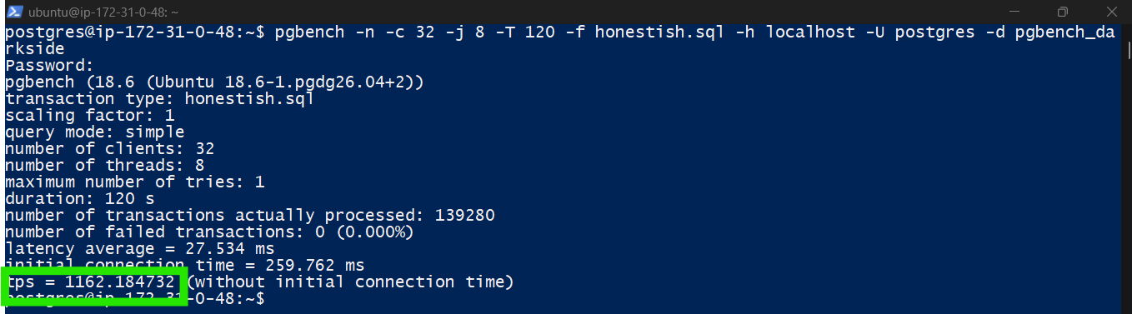
Why not VM in a cloud?
1,162 TPS
cloud VM, 32 clients, 120 s
27.5 ms
average latency
MY DISHONEST BENCHMARK
Notes:
Cloud VMs have throttled IOPS/Bandwidth, Noisy neighbor may steal CPU and latency fluctuation is present. As a result, baseline on entry level Cloud VMs is at least 10 times slower than local desktop or laptop.

Slide 27
Baseline settings before the “cheats”
jit
off
full_page_writes
on
shared_buffers
1GB
fsync
on
synchronous_commit
on
wal_compression
LZ4
Windows machine • local NVMe • tuned OLTP-ish PostgreSQL configuration
MY DISHONEST BENCHMARK
15

Slide 28
INTENTIONALLY FLAWED
Case 0: sabotage the baseline
DELETE FROM bench_audit
WHERE audit_id IN (
SELECT audit_id
FROM bench_audit
WHERE created_at < now() - interval '10 minutes'
ORDER BY created_at
LIMIT 1
);
584
TPS
dishonest baseline
This is not PostgreSQL being slow.
This is the schema being lazy.
NO INDEX ON CREATED_AT
MY DISHONEST BENCHMARK
16

Slide 29
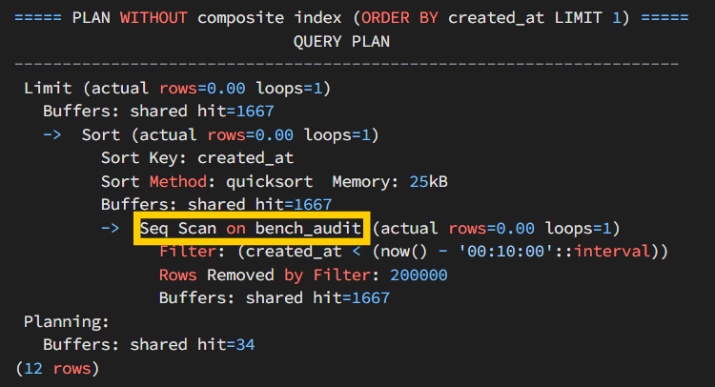
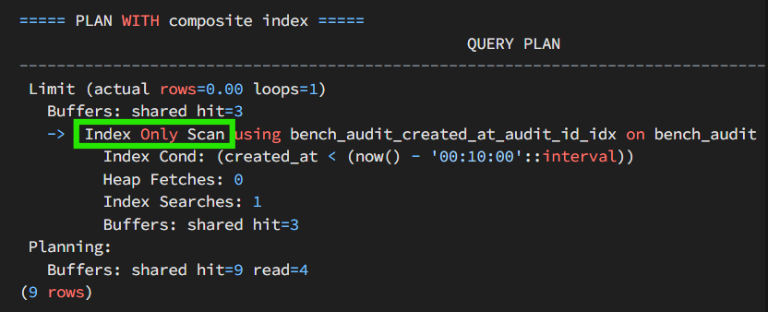
EXPLAIN ANALYZE
WITHOUT INDEX
WITH COMPOSITE INDEX
Index Only Scan reads 3 buffers, 0 heap fetches
MY DISHONEST BENCHMARK

Slide 30
The plan tells you exactly what I broke
WITHOUT INDEX
WITH COMPOSITE INDEX
200,000
rows removed by filter
0
heap fetches
1,667
shared buffers hit
3
shared buffers hit
Seq Scan
→ Sort → Limit
Index Only
Scan → Limit
MY DISHONEST BENCHMARK
17

Slide 31
HONEST BASELINE
Add the obvious missing index.
22,705
CREATE INDEX bench_audit_created_at_audit_id_idx
ON bench_audit(created_at, audit_id);
TPS — HONEST BASELINE
41× OVER CASE 0
MY DISHONEST BENCHMARK
18

Slide 32
FOUR LEVERS
1
2
3
4
GUARANTEES
WORK
EXECUTION
METRIC
durability / WAL / crash promises
do less or change persistence
server-side logic / protocol
batching and a new y-axis
MY DISHONEST BENCHMARK
20

Slide 33
The scary durability knobs barely help
Indexed baseline
22,705
sync_commit off
24,355
full_page_writes off
23,390
fsync off
24,522
checkpoint tuning
23,124
all durability off
24,666
MY DISHONEST BENCHMARK
21
Notes:
Fast local NVMe, compressed WAL, a short period workload, single node and windows wal_sync_method made sure durability knobs did not play major role.

Slide 34
Why Nuclear-sounding settings barely helped
default open_datasync
fdatasync
Measured latency
~40 µs
~2 ms
Write caching
Can remain enabled
Can prevent write caching
Benchmark impact
High TPS
Low TPS
MY DISHONEST BENCHMARK
22
Notes:
Windows' default wal_sync_method = open_datasync doesn't wait for a real device flush (38µs).
“I turned off basically everything people tell you never to turn off... and PostgreSQL rewarded this recklessness with just nine percent.”
“Apparently we're going to have to cheat harder.”

Slide 35
UNLOGGED LEDGER / AUDIT
Write less WAL
37,780
LOGGED
UNLOGGED
ledger
audit
→
ledger
audit
TPS
1.66×
MY DISHONEST BENCHMARK
24

Slide 36
LESS WORK
×
SELECT account
45,145
✓
UPDATE balance
INSERT ledger
TPS
✓
×
FK check
1.99× VS INDEXED
×
INSERT audit
Doing less work is faster.
×
audit cleanup
MY DISHONEST BENCHMARK
23

Slide 37
SERVER-SIDE + PREPARED
Change the execution shape
Indexed baseline
22,705
Stored procedure
74,473
SQL function
72,473
Prepared protocol
34,684
SQL function + prepared
80,178
MY DISHONEST BENCHMARK
25

Slide 38
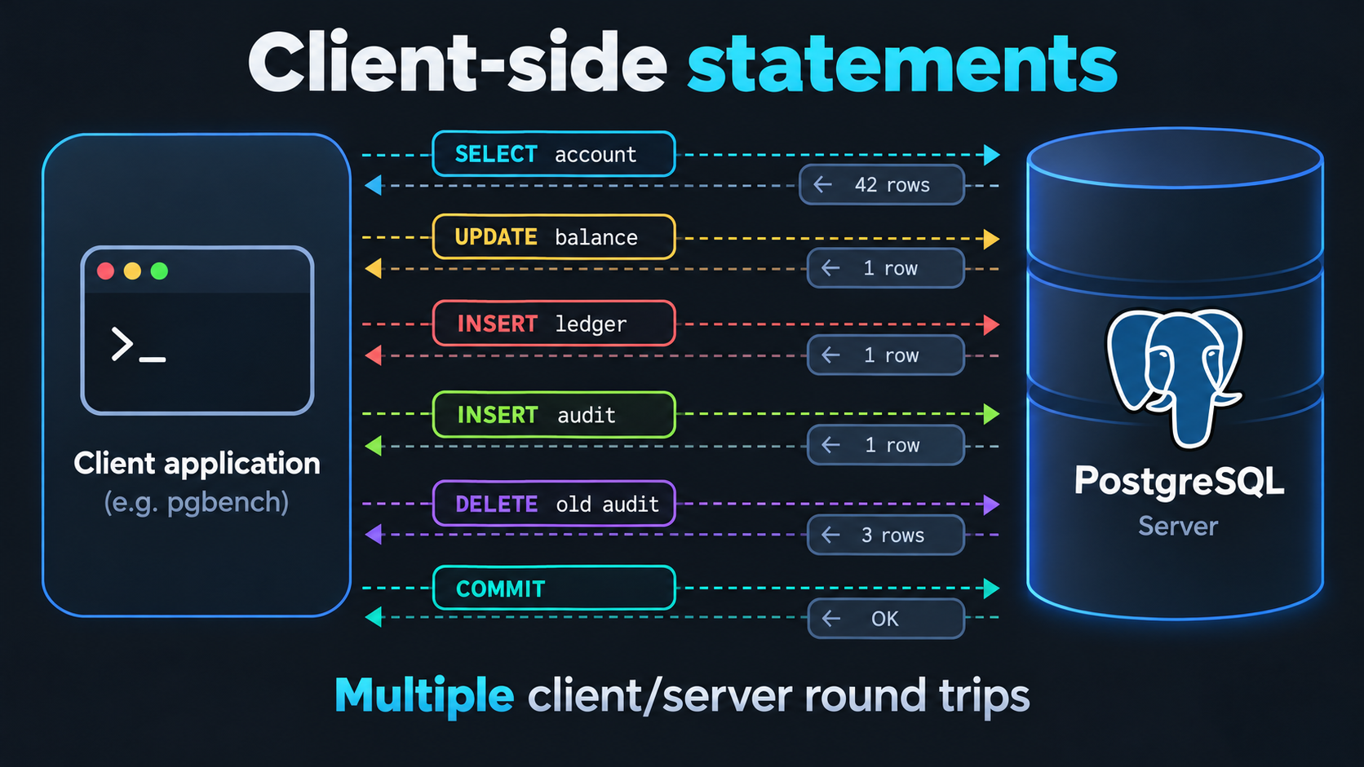
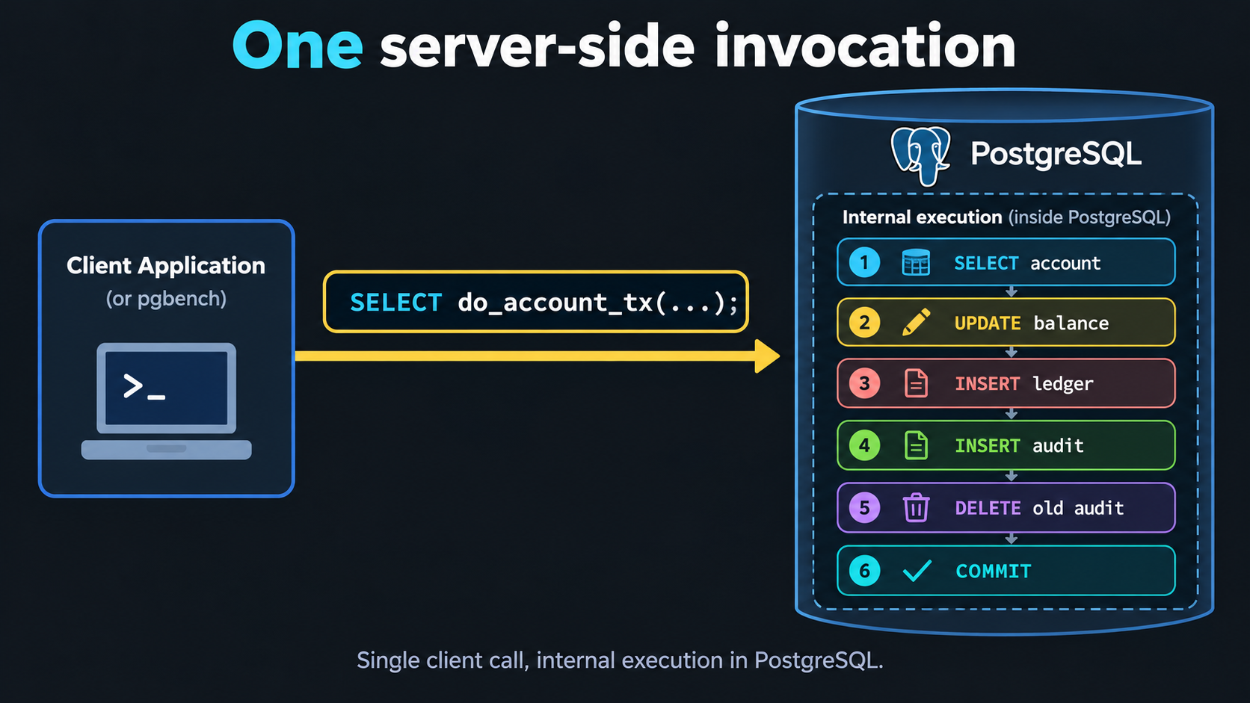
SERVER-SIDE FUNCTIONS
Six round trips become one call
BEFORE Each statement waits on the network
AFTER The whole transaction runs inside PostgreSQL
MY DISHONEST BENCHMARK
30

Slide 39
PREPARED PROTOCOL
Parse and plan once, then only execute
Simple protocol
Prepared protocol
Every statement, every time
After the first run, only Execute
Parse
Parse skipped
Analyze & rewrite
Analyze & rewrite skipped
Plan
Plan skipped
Execute
Execute
22,705 → 34,684 TPS (+53%). Still six round trips per transaction; each statement just costs less CPU.
MY DISHONEST BENCHMARK
30

Slide 40
The respectable hero result.
80,178
TPS
3.53× VS INDEXED
MY DISHONEST BENCHMARK
26
Notes:
“The talk could end here. This is the benchmark I would publish if I were trying to learn something. Unfortunately, today we're trying to sell something.”

Slide 41
BEFORE CHEATING
This is where an honest benchmark pauses.
MY DISHONEST BENCHMARK
19
Notes:
Now the cheating starts.

Slide 42
THE PIVOT
Up to here, the y-axis still means TPS.
Now the y-axis starts doing marketing work.
MY DISHONEST BENCHMARK
27

Slide 43
CHANGE THE UNIT
batch ×8
24,099
ONE TRANSACTION
TPS
1
2
3
4
5
6
7
8
→
8 account operations inside it
192,790
REPORTED OPS
8.49× HEADLINE
MY DISHONEST BENCHMARK
28

Slide 44
BATCH ×32
bigger batch, bigger headline
8,426
269,617
↓
↑
TPS
REPORTED OPS
Marketing metric rises.
11.87× HEADLINE
MY DISHONEST BENCHMARK
29

Slide 45
BENCHMARKETING TRICK #2
TPS ↓ OPS ↑ Headline ↑↑↑
The number is real. The comparison changed.
MY DISHONEST BENCHMARK
30

Slide 46
ALL CHEATS + BATCH ×32
Grand finale: stack the deck
SQL FUNCTION
PREPARED PROTOCOL
32 OPS / TRANSACTION
RELAXED DURABILITY
LESS INTEGRITY WORK
362,789
REPORTED OPERATIONS / SECOND
MY DISHONEST BENCHMARK
31

Slide 47
THE FULL SCOREBOARD
PostgreSQL 18.6 on Windows 11, trusted Dev Drive V: (ReFS), pgbench -c 32 -j 8 -T 120, 1 round
Method | Protocol | TPS | OPS* | Latency (ms) | × baseline | × Case 0
Case 0: bad code / missing index | simple | 584 | 584 | 54.80 | 0.03× | 1.0×
Indexed baseline | simple | 22,705 | 22,705 | 1.41 | 1.00× | 38.9×
synchronous_commit=off | simple | 24,355 | 24,355 | 1.31 | 1.07× | 41.7×
full_page_writes=off | simple | 23,390 | 23,390 | 1.37 | 1.03× | 40.1×
fsync=off | simple | 24,522 | 24,522 | 1.30 | 1.08× | 42.0×
checkpoint tuning | simple | 23,124 | 23,124 | 1.38 | 1.02× | 39.6×
all durability off | simple | 24,666 | 24,666 | 1.30 | 1.09× | 42.2×
less work (drop FK/SELECT/audit) | simple | 45,143 | 45,143 | 0.71 | 1.99× | 77.3×
UNLOGGED ledger/audit | simple | 37,780 | 37,780 | 0.85 | 1.66× | 64.7×
stored procedure | simple | 74,473 | 74,473 | 0.43 | 3.28× | 127.5×
stored function (SQL) | simple | 72,743 | 72,743 | 0.44 | 3.20× | 124.6×
prepared protocol | prepared | 34,684 | 34,684 | 0.92 | 1.53× | 59.4×
sql function + prepared | prepared | 80,178 | 80,178 | 0.40 | 3.53× | 137.3×
batching ×8 | simple | 24,099 | 192,790 | 1.33 | 8.49× | 330.2×
batching ×32 | simple | 8,426 | 269,617 | 3.80 | 11.87× | 461.7×
all cheats + batch ×32 (SQL fn) | prepared | 11,337 | 362,789 | 2.82 | 15.98× | 621.3×
* OPS = operations/second for batched methods, TPS otherwise. × baseline = vs indexed baseline; × Case 0 = vs the crippled Case 0. Highlighted row stacks every cheat at once.
Dev Drive with Defender performance mode keeps real-time scanning out of the commit path (scans run asynchronously).
MY DISHONEST BENCHMARK

Slide 48
CHAMP IS HERE
362,789
REPORTED OPS
15.98×
621×
VS INDEXED BASELINE
VS CRIPPLED CASE 0
The number is not fake. The framing is the trick.
MY DISHONEST BENCHMARK
32
Notes:
“I promised you a 100× claim. Unfortunately, I cheated too successfully. We got 621×.”

Slide 49
THE MARKETING CHART
Now plot the headline number instead
WARNING: TPS → OPS
Case 0 TPS
584
Indexed TPS
22,705
SQL fn TPS
72,743
Batch ×8 OPS
192,790
Batch ×32 OPS
269,617
All cheats OPS
362,789
MY DISHONEST BENCHMARK
34

Slide 50
Extended Trickery
The trick: always benchmark against vanilla PostgreSQL.
VECTOR SEARCH SPEED, RELATIVE TO PGVECTOR
pgvector
the baseline they pick
1x
XYZdb
the published claim
4x
pgvectorscale / VectorChord/ pg_vectorsearch
left out of the chart
20x
B = 4A and C = 20A, so C = 5B?
Against Postgres with the right extension, XYZdb is 5x slower.
MY DISHONEST BENCHMARK
38

Slide 51
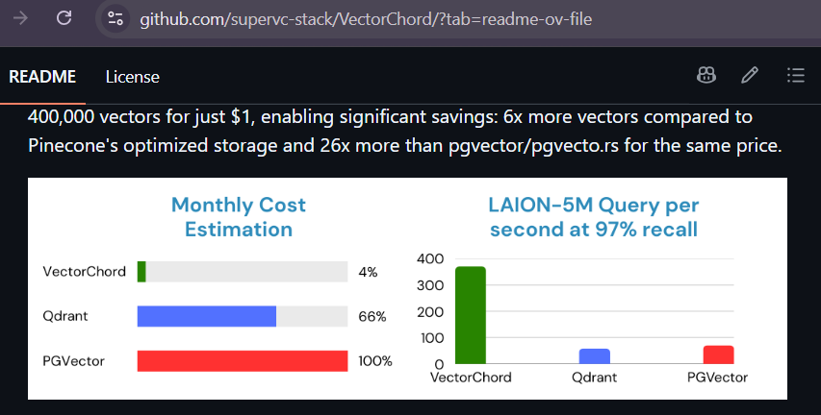

Slide 52
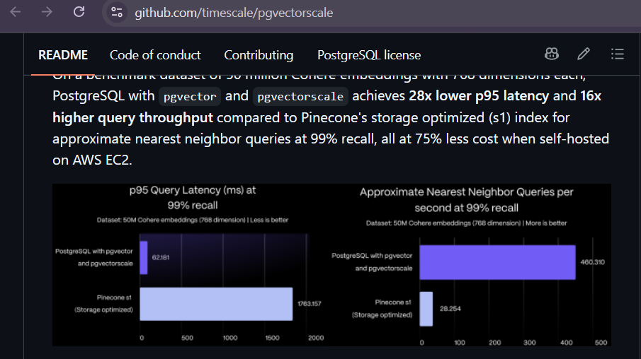

Slide 53
PG_VECTORSEARCH
PRISM beats HNSW on a quarter of the hardware
Median query latency at 95% recall
Lower is better
Index build time
Lower is better
HNSW on the 128 GiB machine never finished its build
PRISM index is 25 GB on both machines
Tiger Data benchmark (rekall), 100M Cohere embeddings. Recall@10 vs. exact search; HNSW is pgvector with halfvec. 128 GiB = r8i.4xlarge, 512 GiB = r8i.16xlarge (4× cost). pg_vectorsearch is alpha and requires PostgreSQL 18+.
Source: Tiger Data, "Announcing pg_vectorsearch", Oct 13, 2026
MY DISHONEST BENCHMARK
35

Slide 54
Before believing the next 100× graph…
Ask what changed between the bars.
MY DISHONEST BENCHMARK
38

Slide 55
DECOMPOSE THE CLAIM
Where did the big number really come from?
Fix broken schema
584 → 22,705 TPS
39× headline opportunity
Durability knobs
1.02×–1.09×
mostly noise here
Do less / UNLOGGED
1.99× / 1.66×
work or guarantees changed
MY DISHONEST BENCHMARK
36

Slide 56
DECOMPOSE THE CLAIM
The last jump comes from changing execution + metric
Server-side SQL function
72,743 TPS
3.20× legitimate hero
Batching
24,099 / 8,426 TPS
headline switches to OPS
Stack everything
362,789 OPS
15.98× vs indexed
MY DISHONEST BENCHMARK
37

Slide 57
THE HONEST CONCLUSION
The number is not fake.
The framing is the trick.
362,789 OPS. Same PostgreSQL. Different story.
MY DISHONEST BENCHMARK
41

Slide 58
BENCHMARK-READING CHECKLIST
are we comparing the same thing?
01
BASELINE
Is the comparison system competently configured?
02
WORK
Are both sides doing the same logical work?
03
GUARANTEES
Same durability, consistency and crash semantics?
MY DISHONEST BENCHMARK
39

Slide 59
BENCHMARK-READING CHECKLIST
Then: interrogate the metric and omissions
04
METRIC
TPS, queries, rows, requests… or “operations”?
05
OMISSIONS
Cost, p99 latency, write amplification, operational complexity?
06
REPRODUCIBLE
Can I see the code, config and workload?
MY DISHONEST BENCHMARK
40

Slide 60
PostgreSQL still gets one compliment
Even a dishonest benchmark had to use real PostgreSQL features to cheat convincingly.
INDEXES
BATCHING
UNLOGGED TABLES
STORED PROCEDURES
SQL FUNCTIONS
PREPARED STATEMENTS
Mature. Boring. Production-grade machinery.
MY DISHONEST BENCHMARK
42

Slide 61
DATABASE WARS
The details change. The crime scene stays familiar.
The same performance ladder could be built with MySQL, MariaDB, or almost any database.
DIFFERENT METRIC
LESS WORK
DIFFERENT GUARANTEES
UNEQUAL SETTINGS
BAD BASELINE
MY DISHONEST BENCHMARK
44

Slide 62
REFERENCES
01
That time Oracle tried to have a professor fired for benchmarking their database
Dan Luu
danluu.com/anon-benchmark/
02
The DeWitt Clause: Why You Rarely See Database Benchmarks
Brent Ozar
www.brentozar.com/archive/2018/05/the-dewitt-clause-why-you-rarely-see-database-benchmarks/
03
The DeWitt clause censorship should be illegal
David A. Wheeler
dwheeler.com/essays/dewitt-clause.html
MY DISHONEST BENCHMARK

Slide 63

THANK YOU
Now go distrust
some graphs.
Questions?
Talk and scripts on GitHub
MY DISHONEST BENCHMARK
45
Notes:
https://github.com/secp256k1-sha256/talks_and_blogs/tree/main/dishonest_benchmark

Slide 64


See you at the Prague PostgreSQL Meetup
RSVP
Scan to
grab a spot
MY DISHONEST BENCHMARK
46

