Slide 1
Anisotropies
Braden Moore
Andrew Duong

Slide 2
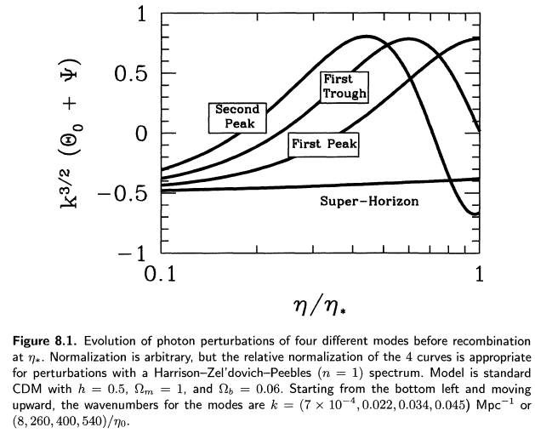
8.1 Overview
Notes:
We start by cheating and looking at the answers first.
Theta = photon perturbation variable; the Fourier transform of (deltaT/T)

Slide 3
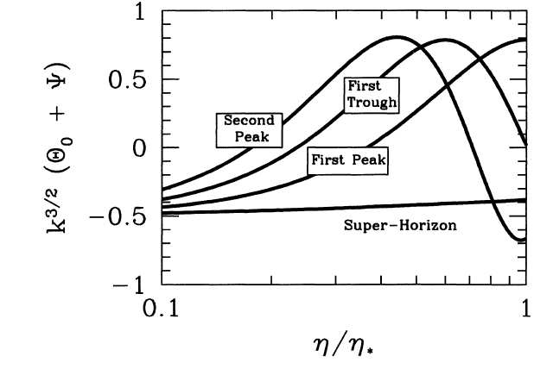
8.1 Overview
η = conformal time (location of particle horizon)
η* = conformal time at recombination
Θ₀ = temperature anisotropy
Ψ = energy lost by photons by emerging from gravitational potential well and hence lost energy
k^{3/2} undoes amplitude scaling of photons

Slide 4
8.1 Overview
perturbations during inflation manifest in radiation and matter distribution
In order to understand the expected anisotropies today we need to understand photon evolution (perturbations).
photon evolution determined by Einstein-Boltzmann equations (set up already)
Photon perturbations evolved differently before and after recombination at z = 1100
Before recombination, photons tightly coupled to matter, electrons protons (baryon photon fluid)
After recombination, photons “free stream” off surface of last scattering
Photon perturbations do not change appreciably in time, compared to matter; perturbations set up in inflation remain linear in growth, small

Slide 5
8.1 Overview
Large scale anisotropies correspond to modes which have not had causal contact from inflationary era
Small scale mode, display oscillatory amplitudes as a function of time; as each mode enters the horizon the perturbation grows
depending on when the mode enters the horizon, we might see a maxima or minima of its perturbation (recall figure)
spectrum will have peaks and troughs depending on angular scales corresponding to these modes, which enter the horizon at different times and have corresponding maxima or minima in perturbation
The acoustic oscillations are due to the pressure of the relativistic photons; more-or-less constant after surface of last scattering/recombination occurs
Notes:
Large scale anisotropies correspond to modes which have not had causal contact from inflationary era
Small scale modes, display oscillatory amplitudes as a function of time, where as each mode enters the horizon the perturbation grows
depending on when the mode enters the horizon, we might see a maxima or minima of its perturbation (recall figure)
Entering a horizon means causal relation to oscillate in mode. Hence the spectrum will have peaks and troughs depending on angular scales corresponding to these modes, which enter the horizon at different times and have corresponding maxima or minima in perturbation
The acoustic oscillations are due to the pressure of the relativistic photons. All these modes set the spectrum in stone-ish, by the time surface of last scattering/recombination occurs. It is a imprint of photon perturbation spectrum at that time.

Slide 6

8.1 Overview
Basic equation governing perturbation is 2nd-order ODE; forced harmonic oscillator
Driving force by gravity, velocity determined by c_{s}, sound speed in the baryon photon fluid
different baryon densities give different frequencies of oscillation (heavier fluid), also leads to greater disparity between over- and underdensities.
above equation ignores damping; damping occurs because scattering rate is not infinite

Slide 7
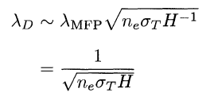
8.1 Overview
Mean distance travelled shown below; any perturbation smaller than this scale would be washed out. In Fourier space this means higher k is damped
note that k ~ 1/λ
since n_{e} is proportional to Ω_{b} when the universe is ionised, a smaller baryon density leads to damping occurring at lower k (see next figure)

Slide 8
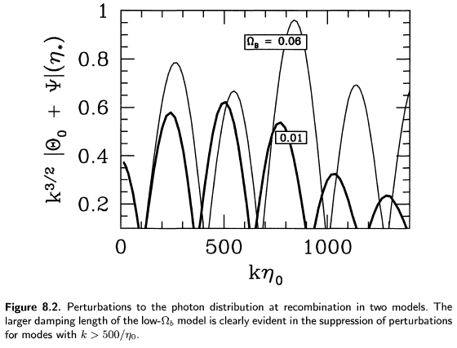
8.1 Overview

Slide 9
8.1 Overview
How to relate this to post recombination anisotropies?
We say that the photons from hot and cold spots are separated by some comoving distance k, with an angular separation
θ = k⁻¹/(distance between now and recombination)
Decomposing the temperature field into multipoles, we find our angular scale roughly corresponds to θ = l⁻¹
since η* << η₀, we can project inhomogeneities (perturbations) of scale k onto anisotropies of scale
Notes:
Also note: integrated Sachs-Wolfe effects produce perturbations of photons of order ~10%; these effects include the change in gravitational potentials due to different energy type domination

Slide 10
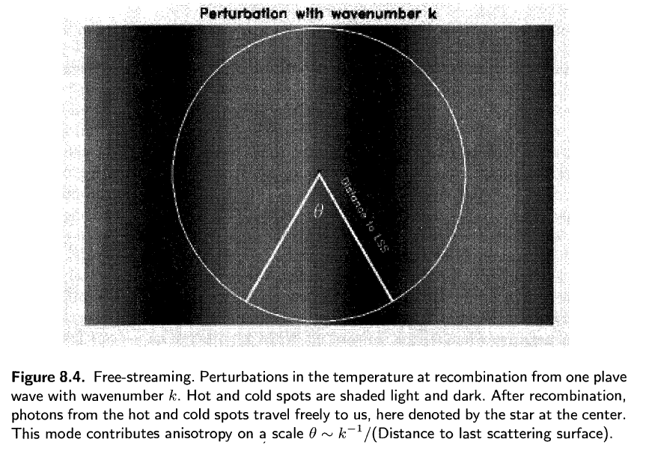
8.1 Overview

Slide 11
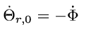
8.2 Large-scale anisotropies
we will exactly solve the large-scale solution for the photon perturbation
we use the super-horizon equation from Ch. 7
which has the solution
initial conditions
where is the primordial potential at inflation

Slide 12

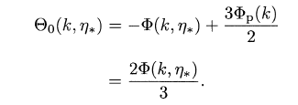
8.2 Large-scale anisotropies
we use the expression for large-scale evolution of Phi (Ch. 7)
we take the y >> 1 limit (recombination occurs long after epoch of equality)
hence temperature variation given in terms of potential

Slide 13

8.2 Large-scale anisotropies
observed anisotropy is
we use the approximation
i.e. PHI is gravitational potential, Ψ is energy lost by photons moving through gravitational potential

Slide 14
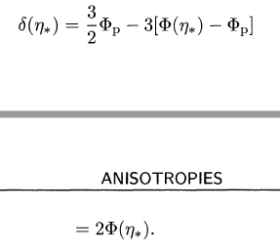
8.2 Large-scale anisotropies
we can express observed anisotropy in terms of dark matter overdensity
from Ch. 6 we have initial conditions and evolution for overdensity
this can be solved to give

Slide 15

8.2 Large-scale anisotropies
large scale anisotropy in terms of dark matter overdensity
interesting to note: overdensity corresponds to negative anisotropy
even though overdense regions contain hotter photons, these photons lose energy travelling out of their potential wells
large scale hot-spots today correspond to underdense regions at recombination
factor of 1/6 is important; most models except inflation have factor ~ 1; they predict greater anisotropy due to overdensities
Notes:
For large scale perturbations then, overdense regions give negative result. This means that even though overdense regions have hotter photons, but gravitational well means the energy loss suffered causes underdensity today. Hot spots today correspond to underdense regions during recombination!

Slide 16
8.3 Acoustic oscillations
using Boltzmann equations we can explore acoustic oscillations during recombination. Baryon fluid was in effect; tightly coupled limit means scattering rate is higher than Hubble.
only the mono- and dipole- moments matter; all higher ones are suppressed – we argue this in the next slide
since we are dealing with a baryon fluid, we only require density and velocity in this regime
we seek to turn the ODE for Θ into an infinite set of coupled equations

Slide 17


8.3 Acoustic oscillations
τ = optical depth, >> 1
from Boltzmann equations for l > 2, we find
first term on LHS of order Θ_{l}/η; first term on RHS of order τΘ_{l}/η; hence we ignore LHS
we also ignore l+1 terms for now, and find
we see for kη ~ 1, Θ_{l} << Θ_{l-1} hence we can ignore l+1 terms

Slide 18

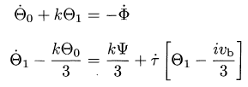
8.3 Acoustic oscillations
higher modes are suppressed because they lead to perturbations of very small wavelength
these are “smoothed out” -> no anisotropy
we can find expressions for the monopole and dipole contributions by using an equation from Ch. 4
which leads to
Notes:
By integr

Slide 19


8.3 Acoustic oscillations
rewriting velocity equation from Ch. 4,
second term on right suppressed by τ⁻¹; to first order we have
substituting this in,
Notes:
By integr

Slide 20

8.3 Acoustic oscillations
substituting v_{b} into
we can rewrite this in just Θ₀ terms by recalling

Slide 21


8.3 Acoustic oscillations
we find a 2nd-order ODE in Θ₀
note this is comparable to our “cartoon” version of the equation governing perturbations
the above can be re-expressed as

Slide 22
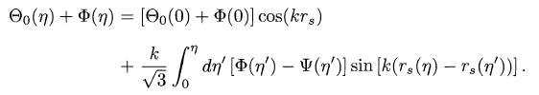
8.3 Acoustic oscillations
we can solve this equation using Green’s method:
we do this by ignoring ignoring damping, as the pressure term is much larger
at least for small-scale modes, or for small R
timescale for oscillations much shorter introduced by pressure, than by damping from expansion of universe

Slide 23
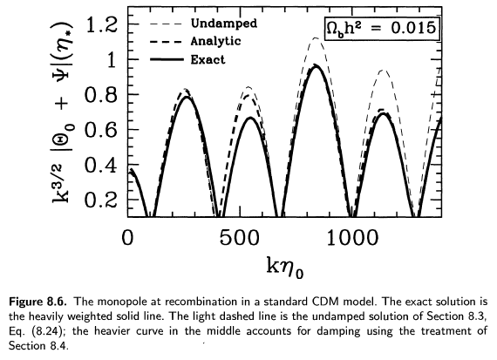
8.3 Acoustic oscillations

Slide 24
8.3 Acoustic oscillations
the analytic (approximate) solution for the monopole gives the peak locations very accurately
peak heights are also close to the exact solution; greater error in heights for higher modes
these errors are due to not considering diffusion damping

Slide 25

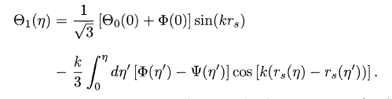
8.3 Acoustic oscillations
from the monopole contribution, we can find the dipole contribution using

Slide 26
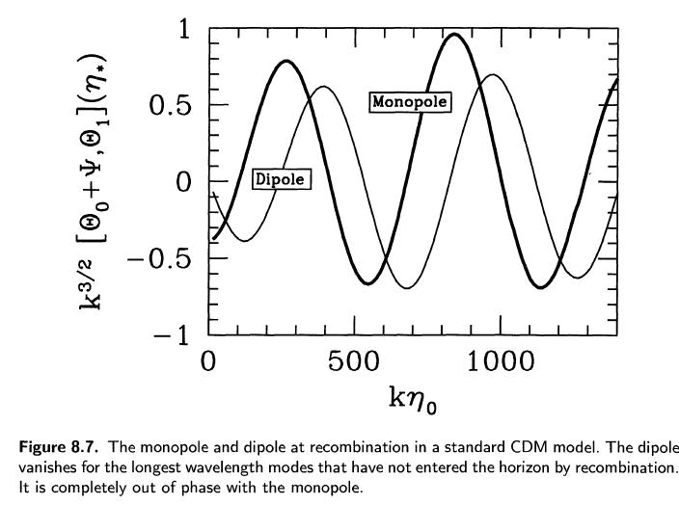
8.3 Acoustic oscillations
we note that the monopole and dipole contributions are completely out-of-phase

Slide 27

8.4 Diffusion Damping
Diffusion affected by quadrupole moment evolution, cannot ignore (recalling previous figures)
only interested in small scales, the potentials are small because of radiation pressure; drop phi and psi everywhere.
we will find diffusion in each higher mode proportional to
so only consider the quadrupole moment

Slide 28
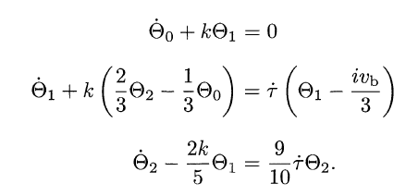
8.4 Diffusion Damping
with these assumptions we have
after a few more lines of calculation, dropping terms of order τ ⁻², and solving velocity equation, we can find new expressions for perturbations

Slide 29



8.4 Diffusion Damping
perturbations are governed by
damping wavenumber k_{D}
which is roughly
agreeing with heuristic estimate from the beginning

