Slide 1
The search for τ → l γ at Belle and Belle II
Braden Moore
Under the supervision of Dr. Phillip Urquijo
Notes:
Belle – cross section of production of taus
- number of taus produced
- number of background events expected
- include backgrounds (diagrams)
Belle II - ~50 billion tau pairs
-

Slide 2
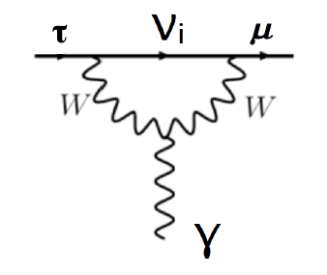
Introduction: τ → l γ
τ → l γ is a prohibited decay in the SM for massless neutrinos
extending the SM to include neutrino masses allows flavour mixing between generations → LFV can occur
even so, LFV in the SM + massive neutrinos is suppressed and is unobservably small
Figure: τ → μ γ via neutrino mixing
Notes:
highly calculable
- include diagram of tau -> mu gamma

Slide 3
Introduction: τ → l γ
unobservably small branching fraction for LFV processes allows New Physics (NP) to be probed without SM contamination
of the tau processes, τ → l γ decays most sensitive
why taus not muons? muons are easier to produce!
expected limit on branching fraction greater than μ → e γ due to tau mass
if this NP is Higgs-like, then would be seen more strongly in tau-sector (taus couple more strongly than muons to the Higgs)
Notes:
- recall Emilie’s slides (dipole enhancement)
- if Higgs like NP, couples stronger to Higgs
-

Slide 4
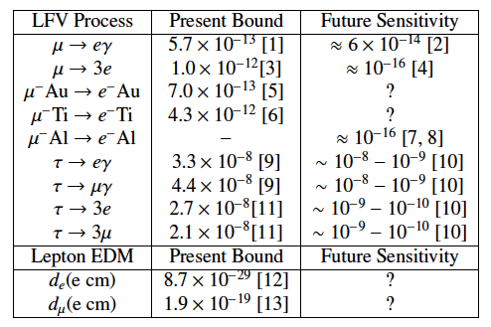
Other LFV
Table 1: Present and future experimental
sensitivities for LFV processes (Paradisi, 2015)

Slide 5
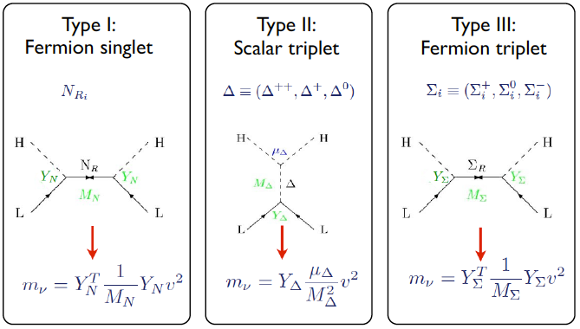
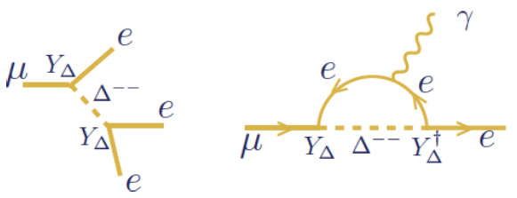
Neutrino mixing
lepton sector not fully understood (see: neutrino masses)
many mechanisms which explain neutrino mixing introduce LFV!
see-saw models, for example, introduce new scalars which could couple with leptons to produce LFV
Figure: New particles introduced via seesaw models
Figure: LFV in Type-II seesaw
Notes:
- Deltas (scalars) are Higgs-like; tau could couple to doubly-charged Higgs which could mediate charged LFV

Slide 6
h → τ μ excess
tau LFV is exciting for the Higgs sector
CMS found some excess ???
ATLAS found (not) an excess (?)
Aristizal Sierra and Vicente (2014) propose an explanation of observed excess
Type-III 2HDM (two Higgs doublet model) allows LFV
Notes:
Put the results up

Slide 7
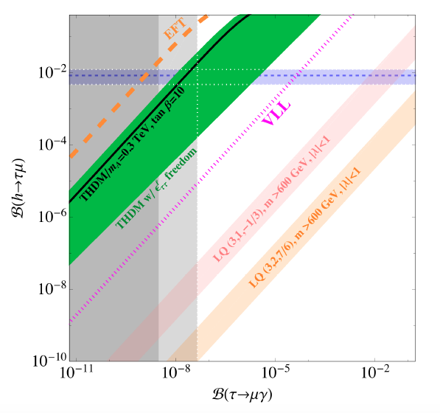
h → τ μ excess
horizontal lines are CMS 1σ bands on BR(h → τ μ) (at 90% CL)
vertical lines are (right) current upper limit BR(τ → μ γ) and (left) Belle II expected sensitivity
under this model we would expect to find a signature in Belle II (!!)
Figure: B(h → τ μ) against B(τ → μ γ), with various ranges predicted by NP models (Dorsner et al., 2015)
Notes:
Use better plot (Emilie’s thing)
Put in ATLAS lines

Slide 8
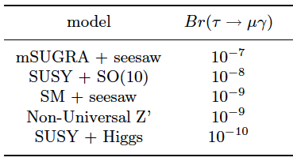
Models predicting τ → l γ
Table 2: Upper limits of branching fractions of τ → μ γ, predicted by models of new physics beyond the SM (various sources)
many NP models predict LFV to occur
present and future bounds on LFV processes can reduce available phase space; determining branching fractions can rule out certain models
Notes:
“Reduce parts of phase space”

Slide 9


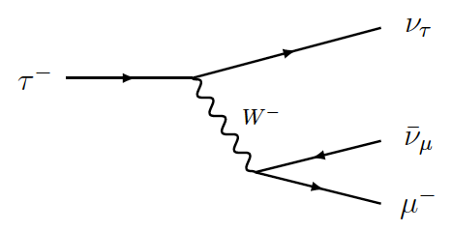
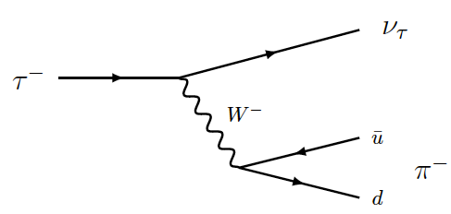
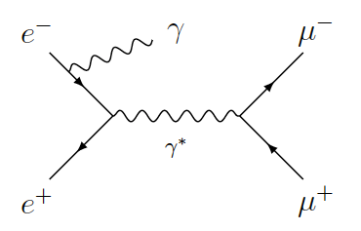

Key backgrounds
Figure: τ → μ ν ν diagram
Figure: τ → π ν diagram
Figure: e e → μ μ γ diagram
Notes:
Note: ee->tau tau cross section ~0.9nb (0.919nb)

Slide 10
Belle & Belle II
Belle – 1000 fb⁻¹ of data (full run data)
e⁺ e⁻ → τ⁺ τ⁻ ~ 900 × 10⁶ tau-pairs
τ → μ ν ν ~ 150 × 10⁶ events
τ → π ν ~ 100 × 10⁶ events
e e → μ μ γ ~ 250 × 10⁶ events
Belle II – 50 ab⁻¹ (predicted luminosity)
e⁺ e⁻ → τ⁺ τ⁻ ~ 450 × 10⁸ tau-pairs
τ → μ ν ν ~ 75 × 10⁸ events
τ → π ν ~ 50 × 10⁸ events
e e → μ μ γ ~ 125 × 10⁸ events
× 50 more luminosity at
Belle II compared to Belle
at my current BG efficiencies (10⁻⁴ %):
~10,000 background events
e e → μ μ γ background not yet studied
Notes:
Belle – cross section of production of taus
- number of taus produced
- number of background events expected
- include backgrounds (diagrams)
Belle II - ~50 billion tau pairs
-

Slide 11
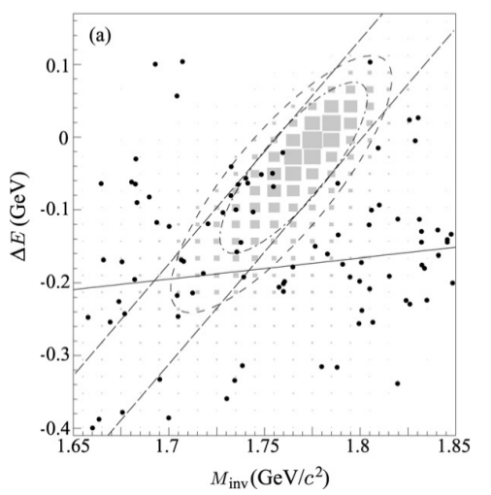
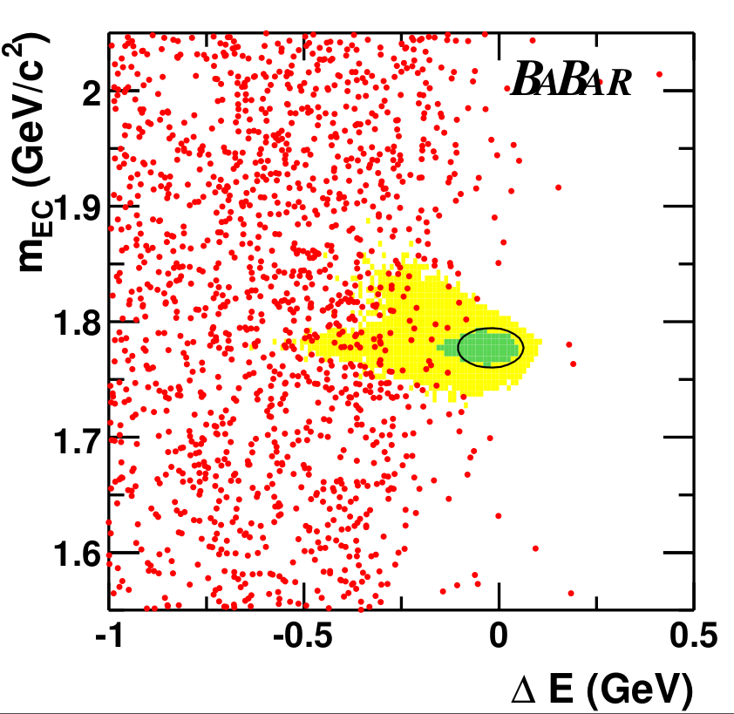
Current searches
Figure: M_{inv} - ΔE distribution in the search for τ → μ γ at Belle (Hayasaka, 2008)
Figure: M_{bc} - ΔE distribution in the search for τ → μ γ at Babar (Babar Collaboration, 2010)

Slide 12
Future searches
Figure: Current and future sensitivities on
tau LFV branching fractions (Urquijo, 2016)

Slide 13
My search
approx 1.5 million signal (τ → μ γ) MC events produced
approx 3,500 million generic (tau-pair) MC events produced by the Belle II Collaboration
24 selection criteria added (based on previous Belle search)
cuts made to suppress various backgrounds
production and analysis being performed in basf2
currently optimising selection criteria for Belle II MC
analysis should be ready for Belle II first data
plan to optimise selection criteria for Belle MC also, to run over complete Belle dataset
Notes:
3,500 million with beam background, ~1,000 without beam background
generic = ee->tau tau, both taus decay via SM processes (as given in PDG)
various backgrounds include bhabha, continuum suppression

Slide 14
My search
Figure: M_{inv} - ΔE distribution for signal MC
(τ → μ γ) after selection cuts
(59,265 events out of 1,632,596)
Figure: M_{inv} - ΔE distribution for
background MC after selection cuts
(6 events out of 5,938,869)

Slide 15
Summary
LFV is an exciting place to search for new physics
neutrino masses?
determining a value of BR(τ → l γ) can exclude certain models
negligible SM background means an observation would be an unambiguous signature of NP
analysis framework is being set up for Belle II data analyses
my next steps?

