Slide 1
The search for τ → l γ at Belle and Belle II
Braden Moore
Under the supervision of Dr. Phillip Urquijo

Slide 2
Introduction: τ → l γ
τ → l γ is a prohibited decay in the SM for massless neutrinos
extending the SM to include neutrino masses allows flavour mixing between generations → LFV can occur
even so, LFV in the SM + massive neutrinos is suppressed and is unobservably small

Slide 3
Introduction: τ → l γ
unobservably small branching fraction for LFV processes allows New Physics (NP) to be probed without SM contamination
of the tau processes, τ → l γ decays predicted to be dominant
why taus not muons? muons are easier to produce!
expected branching fraction greater than μ → e γ due to tau mass

Slide 4
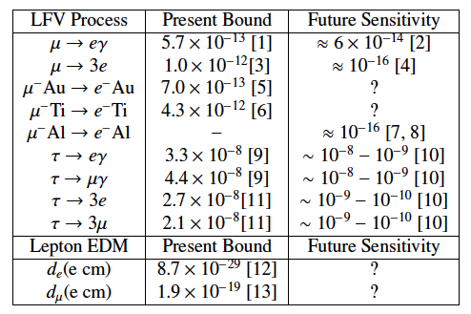
Other LFV
Table 1: Present and future experimental
sensitivities for LFV processes (Paradisi, 2015)

Slide 5
Motivations for LFV searches
1) mechanisms to explain neutrino mixing necessarily introduce LFV (???)
2) interesting anomalies, such as h → τ μ excess, can ….?
3) many NP models predict LFV to occur, AND predict the branching fractions – experimentally determining LFV branching fractions can rule out certain models
Okay I need more here

Slide 6
Neutrino mixing

Slide 7
h → τ μ excess
CMS found some excess ???
ATLAS found (not) an excess (?)
Aristizal Sierra and Vicente (2014) propose an explanation of observed excess
Type-III 2HDM (two Higgs doublet model) allows LFV

Slide 8
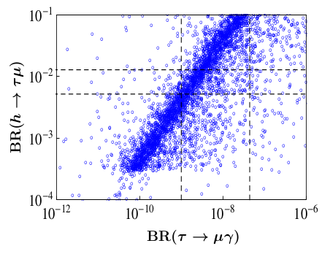
h → τ μ excess
horizontal lines are 1σ bands on BR(h → τ μ) (at 90% CL)
vertical lines are (right) current upper limit BR(τ → μ γ) and (left) Belle II expected sensitivity
under this model we would expect to find a signature in Belle II
Figure: BR(h → τ μ) as a function of BR(τ → μ γ)
(Aristizabal Sierra and Vicente, 2014)

Slide 9
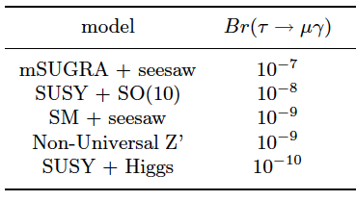
Models predicting τ → l γ
Table 2: Branching fractions of τ → μ γ, predicted by models of new physics beyond the SM (various sources)
recall present and future bounds on some LFV processes

Slide 10
MSSM
“The source of LFV in the MSSM is the potential misalignment between lepton and slepton mass matrices.” Brignole, Rossi (2004).
Not sure if I need this slide (or others specifically discussing models, since theorists will know these models a lot better than I will, and I don’t actually need to know the specifics)

Slide 11
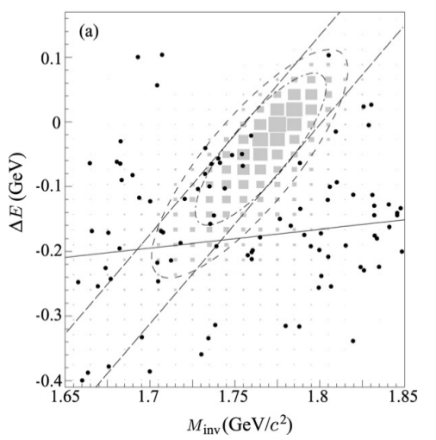
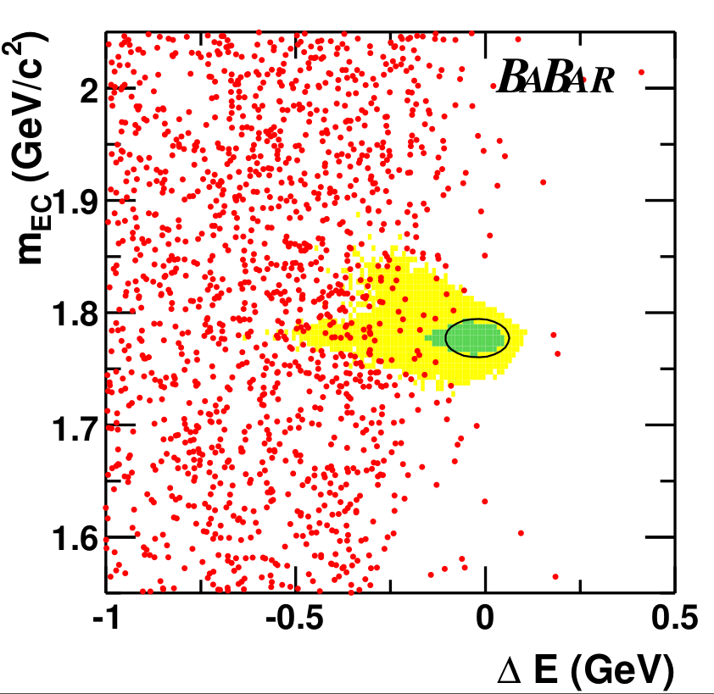
Current searches
Figure: M_{inv} - ΔE distribution in the search for τ → μ γ at Belle (Hayasaka, 2008)
Figure: M_{bc} - ΔE distribution in the search for τ → μ γ at Babar(Babar Collaboration, 2010)

Slide 12
Future searches
Figure: Current and future sensitivities on
tau LFV branching fractions (Urquijo, 2016)

Slide 13
My search
key backgrounds for τ → μ γ:
τ → μ ν ν
τ → π ν (π misidentified as μ)
e e → μ μ γ
approx 1.5 million signal (τ → μ γ) MC events produced
approx 3500 million generic (tau-pair) MC events produced by the Belle II Collaboration
24 selection criteria added (based on previous Belle search)
cuts made to suppress various backgrounds

Slide 14
My search
Figure: M_{inv} - ΔE distribution for
background MC after selection cuts
(6 events out of 5,938,869)
Figure: M_{inv} - ΔE distribution for signal MC
(τ → μ γ) after selection cuts
(59,265 events out of 1,632,596)

Slide 15
Summary
LFV is an exciting place to search for new physics
neutrino masses?
determining a value of BR(τ → l γ) can exclude certain models
negligible SM background means an observation would be an unambiguous signature of NP
analysis framework is being set up for Belle II data analyses
my next steps?

