Slide 1
The search for τ → l γ at Belle and Belle II
Braden Moore
Under the supervision of Dr. Phillip Urquijo
Notes:
Belle – cross section of production of taus
- number of taus produced
- number of background events expected
- include backgrounds (diagrams)
Belle II - ~50 billion tau pairs
-

Slide 2
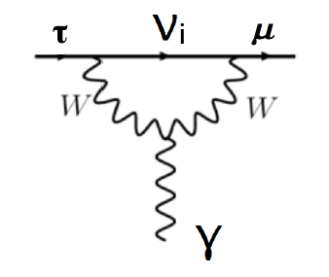
Introduction: τ → l γ
τ → l γ is a prohibited decay in the SM for massless neutrinos
extending the SM to include neutrino masses allows flavour mixing between generations → LFV can occur
even so, LFV in the SM + massive neutrinos is suppressed and is unobservably small
Figure: τ → μ γ via neutrino mixing
Notes:
highly calculable
- include diagram of tau -> mu gamma

Slide 3
Introduction: τ → l γ
unobservably small branching fraction for LFV processes allows New Physics (NP) to be probed without SM contamination
of the tau processes, τ → l γ decays most sensitive
why taus not muons? muons are easier to produce!
expected limit on branching fraction greater than μ → e γ due to tau mass
if this NP is Higgs-like, then would be seen more strongly in tau-sector (taus couple more strongly than muons to the Higgs)
Notes:
- recall Emilie’s slides (dipole enhancement)
- if Higgs like NP, couples stronger to Higgs
-

Slide 4
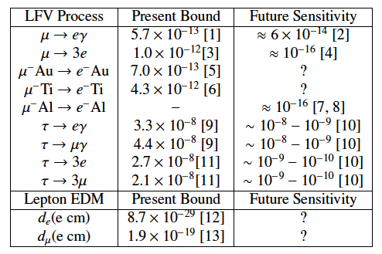
Other LFV
Table 1: Present and future experimental
sensitivities for LFV processes (Paradisi, 2015)

Slide 5
Motivations for LFV searches
Okay I need more here
Notes:
We don’t need these slide (it’s an “Introduction”, rather we just go right in)

Slide 6
Neutrino mixing
many mechanisms to explain neutrino mixing necessarily introduce LFV (???)
Notes:
- lepton sector not fully understood

Slide 7
h → τ μ excess
Tau LFV is exciting for the Higgs sector
CMS found some excess ???
ATLAS found (not) an excess (?)
Aristizal Sierra and Vicente (2014) propose an explanation of observed excess
Type-III 2HDM (two Higgs doublet model) allows LFV
Notes:
Put the results up

Slide 8
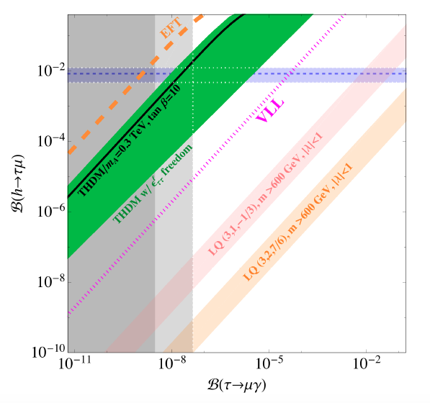
h → τ μ excess
horizontal lines are 1σ bands on BR(h → τ μ) (at 90% CL)
vertical lines are (right) current upper limit BR(τ → μ γ) and (left) Belle II expected sensitivity
under this model we would expect to find a signature in Belle II (!!)
Figure: BR(h → τ μ) as a function of BR(τ → μ γ)
(Aristizabal Sierra and Vicente, 2014)
Notes:
Use better plot (Emilie’s thing)
Put in ATLAS lines

Slide 9
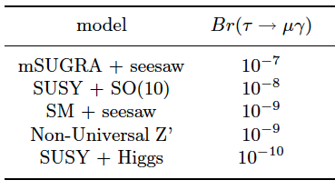
Models predicting τ → l γ
Table 2: Upper limits of branching fractions of τ → μ γ, predicted by models of new physics beyond the SM (various sources)
many NP models predict LFV to occur
present and future bounds on LFV processes can reduce available phase space; determining branching fractions can rule out certain models
Notes:
“Reduce parts of phase space”

Slide 10
Belle & Belle II
Belle ~ 1 billion tau pairs
no. of tau pairs produced
no. of background events expected (efficiency)
background diagrams?
key backgrounds for τ → μ γ:
τ → μ ν ν
τ → π ν (π misidentified as μ)
e e → μ μ γ
Notes:
Belle – cross section of production of taus
- number of taus produced
- number of background events expected
- include backgrounds (diagrams)
Belle II - ~50 billion tau pairs
-

Slide 11
Belle & Belle II
Belle II ~ 50 billion tau pairs
no. of tau pairs produced
no. of background events expected (efficiency)
Notes:
Belle – cross section of production of taus
- number of taus produced
- number of background events expected
- include backgrounds (diagrams)
Belle II - ~50 billion tau pairs
-

Slide 12
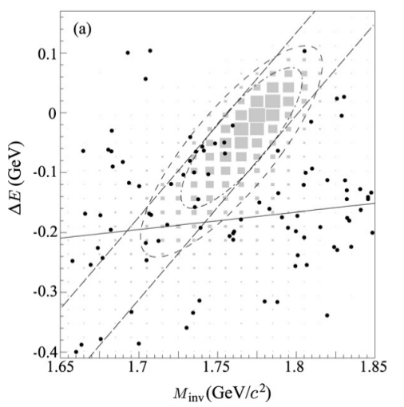
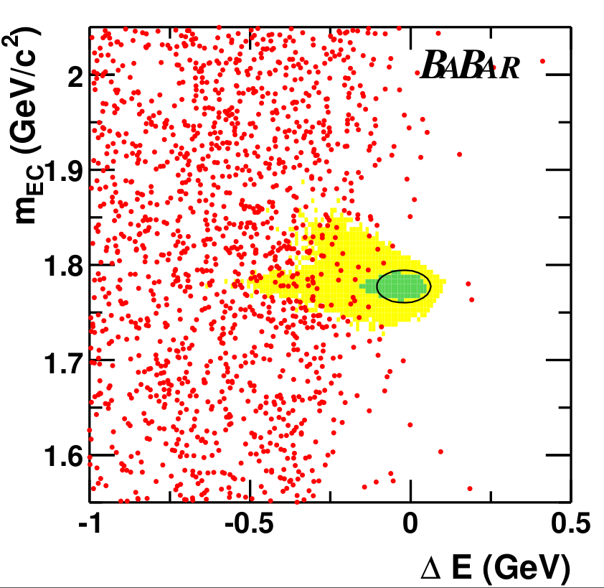
Current searches
Figure: M_{inv} - ΔE distribution in the search for τ → μ γ at Belle (Hayasaka, 2008)
Figure: M_{bc} - ΔE distribution in the search for τ → μ γ at Babar(Babar Collaboration, 2010)

Slide 13
Future searches
Figure: Current and future sensitivities on
tau LFV branching fractions (Urquijo, 2016)

Slide 14
My search
approx 1.5 million signal (τ → μ γ) MC events produced
approx 3500 million generic (tau-pair) MC events produced by the Belle II Collaboration
24 selection criteria added (based on previous Belle search)
cuts made to suppress various backgrounds
analysis performed in basf2
currently optimising selection criteria for Belle II MC
analysis should be ready for Belle II first data!
plan to optimise selection criteria for Belle MC also, to run over complete Belle dataset
Notes:
Extra slide: Belle + Belle II (what I’m doing; using basf2 etc.)

Slide 15
My search
Figure: M_{inv} - ΔE distribution for signal MC
(τ → μ γ) after selection cuts
(59,265 events out of 1,632,596)
Figure: M_{inv} - ΔE distribution for
background MC after selection cuts
(6 events out of 5,938,869)

Slide 16
Summary
LFV is an exciting place to search for new physics
neutrino masses?
determining a value of BR(τ → l γ) can exclude certain models
negligible SM background means an observation would be an unambiguous signature of NP
analysis framework is being set up for Belle II data analyses
my next steps?

