Slide 1
Tunis
C12
Londres
Restaurant
-Public
Tampon
C11
Accès aux parkings Est
(50)
C4
Monaco
TribunesVIP
TribunePrestige
Bamako
(50)
SalleDePresse
Moscow
SousSolSportif
C3
(10)
Dubllin
Harare
(200)
Asia
(800)
(200)
Pekin
(100)
Mexico
(200)
Rome
Berlin
C5
Tokyo
C9
Oslo
Arene
Rabat
Dakar
C1
C2
(800)
Nairobi
C8
Oceania
Madrid
TribunesOuest
Quito
(10)
Lisbonne
Europa
Oceania
TibunesEst
SalleDe-
Controle
Africa
Suva
Caracas
Alger
(200)
Kampala
Riga
(200)
(200)
Entretien
Jerusalem
Kaboul
Kingston
Katmandou
Admin-
istration
VillageSportif
Lima
RestaurantSportif
(10)
ZoneStade
(80)
(300)
(2000)
C6
C7
Washington
(800)
Athenes
Paris
C10
Dubllin
2 bissas Astra
caméra externe
Acces aux parkings Ouest
1 bissas Xtra
(100)
nb de personnes maximum
10 bissas Astra

Slide 2
Parkings employés
Xe
Cd
Cs
Fe
Mn
DM
Ar
PT
(5)
*
zone IL
(60)
U1
*
1 bissas Xtra
(500)
De
U2
*
2 bissas Astra
PO
Na
(10)
caméra externe
(60)
Li
Cs
Accueil
(4)
Salle De controle
X
*
Parking visiteurs
Rn
(20)
Rb
Kr
(2)
Ne
ADministration
morrocoy

Slide 3
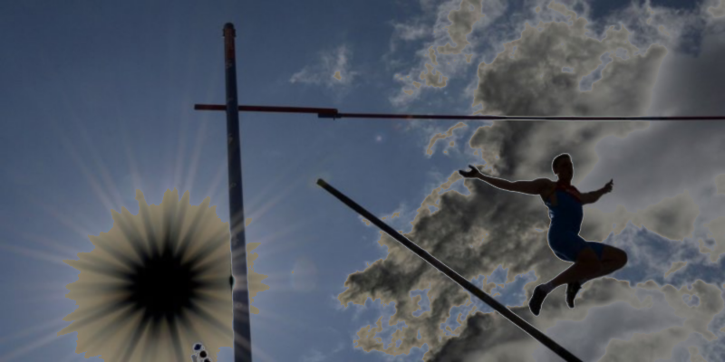
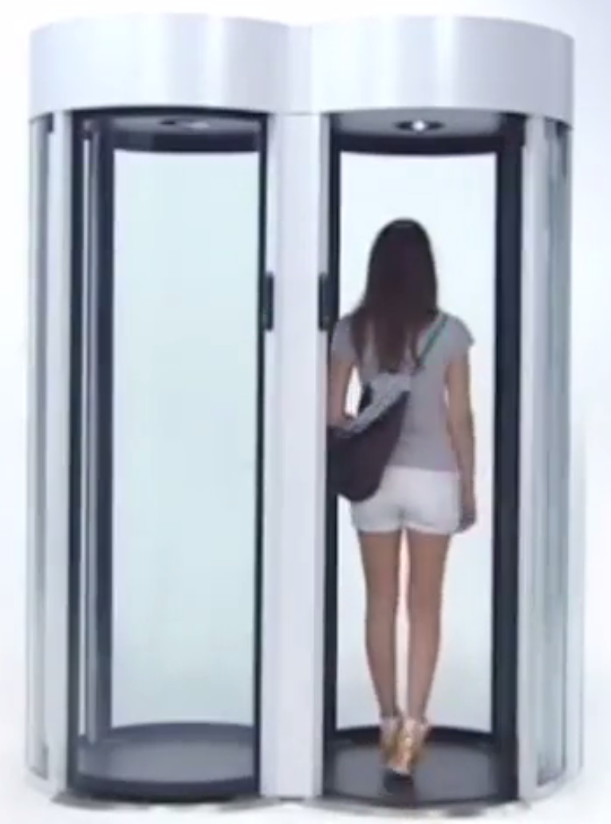
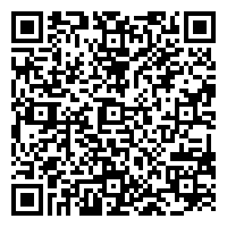
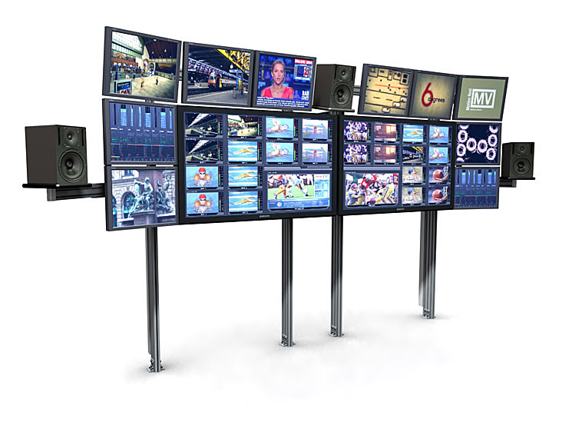
WAT
2015
VIRGINIE-MARIS-P283728746----------------
HOCKEY-B12---------------------------------------
2015-12-16 ---11:00-18:00-----------------------
PARAGUANA-KAMPALA-OUEST-F23------
879277246472
http://www.archiexpo.com/prod/alluser-industrie/sliding-doors-commercial-buildings-security-automatic-52110-624140.html#product-item_142100
<sales transaction="8JH8HHDNKHJA7887787" items="145" date="20141226">
<sale>
<firstName>Virginie</firstName>
<lastName>Maris</lastName>
<nationalId>P283728746</nationalId>
<tickets type='internet' vendor='ticket4all.com' vendorid='4528'>
<ticket id='879277246472''>
<product>Hockey B12</product>
<period start='20150116T1100-0430' end='20150116T1800-0430/>
<qrcode>UDH2846DHSQJ3JF ... GS73Z84DFHDFGSHSDG3657D</qrcode>
<price amount="28" money="EUR"/>
<seat>T23</seat>
...
...
2015
http://www.tbcconsoles.com/gallery.aspx?galleryid=3#.VLAvlytjV8E

