Slide 1



Friend or Foe Inside? Exploring In-Process Isolation to Maintain Memory Safety for Unsafe Rust
Merve Gülmez, Thomas Nyman, Christoph Baumann, Jan Tobias Mühlberg Ericsson & KU Leuven Ericsson Ericsson KU Leuven & ULB
2023/10/20
Notes:
The “Ferris the Crab” and “Corro the Unsafe Rusturchin” illustrations are by Karen Rustad Tölva who has waived all copyright to the illustrations.

Slide 2

Memory Safe Language: Rust
Rust has memory safety guarantees and performance characteristics close to traditional system programming languages such as C and C++
Rust is designed to make programs difficult to exploit by attackers
providing compile-time type-checking
memory management based on ownership rules
Notes:
Rust is an emerging system language, it comes with memory safety guarantees and permontance chareasteic..
Rust is designed to make system diffucult to expolit by attackers, it has so strict compile time checking, and so ownership rules,

Slide 3
Rust hides Unsafe Rust
Unsafe Rust doesn’t enforce memory safety guarantees
Low-level control over implementation details
Optimization
What Unsafe Rust can do?
Dereference raw pointers
Call unsafe functions via Foreign Function Interfaces (FFIs)
Access or modify mutable static variables
More than 72% of packages on the official Rust package registry (crates.io) depend on at least one unsafe FFI-bindings (Li et al, 2022)
Trust me, I know what I’m doing
https://doc.rust-lang.org/nomicon/meet-safe-and-unsafe.html
Notes:
Use-after-free
Well, unlike C, Rust is a safe programming language.
But, like C, Rust is an unsafe programming language.
Rust has a second language hidden inside it that doesn’t enforce these memory safety guarantees: it’s called unsafe Rust and works just like regular Rust, but gives us extra superpowers.

Slide 4
Process-based Isolation vs In-Process Isolation
Process-based Isolation
Integrity: each process runs in its own virtual memory space that prevents a malicious process from accessing the memory of another process, and
Resilience: each process has its own failure boundary so one process’ failure does not affect others.
In-Process Isolation
Notion of creating compartmentalized security domains within the memory space of a single application process.
In-process isolation can significantly reduce the run-time cost of context switching compared to traditional process isolation

Slide 5
Problem Statement
Can we have the best of both worlds?
Integrity and failure boundary similar to process-based isolation
Lower overheads similar to in-process isolation
Goals:
Maintaining Rust application safety
Increasing software resilience of Rust application
Ease-of-use in development

Slide 6

Secure Rewind and Discard with Isolated Domains (IEEE DSN´23)
Secure rewind and discard is an approach for recovering vulnerable applications after an attack is detected for C applications.
Requirements:
Compartmentalizing the application into distinct domains A memory defect within a domain must only affect that domain’s memory Hardware-assisted software fault isolation (SFI) based on Protection Keys for Userspace in CotS processors (Intel, AMD)
Leveraging different pre-existing detection mechanisms such as stack canaries and domain violations
Secure Domain Rewind and Discard (SDRaD), a C library
Notes:
We have an early approaches to recover vulnerable application..

Slide 7

SDRaD-FFI High Level Idea
sandbox!{
fn F(...) {
...
unsafe {
...
}
...
}
}
F(args)
Parent Domain
Nested Domain D
Init
D
Push
arg
Pull
arg
// Trust me, I know
// what I'm doing
Enter
D
Invoke F
yes
fault?
Rewind & Discard
Domain Transition
SDRaD APIs
Track the Rust data types of the arguments

Slide 8
Recovering with SDRaD in Rust
The state of sandboxed code is discarded, and an error is signaled to developer-provided handler code:
➀
let result = std::panic::catch_undwind( || {
F(...);
});
match result {
Err(e) => println!("Fault in nested domain D"),
Ok(value) => ..., // Sandboxed code returned successfully
}
➁
➂
➃
➀ Turn (possibly) panicking function into one yielding a
Result (Rust error handling idiom)…
➁ … in this case sandboxed function F
➂ Error case should avoid triggering failed operation again
➃ Unpack return value if F returned successfully
Function std::panic::catch_unwind is a Rust standard library function to capture causes of unwinding panics (if one occurs)
https://doc.rust-lang.org/std/panic/fn.catch_unwind.html

Slide 9
SDRaD-FFI High Level Idea
sandbox!{
fn F(...) {
...
unsafe {
...
}
...
}
}
F(args)
Parent Domain
Nested Domain D
Init
D
Push
arg
Pull
arg
Enter
D
Invoke F
yes
fault?
Rewind & Discard
Domain Transition
no
SDRaD APIs
Pull rv
Push mutable args and return value
Return to Caller
Domain Transition
Track the Rust data types of the arguments

Slide 10


Track the Rust data types of the arguments
serialization
deserialization
Serialization encodes data into a format for storage or transmission
Deserialization is the reverse process, decoding serialized data back to its original form

Slide 11
Case Studies: Bincode vs. Abomonation
Bincode transforms data into a common binary representation that allows passing data between different platforms
Sandcrust uses Bincode serialization crate to pass arguments to another process using Inter-Process Communication
Abomonation is based on Rust object memory layout representation on a specific single platform
It does not store any metadata or type system information in memory, and it can deserialize in place without the need for another copy operation
Bincode is redundant, Sandcrust and SDRAD-FFI target only a single platform
Abomonation is efficient and suitable for our purpose
Notes:
Only useful for the same platform..

Slide 12
Snappy Performance
Snappy is a fast compression C library from Google It is designed for high-speed compression and decompression of data and is widely used in various applications Presented as a FFI example in the Rust Book
Performance evaluation:
Compressing and uncompressing randomly generated data of different sizes
Measuring the execution time of each operation for different serialization crates: Bincode and Abomonation
Notes:
Upgrade snappy a bit.. Unsafe code.. Mention about different seria….. crates

Slide 13
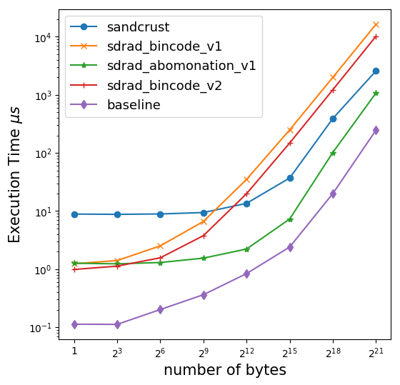
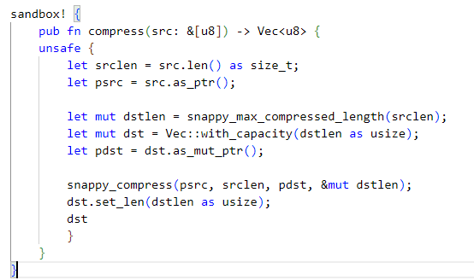
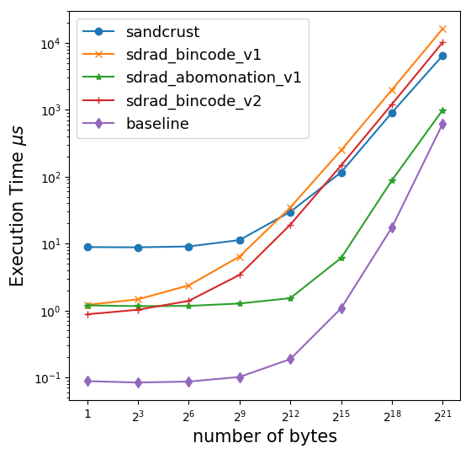
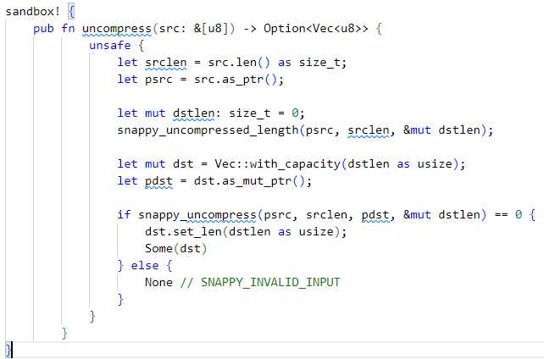
Snappy Performance
LL1) The in-process isolation approach clearly outperforms process isolation in terms of context switch overhead.
LL2) Even for modestly sized arguments, the context switch cost starts to get dominated by the cost of data transfer between domains.
compress
LL3) The data serialization method used can significantly impact performance, it is crucial to optimize it for the use case
Notes:
vec<u8> optimization… create speech balloon, and

Slide 14

In summary
Introducing secure rewind and discard with isolated domains for RUST-FFI,
protect the integrity of a Rust application from memory-safety violations in unsafe program parts or C libraries
increases the Rust application’s availability through a secure rewinding mechanism
Providing a Rust sdradrustffi crates with an easy-to-use API, which provides a high degree of automation
Takeaways:
The in-process isolation approach clearly outperforms process isolation in terms of context switch overhead.
The data serialization method used can significantly impact performance, it is crucial to optimize it for the use case
https://secure-rewind-and-discard.github.io/
Notes:
Takeaways..

Slide 15


https://secure-rewind-and-discard.github.io/
Thank you

Slide 16

Protection Keys for Userspace (PKU)
Virtual addr. space
PTEs
User-level memory access-control mechanism
Associates each memory page with a 4-bit protection key kept in page table entry (PTE)
Access control rules for protection keys maintained by userspace code in PKRU register
phys. addr.
0x0000000000000000
phys. addr.
0x0000000000001000
phys. addr.
0x0000000000002000
phys. addr.
PKRU
phys. addr.
WD 15
AD 15
WD 14
AD 14
WD 13
AD 13
WD 0
AD 0
0x0000000000003000
write disable
access disable
0x0000000000004000
XD
Ignored
0
phys. addr. of 4kb page
Ignored
G
PAT
D
A
PCD
PWT
U/S
R/W
P
Intel. Intel® 64 and IA-32 Architectures Software Developer Manuals. Volume 1. Chapter 2.7., 4.6.2 May 2019
Notes:
16keys,
Access rules,
From Intel® 64 and IA-32 Architectures Software Developer Manuals. Vol. 3A 4-29 PAGING:
Table 4-20. Format of a Page-Table Entry that Maps a 4-KByte Page
0 (P) Present; must be 1 to map a 4-KByte page
1 (R/W) Read/write; if 0, writes may not be allowed to the 4-KByte page referenced by this entry (see Section 4.6) 2 (U/S) User/supervisor; if 0, user-mode accesses are not allowed to the 4-KByte page referenced by this entry (see Section 4.6)
3 (PWT) Page-level write-through; indirectly determines the memory type used to access the 4-KByte page referenced by this entry (see Section 4.9.2)
4 (PCD) Page-level cache disable; indirectly determines the memory type used to access the 4-KByte page referenced by this entry (see Section 4.9.2)
5 (A) Accessed; indicates whether software has accessed the 4-KByte page referenced by this entry (see Section 4.8)
6 (D) Dirty; indicates whether software has written to the 4-KByte page referenced by this entry (see Section 4.8)
7 (PAT) Indirectly determines the memory type used to access the 4-KByte page referenced by this entry (see Section 4.9.2)
8 (G) Global; if CR4.PGE = 1, determines whether the translation is global (see Section 4.10); ignored otherwise
11:9 Ignored
(M–1):12 Physical address of the 4-KByte page referenced by this entry
51:M Reserved (must be 0)
58:52 Ignored
62:59 Protection key; if CR4.PKE = 1 or CR4.PKS = 1, this may control the page’s access rights (see Section 4.6.2); otherwise, it is not used to control access rights.
63 (XD) If IA32_EFER.NXE = 1, execute-disable (if 1, instruction fetches are not allowed from the 4-KByte page controlled by this entry; see Section 4.6); otherwise, reserved (must be 0)

Slide 17
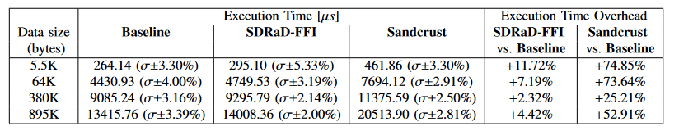
Libpng performance
The C library libpng is used to handle portable network graphic images

Slide 18
sandbox!(func F …)
F(args)
Parent domain
Nested domain D
Init D
Push args
Enter D
Pull args
Call __real_F
❶
❷
❸
❹
❺
args:
mutables
constants
Error handler
Rewind & Discard
yes
Fault?
❽
❼
❻
no
Process return val
Update mutables
Exit & Deinit D
Serialize return val
Serialize mutables
⓭
⓬
⓫
❿
❾
__wrap_F
Result
Error / Panic

Slide 19

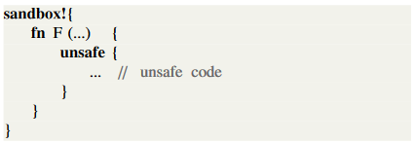
SDRaD-FFI High Level Idea
Easy-to-use
F(args)
Parent Domain
New Domain D
Init
D
Push
arg
Pull
arg
Enter
D
Invoke F
yes
fault?
Rewind & Discard
Domain Transition
no
SDRaD APIs
Pull rv
Push mutable args and return value
Return to Caller
Domain Transition
Track the Rust data types of the arguments

