Slide 1




GIT
By Ali Khorsandfard (English)
15.04.2023

Slide 2
Agenda
Git History
Why learn git
Install Git on your PC
Check if your installation is successful
Create your First Repository : git init
Check if your repository health : dir/a git status
.git folder
Git status command
Do it yourself
Add a new file into your repository
Do it yourself

Slide 3

Git History
Git was created by Linus Torvalds, the creator of the Linux operating system, in 2005.
Torvalds started working on Git in April 2005 After he and his team losing their Project Source Code!!!!
and released the first version of Git in June of that year.
Git was initially designed to be a command-line tool for tracking changes to the Linux kernel codebase, but it quickly gained popularity among developers for its speed, reliability, and flexibility.

Slide 4



Why learn git
If you cannot work with Git,
you won't get JOB!
Doctor
Developer

Slide 5
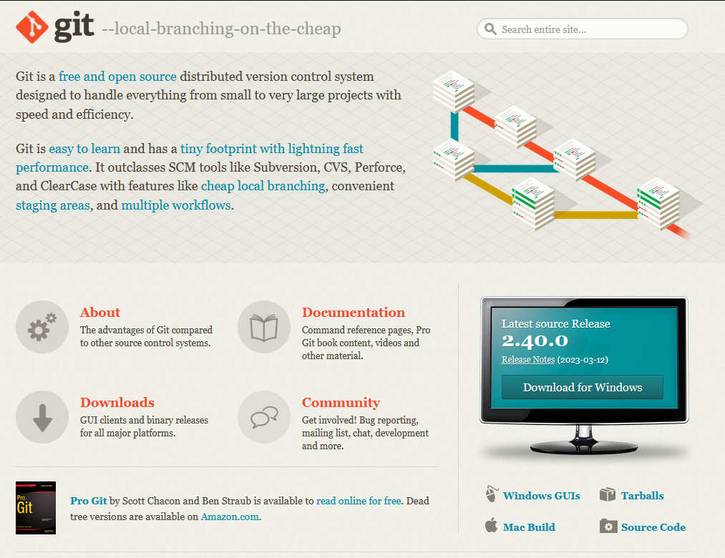
Install it on our PC!
Visit https://git-scm.com/ and download/install software.
You can also check get GUI’s software based on your need! For example, SourceTree software. It is free!
Check if it is installed:
Open CMD
Type: git --version

Slide 6
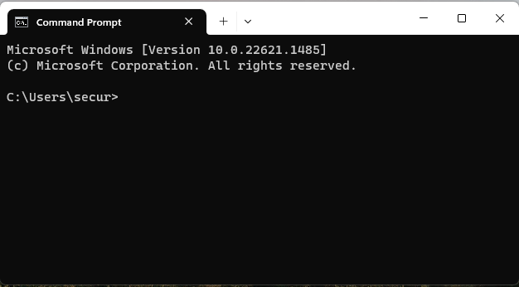
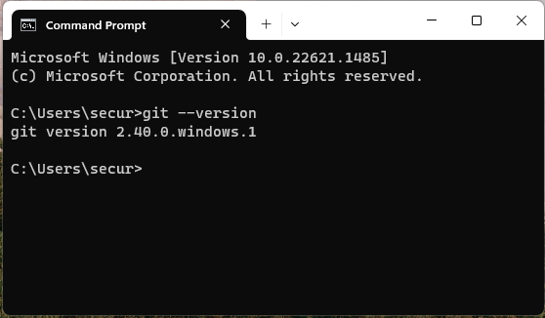
Check if you successfully install git
Open command prompt on your windows. The path doesn’t matter
Type following command:
git -–version and press enter
You shall see answer like the picture
The version number can be different on your machine.
If you see answer git version xxx it means you installed git successfully.
It is the path

Slide 7
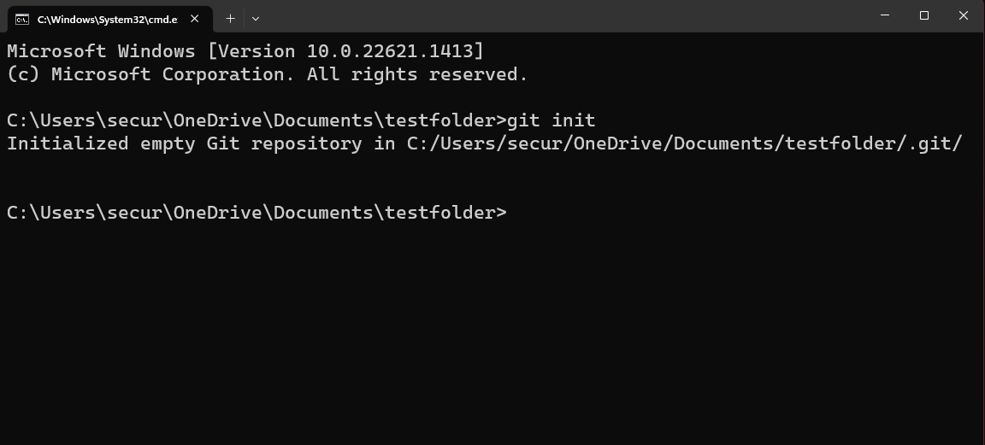
Create your First Repository
Create folder anywhere on your PC
open CMD and go to the folder path that you have created
Type: git init and press Enter
You shall see Initialized empty Git repository in …

Slide 8
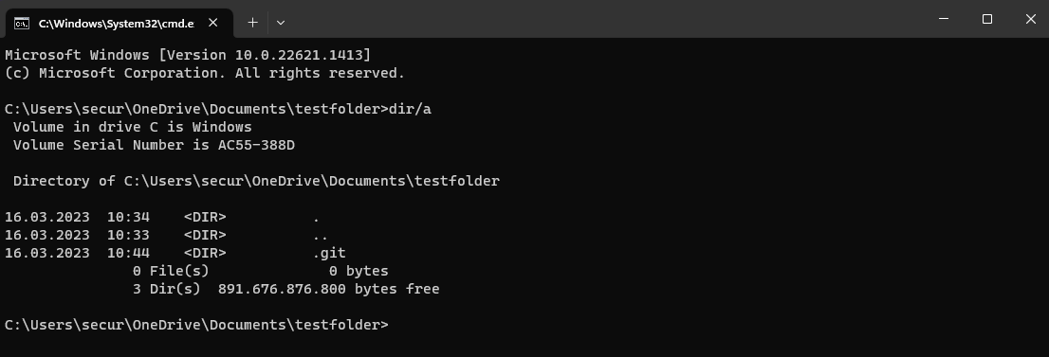
Check Repository Health
After creating your git Repository with git init command
Type dir/a
you see git init created a hidden folder called .git

Slide 9
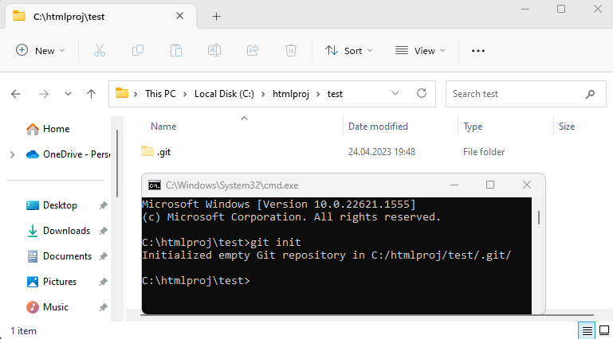
Git init
We go to a folder and type in cmd command git init
We can see after git init command , git create a database folder for us
Becase this folder is empty, files table is also empty

Slide 10
How git works locally?
After git init , git create empty database system in directory .git
Then , git automatically start searching in all existed files and directories as same level and lower level in .git folder (all sister folders) and their subfolders.
Git make a list of all files and their information like last modified, size and of course file name.
If git cannot find any file in his database, it will save the information on the system RAM. This file type that they are not indexed in git database called untracked files.
With command git status, we simply see the list of untracked files.
With git add . Command, git will save all basic file information like name, last modified date in one table of its database. Then we called them Tracked (Staged ) files.
With git commit –m “some commit message” command, we will insert all information for each tracked files into database and from now we can track and changes happened in those files.

Slide 11
What is folder .git?
Git follows every single change in whole directory and sub directory that it initialized with command “git init”.
In reality, git init commands create new empty database in folder .git
For tracking any change in file it need a database.
.git folder , is database and everything git need for this purpose.
Never Ever touch or delete this folder

Slide 12
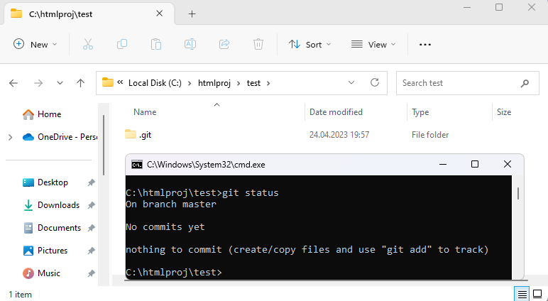
git status
Type git status in CMD.
Please pay attention to :
On branch master

Slide 13
.git Ordner
Git Datenbank
Git status
frank ist nicht in git
Lokal
frank.html

Slide 14
.git Ordner
Git add .
frank information aber nicht inhalt
In DB
Git Datenbank
frank.html
Lokal
frank.html

Slide 15
.git Ordner
Git commit –m frank.html “frank page”
frank inhalt
In DB
Git Datenbank
frank.html
Frank page + commit id
Lokal
frank.html

Slide 16
.git Ordner
git status
Frank is changed!!
Frank is updated
Git Datenbank
frank.html
Frank page + commit id
Lokal
frank.html

Slide 17
Git Datenbank
git add .
Git erstellet ein neue riehe in db abder
Aller inhalt ist leer
id | F-n | Inhalt
Id | Fn
frank.html
Frank page + commit id
Lokal
frank.html

Slide 18
Git Datenbank
git add commit –m new frank
Git erstellet ein neue riehe in db abder
Aller inhalt ist leer
id | F-n | Inhalt
Id | Fn
frank.html
Frank page + commit id
Lokal
Differenze zwischen
frank.html

Slide 19
Git Datenbank
id | F-n | Inhalt
Id | Fn
frank.html
Frank page + commit id
Lokal

Slide 20
Git local Datenbank
Git remote Datenbank
Remote DB
to DB Lokal
Lokale Physikalische files
to Locak DB
Git clone
Git pull
Git push
Git add
Git commit –m „“

Slide 21
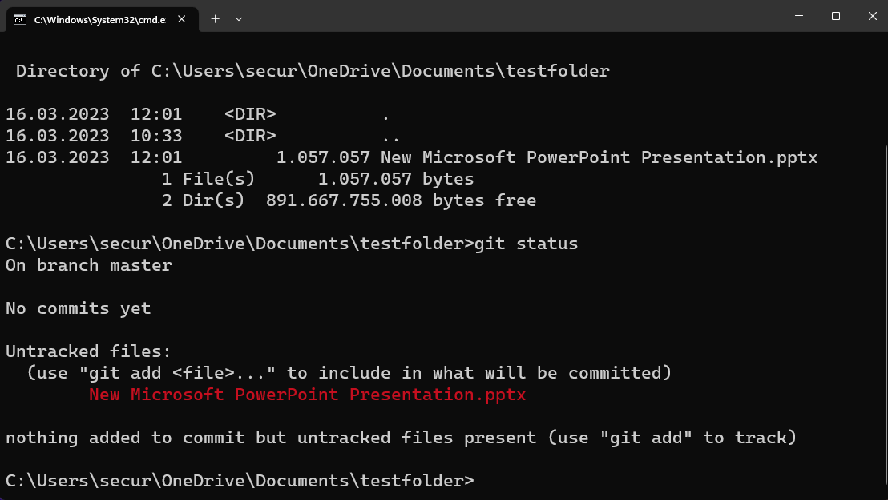

Add new File in Directory
Create new folder and go inside and type “git init” in cmd.
Just create new PowerPoint file inside the folder you have just created. you can add some slides and design. Then save the file
Now go to cmd and run again command git status
You can see git detect new file!
If you delete .git folder git status doesn’t work and say:
fatal: not a git repository (or any of the parent directories): .git

Slide 22
Do it yourself
Install Git on your PC/Laptop
Open CMD and type: “git -–version”
Create a new folder anywhere on your PC or Laptop
Go to folder address with command line
Type command: “git init”
Check if git folder is generated by Typing command: “dir/a”
Type command “git status” to see information about current status.
pay attention on current branch and read answer carefully
Add new empty folder in git directory and type git status
Add new file into newly created folder
Type git status command
3 times Repeat items 2 – 11

Slide 23
Git Commands
command | description
git init | Create new Repository
git status | Show Brief Information About current working branch and status
git add . | Add all Unstaged changes to Staged
git add fileName | Stage just named file
git commit –m „…“ | Commit all staged file to git and create new checkpoint with message
git checkout –b newBranchName | Create new branch
git checkout branchName | Switch branch
git checkout commitId | Checkout Commit with its Id
git switch branchName | Switch to branch
git clone remote-address | Clone git repository to local from remote-address
git pull | Update local repo from remote
git push | Push local repo changes to remote
git –-help | Show list all commands with information
git merge branch-name | Merge branch changes to current branch

