Slide 1

CLAUDE CODE PLUGIN · HOW IT WORKS
SecureCoder
$ claude --plugin securecoder
✔ skill secure-codegen
✔ hook post-write SAST
✔ mcp guardian pipeline
✔ agent remediator
ready.
Security-aware code generation,
inside the agent loop.
STG Group at TU Darmstadt · July 2026
/plugin install securecoder

Slide 2


THE PROBLEM
LLMs still write vulnerable code
40%
user_service.py
@app.route("/user")
def get_user():
uid = request.args["id"]
q = f"SELECT * FROM users
WHERE id={uid}"
return db.execute(q)
of AI-generated programs contained exploitable vulnerabilities.
Pearce et al., IEEE S&P 2022
The same old bugs
SQL injection, path traversal, hardcoded secrets. The CWE top list has barely changed.
Agents make it worse
CWE-89 · SQL injection
Written in seconds, exploitable from day one.
An agent writes and runs code far faster than anyone can review it.
SecureCoder · Claude Code plugin
02

Slide 3



THE SOLUTION
Put the checks inside the loop
Guide the generation
Close the feedback loop
Enrich every prompt with security constraints, so code is born secure instead of patched later.
Agents can correct their own mistakes, when analyzer findings flow straight back into their context.
One channel to the analyzers
Verify until clean
Classical, deterministic analysis and agentic reasoning talk through a single, unified interface.
Fix and re-check iteratively, with clear stopping rules; security is proven, not assumed.
SecureCoder · Claude Code plugin
03

Slide 4
DIVISION OF LABOR
Claude runs the loop, the server runs the checks
Claude handles generation, triage and fixes; the plugin's MCP server delivers fast, deterministic security analysis.
PIPELINE ROLE
IMPLEMENTED BY
Generate → analyze → fix loop
→
Claude Code's agentic loop
Security constraint injection
→
secure-codegen skill + MCP enricher
Guardians: CodeQL, semgrep, bandit
→
Zero-dependency MCP server
Triage & retry decisions
→
Claude in-context; the server keeps score
SecureCoder · Claude Code plugin
04

Slide 5




THE BUILDING BLOCKS
Four building blocks, in plain terms
These are standard parts of agentic coding tools, not unique to us. Here is what each one means.
Skill
Hook
A file of detailed instructions for carrying out a particular kind of task.
A shell command that fires automatically at a set point in the run. Hard, programmatic certainty for when instructions are too loose.
In this plugin: the rules applied before any code is written.
In this plugin: scans each file the moment it is saved.
MCP server
Agent
A standard interface that lets AI models talk to external tools and data.
A self-contained AI worker with its own context and tools, aimed at one goal.
In this plugin: runs the scanners: semgrep, bandit, CodeQL.
In this plugin: repairs findings and re-checks until clean.
SecureCoder · Claude Code plugin
05

Slide 6
HOW IT RUNS
The workflow, step by step
You only touch the first and last step. Everything between runs on its own.
1
You ask for code
Give Claude a normal task, like “add a login endpoint.” Nothing special on your side.
2
The prompt is hardened first
The secure-codegen skill adds security constraints to your task before any code is written.
3
Claude writes the file
The same generation as always, now guided by those constraints.
4
Every save is scanned
A hook runs fast analyzers (semgrep, bandit, syntax) after each write and feeds findings back to Claude.
5
A fix agent takes over
If findings exist, the remediator agent patches them and re-scans, tracking one session so it knows what changed.
6
It stops when clean
The loop repeats until the analyzers pass, then returns clean code. If it stalls, it hands the rest back to you.
SecureCoder · Claude Code plugin
06

Slide 7
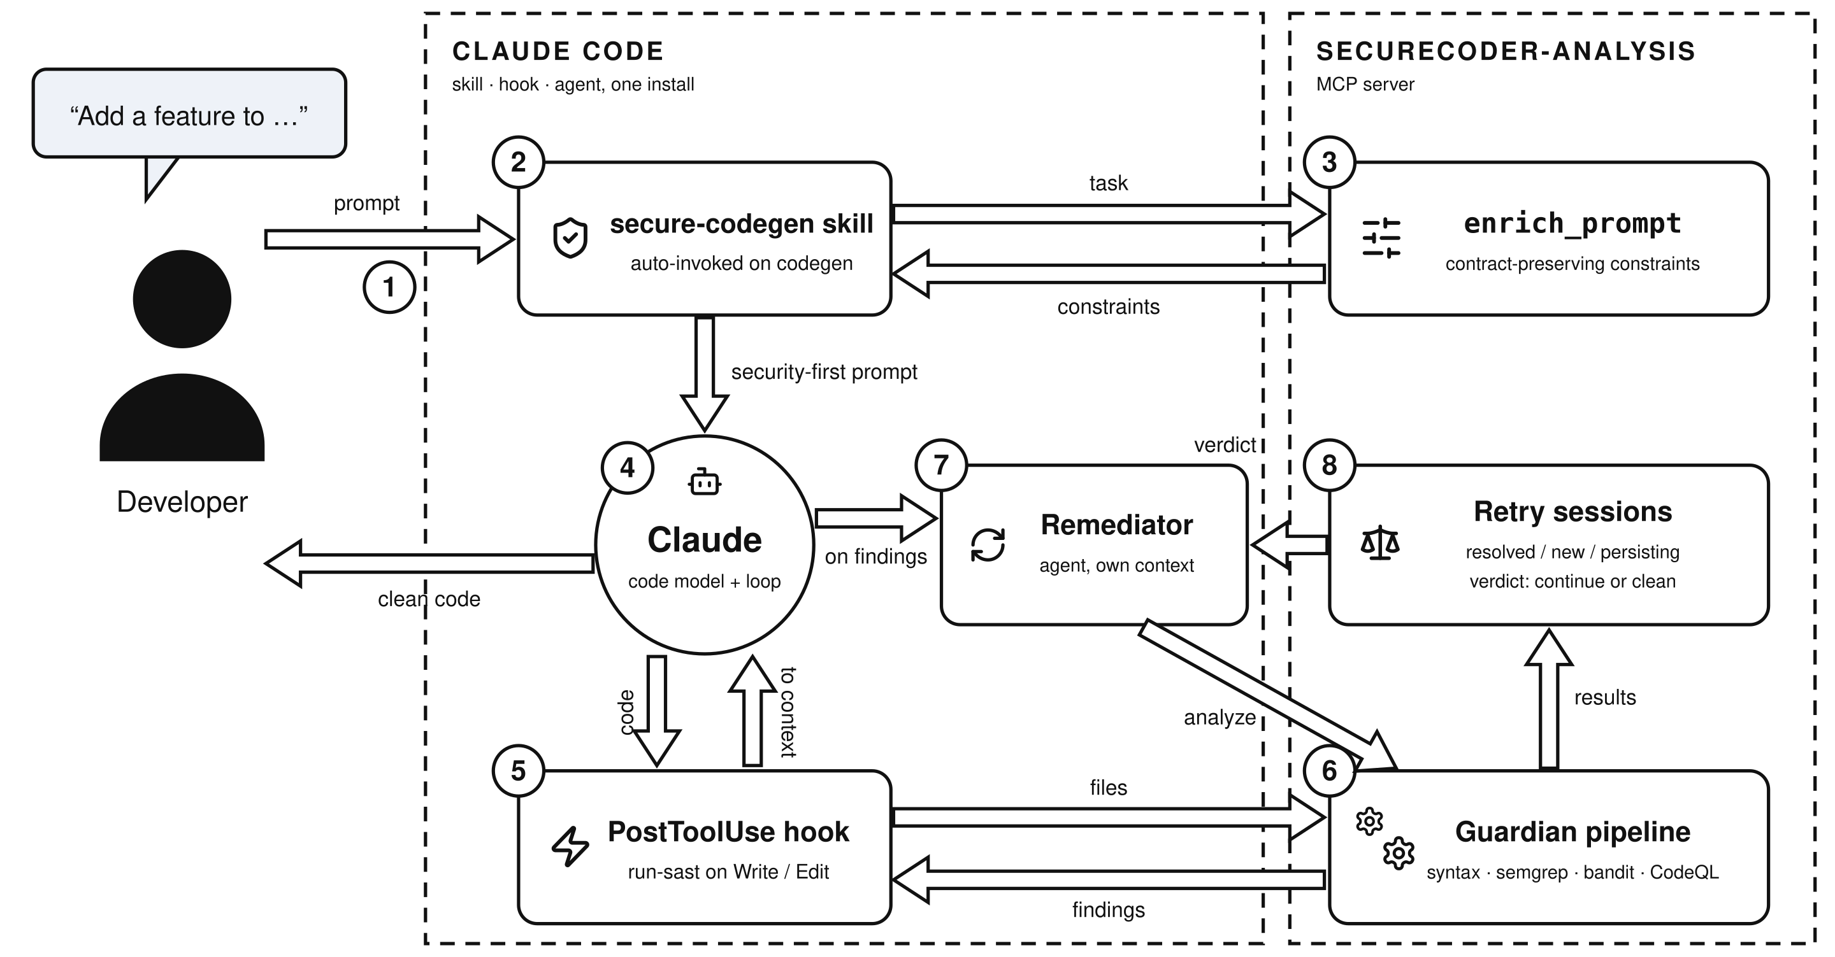
ARCHITECTURE
How the pieces fit together
SecureCoder · Claude Code plugin
07

Slide 8



UNDER THE HOOD
Two speeds of analysis
Fast lane · seconds
Deep lane · on demand
Runs after every file write.
Used for the first pass and the final check.
syntax check · semgrep · bandit
CodeQL · security-extended suites
The server tracks each session: which findings were fixed, which are new, which persist, and when to stop retrying.
SecureCoder · Claude Code plugin
08

Slide 9
IN ACTION
What Claude sees
hook output
remediation report
[securecoder] 2 findings
HIGH CWE-89 SQL injection
→ use parameterized queries
MED CWE-798 hardcoded secret
→ move to a secret manager
attempt 2 / 7
resolved 2
persisting 0
deep pass CodeQL ✔
verdict CLEAN ✔
All of this happens on its own during a normal coding session.
SecureCoder · Claude Code plugin
09

Slide 10



FEATURES
Built for real-world repos
Feedback, not noise
Knows when to stop
Per-rule remediation guidance with code snippets, deduplicated before it reaches Claude.
Tracks resolved, new and persisting findings per session; soft and hard limits end unproductive fix loops.
Configurable per repo
Degrades gracefully
.securecoder.json controls analyzers, custom CodeQL query packs, exclude patterns and retry limits.
Analyzers are picked up from PATH; anything missing is skipped and never breaks the workflow.
SecureCoder · Claude Code plugin
10

Slide 11



Security as a first-class constraint of the agent loop.
Checked before generation, after every write, and until the analyzers come back clean.
Node ≥ 18 · zero npm dependencies
/plugin install securecoder
skill · hook · mcp server · agent
Thank you · SecureCoder plugin for Claude Code

