Slide 1

ATHENE MISSION PROJECT · TU DARMSTADT
SecureCoder
$ claude --plugin securecoder
✔ skill secure-codegen
✔ hook post-write SAST
✔ mcp guardian pipeline
✔ agent remediator
ready.
Security-aware code generation,
inside the agent loop.
July 2026
securecoder-project.github.io

Slide 2


THE PROBLEM
LLMs still write vulnerable code
40%
user_service.py
@app.route("/user")
def get_user():
uid = request.args["id"]
q = f"SELECT * FROM users
WHERE id={uid}"
return db.execute(q)
of AI-generated programs contained exploitable vulnerabilities.
Pearce et al., IEEE S&P 2022
The same old bugs
SQL injection, path traversal, hardcoded secrets. The CWE top list has barely changed.
CWE-89 · SQL injection
Written in seconds, exploitable from day one.
Agents make it worse
An agent writes and runs code far faster than anyone can review it.
SecureCoder · TU Darmstadt · ATHENE
02

Slide 3

THE INITIATIVE
Who's behind it
An ATHENE mission project at TU Darmstadt, run jointly by three groups: programming languages, NLP and machine learning.
MM
IG
KK
Prof. Mira Mezini
Prof. Iryna Gurevych
Prof. Kristian Kersting
Principal Investigator · Software Technology Group
Principal Investigator · UKP Lab
Principal Investigator · ML Group
Programming languages & secure software
NLP & large language models
Machine learning & reasoning
Plus six researchers working on symbolic execution, benchmarking, constraint decoding and developer tooling.
SecureCoder · TU Darmstadt · ATHENE
03

Slide 4




RESEARCH
The research, in four parts
Data Curation
Model Training
CWE-annotated vulnerability datasets that others can reproduce and compare against.
Fine-tuning with symbolic execution feedback, so models learn what unsafe code looks like.
Constraint Decoding
IDE & Benchmarking
A discriminator critiques code during decoding and steers it away from known vulnerable patterns.
A JetBrains plugin, plus one CLI that runs CWEval, SecCodePLT and CyberSecEval.
SecureCoder · TU Darmstadt · ATHENE
04

Slide 5



PRODUCTS
Research that ships
JetBrains IDE Plugin
Benchmark CLI
Highlights vulnerable suggestions in the editor and proposes safer alternatives.
Runs any model, hosted or local, against three standard security benchmarks.
Live on JetBrains Marketplace
Open source
The third frontend is why we're here: a plugin for Claude Code.
SecureCoder · TU Darmstadt · ATHENE
05

Slide 6
WHY CLAUDE CODE
Claude Code already is our workflow engine
We only had to port the static analysis. Claude already covers the rest.
OUR KOTLIN ENGINE
IN THE PLUGIN
Workflow engine
→
Claude Code's agentic loop
Prompt enricher
→
secure-codegen skill
Guardians: CodeQL, semgrep, bandit
→
Zero-dependency MCP server
Violation triage
→
Claude, in-context
SecureCoder · TU Darmstadt · ATHENE
06

Slide 7




THE PLUGIN
One install, three lines of defense
→
→
1 · BEFORE
2 · AFTER EVERY WRITE
3 · UNTIL CLEAN
The skill adds security constraints and a short threat model to the prompt.
A hook runs semgrep and bandit after each write and puts the findings in context.
A remediation agent keeps fixing and re-checking until the analyzers pass.
securecoder-analysis MCP server runs the analysis for all three stages.
SecureCoder · TU Darmstadt · ATHENE
07

Slide 8
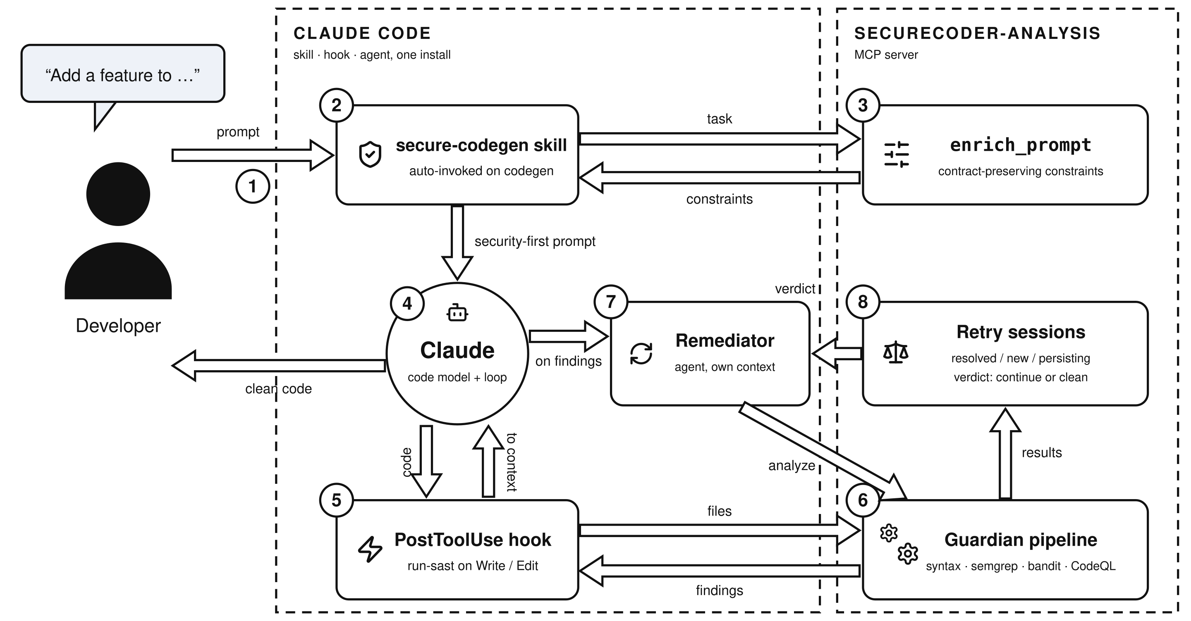
ARCHITECTURE
How the pieces fit together
SecureCoder · TU Darmstadt · ATHENE
08

Slide 9

UNDER THE HOOD
Two speeds of analysis
Fast lane · seconds
Deep lane · on demand
Runs after every file write.
Used for the first pass and the final check.
syntax check · semgrep · bandit
CodeQL · security-extended suites
The server tracks each session: which findings were fixed, which are new, which persist, and when to stop retrying.
SecureCoder · TU Darmstadt · ATHENE
09

Slide 10
IN ACTION
What Claude sees
hook output
remediation report
[securecoder] 2 findings
HIGH CWE-89 SQL injection
→ use parameterized queries
MED CWE-798 hardcoded secret
→ move to a secret manager
attempt 2 / 7
resolved 2
persisting 0
deep pass CodeQL ✔
verdict CLEAN ✔
All of this happens on its own during a normal coding session.
SecureCoder · TU Darmstadt · ATHENE
10

Slide 11


ROADMAP
Where this goes next
Constraint decoding in the harness
Security benchmarks for frontier models
Bring discriminator-guided decoding from the research side into agent workflows.
Our CLI can measure how securely a given model writes code.
Claude Code marketplace
Shared security datasets
Publish the plugin and keep both frontends on the same engine.
Our CWE-annotated data is usable for training and for evals.
SecureCoder · TU Darmstadt · ATHENE
11

Slide 12



Security as a first-class constraint of the agent loop.
Checked before generation, after every write, and until the analyzers come back clean.
securecoder-project.github.io
github.com/SecureCoder-Project
STG · UKP · ML · TU Darmstadt
Thank you · SecureCoder · ATHENE Mission Project · TU Darmstadt

