Slide 1
Samson Blackburn_ T1A3
Terminal application

Slide 2

the problem:
"It is not that we have a short time to live but that we waste alot of it.“ – Seneca
What is given attention is in some important the reality. This application provides a quick calculation with some accuracy as to how many hours of life you have left.

Slide 3
Proposed features:
Life expectancy calculator
Update answers at a later stage
Lookup results and recalculate a new time

Slide 4
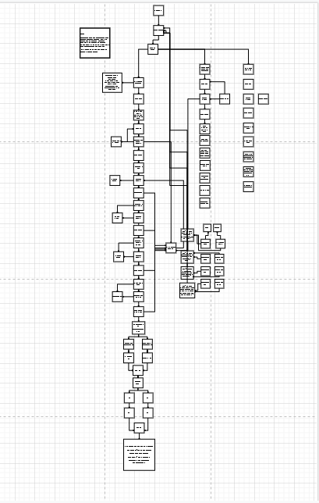
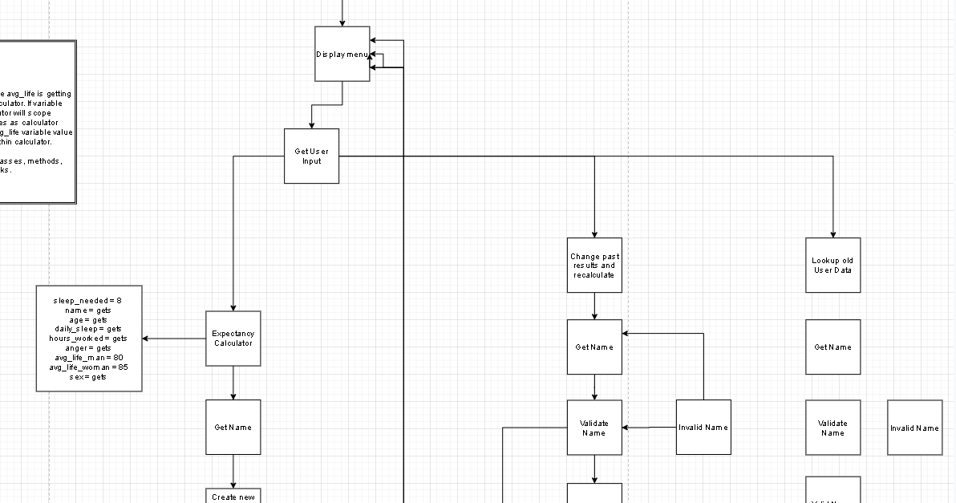
Flow Chart:

Slide 5
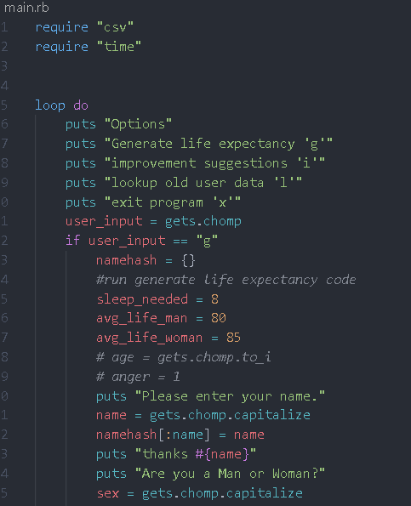
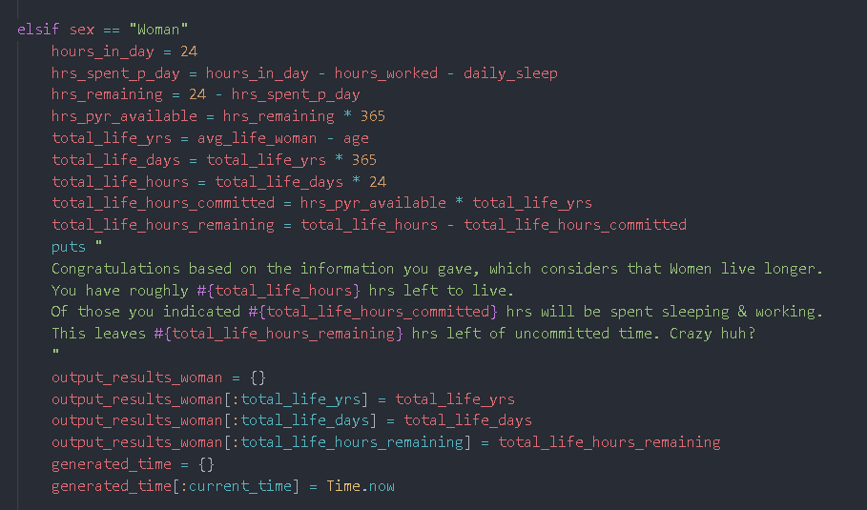
Menu and output calculation

Slide 6
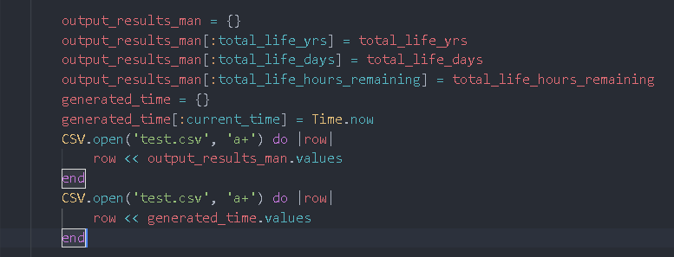
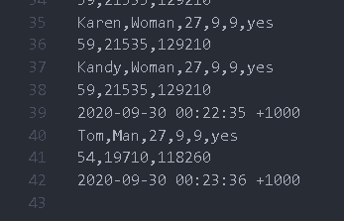
CSV & Gems & Extra Features?
Timestamps generation and saves to CSV with results.
Colourise, time, ???, profit $$$
Turn output into hourly countdown, push countdown output to a clock and/or HTML page.

Slide 7
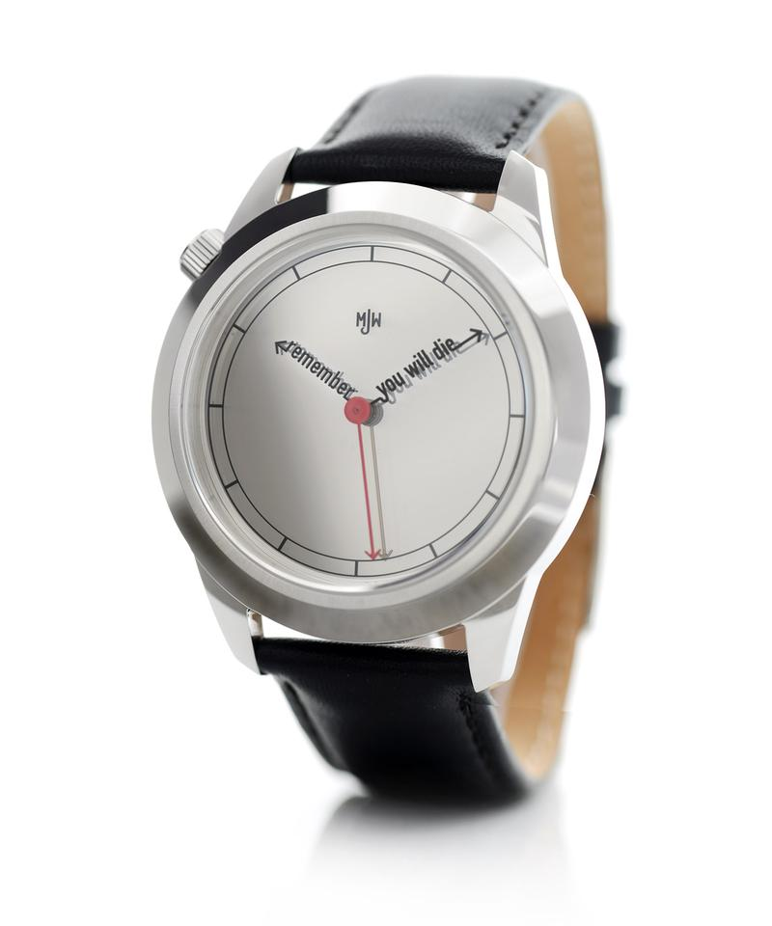

Thankyou.

