Slide 1
Software isolation in Linux
Nikos Mavrogiannopoulos
Senior Software Engineer
Red Hat Security Technologies
January, 2015

Slide 2
What I work on
GnuTLS
OpenConnect VPN server

Slide 3
What I work on
GnuTLS
OpenConnect VPN server
Libtasn1
nettle
Cryptodev-linux
Freeradius-client
OpenSC
P11-kit
Openwrt
sniproxy
openssl

Slide 4
Openconnect VPN server design
Reasons for software isolation
Threats defending from
Restricting process privileges: from setuid() to namespaces

Slide 5


Openconnect VPN server design
Server

Slide 6

Openconnect VPN server design
PAM
authentication
Server
TLS/SSL
key

Slide 7
Openconnect VPN server design
PAM
authentication
Server
TLS/SSL
key

Slide 8
Openconnect VPN server design
PAM
authentication
Server
TLS/SSL
key

Slide 9
Reasons for software isolation
HTTP
parsing
TLS/DTLS
parsing
XML form
parsing
Server
X.509
Certificate
parsing
LZS/LZ4
compression

Slide 10
Reasons for software isolation
That's 4-5 different external libraries used for parsing (some 100k LoC or more)

Slide 11
Reasons for software isolation
That's 4-5 different external libraries used for parsing (some 100k LoC or more)
  Verify them all and ensure there are no bugs

Slide 12
Reasons for software isolation
That's 4-5 different external libraries used for parsing (some 100k LoC or more)
  Verify them all and ensure there are no bugs
  Write software that can be reliable despite bugs

Slide 13
Reasons for software isolation
That's 4-5 different external libraries used for parsing (some 100k LoC or more)
  Verify them all and ensure there are no bugs
  Write software that can be reliable despite bugs
    Follow the design principle of privilege separation
    Using the latest Linux kernel enhancements

Slide 14
Threats defending from
Code injection

Slide 15
Threats defending from
Code injection
  A succesful attack is able to execute arbitrary code, read arbitrary memory...

Slide 16
Available tools in Linux
Isolate memory
  fork + setuid
  fork + setuid + exec
Isolate FS
  chroot
Linux specific tools
  Seccomp
  prctl()
  SELinux
  Linux Namespaces

Slide 17
Available tools in Linux
Isolate memory
  fork + setuid
  fork + setuid + exec
Isolate FS
  chroot
Linux specific tools
  Seccomp
  prctl()
  SELinux
  Linux Namespaces

Slide 18
Openconnect VPN server design
PAM
authentication
Server
TLS/SSL
key

Slide 19
Openconnect VPN server design
Worker
process
Main
process
Worker
process
TLS/SSL
key
Sec-mod
process
PAM
authentication

Slide 20
Openconnect VPN server design
Worker
process
fork() + setuid()
Main
process
IPC
Worker
process
Sec-mod
process
IPC
PAM
authentication

Slide 21
Openconnect VPN server design
Worker
Process
p1
fork() + setuid()
Main
process
IPC
?
Worker
Process
p2
Sec-mod
process
IPC
  Can p1 kill p2?
  Can p1 read the memory of p2?
  Can p1 access shared memory in the system?
  Can p1 exploit a bug in a system call?
PAM
authentication

Slide 22
What is a process?
Code in memory scheduled to have a time slot in the CPU
  Can access its own segment of memory
  Can make special calls to kernel
    To obtain additional memory segments
    To access filesystem
    To access IPC filesystem
    To read/write the memory of other processes (ptrace)
    To change the state of other processes (kill)

Slide 23


Restricting process privileges: seccomp
Restricts the available system calls in a process

Slide 24
Restricting process privileges: seccomp
Restricts the available system calls in a process
  e.g., allow read() and write() but not anything else

Slide 25


Restricting process privileges: seccomp
Serving
process
IPC
Authenticating
process
?
Serving
process
open(“/anyfile, ...) == failed

Slide 26
Restricting process privileges: seccomp
Serving
process
System calls to kill or
debug another process
are not allowed
IPC
Authenticating
process
?
Serving
process

Slide 27
Restricting process privileges: seccomp
Reasonable API via libseccomp
Currently works well on x86, x86-64
Tedious task to determine the system calls to block
  strace
  Libc's exit() may use exit_group() internally
  Libc may use different system calls in different archs
  An update of libc or a library may change the system calls in use

Slide 28
Restricting process privileges: seccomp
libseccomp
ctx = seccomp_init(SCMP_ACT_ERRNO(EPERM))
assert(ctx == 0);
assert(seccomp_rule_add(ctx, SCMP_ACT_ALLOW, SCMP_SYS(read), 0) == 0);
assert(seccomp_rule_add(ctx, SCMP_ACT_ALLOW, SCMP_SYS(write), 0) == 0);
assert (seccomp_rule_add(ctx, SCMP_ACT_ALLOW, SCMP_SYS(ioctl), 1, SCMP_A1(SCMP_CMP_EQ, (int)SIOCGIFMTU)) == 0);
assert (seccomp_load(ctx) == 0);

Slide 29

Restricting process privileges: prctl
Can p1 access the memory of p2?

Slide 30
Restricting process privileges: prctl
Can p1 access the memory of p2?
#include <sys/prctl.h>
prctl(PR_SET_DUMPABLE, 0);

Slide 31

Restricting process privileges: SELinux
Restricts processes from accessing objects

Slide 32
Restricting process privileges: SELinux
Restricts processes from accessing objects
  Objects can be: files, processes, pipes, network interfaces ...

Slide 33
Restricting process privileges: SELinux
Restricts processes from accessing objects
  Objects can be: files, processes, pipes, network interfaces ...
Can enhance seccomp with fine-grained access control
  e.g., prevent read() from accessing file descriptors not intended to be read

Slide 34
Restricting process privileges: SELinux
Restricts processes from accessing objects
  Objects can be: files, processes, pipes, network interfaces ...
Can enhance seccomp with fine-grained access control
  e.g., prevent read() from accessing file descriptors not intended to be read
Not universally enabled
System-wide configuration that can be enabled/disabled by the administrator

Slide 35
Restricting process privileges: SELinux
With seccomp:
  Seccomp allows: open(), read(), write()
  SELinux can allow access only to a class of files
    After a policy is set
    Through exec() or via calling setcon() after fork

Slide 36
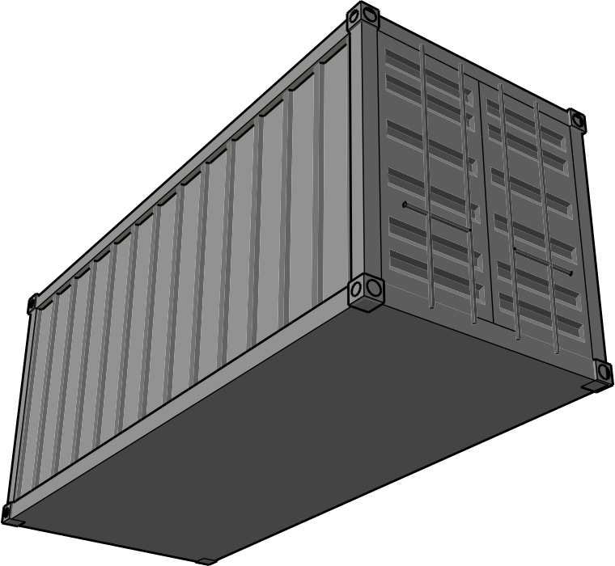
Restricting process privileges: Linux Namespaces
Fine-tuned process restrictions

Slide 37
Restricting process privileges: Linux Namespaces
Fine-tuned process restrictions
Low-level API: clone()
Like fork()
with flags

Slide 38
Restricting process privileges: Linux Namespaces
Fine-tuned process restrictions
Low-level API: clone()
  CLONE_NEWPID: Each process cannot see/access processes outside the new namespace
    The spawning server can be in a new PID namespace to prevent processes from accessing processes outside it

Slide 39
Restricting process privileges: Linux Namespaces
Fine-tuned process restrictions
Low-level API: clone()
  CLONE_NEWNS: New mount name spaces
    Can isolate mount points to stay within a process
    Feature-rich chroot()

Slide 40
Restricting process privileges: Linux Namespaces
Fine-tuned process restrictions
Low-level API: clone()
  CLONE_NEWNS: New mount name spaces
assert (unshare(CLONE_NEWNS) == 0);
assert (mount("./jail", "./jail", "bind", MS_BIND, NULL) == 0);
assert (pivot_root("./jail/", "./jail/old_root") == 0);
assert (chdir("/") == 0);
assert (mount("proc", "/proc", "proc", 0, NULL) == 0);
assert (mount("/old_root/bin", "./bin", NULL, MS_NOSETUID|MS_BIND, NULL) == 0);
assert (mount("/old_root/usr", "./usr", NULL, MS_NOSETUID|MS_BIND, NULL) == 0);
assert (mount("/old_root/lib64", "./lib64", NULL, MS_NOSETUID|MS_BIND, NULL) == 0);
assert (umount2("/old_root", MNT_DETACH)==0);

Slide 41
Restricting process privileges: Linux Namespaces
Fine-tuned process restrictions
Low-level API: clone()
  CLONE_NEWIPC: provides a new IPC system
    Prevent processes in the container from accessing any IPC resources (shared memory segments, msg queues)

Slide 42
Restricting process privileges: Linux Namespaces
Fine-tuned process restrictions
Low-level API: clone()
  CLONE_NEWNET: New network name space
    Separate device interfaces, IP stack, routing tables, ...

Slide 43
Restricting process privileges: Linux Namespaces
Fine-tuned process restrictions
Low-level API: clone()
  CLONE_NEWNS
  CLONE_NEWUSER

Slide 44
Restricting process privileges: Linux Namespaces
Fine-tuned process restrictions
Low-level API: clone()
#if defined(__i386__) || defined(__arm__) || defined(__x86_64__) || defined(__mips__)
long ret;
int flags = SIGCHLD|CLONE_NEWPID;
ret = syscall(SYS_clone, flags, 0, 0, 0);
if (ret == 0 && syscall(SYS_getpid) != 1)
return -1;
return ret;
#endif

Slide 45
Restricting process privileges: Linux Namespaces
Limitations:
  No higher-level libraries or reasonable libc API for that functionality
  Effectively a black list rather than a white list

Slide 46


Summarizing
 | Prevent killing other processes | Prevent access to memory of other processes | Prevent access to shared memory in the system | Prevent exploitation of a bug in a system call
Seccomp
prctl(DUMPABLE)
SELinux
Namespaces

Slide 47
Summarizing: performance
fork() vs clone(): x86-64, kernel 3.17.8
fork | fork + seccomp | CLONE_NEWPID|CLONE_NEWNET|CLONE_NEWIPC | CLONE_NEWPID|CLONE_IPC | CLONE_NEWPID
0.04 ms | 0.07 ms | 0.78 ms | 0.08 ms | 0.05 ms

Slide 48
Summarizing: performance
Seccomp overhead:
seccomp | 607 Mbps
No seccomp | 624 Mbps

Slide 49
Summarizing: Openconnect VPN server design
Worker
process
fork() + setuid()
+ seccomp
Main
process
IPC
Worker
process
Sec-mod
process
IPC
PAM
authentication

Slide 50
Questions?
Contact me at: nmav@redhat.com

