Slide 1
ISCTF 2015 Capture The Flag Competition
Sep 17, 2015

Slide 2
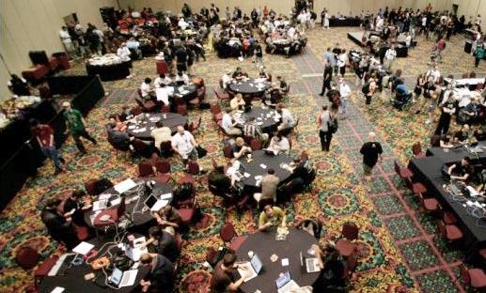
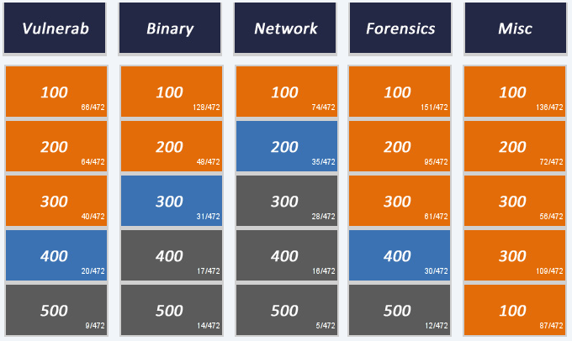
CTF Competition
Capture The Flag
Challenges for hacking skill
Attack-Defense
Each team owns their server and attack another team’s server or fix their server’s vulnerability to defend attacks.
Jeopardy
Solve the problem and get the score of each problem
DEF CON: The world’s most popular hacking conference (Attack-Defense)
Codegate: Korea’s most popular hacking conference(Jeopardy)

Slide 3
ISCTF 2015
Information Security CTF
A CTF competition for COSE354 students
CTF team member == Term project team member
Jeopardy

Slide 4
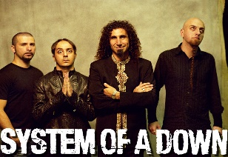

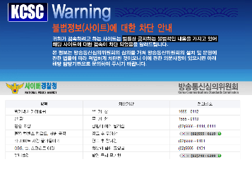

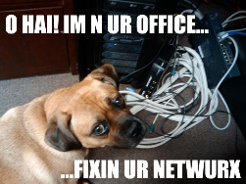
ISCTF – Fields of problem
Fields of problems
System
System penetration(ex. Race condition)
Vulnerability
Find a vulnerability of an application
Web
Find a vulnerability of web sites or databases (Layer 7)
Forensic
Investigate or trace suspect’s forensic artifacts(ex. Hard disk)
Network
Investigate network packets
Cryptography
Reversing
Reverse engineering

Slide 5
ISCTF – Topic of each field
Topics of each field (Briefly)
System
BOF, Format String Bug, Race condition
Vulnerability
Privilege escalation, Logical problem
Web
SQL injection, Cookie injection
Forensic
File system forensic, Carving
Network
Packet analysis
Cryptography
Steganography, Basic crypto, Block cipher
Reversing
x86 reversing, ELF reversing

Slide 6
ISCTF – Schedule
Schedule(KST): 36 hours / Nov 6 ~ 8 or 13 ~ 15
Oct 6(or 13) (Fri)
Oct 7(or 14) (Sat)
Oct 8(or 15) (Sun)
Schedule will be fixed later
Start
0
3
6
9
12
15
18
21
24
0
3
6
9
12
15
18
21
24
End
0
3
6
9
12
15
18
21
24

Slide 7
ISCTF – Rules
Rules
DO NOT CHEAT
All auth log will be remained
We will look for you, We will find you, and….
DO NOT CHEAT
Cheating includes: Sharing answer(key), sharing solution, peeking, attack the CTF server, etc.
But, if you found our site’s vulnerability, then we will give you several score (Come to us!)

Slide 8
ISCTF – Write-up
All teams must submit a write-up about solved problems
How to write write-ups?
See many examples at https://ctftime.org/writeups

Slide 9
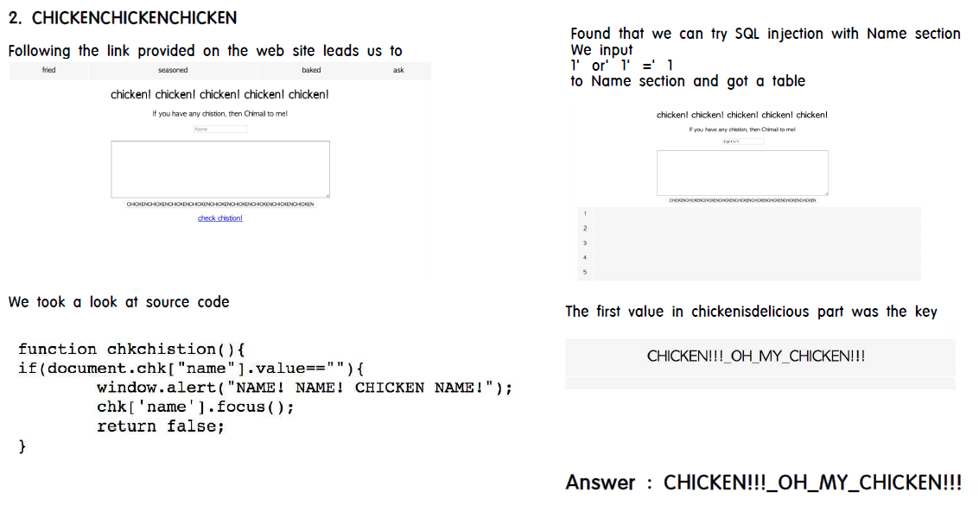
ISCTF – Example(1)
Write-up example in ISCTF2014

Slide 10
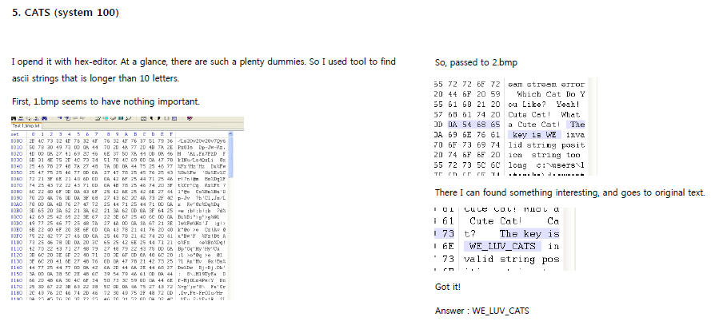
ISCTF – Example(2)
Write-up example in ISCTF2014

Slide 11
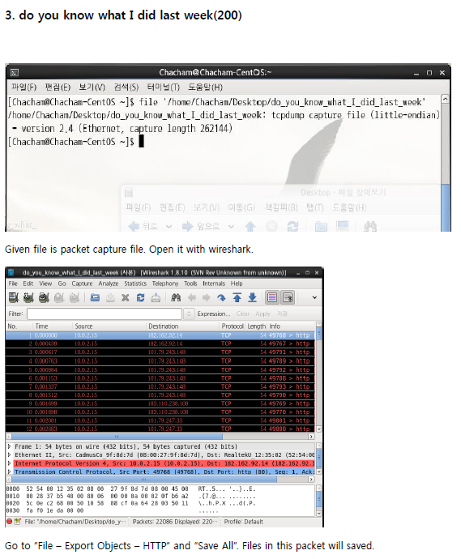
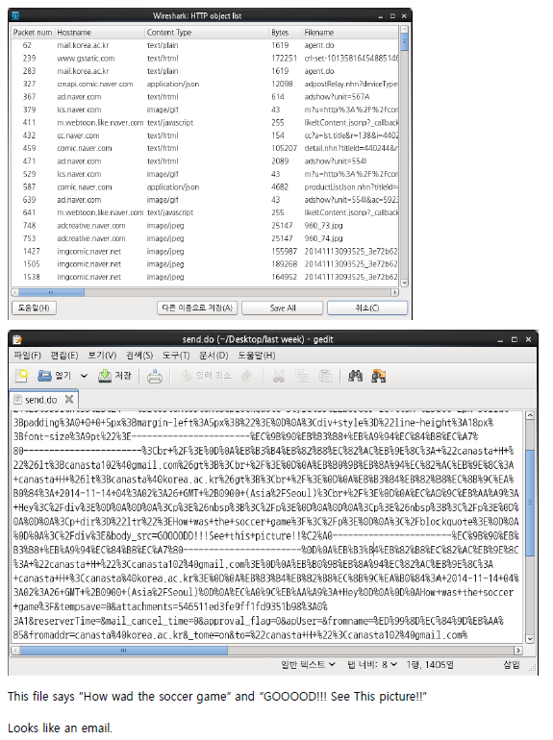
ISCTF – Example(3)
Write-up example in ISCTF2014

Slide 12
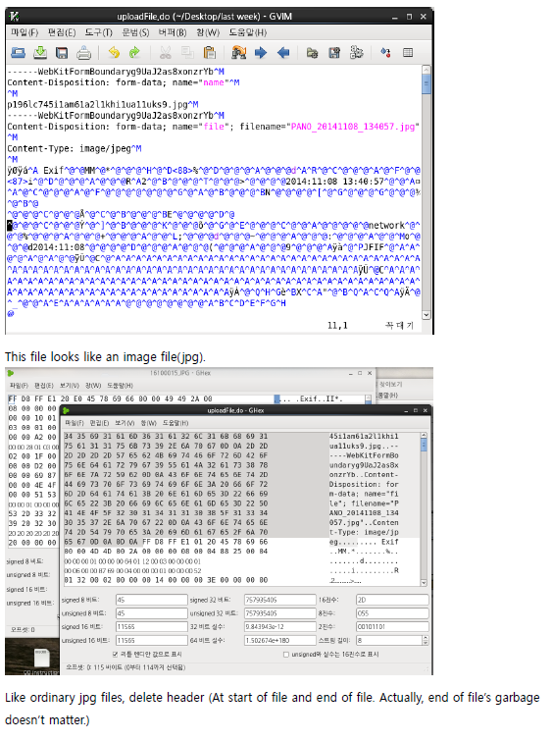
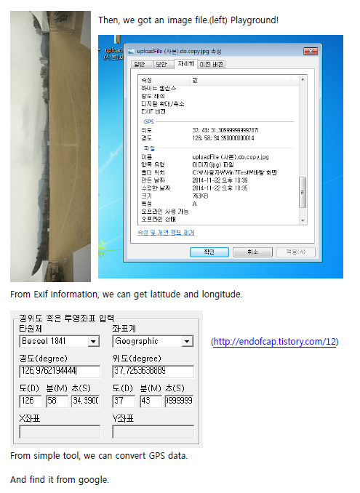
ISCTF – Example(3)
Write-up example in ISCTF2014

Slide 13
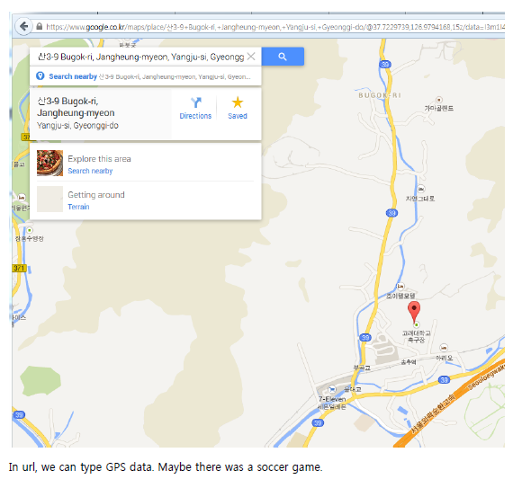
ISCTF – Example(3)
Write-up example in ISCTF2014

Slide 14
How to prepare
Useful sites (Challenges)
http://webhacking.kr
Web. Difficulty ★★☆☆☆ Recommended for beginners
http://suninatas.com
Web, Binary, Forensic, System. Difficulty ★★★☆☆
http://exploit-exercises.com/
System(Provides VM’s ISO file). Difficulty ★★★★☆
http://hack-me.org/
Web, Binary, etc. Difficulty ★★★★☆
http://ba.ckwith.me/#/Images/TheLordOfTheBOF_redhat.zip
The Fellowship of the BOF: System. Difficulty ★★☆☆☆
http://reversing.kr
Reversing. Difficulty ★★★★☆

Slide 15
How to prepare (Cont.)
Useful sites (Information)
http://forensic-proof.com
Forensic. Korean best site(about forensic) I think.
http://codeengn.org
Reversing. Information with challenges.
http://ctftime.org
Many write-ups(solution) for previous CTF competitions
http://www.metasploit.com/
Penetration testing software

Slide 16
How to prepare (Cont.)
Useful sites (Tools)
http://www.wireshark.org/
Wireshark: Packet capturing tool
http://www.immunityinc.com/products-immdbg.shtml
Immunity debugger: x86 debugger (Windows)
http://www.aircrack-ng.org/
Aircrack-ng: Wireless password cracker (WEP) & Other wireless pen-tools
http://www.aldeid.com/wiki/PEiD
PEiD: PE identification tool
http://mh-nexus.de/en/hxd/
HxD: Freeware hex editor

Slide 17
Q & A
vydudqls@korea.ac.kr
canasta@korea.ac.kr
songjieun@korea.ac.kr

Slide 18
Thank you

