Slide 1
EXTRACT PASSWORD FROM MEMORY WITH LAZAGNE

Slide 2
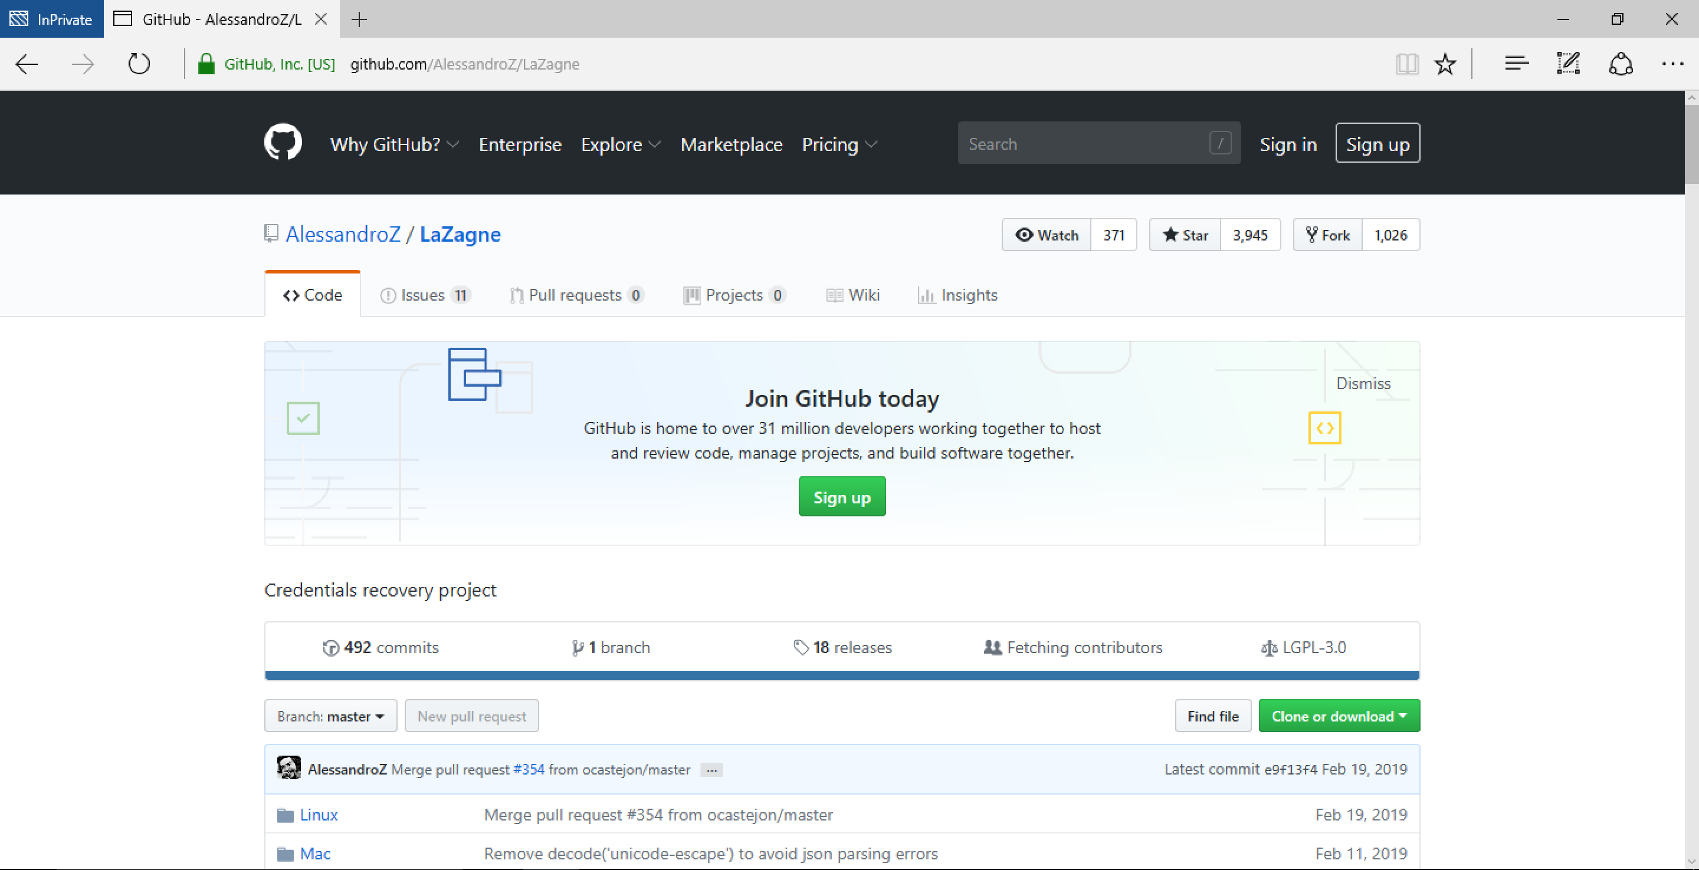
Lazagne github page

Slide 3
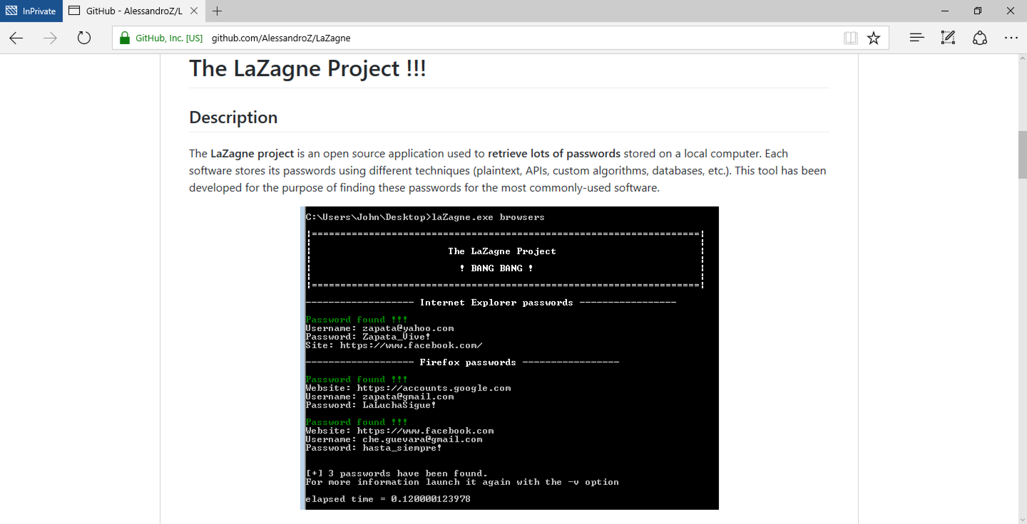
What is lazagne

Slide 4
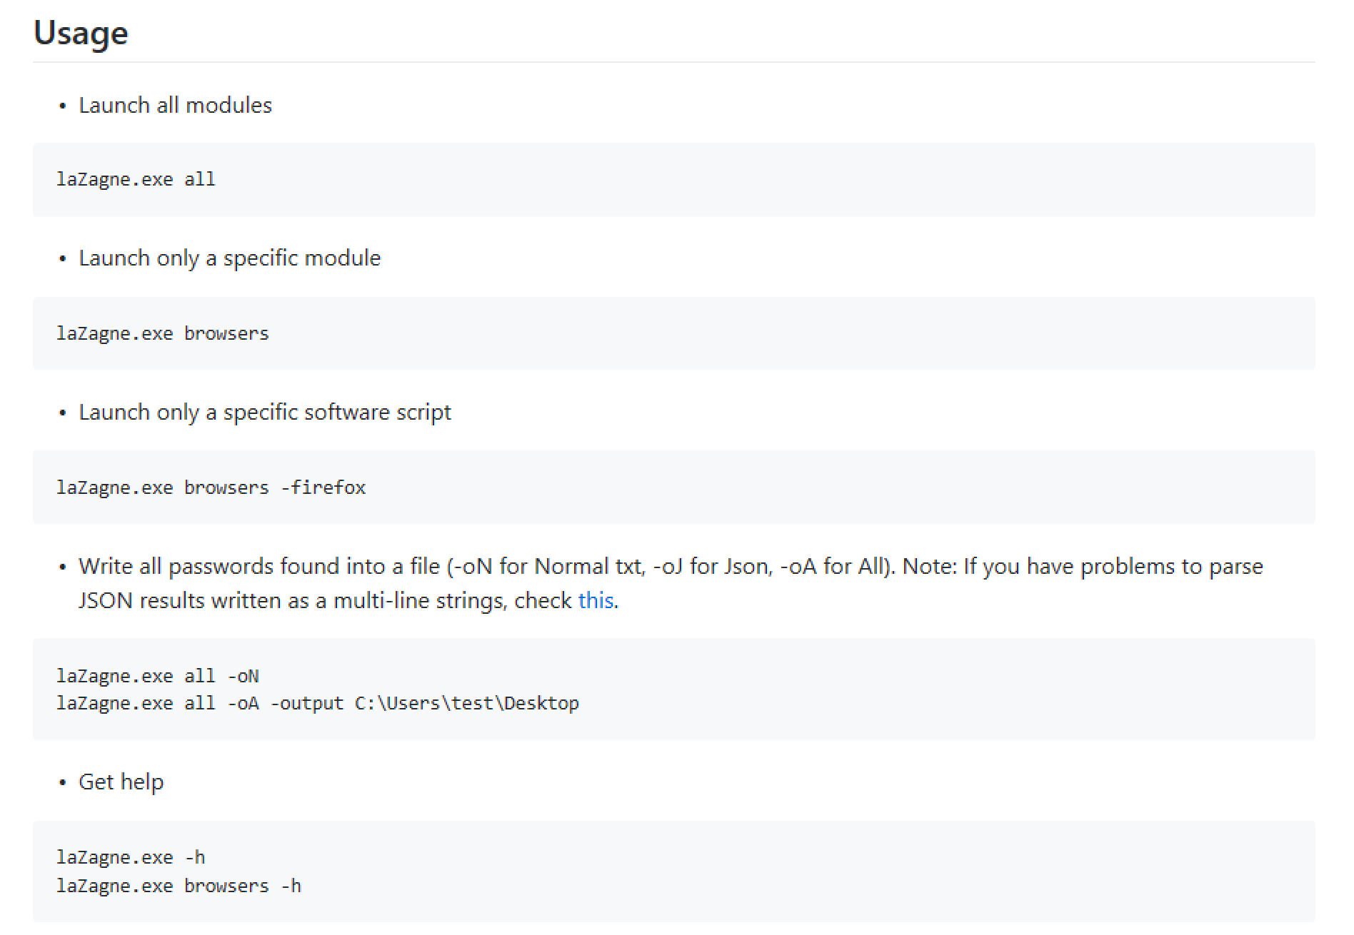
Usage…

Slide 5
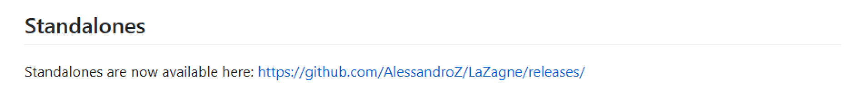
Lazagne Executable link

Slide 6
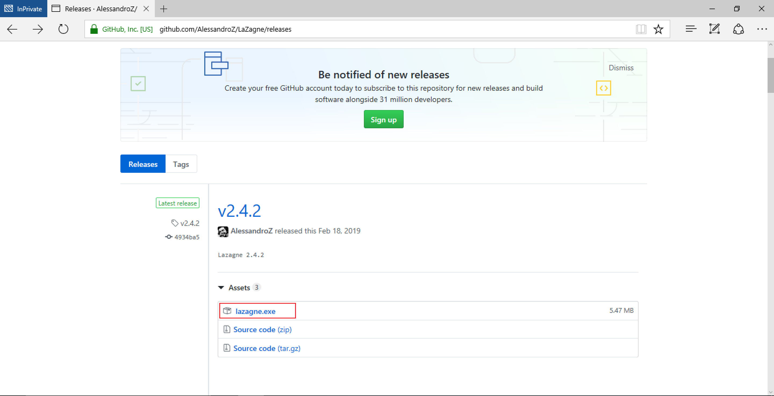
Download lazagne

Slide 7
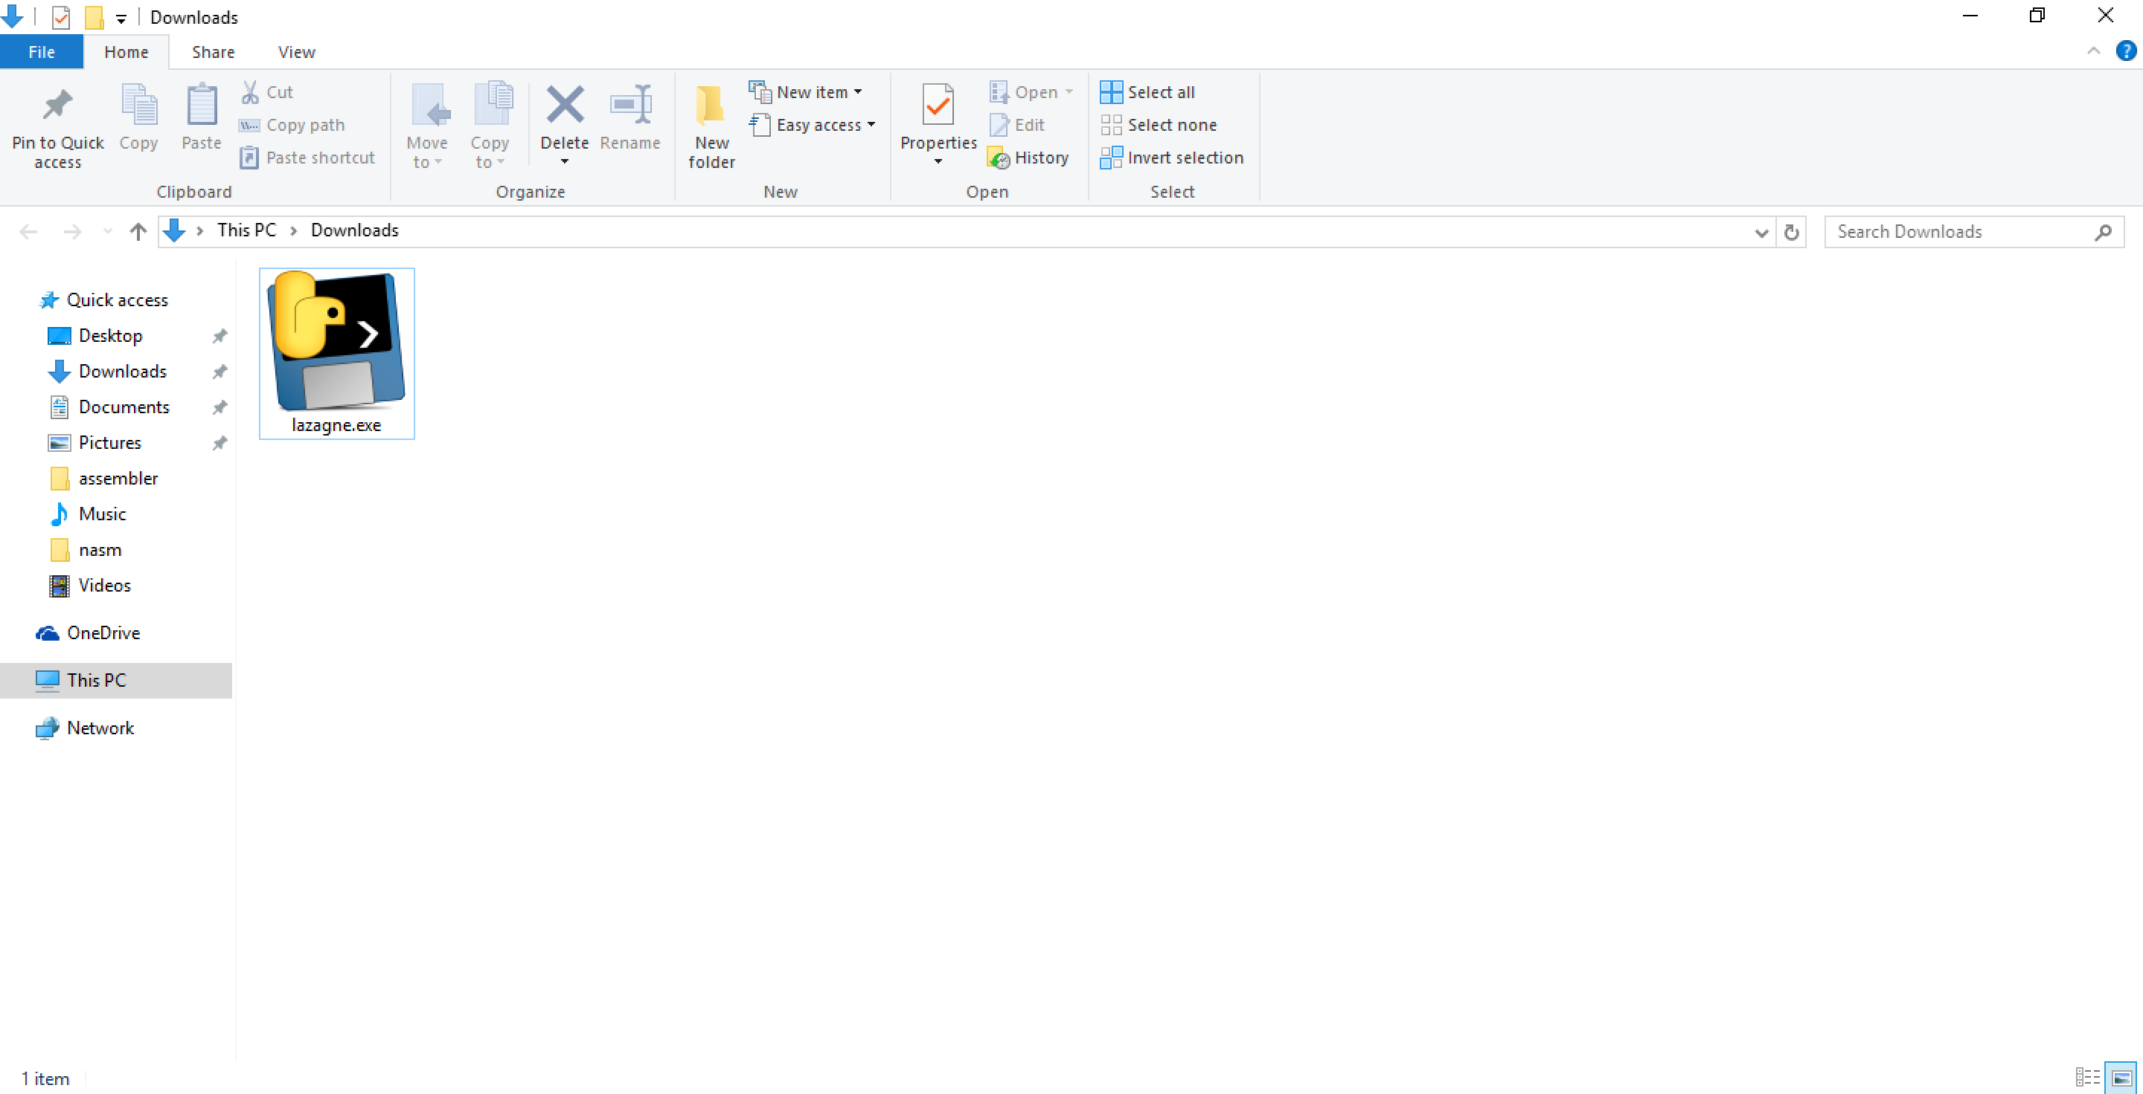
Lazagne downloaded

Slide 8
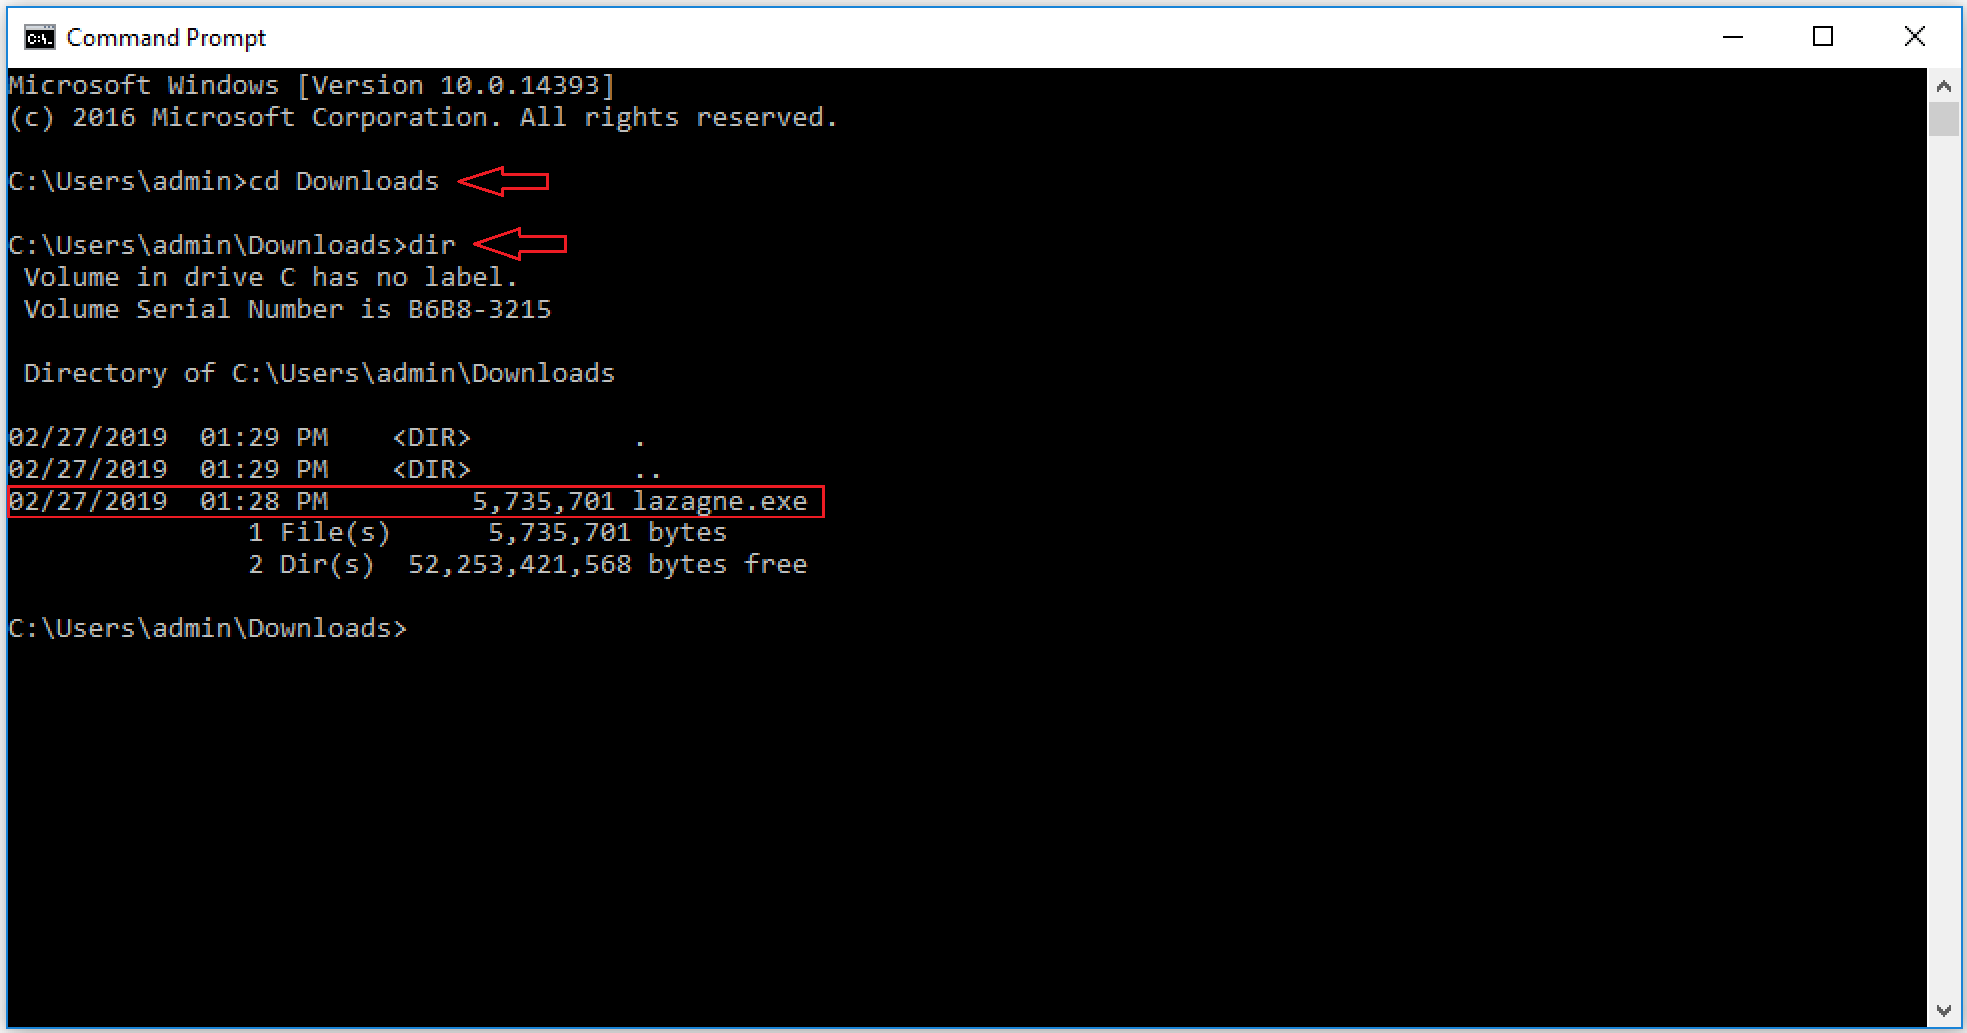
Lazagne through command prompt

Slide 9
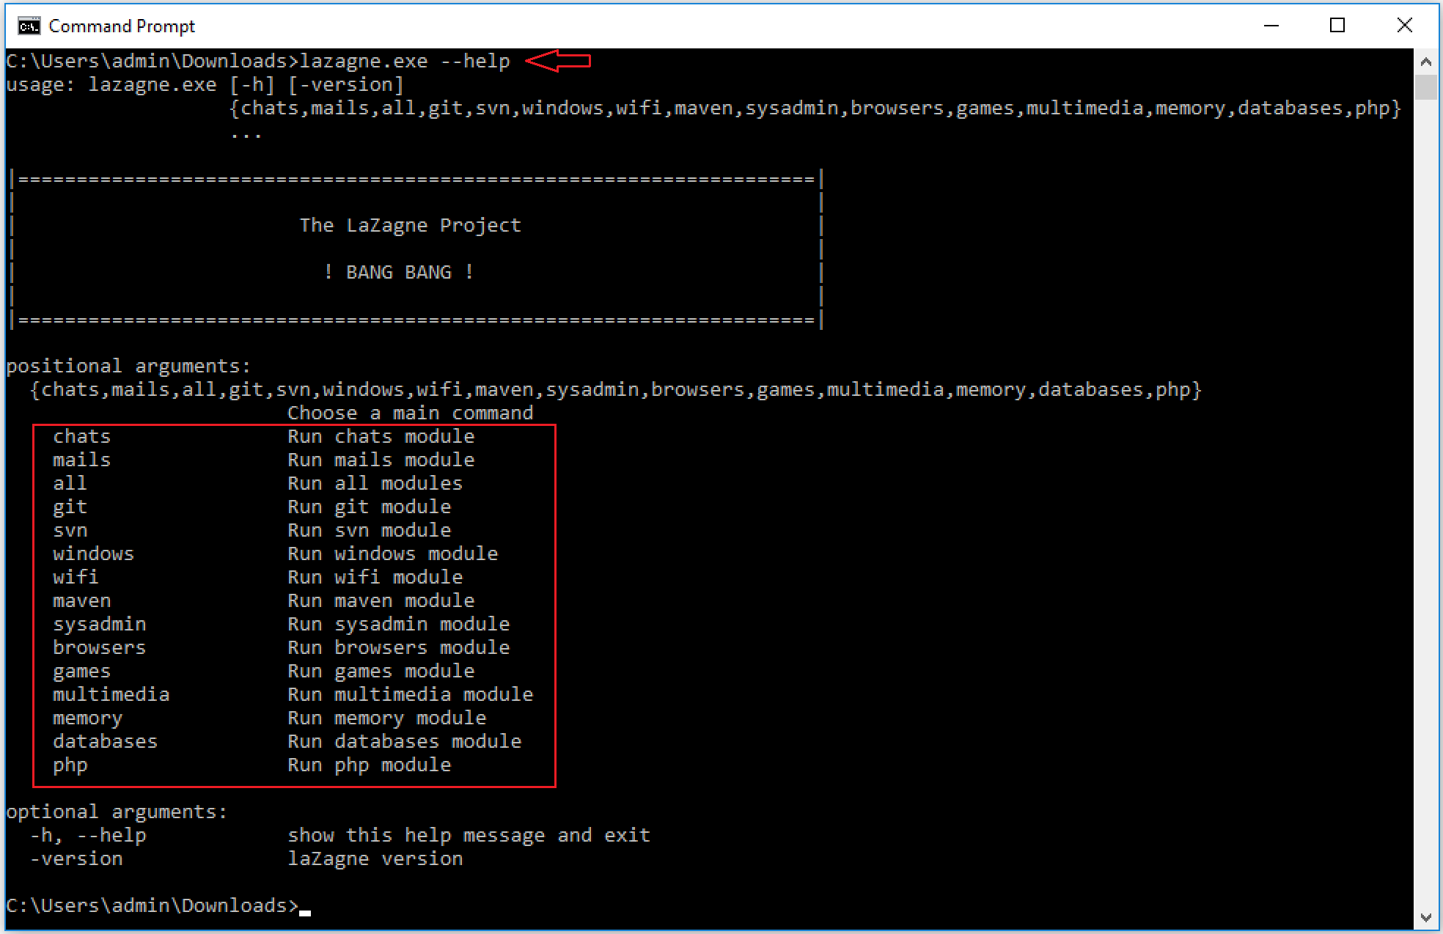
Available modules in lazagne

Slide 10
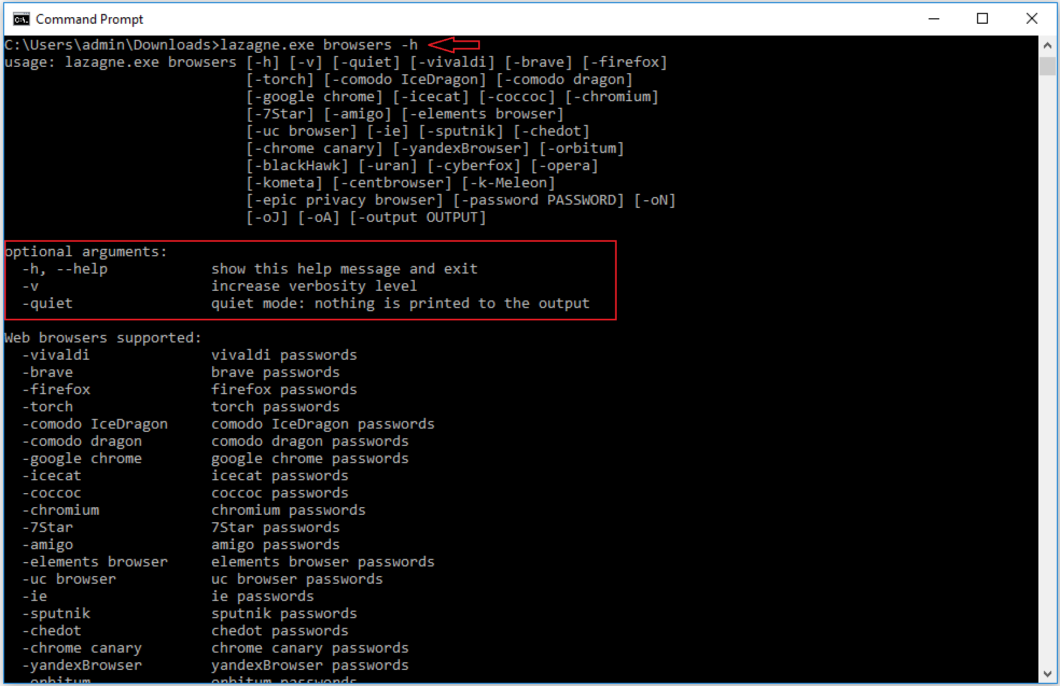
Optional arguments of lazagne

Slide 11
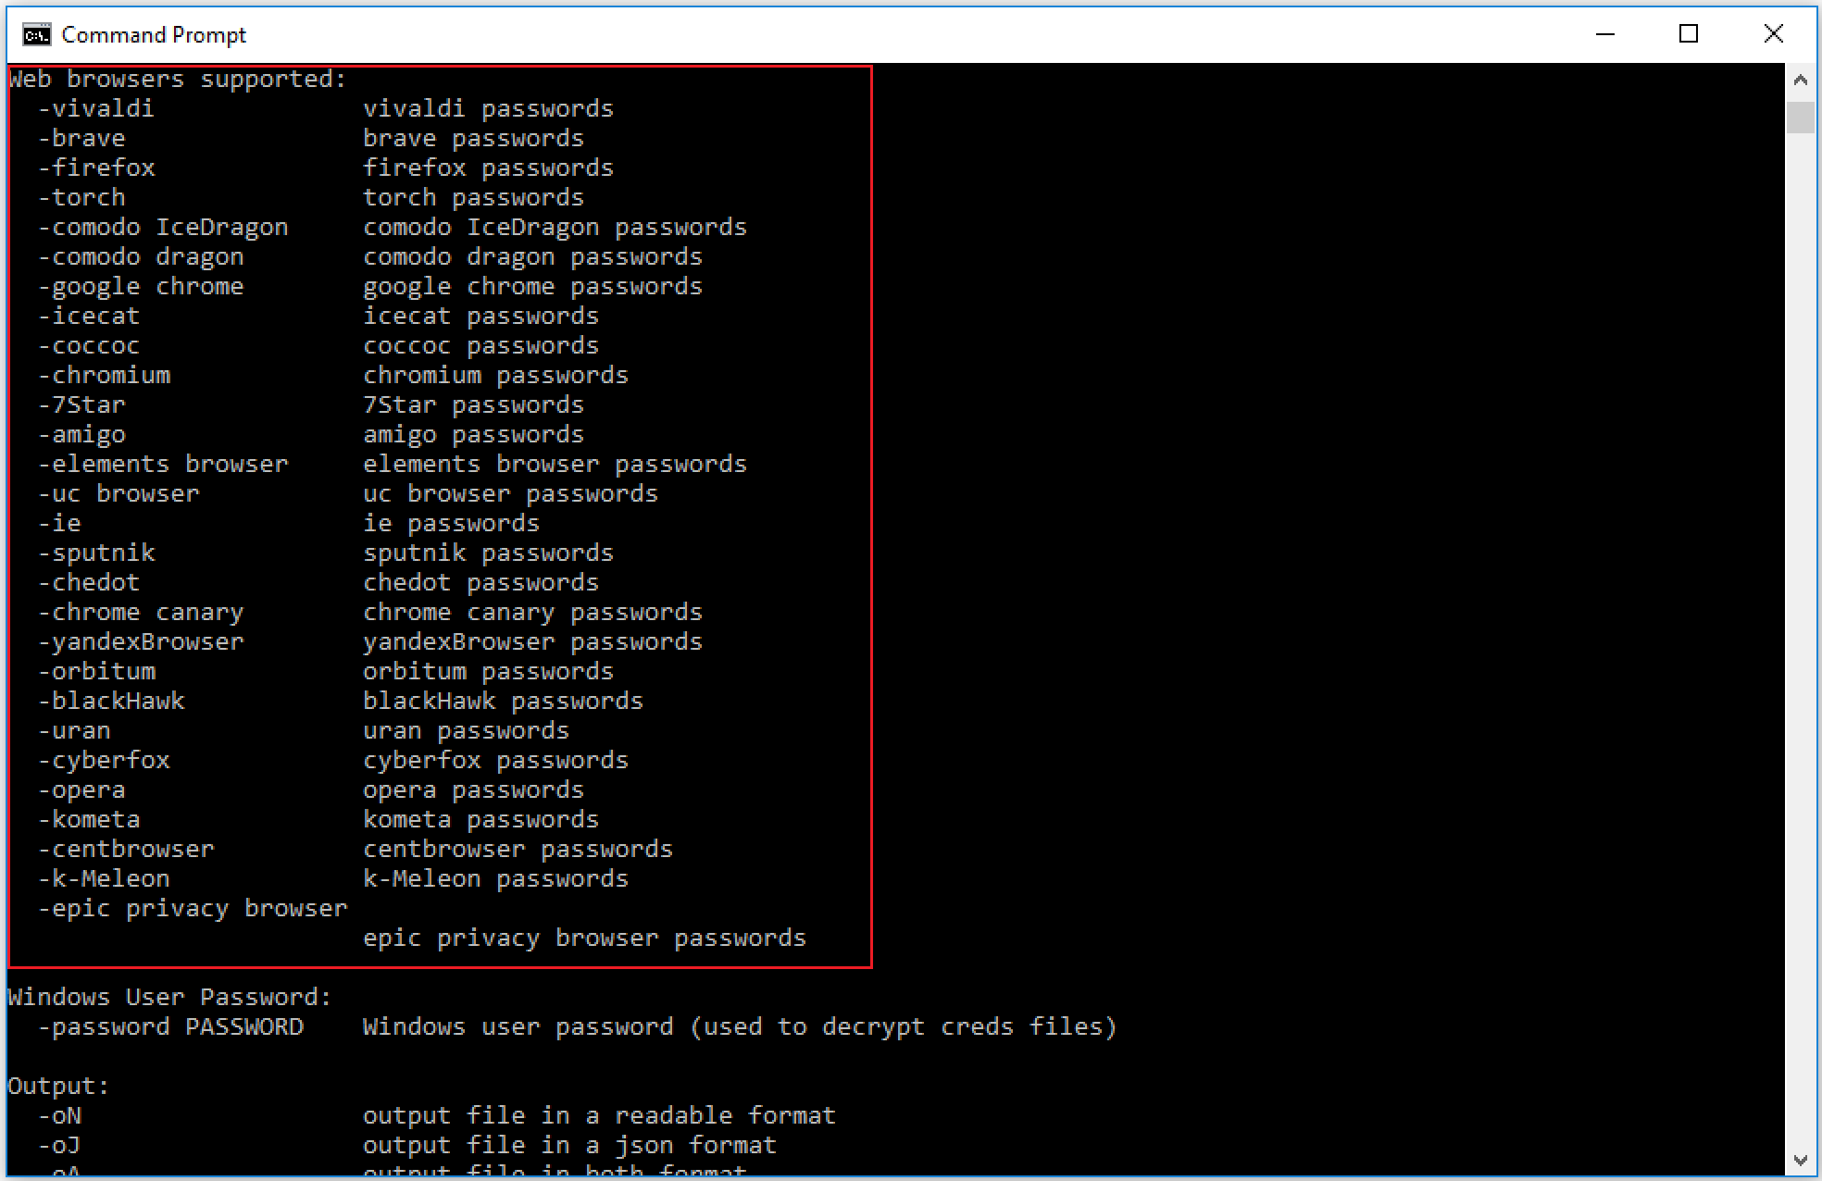
Web browsers supported by lazagne

Slide 12
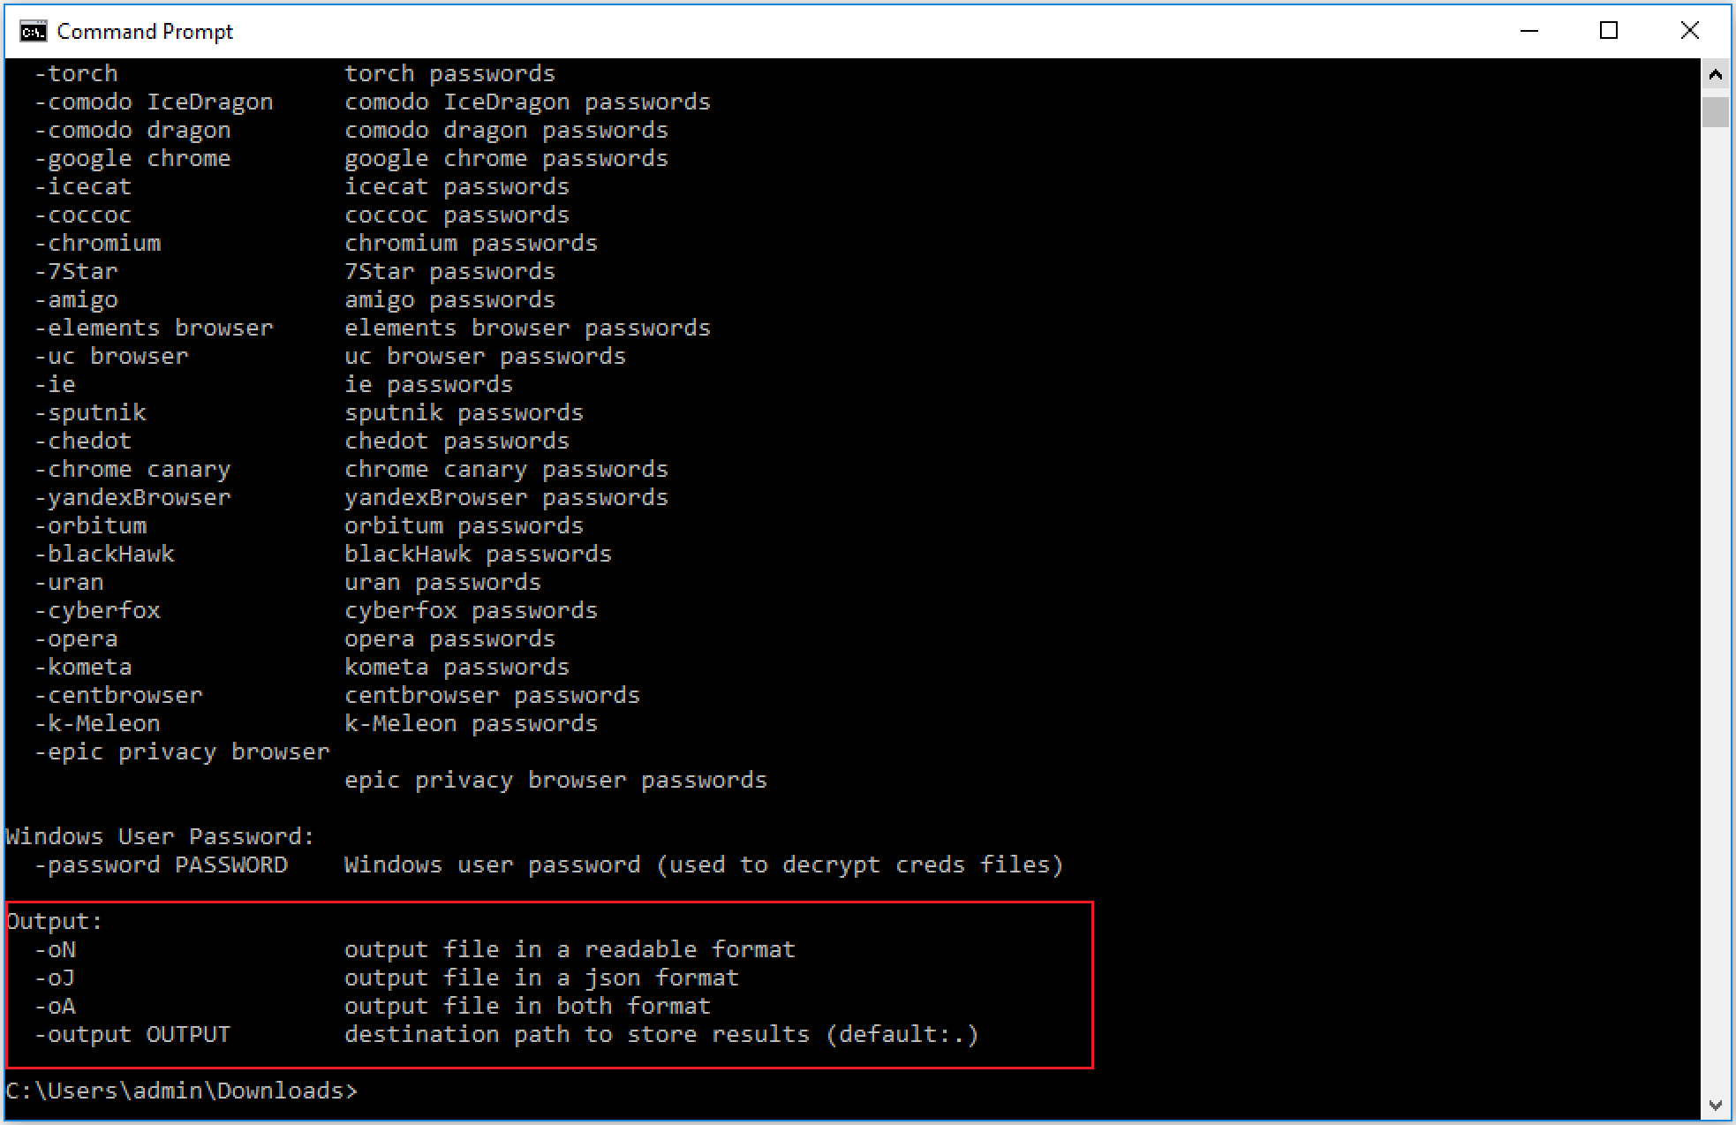
Output formats

Slide 13
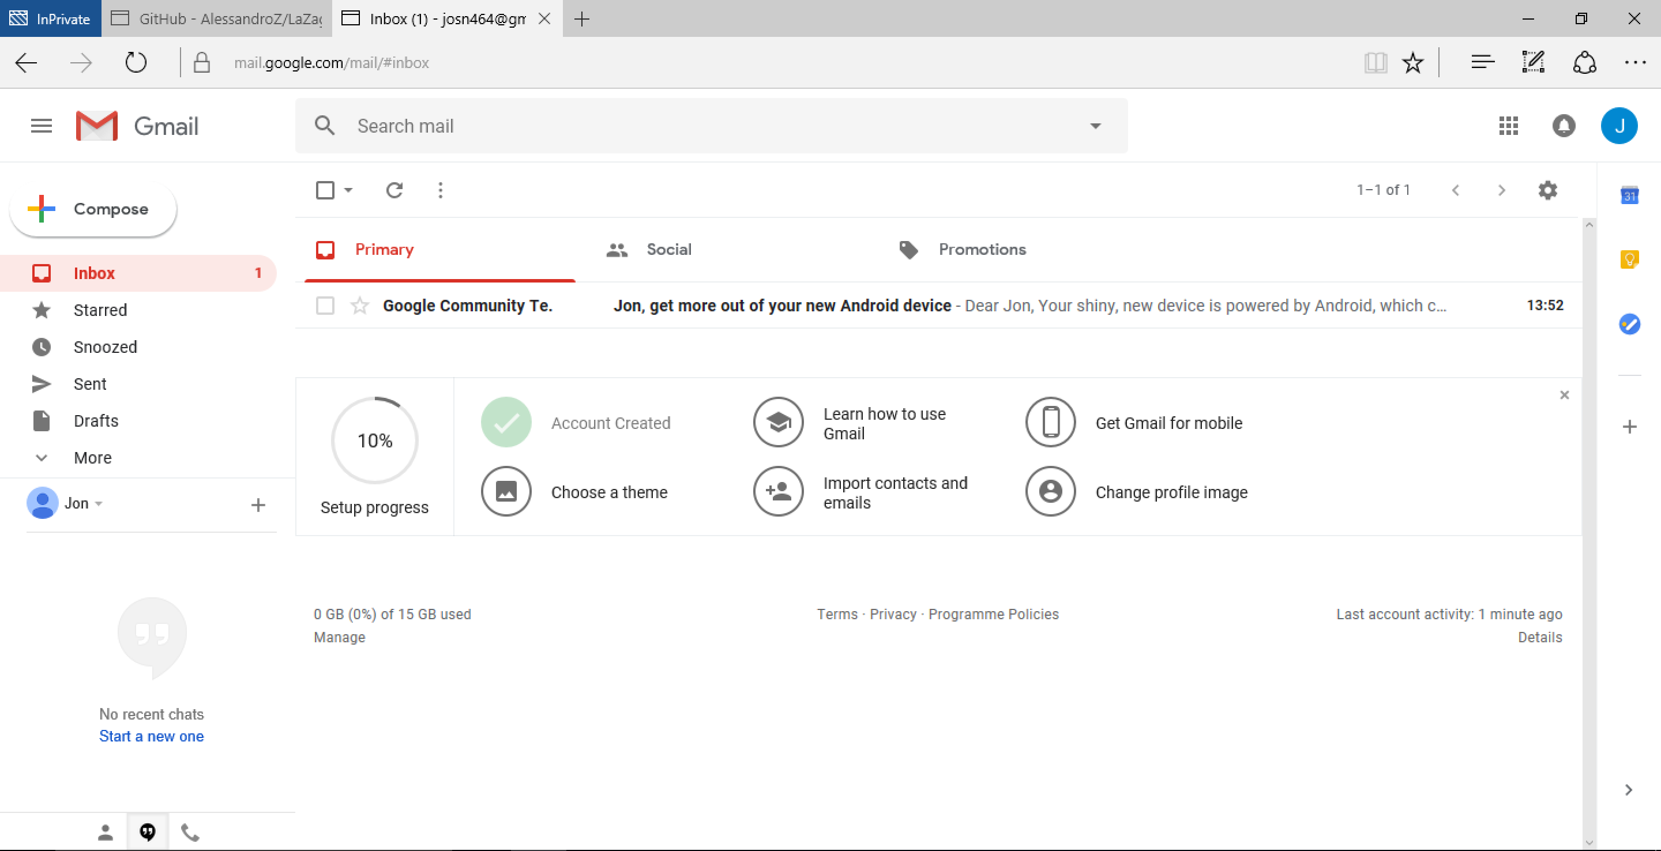
Gmail account

Slide 14
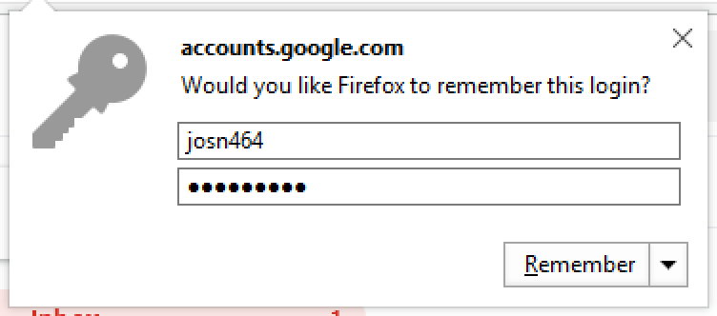
Remember the password

Slide 15
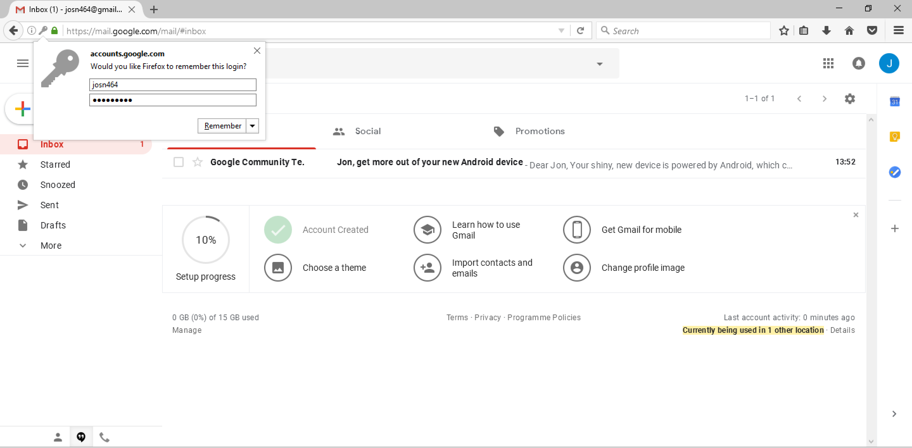
Remember the password

Slide 16
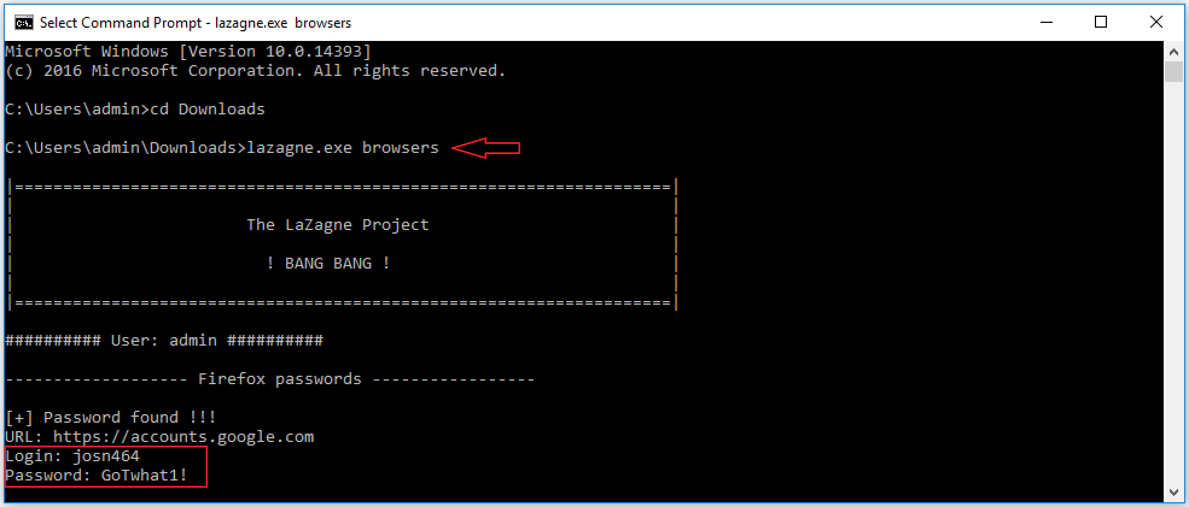
Password extracted

Slide 17
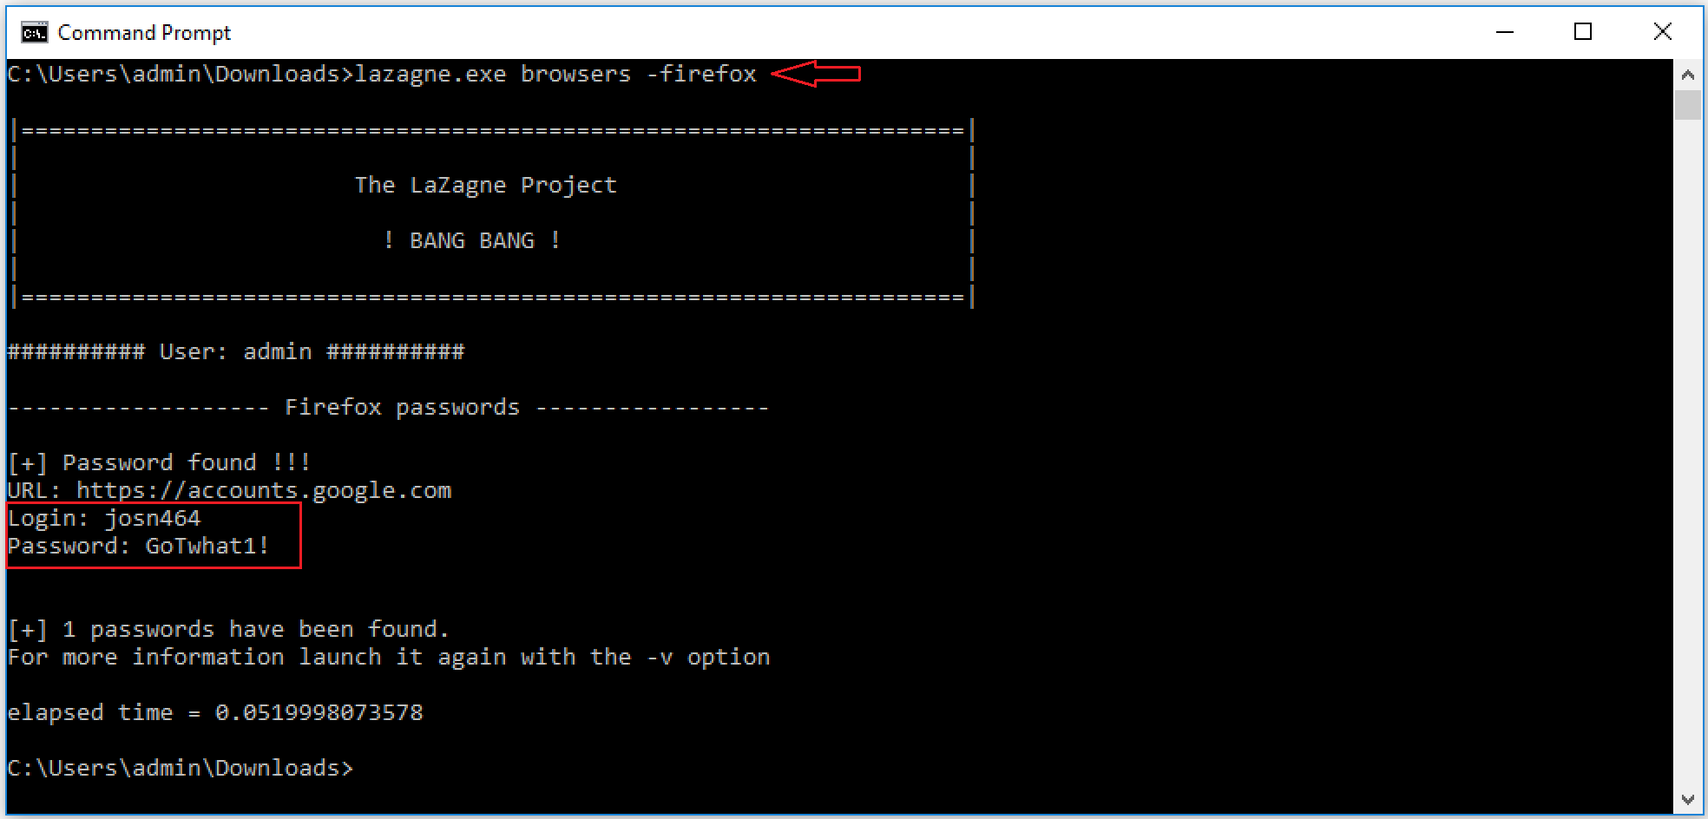
Password extracted

