Slide 1

Cybersecurity: Robustness in Incremental Learning
Adversarial Attacks
Catastrophic Forgetting
Replay Mechanisms

Slide 2
Dataset Model Result
DIRECTORY:

Slide 3
DATASET

Slide 4
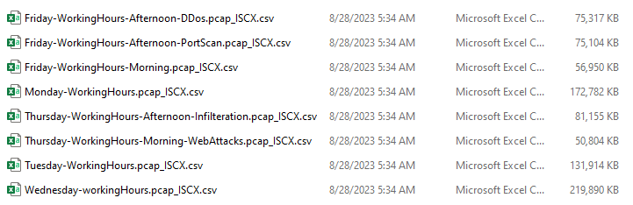
Dataset Overview
The CIC-DDoS2019 dataset is a highly reliable benchmark dataset that is widely used for detection and evaluation of distributed denial of service (DDoS) attacks. The dataset simulates a real network environment and provides a variety of network behavior samples by capturing normal traffic and attack traffic. The dataset is designed to provide strong data support for the training and testing of machine learning models.
Data characteristics
Data source: The dataset contains 8 CSV files, each of which represents network traffic records in different time periods.
Sample size:The total number of samples is 2,826,876 rows. Each sample represents a network flow, describing its characteristics and corresponding labels.
Feature dimension:Each record has 78 features, covering network behavior information in multiple aspects such as traffic statistics, time intervals, packet sizes, and flags. Feature types include numerical and categorical types.
Label distribution:The label column Label indicates whether the sample is normal traffic or a certain attack type.Attack types include DDoS, PortScan, Infiltration and other common network threats, as well as normal traffic (Benign).

Slide 5
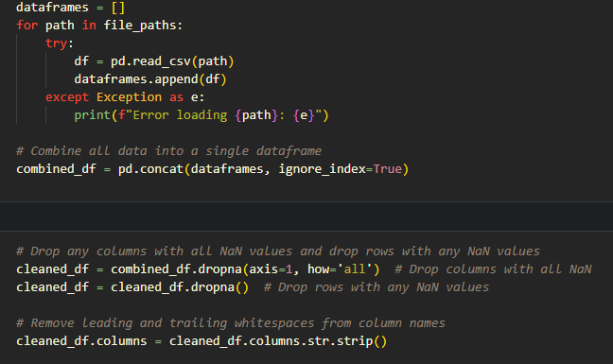


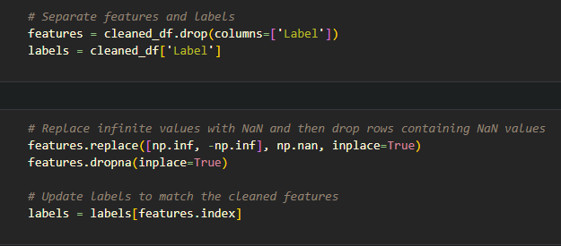
Data integration and cleaning
Feature and label separation
Dataset partitioning
Numerically encode label columns
Merge all CSV files to generate a unified dataset. Delete columns containing only missing values ​​and rows with any missing values ​​to ensure data integrity.
Separate feature columns and label columns to provide clear boundaries for the input and output of subsequent machine learning models.
encoding Benign as 0 and attack types as other integer values.
Standardization
Use the z-score standardization method to normalize all feature columns to a standard distribution with a mean of 0 and a standard deviation of 1 to avoid the scale differences between features affecting model training.
Use stratified sampling to divide the data into training set (60%), validation set (20%) and test set (20%) to ensure that each category is evenly distributed in each subset.
Data Processing Flow

Slide 6
Dataset features and advantages
The dataset covers a variety of network threats, which enhances the generalization ability of the model in different scenarios.
The ratio of attack to normal traffic is reasonably distributed, making the dataset representative when simulating real-world scenarios.
The structure of the dataset facilitates the integration of more traffic records and is suitable for incremental learning scenarios.
The 78 features provided cover all aspects of network traffic, providing sufficient information for feature engineering and pattern learning of the model.
The dataset has been widely used by the community and supports cross-study results comparison.

Slide 7
MODEL

Slide 8
The model design in this study is aimed at detecting distributed denial of service attacks (DDoS). It adopts an incremental learning framework based on a fully connected neural network, combined with adversarial attack mitigation and catastrophic forgetting solution mechanisms. The model architecture is simple and efficient, designed to handle high-dimensional features and cope with complex challenges in dynamic data streams.

Slide 9

Data poisoning strategy
Feature Perturbation: Introducing random noise or systematic perturbations at the feature level. The goal is to disrupt the normal feature distribution of the input data so that the model learns wrong or meaningless patterns.
Label Flip: Changing the true label of the sample, thereby confusing the model training. Usually labeling "positive" samples as "negative" or marking attack traffic as normal traffic.
Logic Disruption: Disrupt the logical relationship or dependency between features. Simulate malicious attackers to disrupt model learning by destroying normal feature correlations.
Malicious Pattern Injection: Inject artificially designed patterns into data to disguise as legitimate or malicious samples. Simulate complex network attack strategies and forge normal traffic to cover up attack behavior.
PGD Attack (Projected Gradient Descent): A classic adversarial attack method that generates adversarial samples through gradient calculation. The goal is to introduce minimal perturbations in the input features by maximizing the prediction loss of the model.
$$x^{′}={\text{clip}}_{x,ε}\left(x+α⋅\text{sign}\left(∇_{x}ℒ\right)\right)$$
Where
$x^{′}$:Perturbed input.
$ε$ : Maximum allowable perturbation. $α$ : Step size for each iteration.
$ℒ$ : Loss function.

Slide 10
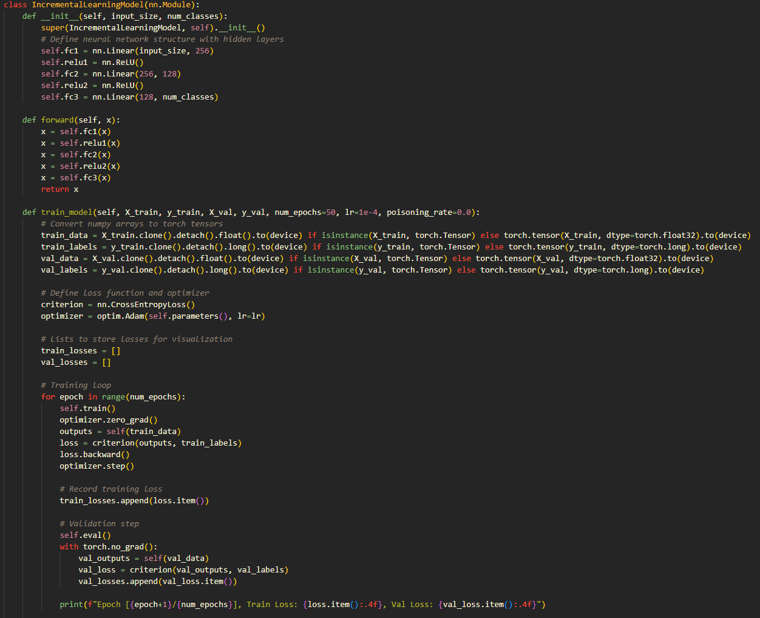
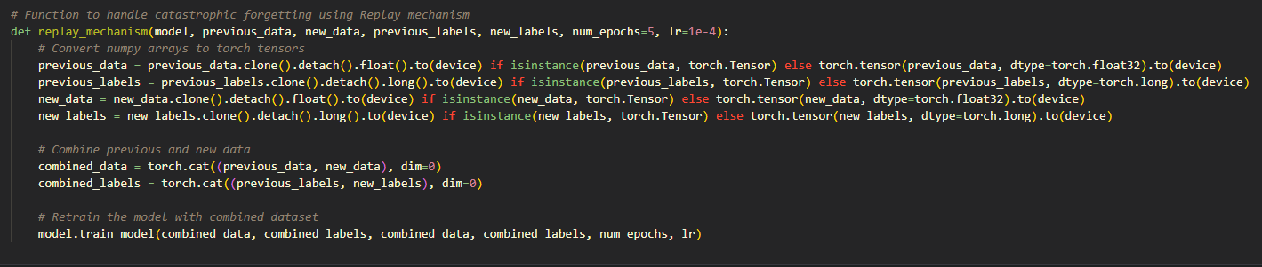
Model includes two parts:
Basic model
Adversarial Data Poisoning and Replay Mechanism

Slide 11
Adversarial Data Poisoning and Replay Mechanism
Input Data (78 Features)
Adversarial Poisoning(PGD, Label Flip, etc.)
Replay Buffer(Retained Data)
Merge Poisonedand Replayed Data

Slide 12
Basic Model (FC MEANS FULL CONNECTION)
Input Layer
78 features
Layer fc1
256 neurons, ReLU
Feature Extraction
Layer fc2
128 neurons, ReLU
Output Layer fc3
Logits for classification
Softmax Output
Class Probabilities by using Softmax
Evaluation
Accuracy, F1, etc.

Slide 13
Analysis Results
This study systematically evaluates the robustness of a class-incremental learning system under various adversarial data poisoning strategies. Through detailed experiments and metrics analysis, the following key insights were obtained.

Slide 14
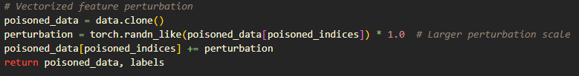
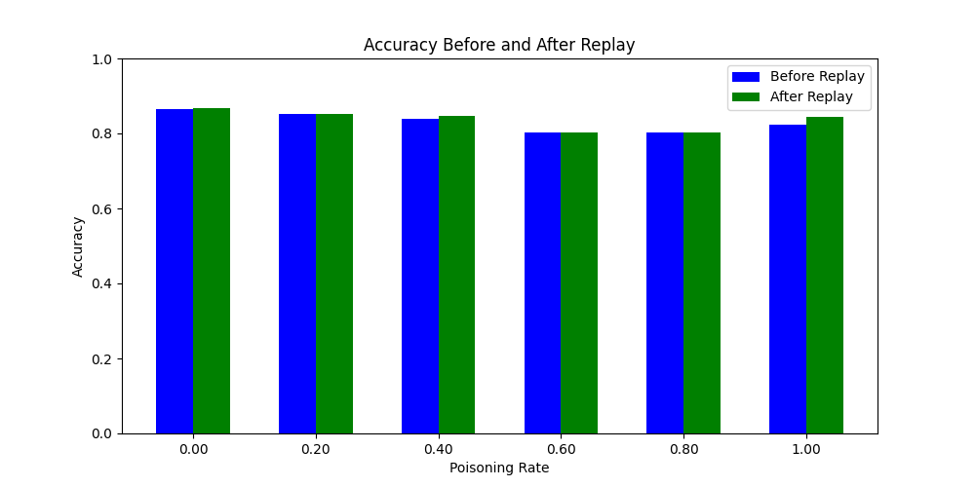
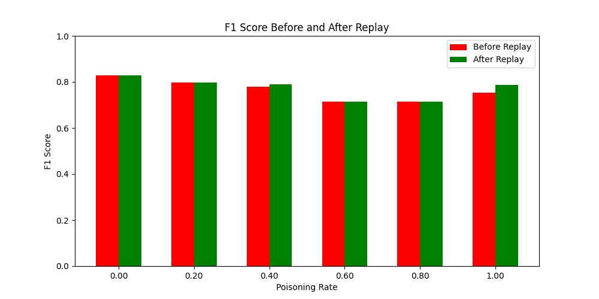
Feature Perturbation
Injecting random noise into feature data causes the model to learn erroneous or non-relevant patterns.
poisoning_rate | accuracy_before | precision_before | recall_before | f1_score_before | accuracy_after | precision_after | recall_after | f1_score_after
0 | 0.865686 | 0.8706 | 0.865686 | 0.828017 | 0.86744 | 0.871617 | 0.86744 | 0.828546
0.2 | 0.852068 | 0.871875 | 0.852068 | 0.796423 | 0.852107 | 0.871776 | 0.852107 | 0.796464
0.4 | 0.839141 | 0.86446 | 0.839141 | 0.779978 | 0.846779 | 0.870003 | 0.846779 | 0.790008
0.6 | 0.803011 | 0.841816 | 0.803011 | 0.715278 | 0.803011 | 0.841816 | 0.803011 | 0.715278
0.8 | 0.803011 | 0.841816 | 0.803011 | 0.715278 | 0.803011 | 0.841816 | 0.803011 | 0.715278
1 | 0.822415 | 0.854413 | 0.822415 | 0.754416 | 0.843738 | 0.868866 | 0.843738 | 0.786134
Low poisoning rate (Poisoning Rate≤0.4): It can be seen that with the increase of poisoning rate, the accuracy of the data has
decreased significantly, but the poisoning rate is low, so the decrease in the data is not too obvious from 0.87 to 0.84, but the F1
value has a more obvious decrease from 0.83 to 0.78. However, after using the reply mechanism, the data has improved to varying
degrees.
High poisoning rate (Poisoning Rate > 0.4): The accuracy dropped to around 0.80 and the F1 score dropped to 0.71. The recovery
effect of Replay is weakened, and the performance loss is still obvious under high poisoning rates.
So that, the impact of feature perturbations gradually emerges, but the overall destructiveness is limited. However, we still can
observe that replay has good recovery ability at low poisoning rates.

Slide 15

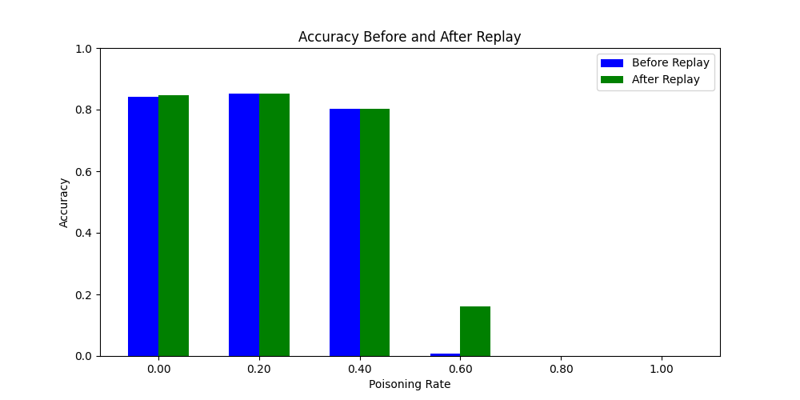
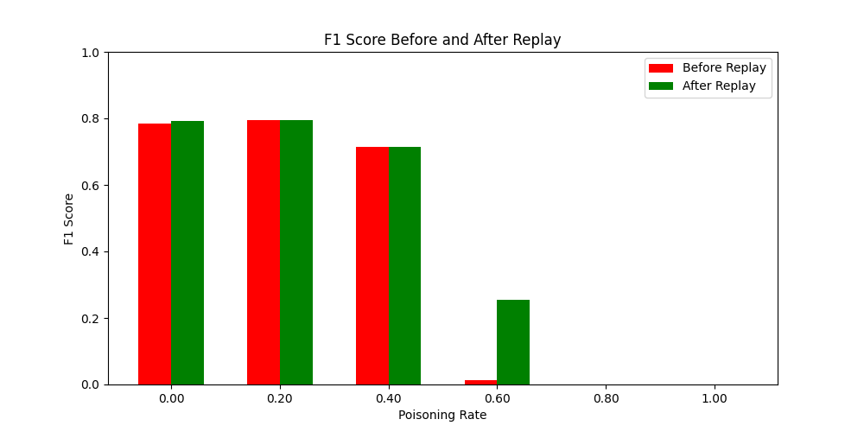
Label Flip
Randomly flip the labels to increase the confusion of the categories.
poisoning_rate | accuracy_before | precision_before | recall_before | f1_score_before | accuracy_after | precision_after | recall_after | f1_score_after
0 | 0.842051 | 0.866497 | 0.842051 | 0.783897 | 0.847566 | 0.87054 | 0.847566 | 0.790993
0.2 | 0.851504 | 0.870155 | 0.851504 | 0.795888 | 0.851511 | 0.870217 | 0.851511 | 0.795896
0.4 | 0.803011 | 0.841816 | 0.803011 | 0.715278 | 0.803011 | 0.841816 | 0.803011 | 0.715278
0.6 | 0.008163 | 0.918696 | 0.008163 | 0.013855 | 0.159986 | 0.860659 | 0.159986 | 0.255541
0.8 | 0.00069 | 0.997357 | 0.00069 | 1.01E-06 | 0.00069 | 0.997357 | 0.00069 | 1.02E-06
1 | 0.00069 | 0.997357 | 0.00069 | 9.50E-07 | 0.00069 | 0.997357 | 0.00069 | 9.55E-07
Low poisoning rate (Poisoning Rate≤0.2):Accuracy is between 0.84 - 0.85, and F1 score is close to 0.79.Replay can effectively
restore F1 score and accuracy.
High poisoning rate (Poisoning Rate>0.4Poisoning Rate>0.4): Accuracy drops below 0.01, and F1 score is close to 0. Replay has
limited recovery effect in extreme cases, and performance loss is difficult to make up.
Label Flip is one of the most destructive strategies, especially at high poison rates. Replay does not recover much in extreme
situations.

Slide 16
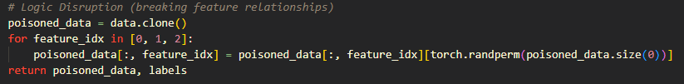
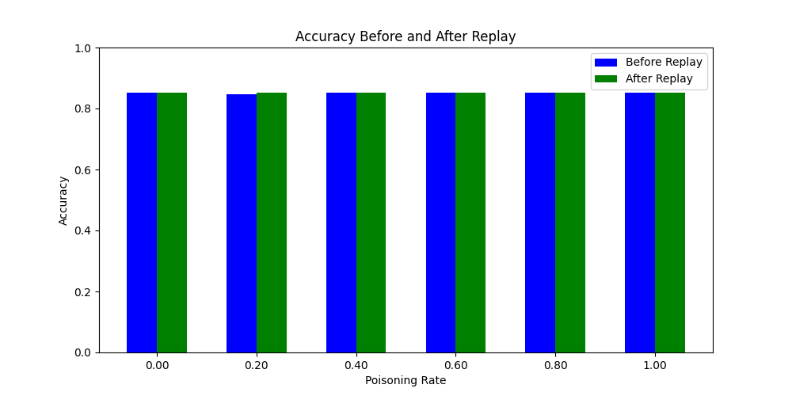
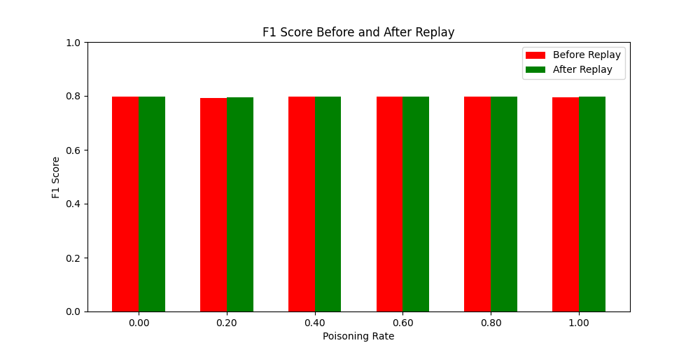
Logic Disruption
Destroy the logical relationship between features, such as disrupting the order.
poisoning_rate | accuracy_before | precision_before | recall_before | f1_score_before | accuracy_after | precision_after | recall_after | f1_score_after
0 | 0.851963 | 0.872902 | 0.851963 | 0.796367 | 0.851995 | 0.872915 | 0.851995 | 0.796402
0.2 | 0.8476 | 0.870686 | 0.8476 | 0.791039 | 0.851019 | 0.873017 | 0.851019 | 0.795234
0.4 | 0.851986 | 0.873008 | 0.851986 | 0.796369 | 0.85199 | 0.872957 | 0.85199 | 0.796371
0.6 | 0.852395 | 0.870023 | 0.852395 | 0.796907 | 0.852409 | 0.87003 | 0.852409 | 0.796922
0.8 | 0.851947 | 0.873388 | 0.851947 | 0.796336 | 0.852002 | 0.873398 | 0.852002 | 0.7964
1 | 0.851672 | 0.872696 | 0.851672 | 0.796089 | 0.851691 | 0.872685 | 0.851691 | 0.796106
There was little significant impact on model performance, with accuracy consistently maintained in the 0.85 - 0.87 range.
Replay's performance improvement is almost negligible.
The model has low reliance on feature logic and high robustness to Logic Disruption.
The Replay mechanism has limited effect under this strategy.

Slide 17
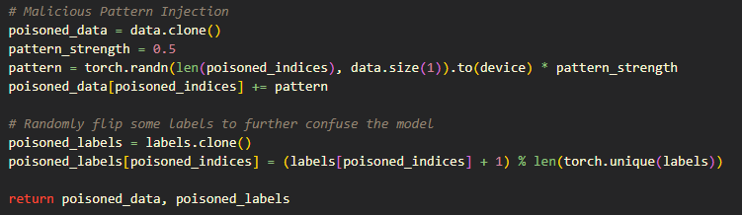
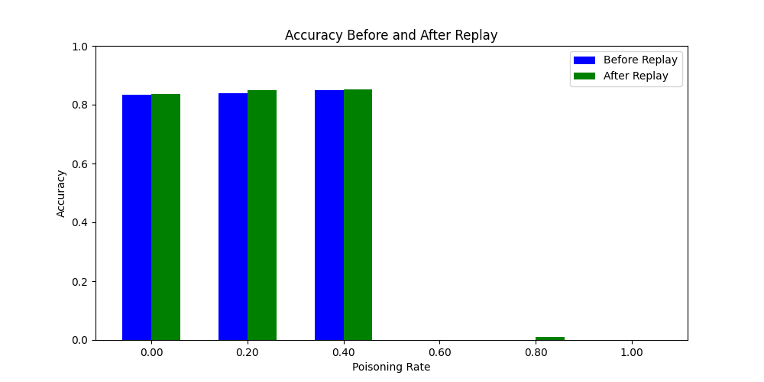
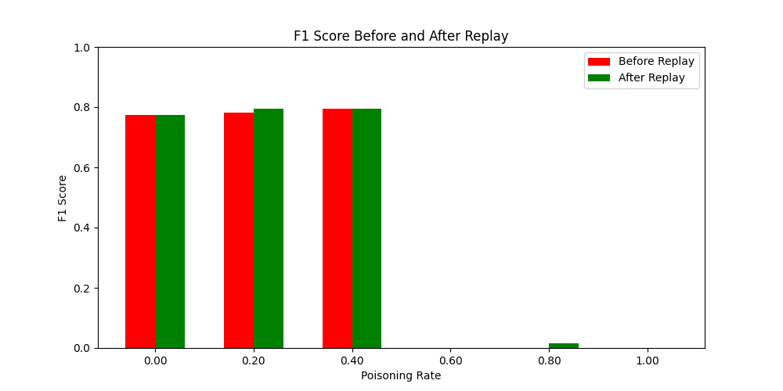
Malicious Pattern Injection
Inject artificially designed malicious patterns into the data to interfere with model classification.
poisoning_rate | accuracy_before | precision_before | recall_before | f1_score_before | accuracy_after | precision_after | recall_after | f1_score_after
0 | 0.834974 | 0.861955 | 0.834974 | 0.774123 | 0.835592 | 0.862208 | 0.835592 | 0.775012
0.2 | 0.840066 | 0.864875 | 0.840066 | 0.781241 | 0.849644 | 0.871934 | 0.849644 | 0.793561
0.4 | 0.84938 | 0.872461 | 0.84938 | 0.794111 | 0.851127 | 0.872931 | 0.851127 | 0.795393
0.6 | 0.00069 | 0.997357 | 0.00069 | 9.73E-07 | 0.00069 | 0.997357 | 0.00069 | 9.83E-07
0.8 | 0.00069 | 0.997357 | 0.00069 | 1.01E-06 | 0.009123 | 0.997357 | 0.009123 | 0.016693
1 | 0.00069 | 0.997357 | 0.00069 | 9.50E-07 | 0.00069 | 0.997357 | 0.00069 | 9.50E-07
Low poisoning rate (Poisoning Rate≤0.4): Accuracy is 0.83 - 0.85, F1 score is 0.77 - 0.79.Replay can effectively restore some
performance, especially when the poisoning rate is low.
High poisoning rate (Poisoning Rate>0.4): Accuracy and F1 scores both dropped significantly, and Replay was of limited use.
Injecting malicious patterns can significantly interfere with the model's classification capabilities. Replay is effective at low poison
rates, but has weak recovery at high poison rates.

Slide 18
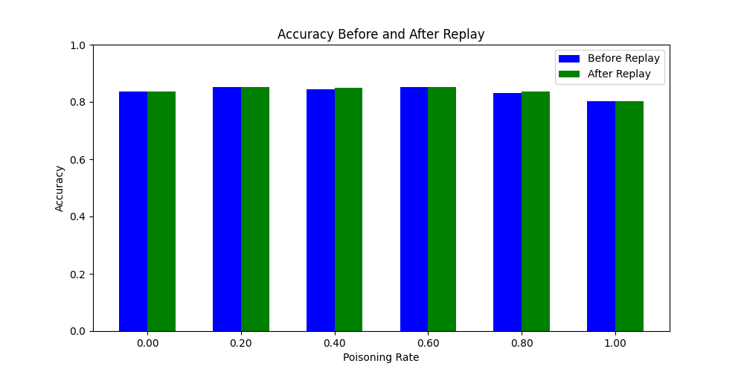
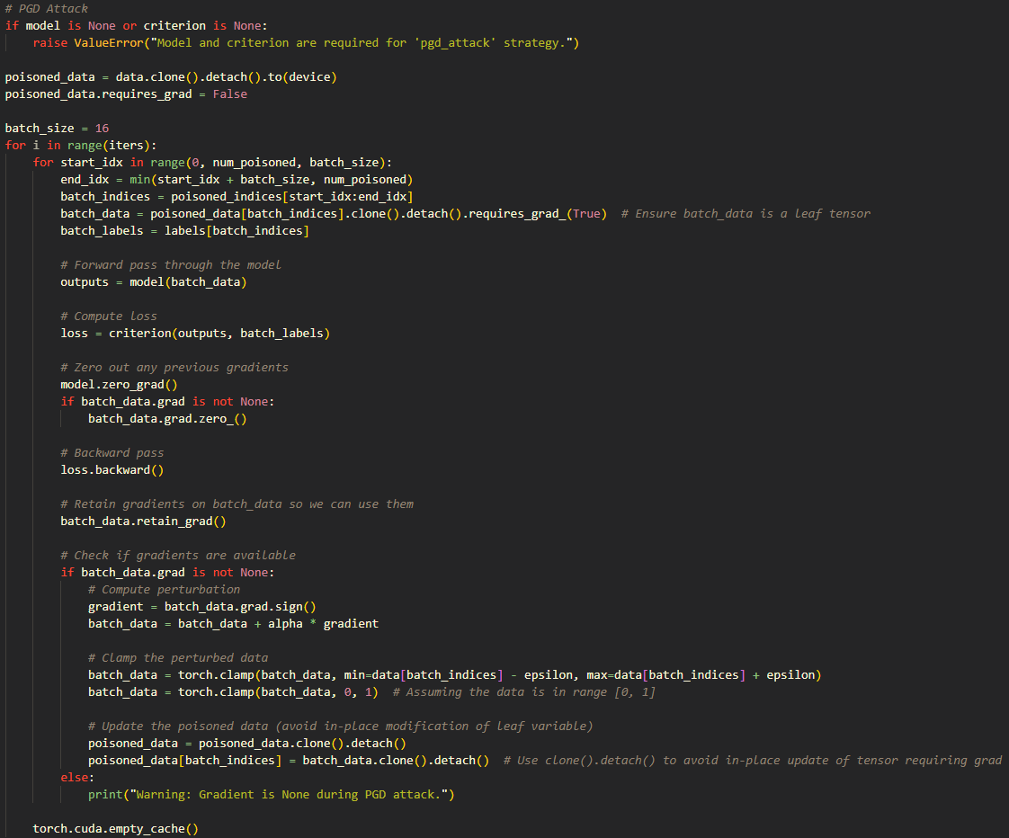
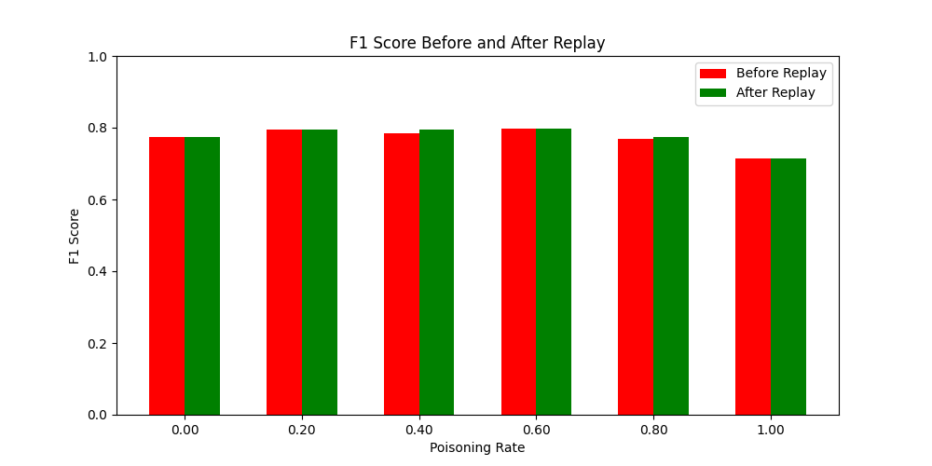
PGD Attack
Generate adversarial examples using gradient optimization to maximize the model’s classification error.
poisoning_rate | accuracy_before | precision_before | recall_before | f1_score_before | accuracy_after | precision_after | recall_after | f1_score_after
0 | 0.83529 | 0.861762 | 0.83529 | 0.774581 | 0.835557 | 0.861841 | 0.835557 | 0.774964
0.2 | 0.851505 | 0.873641 | 0.851505 | 0.795829 | 0.851695 | 0.873652 | 0.851695 | 0.796051
0.4 | 0.842886 | 0.867832 | 0.842886 | 0.785009 | 0.850323 | 0.872969 | 0.850323 | 0.794406
0.6 | 0.852084 | 0.872496 | 0.852084 | 0.796465 | 0.852103 | 0.872169 | 0.852103 | 0.796478
0.8 | 0.832097 | 0.853689 | 0.832097 | 0.770048 | 0.835242 | 0.856016 | 0.835242 | 0.774616
1 | 0.803011 | 0.841816 | 0.803011 | 0.715278 | 0.803011 | 0.841816 | 0.803011 | 0.715278
Low poisoning rate (Poisoning Rate≤0.2): Accuracy and F1 score are close to 0.85 - 0.86.Replay shows good recovery ability at low
poisoning rate.
High poisoning rate (Poisoning Rate>0.4): Accuracy drops below 0.80 and F1 score drops to 0.77.Replay has limited recovery ability
at high poisoning rate.
PGD attack has moderate impact on the model, and Replay can effectively mitigate performance loss at low poisoning rate.

Slide 19
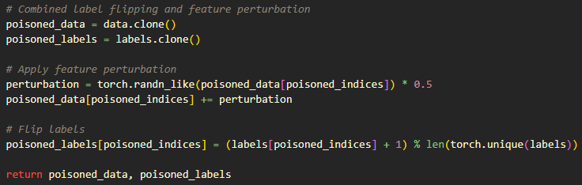
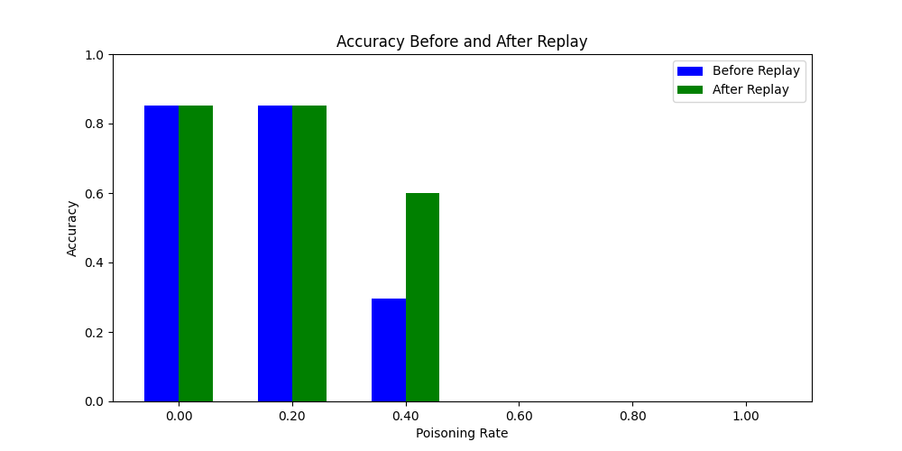
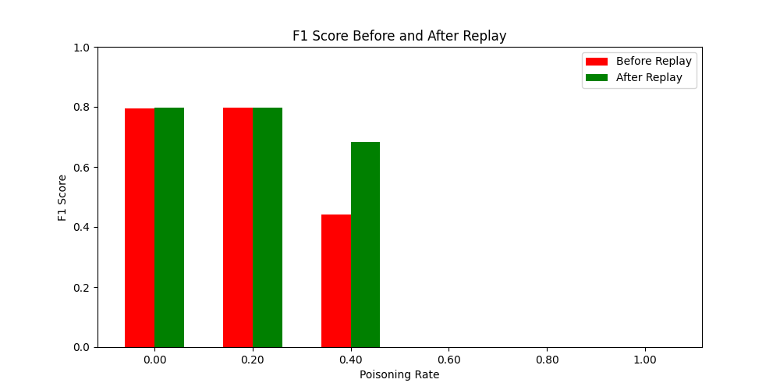
Combined Strategy
Combine multiple attack strategies (such as Label Flip and Feature Perturbation) to maximize the performance loss.
poisoning_rate | accuracy_before | precision_before | recall_before | f1_score_before | accuracy_after | precision_after | recall_after | f1_score_after
0 | 0.851585 | 0.874223 | 0.851585 | 0.795949 | 0.851825 | 0.874279 | 0.851825 | 0.796233
0.2 | 0.852085 | 0.872143 | 0.852085 | 0.79646 | 0.852103 | 0.872114 | 0.852103 | 0.796477
0.4 | 0.296821 | 0.991691 | 0.296821 | 0.44216 | 0.600043 | 0.911969 | 0.600043 | 0.683943
0.6 | 0.00069 | 0.999311 | 0.00069 | 9.50E-07 | 0.00069 | 0.999311 | 0.00069 | 9.50E-07
0.8 | 0.00069 | 0.999311 | 0.00069 | 9.50E-07 | 0.00069 | 0.997357 | 0.00069 | 9.50E-07
1 | 0.00069 | 0.999311 | 0.00069 | 9.50E-07 | 0.00069 | 0.999311 | 0.00069 | 9.50E-07
Low poisoning rate (Poisoning Rate≤0.4): Both accuracy and F1 score drop significantly, but Replay can partially recover the
performance.
High poisoning rate (Poisoning Rate>0.4): The accuracy is close to 0 and the F1 score is almost not restored.
Replay cannot effectively alleviate the performance loss in extreme cases.
Combined Strategy is a destructive strategy.
Replay mechanism is effective at low poisoning rate, but has no significant effect at high poisoning attack.

Slide 20
Thank you for watching my report

