Slide 1


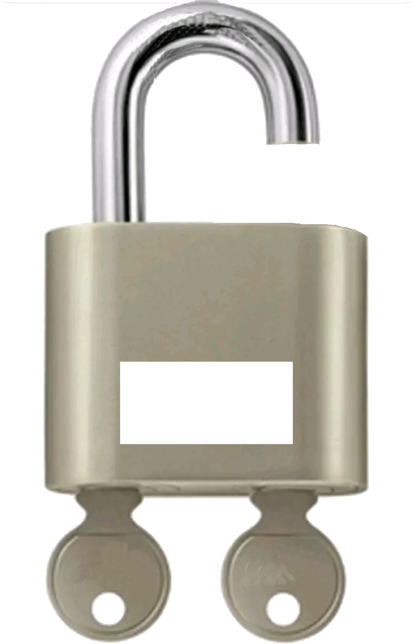
Boosting Documentation Efficiency
Documentation Workshop
19. Januar 2024
Sebastian Fernandez

Slide 2
Agenda
Introduction
What Data shall be made available
What is the data structuring
How are articles added/maintained
Hands-on Tutorial: Setting up Docusaurus and create first page
Best Practices for Documentation
Q&A Session

Slide 3
Problem
As-Is
Fast growing application landscape at Securosys
(HCVault, XKS, CSE, Docker Signing, Docker Encryption, DKE, TSB,….)
Hard to maintain documentation
OTRS (Word -> PDF -> Upload to Hostpoint -> Link in OTRS KBA, Notify customers)
Old PDF versions floating around at customer disks
Knowledgebase Article in OTRS
do not support syntax highlighting and are hard to structure
PDF are not suitable for CodeLines and technical documentation

Slide 4
Solution
To-Be
Central Webbased Documentation Platform
Docusaurus (Web-based Documentation developed and maintained by Facebook)
OpenSource
Capabillity of live updates of Userguides, KBA’s
Easy to use `markdown language`
Already 6 People knows how to use at Securosys
Peter, Mikolaj, Tomasz, Dimitrios, Florian, Sebastian
https://docs.securosys.ch/ (Internal)
versioning system, aligns with product version
npm run docusaurus docs:version 1.17.0

Slide 5
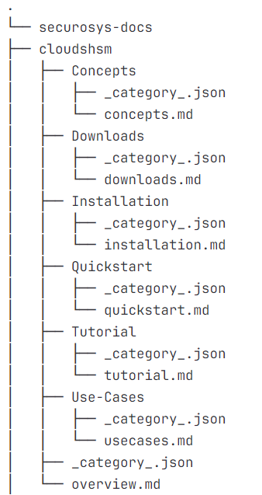
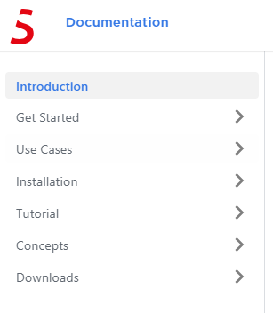
Data Structuring
Guidelines

Slide 6
Usage
How to Markdown
Add a new Page
(=) add new file
Markdown
https://www.markdownguide.org/cheat-sheet/
https://git.securosys.ch/application/securosys-docs
Contribution
Installing dependencies: npm install
Start server: npm run start

Slide 7
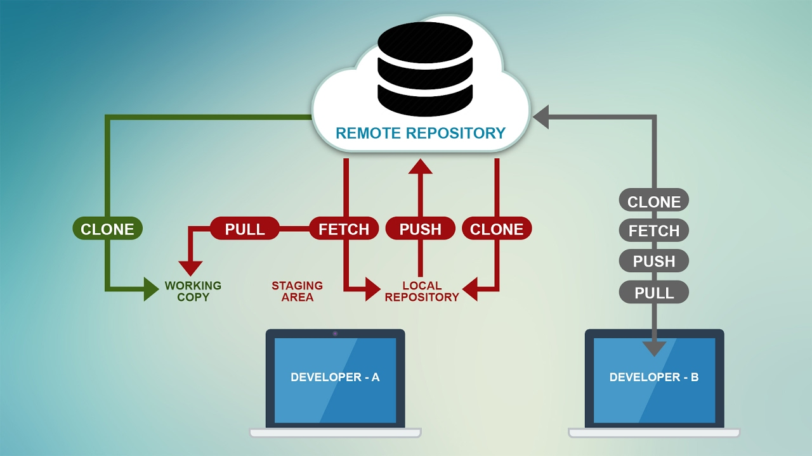
Git
How to Git
Git (Guideline)
Before Work: Pull
Work: Commit
After Work: Push
Git Workflow

Slide 8
Hands-On
Goal
General Topics (Application Notes): https://support.securosys.com/external/knowledge-base/article/64
Project | Maintainer
CloudsHSM | John Dingelstad
JCE | Sebastian Fernandez
PKCS#11 | Florian Wernli / Peter Fernandez
AWS-XKS | Miha Simonovic
OpenSSL | Florian Wernli
Hashicorp Vault (Rest-Integration) | Dimitrios Sakellaropoulos
Securosys Secrets Engine | Tomasz Madej
Docker-Signing | Mikolaj Szargut
Docker-Encryption | Reto Stäuble
TSB | Sebastian Fernandez

