Slide 1
AngularJS
Superheroic Javascript MVW Framework

Slide 2
Summary
What is AngularJS ?
Require.js vs AngularJS vs ExtJS
Module
Dependency injection - Services
Controller - $scope
View - Angular Templates
Promise objects
RESTful client $resource

Slide 3

What is AngularJS ?
jQuery
Modules
Data binding
Dependency injection
Routing / Multiple views
Angular Templates
Easy RESTful
Testing

Slide 4


Require.js vs AngularJS vs ExtJS
Require.js
AngularJS
ExtJS
Code isolation
Dynamic file loading
View management
Full stack framework
100% Javascript (no HTML, even for view)

Slide 5
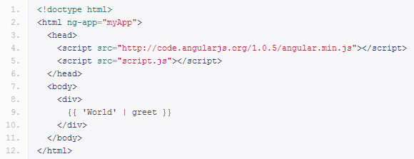
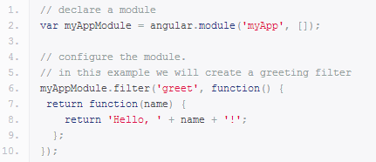
Module
An application is composed of modules
Modules contains
Filters
Directives
Services
script.js
index.html

Slide 6
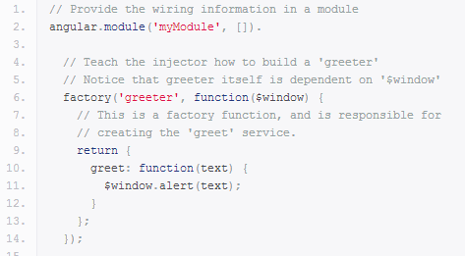
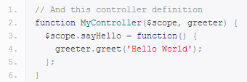
Dependency injection - Services
Directly instanciated or provided through factories
Injected through controller parameters
AngularJS services's name starts with $
controller.js
module.js

Slide 7
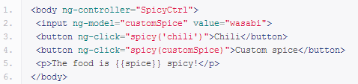
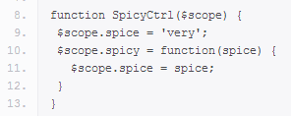
Controller - $scope
A controller is responsible of the view's behavior
It's a simple function accepting services as parameters
$scope represent the current scope accessible through the view
controller.js
index.html

Slide 8
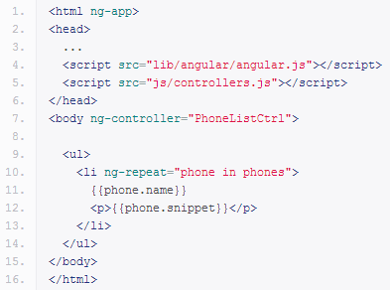
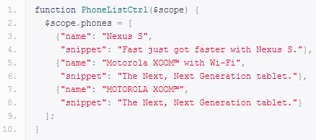
View - Angular Templates
Use HTML5's capabilities to create custom attributes and tags
Generate HTML dynamically with $scope data
controller.js
index.html

Slide 9

Promise objects
Represent result of asynchronous methods
Managed by the view like simple variables
Unfortunately, $http don't use promise API
But $resource do
Makes code more readable

Slide 10
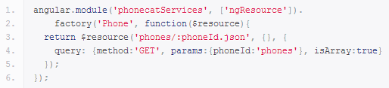

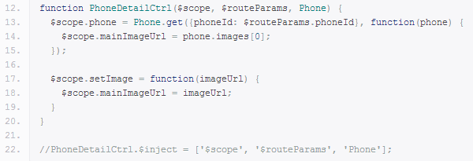
RESTful client $resource
Easy RESTful service request
Use as a service
controller.js
module.js

Slide 11

Questions ?
Let's play !

