Slide 1
The Password Rules
Horror Show
Joachim Strömbergson
Assured AB

Slide 2
We enforce password rules onto users
in order to improve the strength of the passwords.
Unfortunately, the research of what constitutes good password rules are severely lacking. Instead everyone and their cat invent their own rules for their service. Bad rules.
This of course makes the users not only confused but also reduces the trust in security mechanisms.
This presentation tries to collect confusing, illogical and bad password rules.

Slide 3


Slide 4
TRY TO USE THIS STRATEGY
ON A WEBSITE WITH
PASSWORD RULES

Slide 5
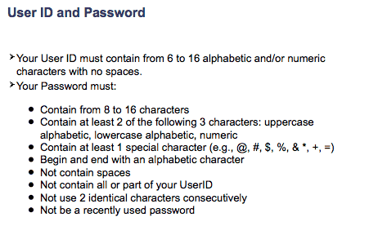

Slide 6
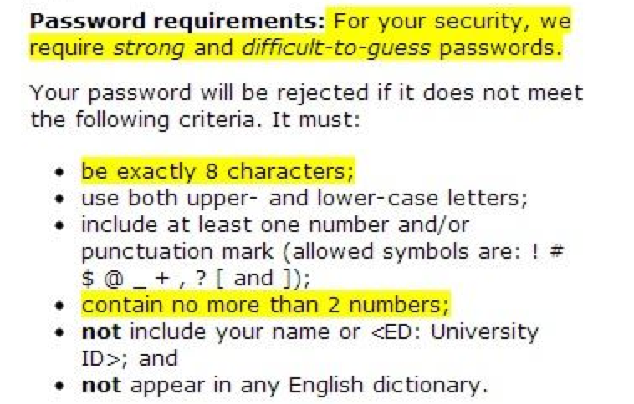

Slide 7
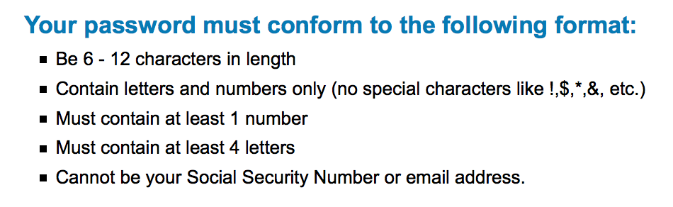

Slide 8
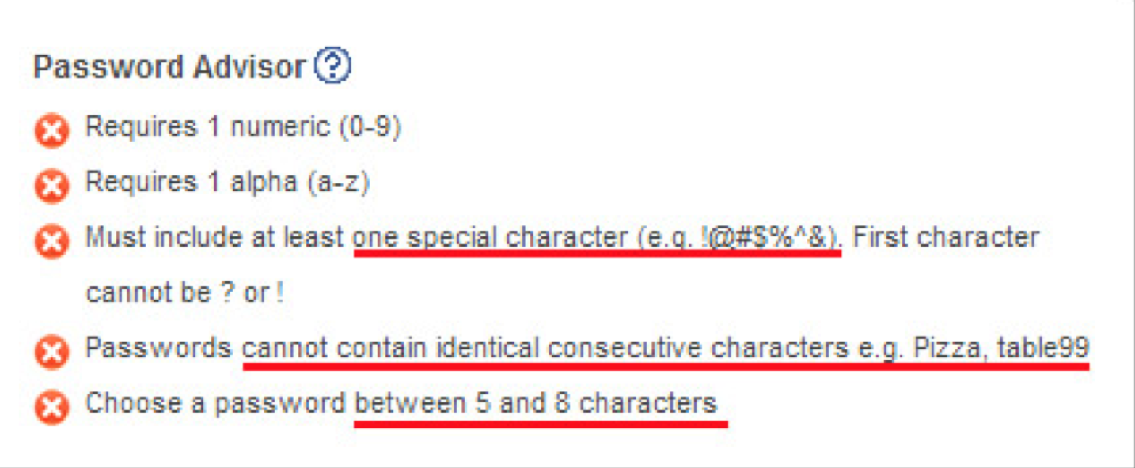

Slide 9
American Express (2010)
The length of the password is limited to 8 characters to reduce keyboard contact.
Some softwares can decipher a password based on the information
of "most common keys pressed".
Therefore, lesser keys punched in a given frame of time lessen
the possibility of the password being cracked.
http://www.troyhunt.com/2011/01/whos-who-of-bad-password-practices.html

Slide 10
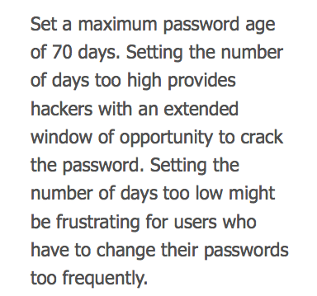
http://windows.microsoft.com/en-us/windows/change-password-policy-settings#1TC=windows-7
Bra forskning: https://www.cl.cam.ac.uk/~rja14/shb10/angela2.pdf

Slide 11
