Slide 1
Implemeting ResNet
Seda Manukyan

Slide 2
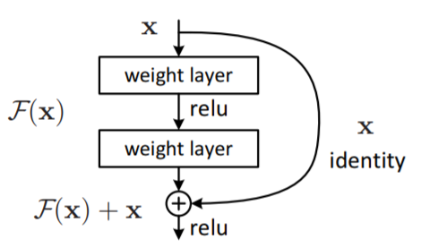
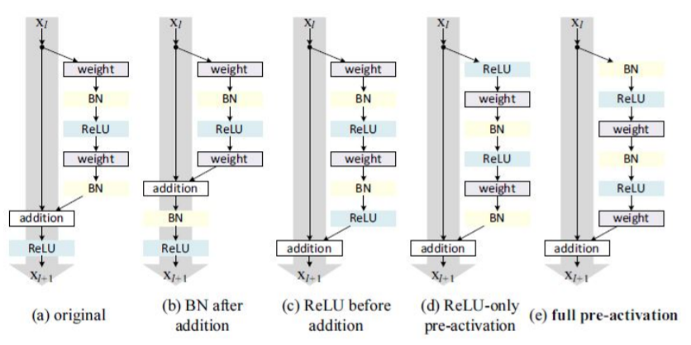
What is ResNet?
Plain deep convolutional network with
“shortcut” connections.
No vanishing gradient problem.
Easy way of adding new layers.
5 ways for residual
block configuration

Slide 3
Models proposed
ResNet20:
A mixture of blocks with configuration (c) Conv2D-BN-ReLU and configuration (e) BN-ReLU-Conv2D.
VGG16:
Simple implementation of VGG16 (several convolutions followed by MaxPooling layers.

Slide 4
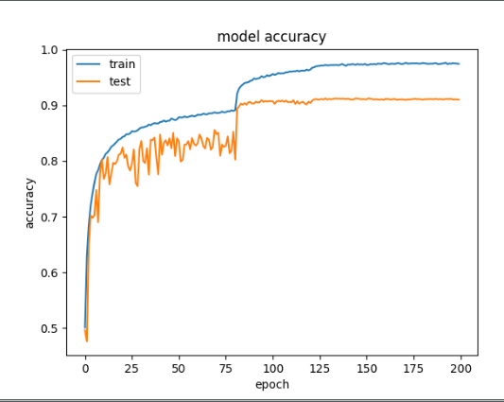
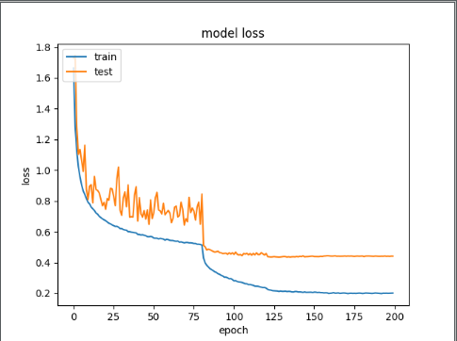
Results on ResNet20

Slide 5
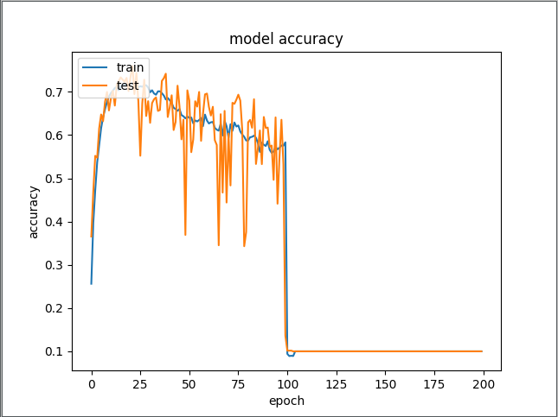
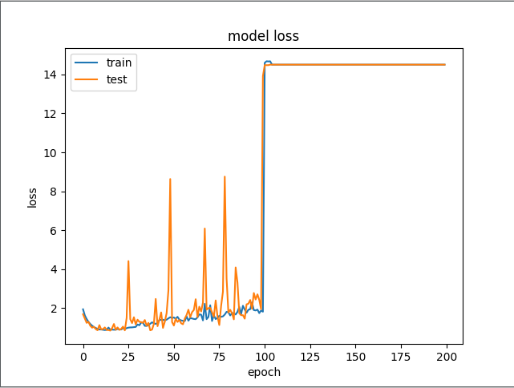
Results on VGG16

Slide 6
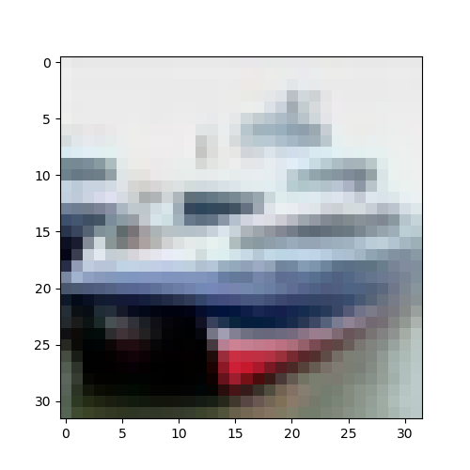
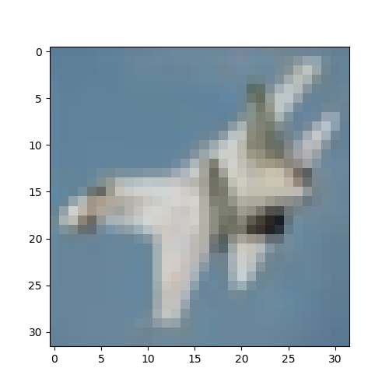
Testing ResNet20
Successfully classified as ship with 99.7% confidence
Unsuccessful result. It is a plane but our network predicted it as a truck with 99.9% confidence

