Slide 1



Histopathologic Cancer Detection
Capstone Project 2

Slide 2
Introduction
With the increases in cases of cancer, early detection and treatment is of vital importance as it relates to reduction in mortality rate among certain groups in the population. This project focuses on identifying metastatic tissue in histopathologic scans of lymph node sections.

Slide 3
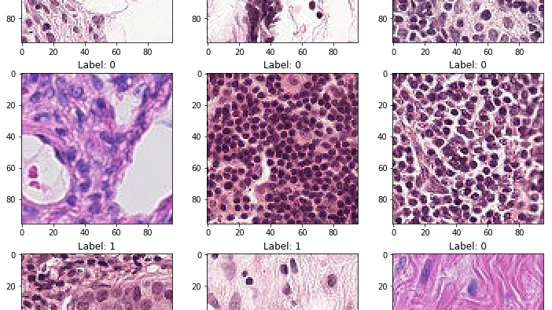
Data
Data was obtained from the Kaggle competition, Histopathologic Cancer Detection. www.kaggle.com/c/histopathologic-cancer-detection
The dataset consist of 277,483 (96 x 96 px) pathology images of which 220,025 are for training and 57,458 for testing.

Slide 4
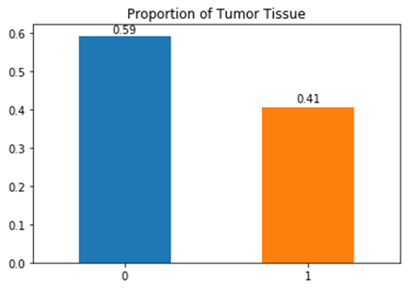
Exploratory Data Analysis
A positive image contains tumor cells in the center 32 x 32 px region, 90,210 (41%) of the train data.

Slide 5
Supervised learning
Model Architecture
Construction – neural network
Training – use a subset (75%) of the labelled images for deep learning
Testing – use an unseen subset (25%) of the train data for accuracy verification
Evaluation – use the best model to classify test set images

Slide 6
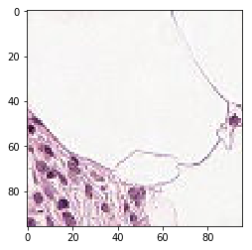
Image processing
Image augmentation was applied to increase the number of images by apply random transformations; rotations, flips (horizontal and vertical), shear, zoom, shifts (channel, width and height).
Learning is enhanced using these transformation by multiplying the possible orientation of the tumor pixels.

Slide 7
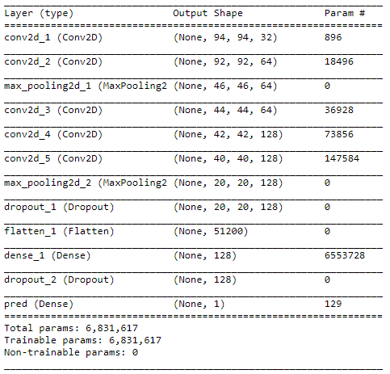
model

Slide 8
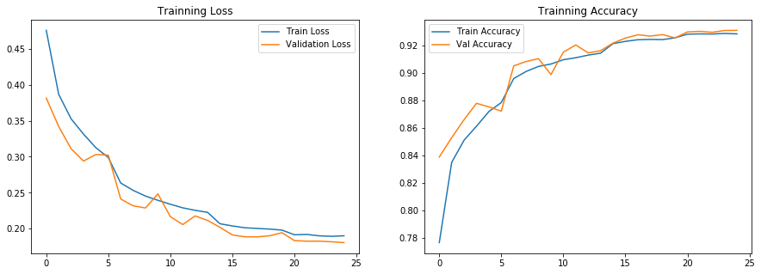
Results

Slide 9
Conclusion
This model generalizes well with a validation score of 93% using 25 epochs.
Using additional image augmentation and epochs may improve the model learning process.
It would be interesting to evaluate model performance with more images

