Slide 1



Home Loan Prediction
Sean R Grant

Slide 2

Dream Housing Finance
Dream Home Financing is a company that is dedicated to helping consumers to find the right loan program and lender to suit their needs. They have presence across all urban, semi urban and rural areas. The application process requires that the customer’s eligibility for the loan is validated first. Dream Home Financing wants to automate the loan eligibility process (real time) based on customer details provided while in an online application form.

Slide 3
Problem Statement
How can automating the loan eligibility process identify highly qualified customers?
How can automation help with marketing by targeting potential customers?
How can eligibility automation reduce risk and increase profitability?

Slide 4

Data Source and Description
The data for this project was acquired from,
https://datahack.analyticsvidhya.com/contest/practice-problem-loan-prediction-iii/
The original data contains 614 applications and 13 features (LoanID, Gender, Married, Self Employed, Education, Dependents, Applicant Income, Coapplicant Income, Loan Amount, Loan Amount Term, Property Area, Credit History, and Loan Status)

Slide 5
Feature Descriptions
LoanID – Unique code that identifies the loan application
Gender – Male/Female
Marital Status – Married (Yes/No)
Self Employed – Self Employed (Yes/No)
Education – Graduate/Undergraduate
Dependents - Number of Dependents
Applicant Income – Main Applicant Income
Coapplicant Income – Co-applicant Income
Loan Amount – Borrowing amount in thousands
Loan Amount Term – Length of loan in months
Property Area – Location of property under consideration
Credit History – Having good credit history
Loan Status – Status of the application (Y/N)

Slide 6
Challenge: Treating Missing Data
Feature | Number of Missing Data | Handling | Reason
Gender | 13 | Male | 81% of applicants are males
Married | 3 | Yes | 65% of applicants are married
Dependents | 15 | 0 | 53%, 0; 17%, 1; 17%, 2; 9%, 3+
Self Employed | 32 | Not Self Employed | 86% Not Self Employed
Loan Amount | 22 | Median | Avoid the effects outliers
Loan Amount Term | 14 | 360 months | 83% borrowed under a 360 month term and loan amounts were $77k+
Credit History | 50 | Approved loans were filled as 1.0 Denied loans were filled as 0.0 | 81% of approved loans had credit history

Slide 7
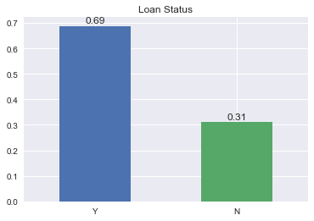
Loan Approval Rate

Slide 8
Hypothesis
Factors that may affect the approval of a loan are the factors worth considering when determining the hypothesis. Here are a few,
Income: The total income (combined applicant and coapplicant) is a determining factor. The higher the total income the higher the chances of being approved.
Credit History: Having a history of previous loans help to improve approval possibility because it indicates loan worthiness.
Monthly payments: The lower to monthly payment to income the greater the chances of approval.
Term: The shorter the term, the chances of approval increases however this is also dependent previously mentioned factors.
Loan amount: The lower the loan amount the greater the chance of approval.

Slide 9
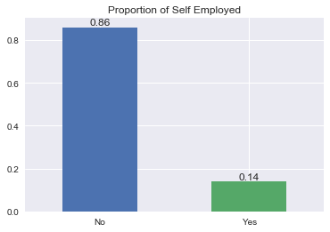
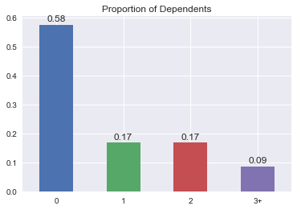
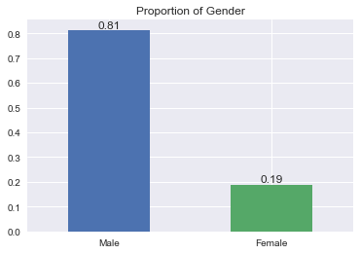
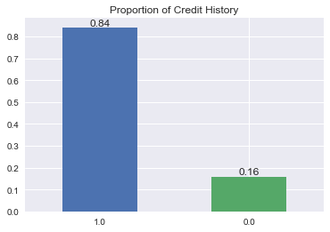
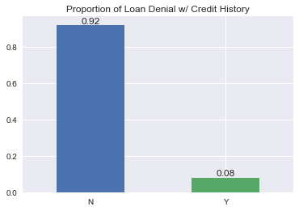
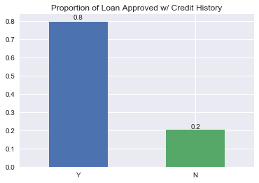
Feature Proportions

Slide 10
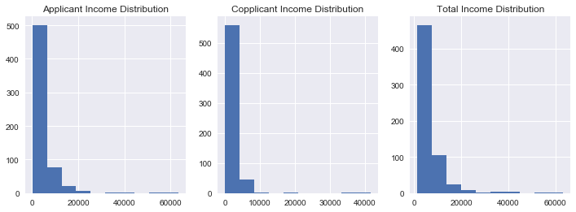
Income Distribution

Slide 11
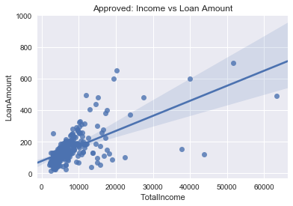
Loan Amount and Total Income Correlation

Slide 12
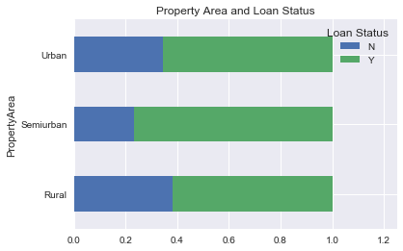
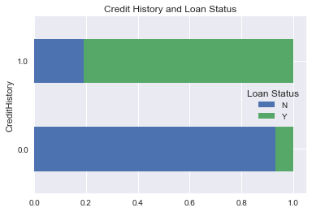
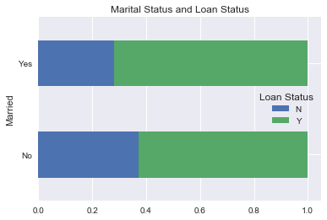
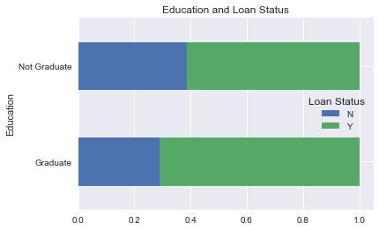
Statistically and Practically Significant
P-value = 0.0025
P-value = 4.61e-48
P-value = 0.04
P-value = 0.026

Slide 13

Model Selection

Slide 14
The Approach
Test key features using supervised learning algorithm; Linear Regression, SVM, Random Forest, Naïve Bayes.
Using the Linear model to evaluate the effects of each key feature using coefficient values.
Identify the best model after understanding the model results.

Slide 15
ML Model Results
Data Cleaning Done:
Removing rows with missing data for Loan Amount, Dependents, and Credit History.
Self-Employed if income is above $7,000 monthly.
Loan term 360.
Challenges:
This may not result in a generalize model.
 | Precision | Recall | Accuracy
Logistic Regression | 0.791 | 1.0 | 0.834
Random Forest | 0.833 | 0.979 | 0.855
Naives Bayes | 0.784 | 1.0 | 0.828
SVM | 0.784 | 1.0 | 0.828

Slide 16
Missing Data Handling
Feature | Number of Missing Data | Handling | Reason
Gender | 13 | Male | 81% of applicants are males
Married | 3 | Yes | 65% of applicants are married
Dependents | 15 | 0 | 53%, 0; 17%, 1; 17%, 2; 9%, 3+
Self Employed | 32 | Not Self Employed Self Employed for incomes over $7k | 86% Not Self Employed Higher salaries for Self-Employed
Loan Amount | 22 | Median | Avoid the effects outliers
Loan Amount Term | 14 | 360 months | 83% borrowed under a 360 month term
Credit History | 50 | Approved loans were filled as 1.0 Denied loans were filled as 0.0 | 81% of approved loans had credit history

Slide 17
ML Model Results
Advantage: A model that is more generalize and therefore can handle new data well.
 | Precision | Recall | Accuracy
Logistic Regression | 0.845 | 0.973 | 0.851
Random Forest | 0.862 | 0.946 | 0.851
Naives Bayes | 0.852 | 0.973 | 0.857
SVM | 0.84 | 0.982 | 0.851

Slide 18
ML Model Results
Feature engineering: Created logs for TotalIncome and MonthPaymentNoInterest
 | Precision | Recall | Accuracy
Logistic Regression | 0.845 | 0.973 | 0.851
Random Forest | 0.862 | 0.946 | 0.851
Naives Bayes | 0.852 | 0.973 | 0.857
SVM | 0.846 | 0.982 | 0.857

Slide 19
ML Model Results
C optimization and Feature selection based on coef of Linear model
GridSearchCV for RandomForest model
 | Precision | Recall | Accuracy
Logistic Regression | 0.846 | 0.982 | 0.857
Random Forest | 0.846 | 0.982 | 0.857
Naives Bayes | 0.846 | 0.982 | 0.857
SVM | 0.846 | 0.982 | 0.857

Slide 20

Conclusion
Naïve Bayes seem to the model that is best fitted for generalization. Therefore it is the model I would choose for application to the problem.

Slide 21
Recommendations
Gather additional data based on current debt and savings.
Helps with identifying highly qualified customers.
This will better estimate the likelihood of repayment, preventing defaults.

