Slide 1
acetic acid
CO
methanol
CO₂
H₂
H₂O
formaldehyde
formic acid
CO₂ + H₂ → formic acid
formic acid + H₂ → formaldehyde + H₂O
formaldehyde + H₂ → methanol
CO₂ + H₂ → CO + H₂O
methanol + CO → acetic acid

Slide 2
acetic acid
CO
methanol
H₂O
CO₂
formic acid
formaldehyde
H₂
CO₂ + H₂ → formic acid
formic acid + H₂ → formaldehyde + H₂O
formaldehyde + H₂ → methanol
CO₂ + H₂ → CO + H₂O
methanol + CO → acetic acid

Slide 3
acetic acid
CO
methanol
H₂O
CO₂
formic acid
formaldehyde
H₂

Slide 4
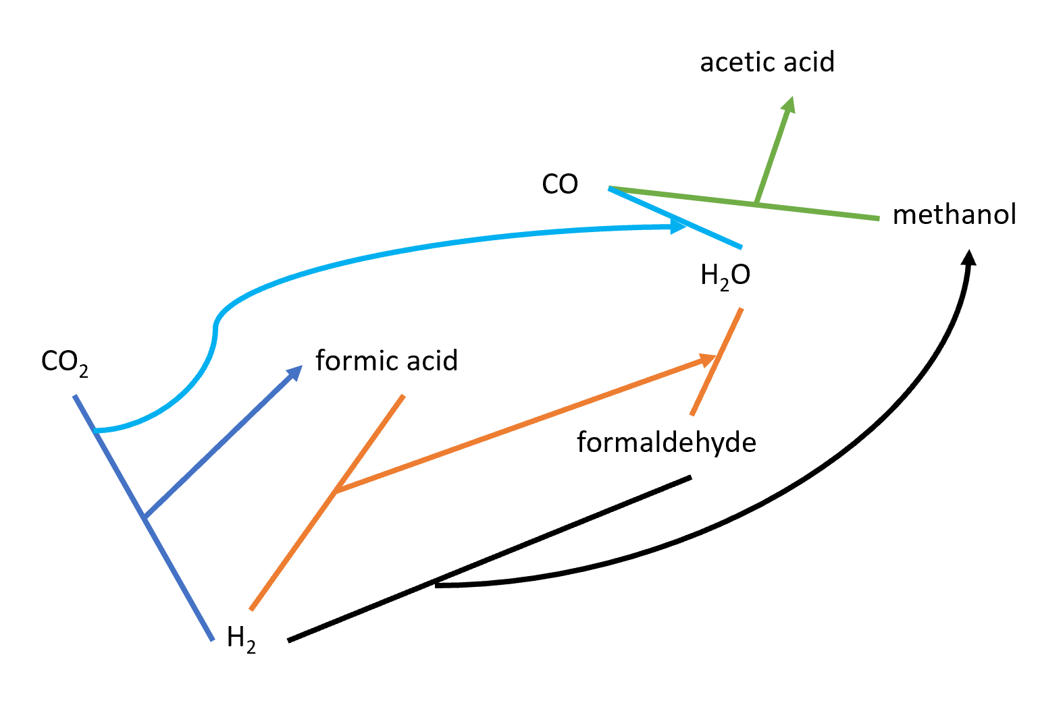

Slide 5
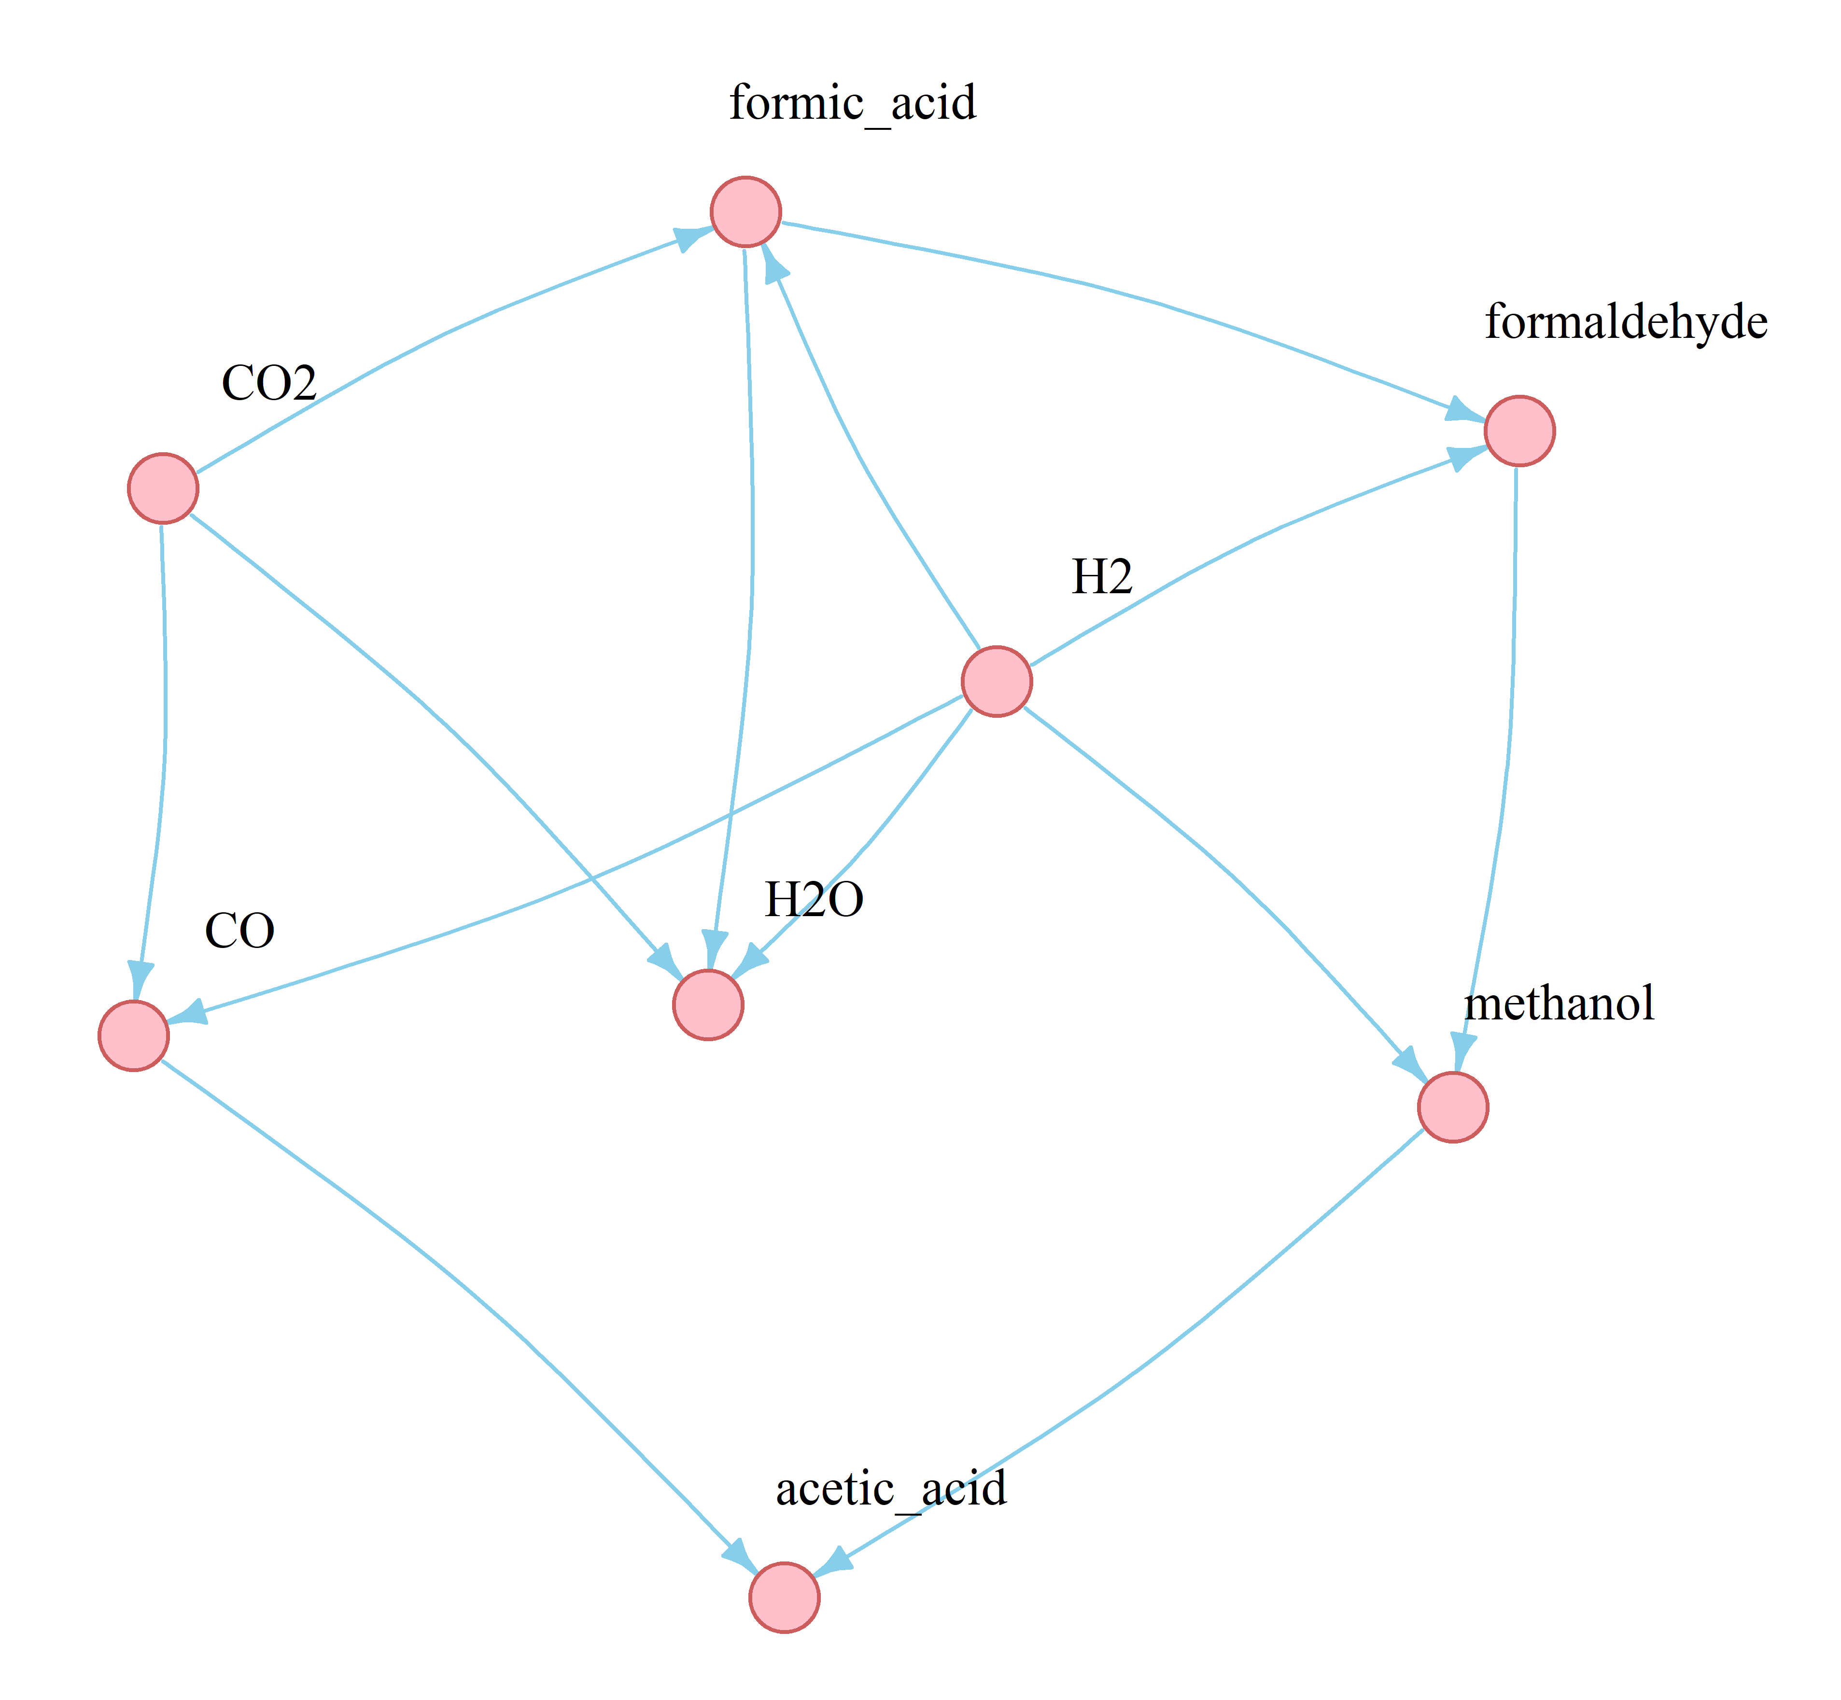

Slide 6
