Slide 1
Understanding the restrictions at the time of data collection

Slide 2
Dataset notes - variables
pair_id
For both infectors and infectees
id, age, gender,
reported_city, infected_city
infector_onset_date
infector_relation_to_infectee and vice versa
is_household
data_source data_URL

Slide 3
Dataset
TIMELINE
Covers almost 2 months at the beginning of 2020
start of the pandemic
from 2020-01-07 to 2020-02-28
(infector and infectee onset)
SOURCES OF DATA
lots of municipalities, health commissions, etc – 158 distinct sources
CITIES covered – at least 200 different cities/places

Slide 4
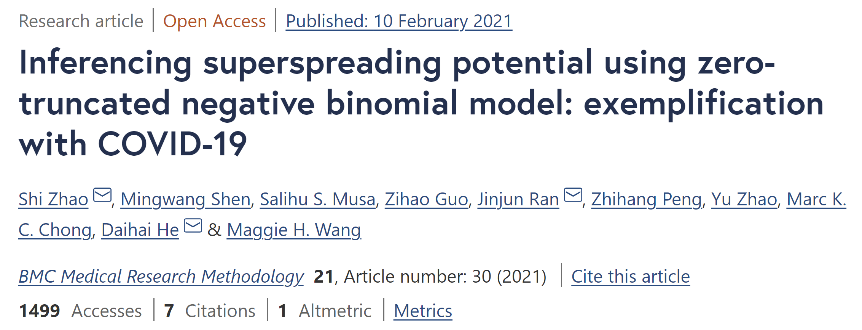
Data source (secondary)
Dataset #1: COVID-19 contact tracing data in mainland China
https://bmcmedresmethodol.biomedcentral.com/articles/10.1186/s12874-021-01225-w
https://github.com/linwangidd/covid19_transmissionPairs_China/blob/master/transmission_pairs_covid_v2.csv

Slide 5
Zhao et al., 2021
The dataset contains 1407 transmission pairs that are identified and reconstructed according to the previous studies, governmental news release, and official situation reports in mainland China.
We identified 807 infectors, and we extract the information about the number of offspring infectees generated by each infector. There are 1241 terminal cases identified from the transmission pairs.
This dataset was originally collected for characterizing the epidemiological features in transmission pairs, e.g., serial interval, and thus no sporadic case is involved in this dataset.

Slide 6
He et al., 2020
Low dispersion in the infectiousness of COVID-19 cases implies difficulty in control
Based on patient data of 9120 confirmed cases in China, we calculated the variation of the individual infectiousness, i.e., the dispersion parameter k of the NB distribution, at 0.70 (95% confidence interval: 0.59, 0.98).
Our data are from mainland China where strict surveillance guaranteed the quality of the data.

Slide 7
Original paper: Xu et al., 2020
Reconstruction of Transmission Pairs for Novel Coronavirus Disease 2019 (COVID-19) in Mainland China: Estimation of Superspreading Events, Serial Interval, and Hazard of Infection
https://academic.oup.com/cid/article/71/12/3163/5859582?login=false
A unique database with detailed demographic characteristics, travel history, social relationships, and epidemiological timelines for 1407 transmission pairs that formed 643 transmission clusters in mainland China was reconstructed from 9120 COVID-19 confirmed cases reported during 15 January–29 February 2020.
Statistical model fittings were used to identify the superspreading events and estimate serial interval distributions. Age- and sex-stratified hazards of infection were estimated for household vs nonhousehold transmissions.

Slide 8
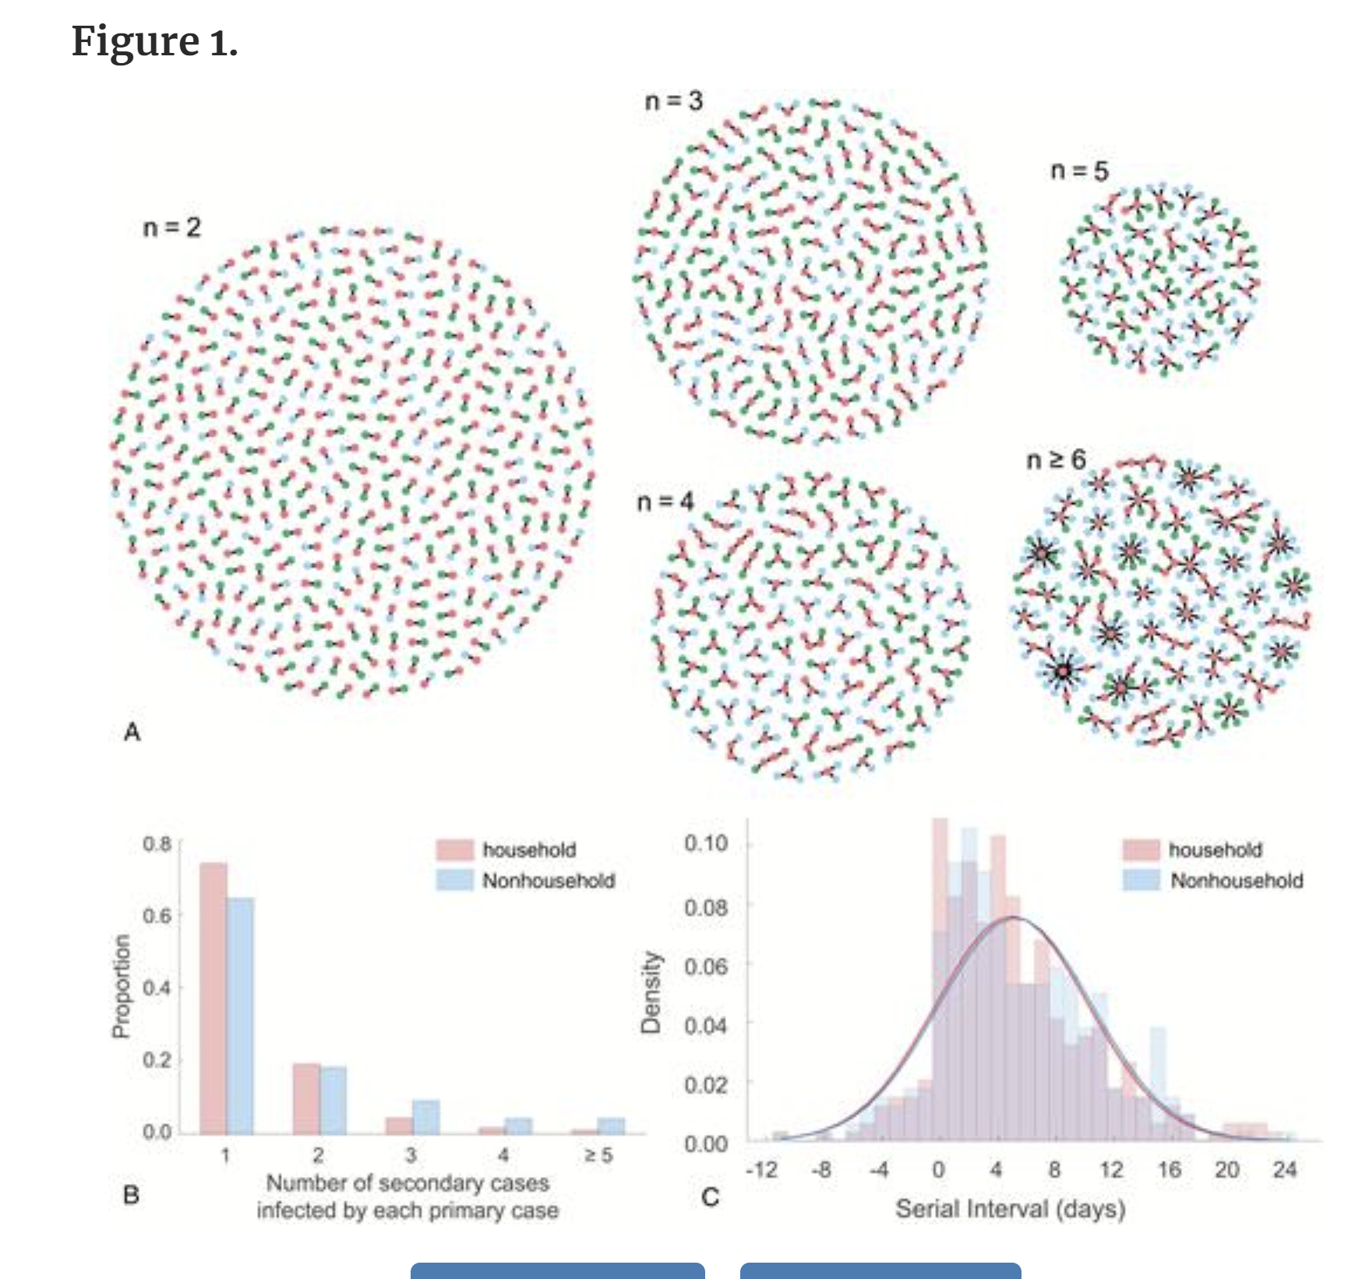
The hazard of being infected outside of households is higher for people aged 18–64 years, whereas hazard of being infected within households is higher for young and old people.

Slide 9
Household vs non-household (def.)
We categorized each transmission pair by the social relationship between primary and secondary cases (eg, familial members of the same household, nonhousehold relatives, colleagues, classmates, friends, and other face-to-face contacts).
Considering that during the Spring Festival travel season (10 January–18 February 2020), several billion human movements can occur because of the tradition of Chinese New Year (to visit and live with their original families), we considered any transmission pair with immediate familial relationships (eg, a person’s spouse, parents, and children) as a household transmission pair, and with other familial relationships (eg, a person’s siblings with age >17 years) or close contacts with no familial information (eg, classmates, colleagues) as a nonhousehold transmission pair.
The numbers of household (662) and nonhousehold (745) transmission pairs are almost even.

Slide 10
Lockdown
On 23 January 2020, China raised the national emergency response to the highest level, which triggered an unprecedented travel ban starting from the lockdown of Wuhan on 23 January, 14 cities in Hubei province on 24 January, and >30 provinces thereafter. Despite this unprecedented intervention, we estimated that COVID-19 cases had been introduced into 130 (95% credible interval [CrI], 190–369) cities in mainland China prior to the lockdown of Wuhan on 23 January 2020 [4].
Starting from the last week of January 2020, >260 Chinese cities have implemented intensive social distancing and confinement policies, which brought the epidemic under control [7–10]. However, the epidemic has still caused >10 000 confirmed cases in China outside Hubei Province within a month.

Slide 11
Data sources
To enhance public health preparedness and awareness, Chinese health authorities have publicly reported detailed records of confirmed COVID-19 cases since mid-January. This provides a unique resource for studying the transmission patterns, routes, and risk factors of COVID-19.
In mainland China, 27 provincial and 264 urban health commissions have publicly posted 9120 confirmed case reports online during 15 January–29 February 2020, which accounts for 72% of all cases confirmed in mainland China outside Hubei province.

Slide 12
Why are children missing?
https://www.who.int/docs/default-source/coronaviruse/who-china-joint-mission-on-covid-19-final-report.pdf
Children Data on individuals aged 18 years old and under suggest that there is a relatively low attack rate in this age group (2.4% of all reported cases). Within Wuhan, among testing of ILI samples, no children were positive in November and December of 2019 and in the first two weeks of January 2020. From available data, and in the absence of results from serologic studies, it is not possible to determine the extent of infection among children, what role children play in transmission, whether children are less susceptible or if they present differently clinically (i.e. generally milder presentations). The Joint Mission learned that infected children have largely been identified through contact tracing in households of adults. Of note, people interviewed by the Joint Mission Team could not recall episodes in which transmission occurred from a child to an adult.
OPEN STAGES FROM LINK

Slide 13
Covid in children, China
Epidemiology of COVID-19 Among Children in China
(Dong et al., 2020)
Nationwide case series of 2135 pediatric patients with COVID-19 reported to the Chinese Center for Disease Control and Prevention from January 16, 2020, to February 8, 2020, were included.
There were 728 (34.1%) laboratory-confirmed cases and 1407 (65.9%) suspected cases. The median age of all patients was 7 years (interquartile range: 2-13 years), and 1208 case patients (56.6%) were boys. More than 90% of all patients had asymptomatic, mild, or moderate cases. The median time from illness onset to diagnoses was 2 days (range: 0-42 days).

Slide 14
Covid in children, China (Dong et al., 2020)
Children of all ages appeared susceptible to COVID-19, and there was no significant sex difference. Although clinical manifestations of children's COVID-19 cases were generally less severe than those of adult patients, young children, particularly infants, were vulnerable to infection.
The distribution of children's COVID-19 cases varied with time and space, and most of the cases were concentrated in Hubei province and surrounding areas. Furthermore, this study provides strong evidence of human-to-human transmission.

