Slide 1
Heterogeneity in Covid-19 transmission

Slide 2
China dataset
Infector and infectee age distributions

Slide 3
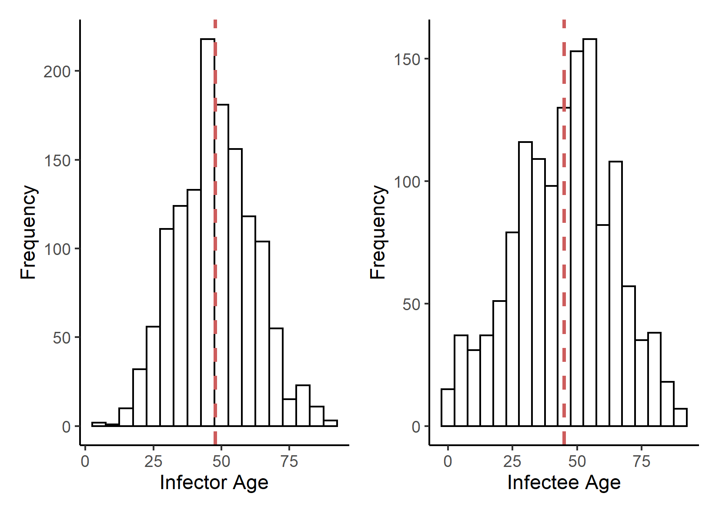

Slide 4
Infector and infectee age distribution by household

Slide 5
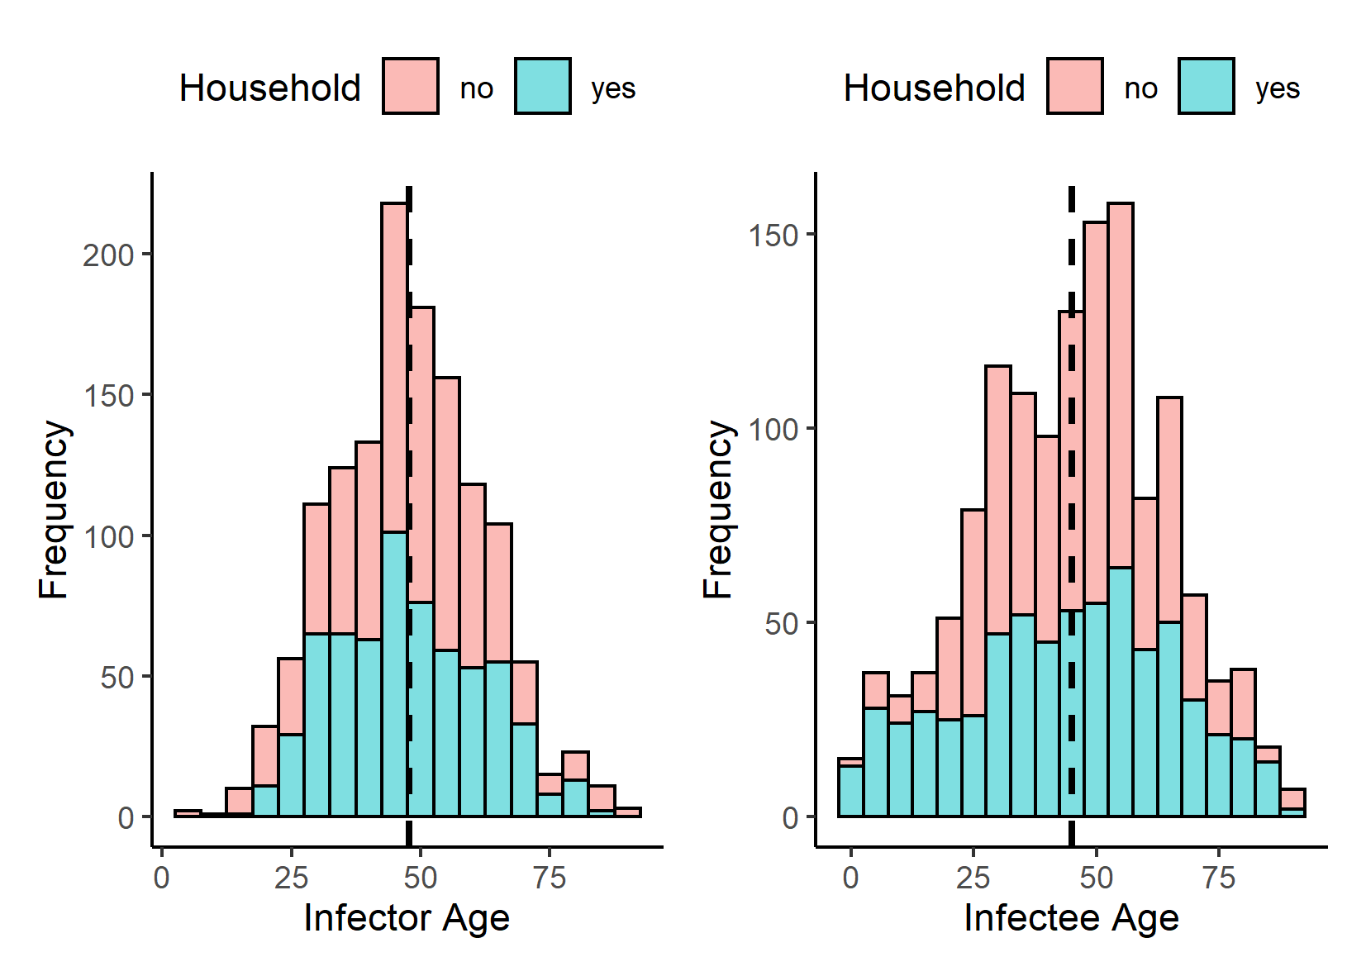

Slide 6
Infector age distribution stratified by infectee age

Slide 7
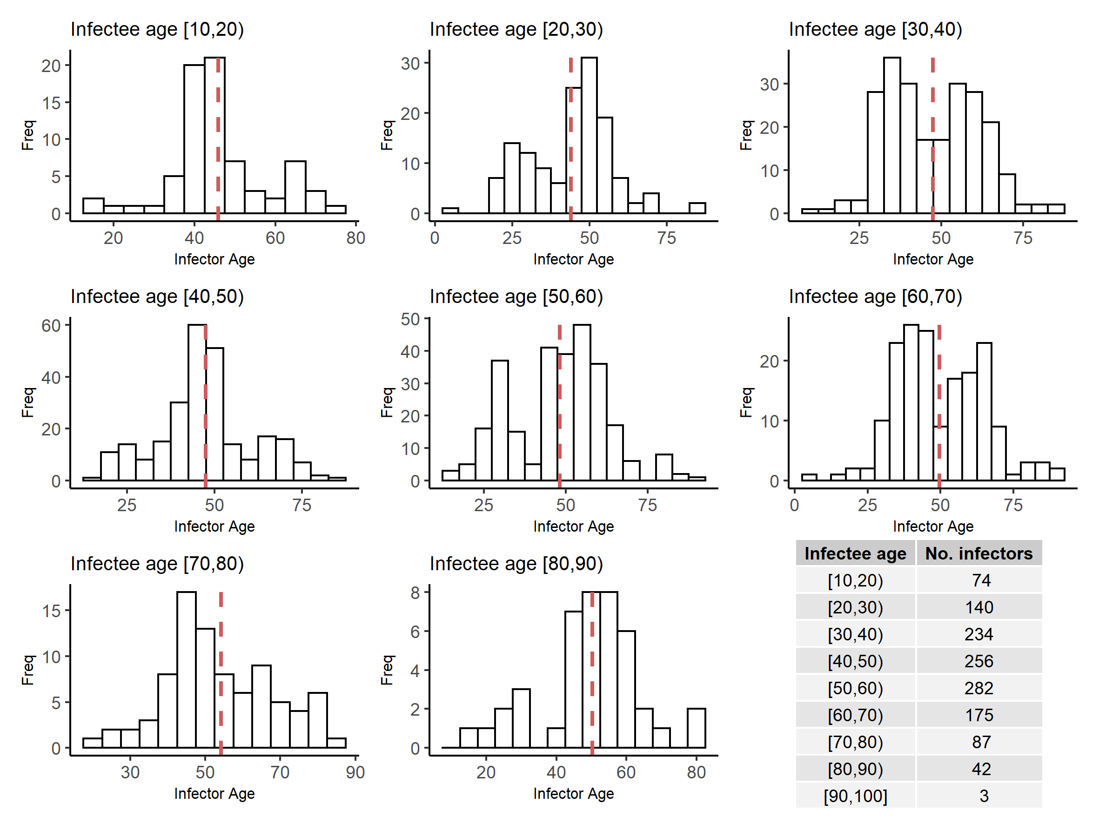

Slide 8
Infectee age distribution stratified by infector age

Slide 9
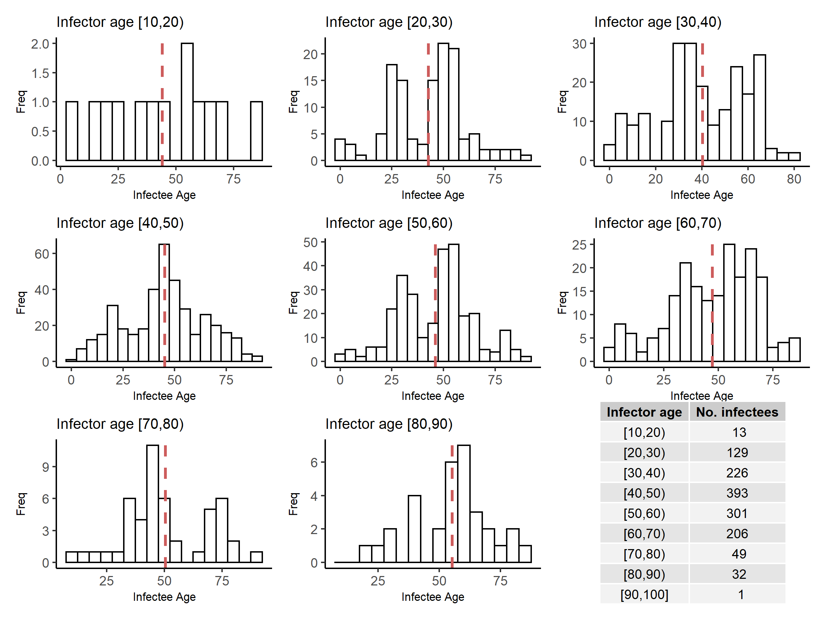

Slide 10
Age-specific infection patterns

Slide 11
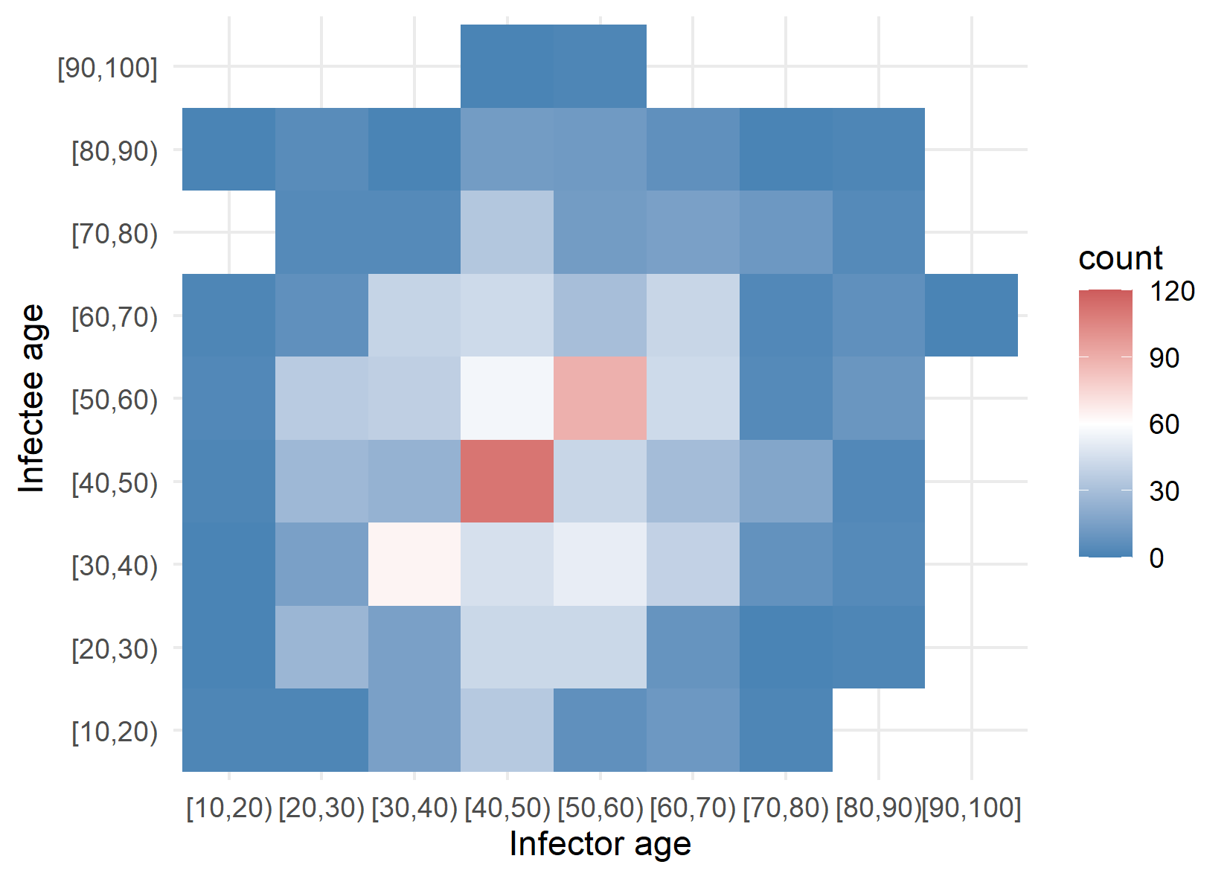

Slide 12
Age-specific infection patterns

Slide 13
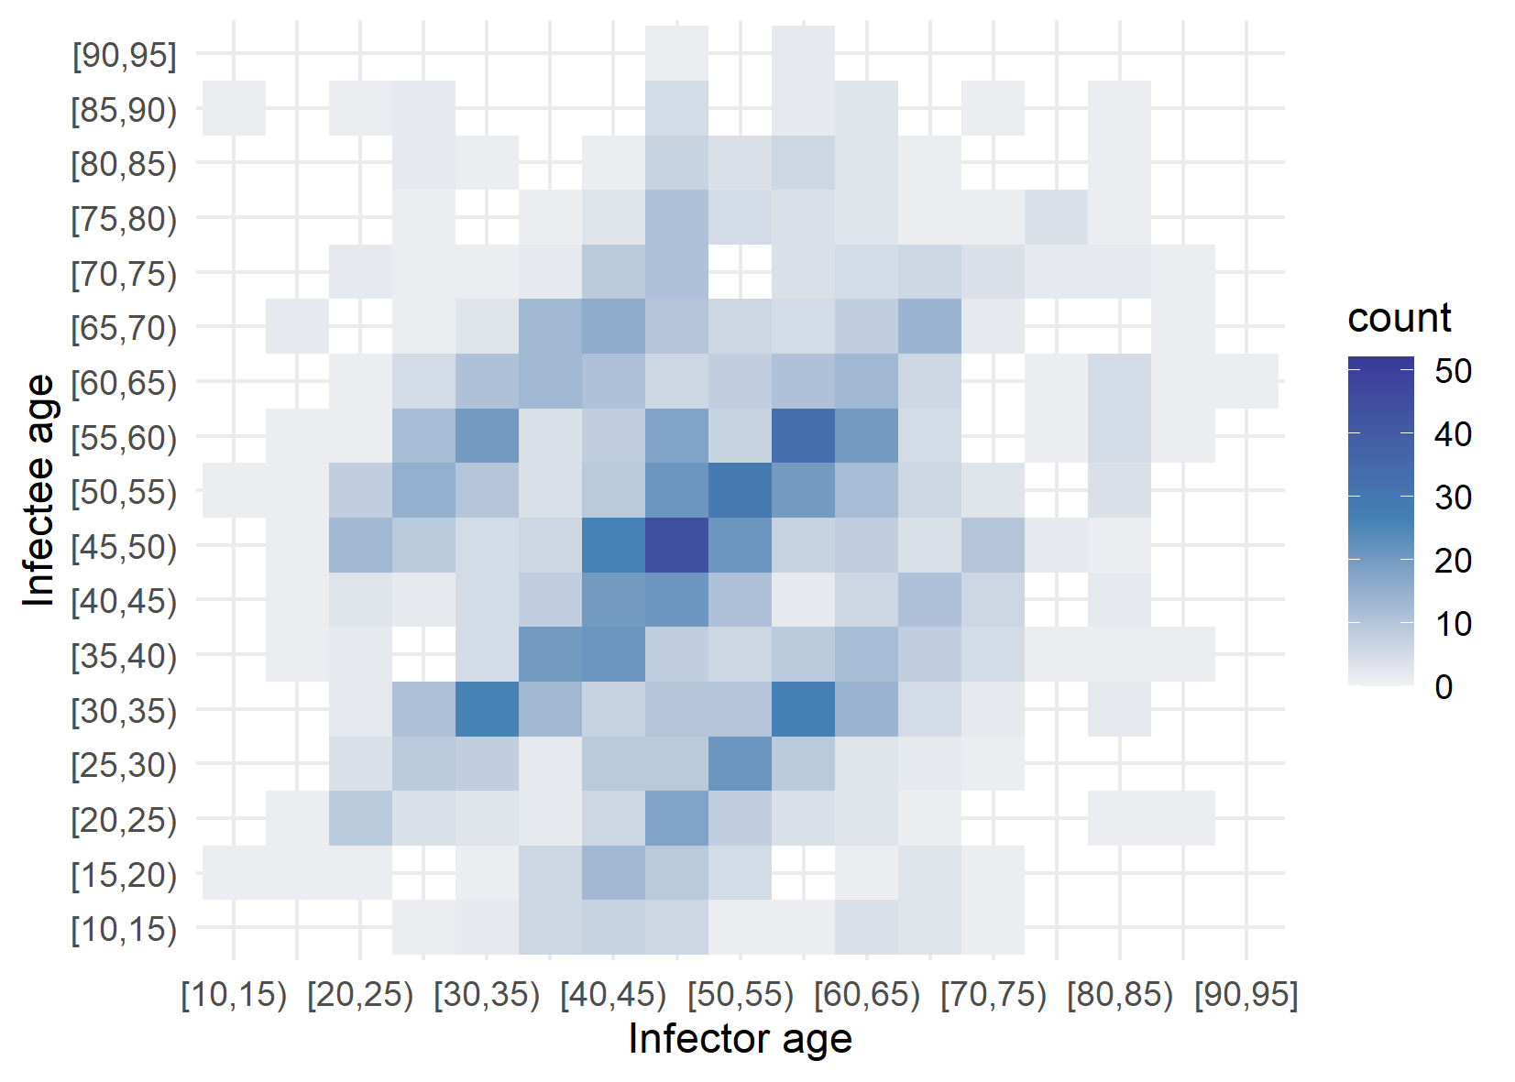

Slide 14
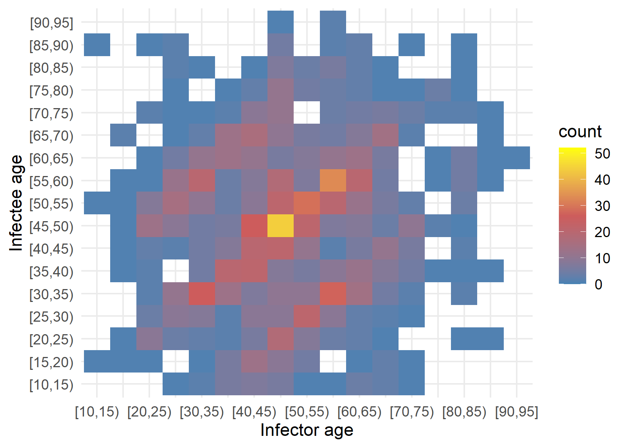

Slide 15
Hong Kong data set
Network visualisation of transmission chains

Slide 16
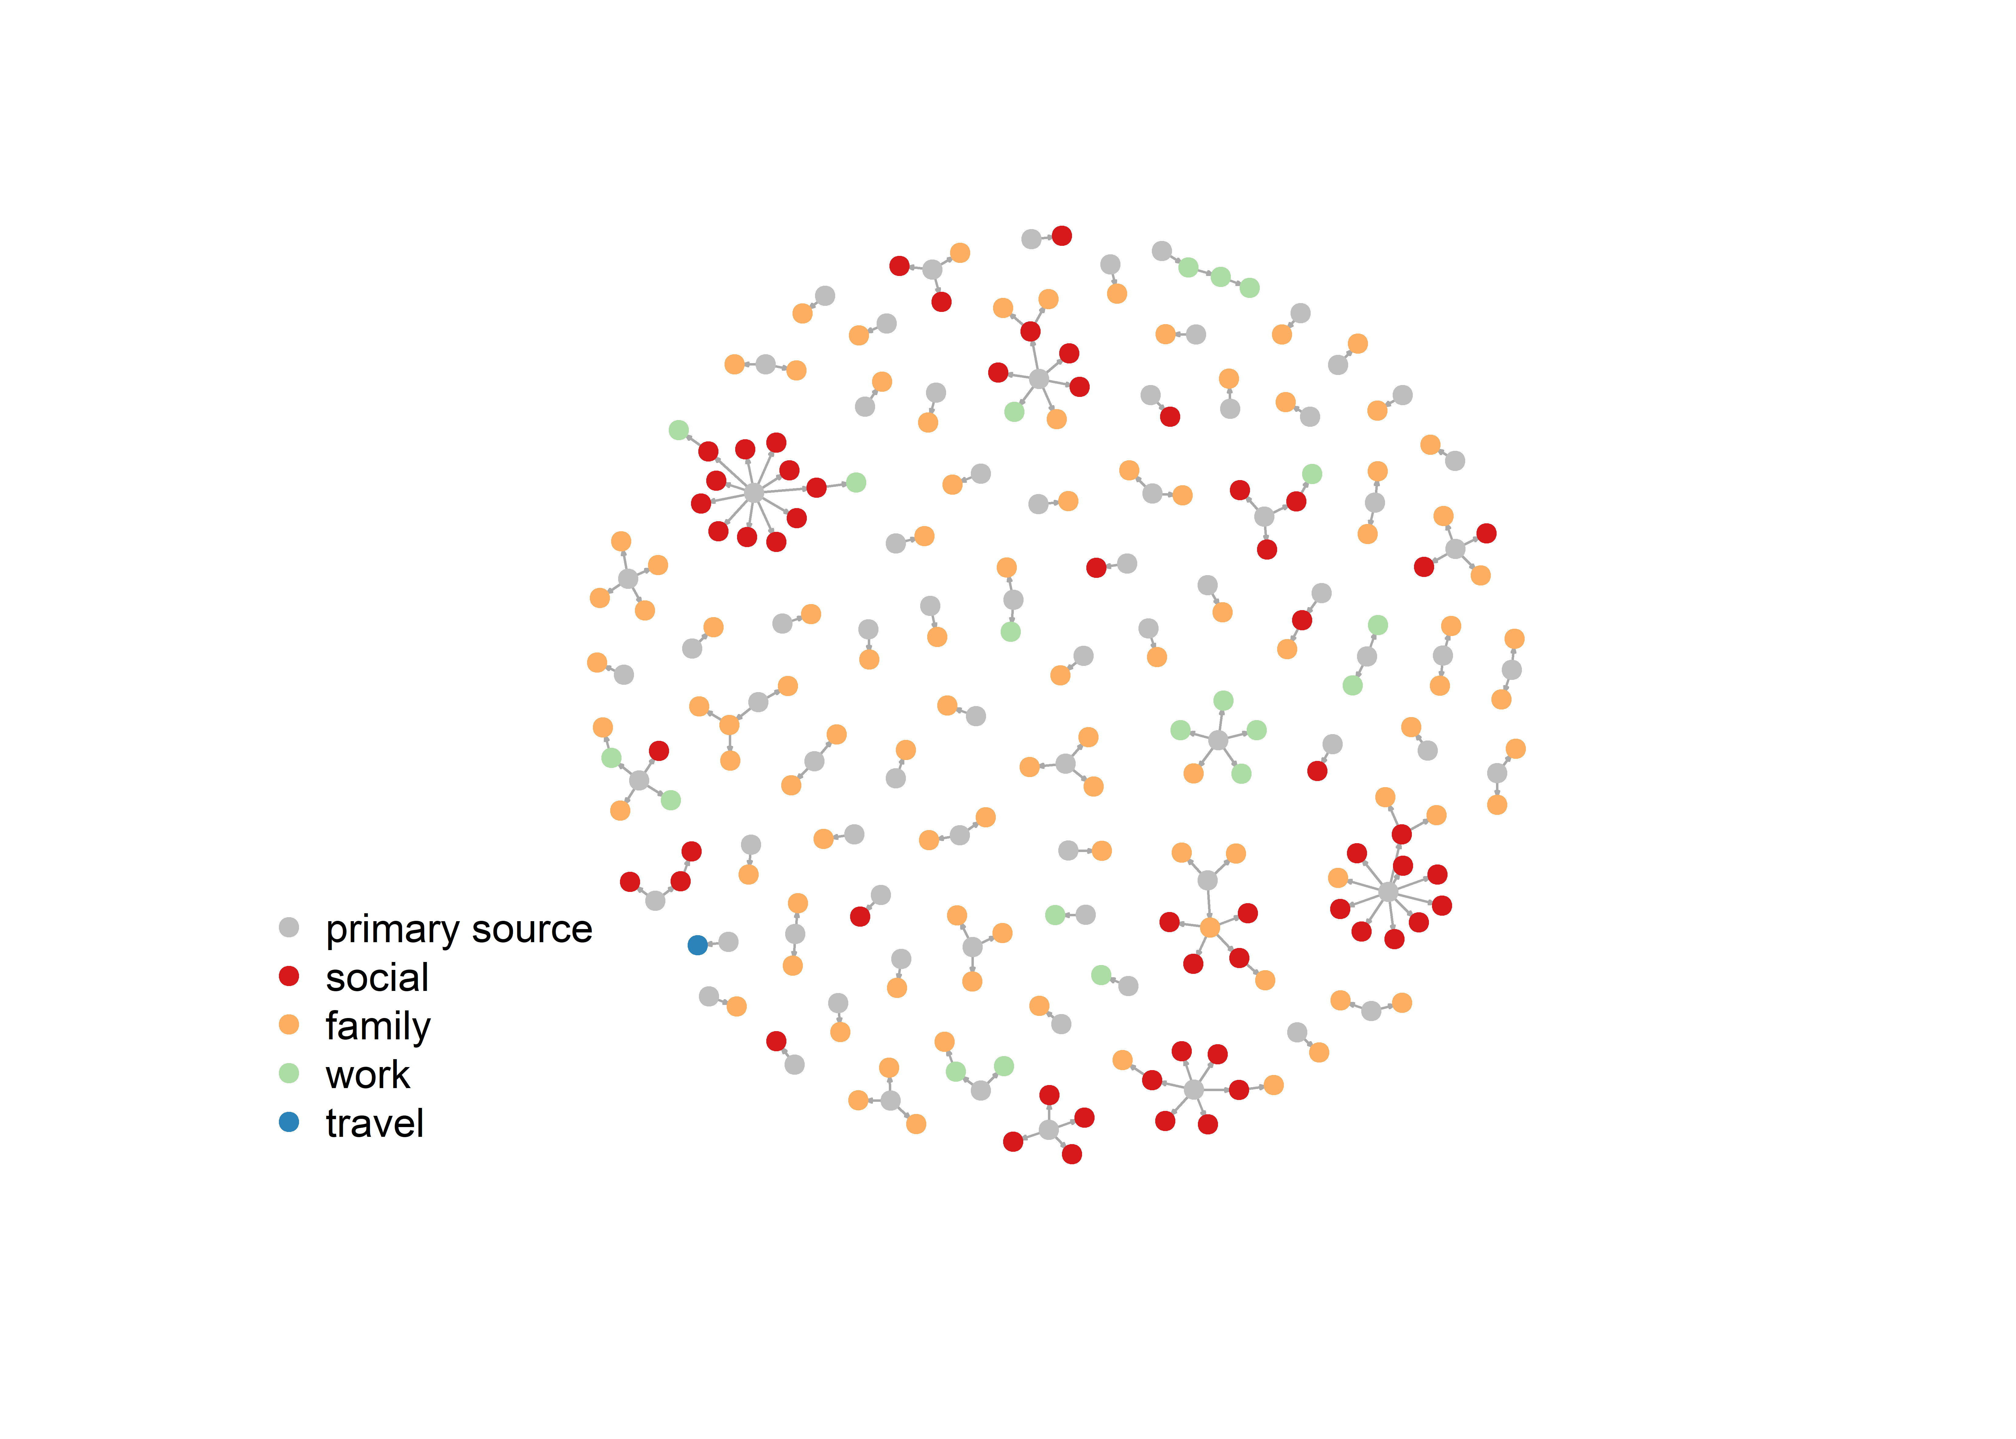

Slide 17
Korea dataset

Slide 18
Network visualisation of hospital transmission

Slide 19
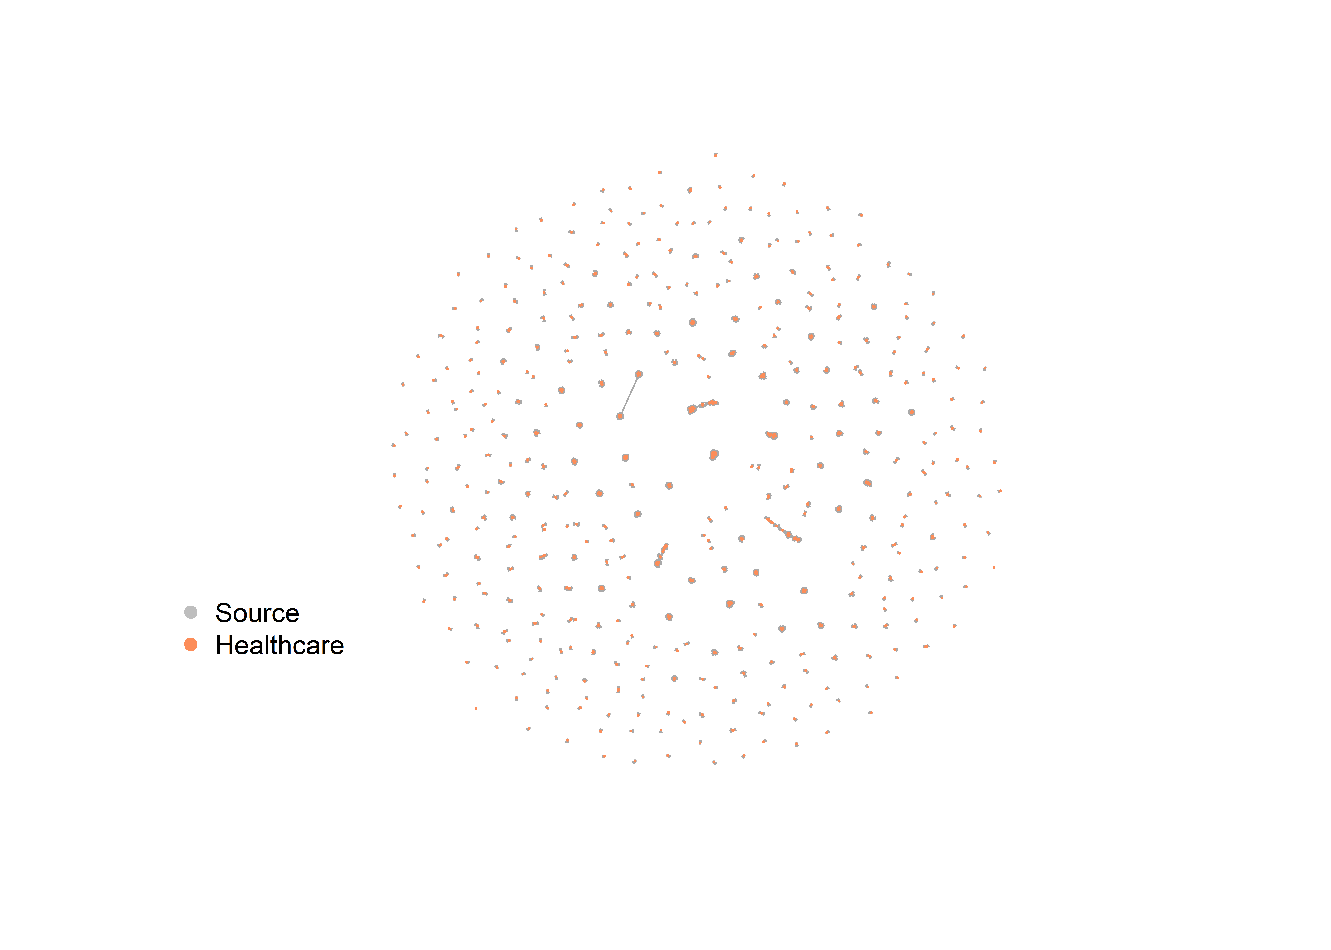

Slide 20
Network visualisation of transmission by setting

Slide 21
