Slide 1

Exploratory Data Analysis
Analysis of Cab Data
20.10.2022

Slide 2

Agenda
Executive Summary
Problem Statement
Approach
EDA
EDA Summary
Recommendations

Slide 3
Executive Summary
The project analyzes ‘cab data’ which contains the data of two cap companies, namely ‘Pink’ and ‘Yellow’ in the USA between 2016-2018 to find the potential company for investment. The project concludes that Yellow Cub is the better choice for investment on the grounds that it generates more profit in total and per km. Moreover, on the basis of the size of operation and number of users Yellow Cab is bigger and therefore it is a more reliable company.

Slide 4
Approach
Decisions on the investment rely on the
comparisons of :
Size
Profit
Stability
Operation

Slide 5
Eda
Questions
1- What is the profit generated by these two companies?( which one generates more?)
2- What is the profit generated per km by these two companies?
3- Which company has more rides and more profit?
4- What is the gender and age distribution of customers?
5- What is the market share of the companies in different years (2016-2017)?
6- What is the number of users of each company in cities?
7- What is the market share of companies in the cities?
The Data Contains
355032 entries
18 columns
Cleaning:
‘Date of Travel’ Problem?

Slide 6
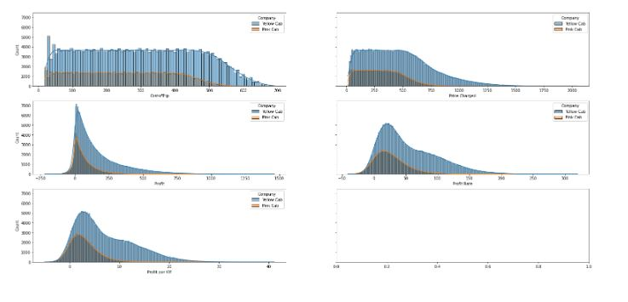
Eda
Questions
1- What is the profit generated by these two companies?( which one generates more?)
2- What is the profit generated per km by these two companies?

Slide 7
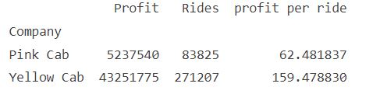
Eda
Questions
3- Which company have more ride and more profit?
Yellow Cab has advantageous position

Slide 8
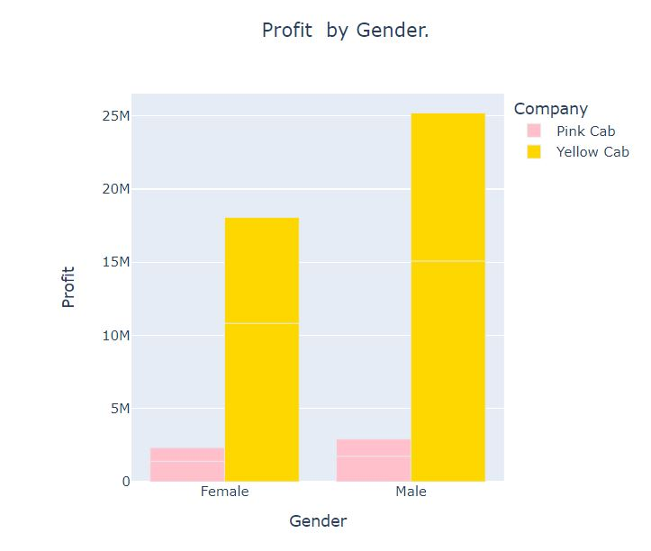
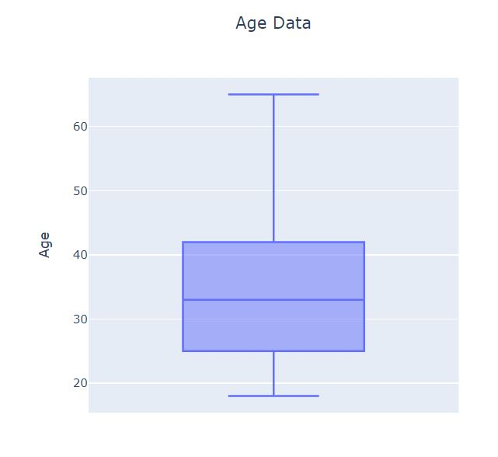
Eda
Questions
4- What are gender and age distribution of costumers?
Not significant

Slide 9
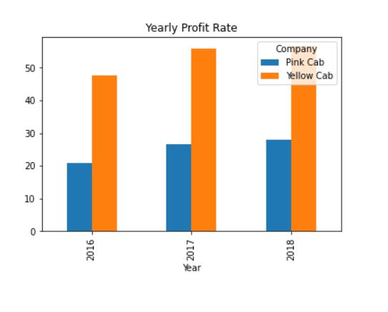
Eda
5- What is the market share of the companies in different years?
Yellow generates more profit each year

Slide 10
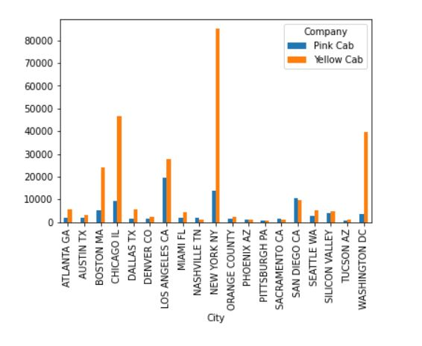
Eda
6- What is the number of users of each companies in cities?
Yellow dominantion in cities

Slide 11
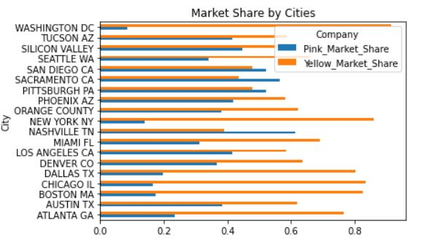
Eda
7- what is market share of companies in the cities?
The Yellow still dominantes

Slide 12
EDA Summary
Yellow Cub surpasses The Pink over:
Profit in total and per km.
Yearly market share
Size of operation
Number of users

Slide 13
Recommendations
As Yellow would be a better choice for investement.

Slide 14
Exploratory Data Analysis Analysis of Cab Data Sedat CAN
Thank You

