Slide 1

JWT TOKENS
Trainer – dimitrov.gjorge@protonmail.com
Assistant – anetastankovskaane@gmail.com

Slide 2
WHAT IS A JWT BEARER TOKEN?
A JWT or JSON Web Token is a json that follows certain rules, is digitally signed and is used for securely exchanging information between client and server.
JWT Tokens can be signed digitally by a secret which only the server knows or with public/private key pairs.
The JWT token has a defined structure consisting of 3 parts:

Slide 3
Header - Data about the token it self ( Encoded in Base64Url )
alg - Algorithm used for signing hash ( "SHA256" )
typ - Type of cookie ( "JWT" )
Payload - Statements for our business logic called claims ( Encoded in Base64Url )
iss - issuer of the token ( Who is issuing the token )
exp - what time does the token expire
sub - subject of the token ( Some data that is important for the business logic )
aud - audience of the token ( Who is the token meant for )
Signature - a unique signature hashed with the encryption written in the header. The input data that is hashed is the header, payload and a secret ( a string that only the server knows )

Slide 4
Payload* (a bit more for this part)
The payload will carry the bulk of our JWT, also called the JWT Claims. This is where we will put the information that we want to transmit and other information about our token.
There are multiple claims that we can provide. This includes registered claim names, public claim names, and private claim names.

Slide 5
Registered Claims - Claims that are not mandatory whose names are reserved for us. These include:
iss: The issuer of the token
sub: The subject of the token
aud: The audience of the token
exp: This will probably be the registered claim most often used. This will define the expiration in NumericDate value. The expiration MUST be after the current date/time.
nbf: Defines the time before which the JWT MUST NOT be accepted for processing
iat: The time the JWT was issued. Can be used to determine the age of the JWT
jti: Unique identifier for the JWT. Can be used to prevent the JWT from being replayed. This is helpful for a one-time use token.

Slide 6
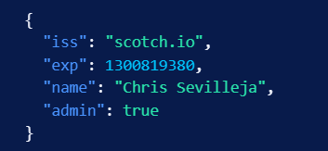
Public Claims - these are the claims that we create ourselves like user name, information, and other important information.
Private Claims - these are the claims that are private.
Our example payload has two registered claims (iss, and exp) and two public claims (name, admin).

Slide 7
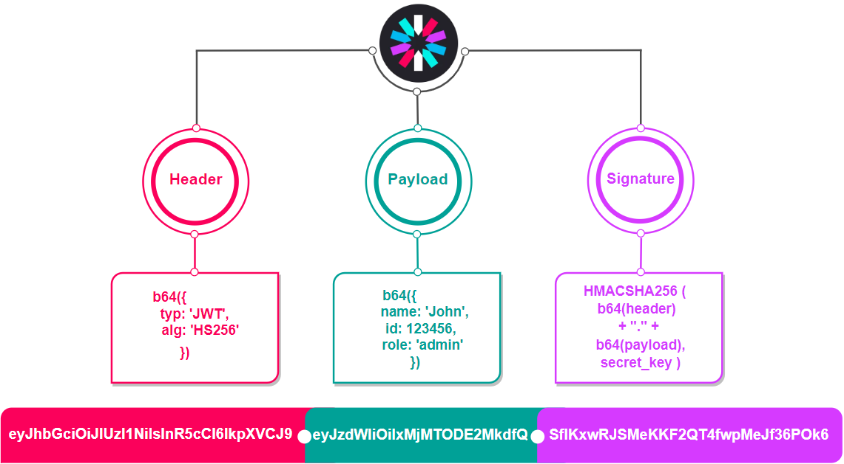

Slide 8
HASHING
The process of converting an input from a different length to a fixed set of numbers or text of same length ( by mathematical algorithm ). This process creates a string that is totally different from the string it started. This makes the string useless, unless compared with a hash that came from the same string. Hashing is used for various purposes, mostly for verification of things such as addresses, passwords, file names etc.

Slide 9
The hashing process goes like this:
Input: a string of any length is selected
Hash Method: A method that executes a mathematical algorithm is selected that will convert the string in to a fixed set of string characters or numbers ( MD5, SHA256 etc. )
Hash: The hash method returns a new string or set of numbers that is called hash

Slide 10
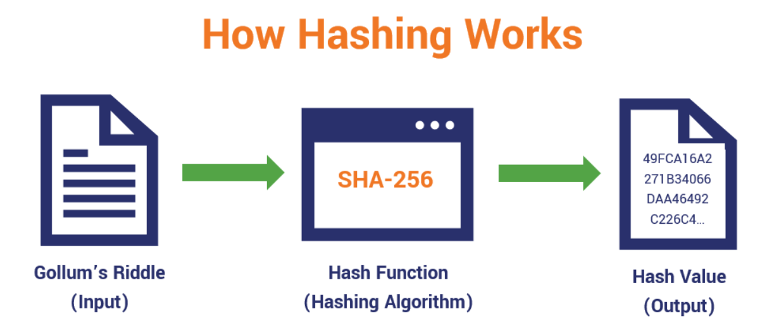

Slide 11
How do JWT tokens work
When a Client requests something from a server the server validates the request ( Ex: username and password ). After that the server creates a token by adding the header, adding some claims about the user that is relevant for when the token is returned back ( Ex: Username and UserId ). Then it combines them with the secret and creates a hash with the preferred algorithm. It combines everything and creates the JWT string. The token is returned to the client. The client decides how to keep the token. On every other call, the client will just give the token to the server. The token will validate the token to see if it has been changed or tampered. If it is valid it will allow the client request. The token can be invalidated by trying to change it or if the token is expired.

Slide 12
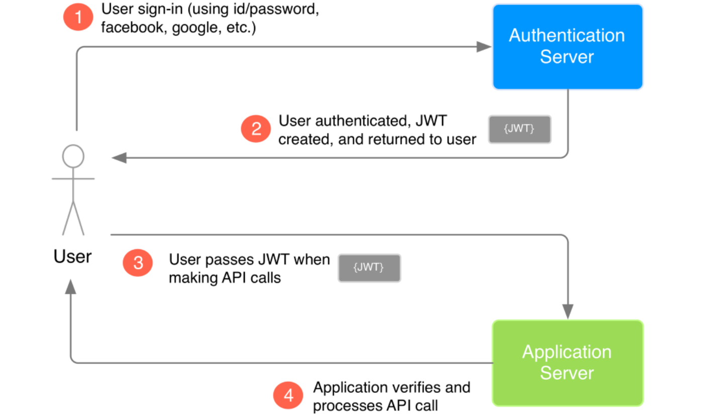

Slide 13
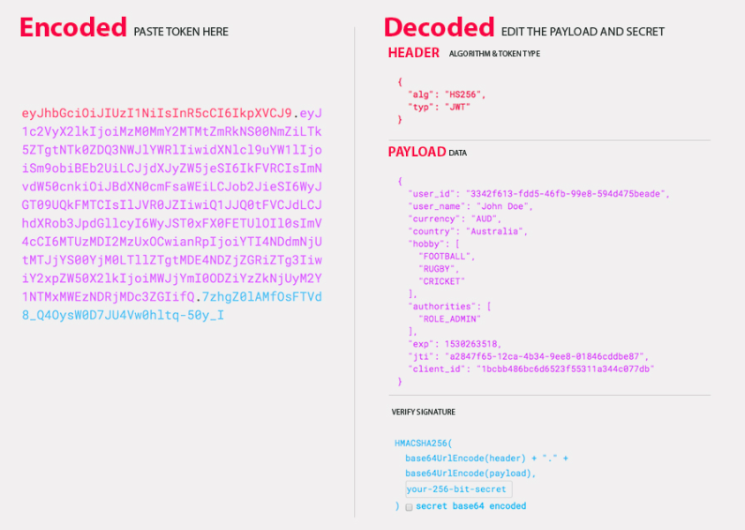
Check out jwt.io to play around and check JWT tokens

Slide 14
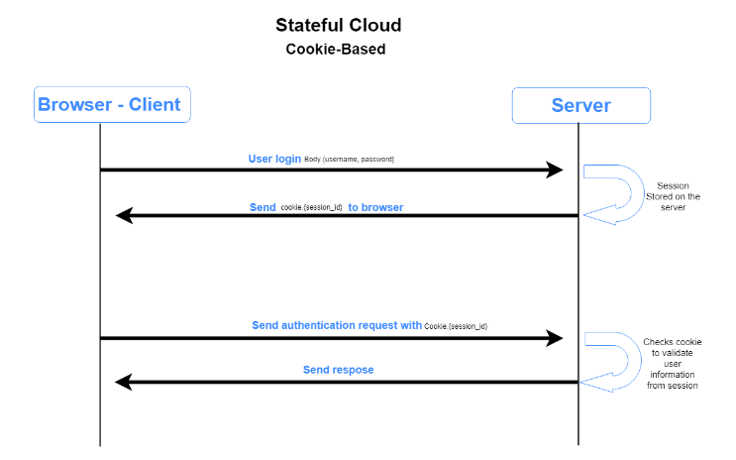

Slide 15
SSR (SERVER-SIDE RENDERING)
Server-side rendering (SSR) is a popular technique for rendering a normally client-side only single page app (SPA) on the server and then sending a fully rendered page to the client. The client’s JavaScript bundle can then take over and the SPA can operate as normal. SSR technique is helpful in situations like the client has a slow internet connection and then rendering of the whole page on client-side takes too much time in certain situations Server Side Rendering might come as handy.

Slide 16
One of the widely used modules used to do Server Side Rendering in Node.js is EJS Module. EJS stands for Embedded JavaScript template.
Feature of EJS Module:
Use plain javascript.
Fast Development time.
Simple syntax.
Faster execution.
Easy Debugging.
Active Development.

Slide 17

Render file using EJS renderFIle() method
To perform Server Side Rendering we use renderFile() method of the ejs module, which helps us to render the ejs file on the server-side.
Syntax:
Here, callback function takes two arguments first is an error (if there is an error occurs then the renderFile returns an error) and on successful rendering it returns a template.

Slide 18
QUESTIONS?
You can find us at
Trainer's Facebook profile
Assistant's Facebook Profile
Demo code and Materials
Link to GitHub repository

