Slide 1

Modules and I/O
Trainer – dimitrov.gjorge@protonmail.com
Assistant – anetastankovskaane@gmail.com

Slide 2
WHAT ARE MODULES?
In simple terms, a module is a piece of reusable JavaScript code. It could be a .js file or a directory containing .js files. You can export the content of these files and use them in other files.
Modules help developers to be committed to the DRY (Don't Repeat Yourself) principle in programming. They also help to break down complex logic into small, simple, and manageable chunks.

Slide 3
TYPES OF MODULES
There are three main types of Node modules that you will work with as a Node.js developer. They include the following.
Built-in modules
Local modules
Third-party modules.

Slide 4
BUILT-IN MODULES
Node.js comes with some modules out of the box. These modules are available for use when you install Node.js. Some common examples of built-in Node modules are the following:
http
url
path
fs

Slide 5
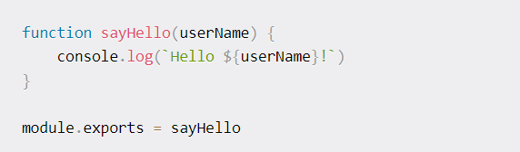
LOCAL MODULES
When you work with Node.js, you create local modules that you load and use in your program. First, you need to create the module. Your module can export an object, array, a function or any data type. Then you export it using a specific syntax.

Slide 6
Types of exports
The export declaration is used to export values from a JavaScript module.
Every module can have two different types of export, named export and default export. You can have multiple named exports per module but only one default export.

Slide 7
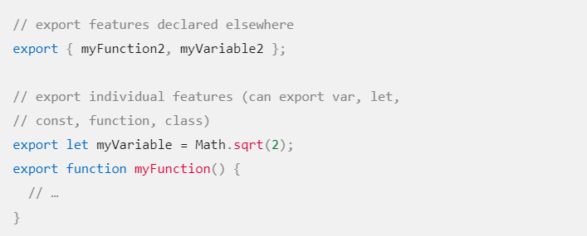
NAMED EXPORTS
After the export keyword, you can use let, const, and var declarations, as well as function or class declarations. You can also use the export { name1, name2 } syntax to export a list of names declared elsewhere.

Slide 8
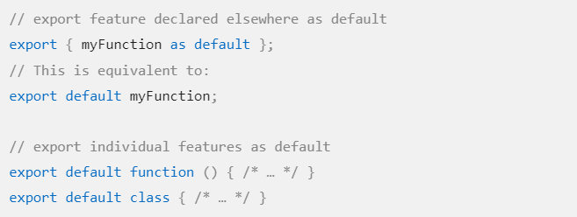
DEFAULT EXPORTS
The export default syntax allows any expression. Named exports are useful when you need to export several values. When importing this module, named exports must be referred to by the exact same name (optionally renaming it with as), but the default export can be imported with any name.

Slide 9
How to load you local modules
You can load your local modules and use them in other files.
This can be done by using the require function
Another option is import declaration that is used to import read-only live bindings which are exported by another module. There are four forms of import declarations:

Slide 10


NAMED IMPORT
Given a value named myExport which has been exported from the module my-module either implicitly as export * from 'another.js') or explicitly using the export statement, this inserts myExport into the current scope.
You can import multiple names from the same module.

Slide 11


DEFAULT IMPORT
Default exports need to be imported with the corresponding default import syntax. The simplest version directly imports the default.
It is also possible to specify a default import with namespace imports or named imports. In such cases, the default import will have to be declared first.

Slide 12


NAMESPACE IMPORT
The following code inserts myModule into the current scope, containing all the exports from the module located at /modules/my-module.js.
Here, myModule represents a namespace object which contains all exports as properties. For example, if the module imported above includes an export doAllTheAmazingThings(), you would call it like this:

Slide 13

SIDE-EFFECT IMPORT
Import an entire module for side effects only, without importing anything. This runs the module's global code, but doesn't actually import any values.

Slide 14
NODE.JS FILE PATHS
Every file in the system has a path. On Linux and macOS, a path might look like: /users/joe/file.txt while Windows computers are different, and have a structure such as: C:\users\joe\file.tx
You need to pay attention when using paths in your applications, as this difference must be taken into account.
You include this module in your files using const path = require('path'); and you can start using its methods.

Slide 15
Working with paths
You can join two or more parts of a path by using path.join()
You can get the absolute path calculation of a relative path using path.resolve()

Slide 16
Getting information out of a path
Given a path, you can extract information out of it using those methods:
dirname: get the parent folder of a file
basename: get the filename part
extname: get the file extension

Slide 17
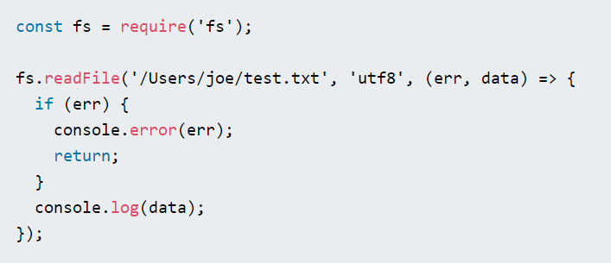
READING FILES
The simplest way to read a file in Node.js is to use the fs.readFile() method, passing it the file path, encoding and a callback function that will be called with the file data (and the error)

Slide 18
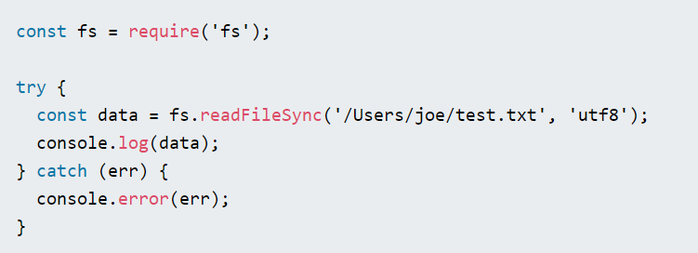
Alternatively, you can use the synchronous version fs.readFileSync()

Slide 19
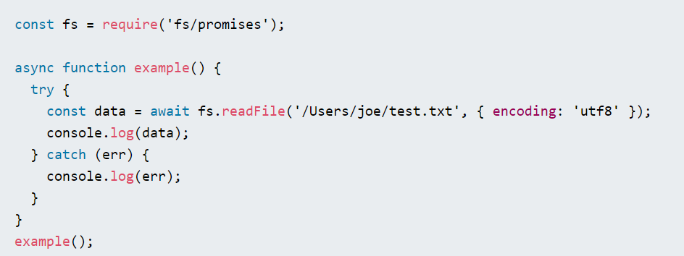
You can also use the promise-based fsPromises.readFile() method offered by the fs/promises module

Slide 20
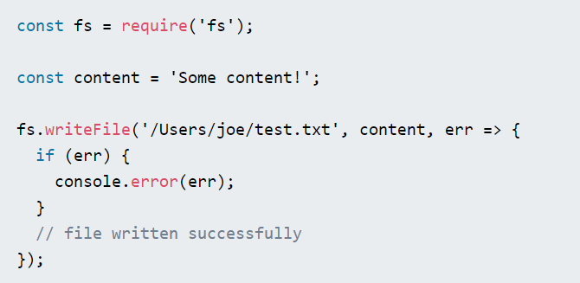
WRITING TO FILES
The easiest way to write to files in Node.js is to use the fs.writeFile() API. This method will overwrite the file if the file already exists. The fs.writeFile() method is used to asynchronously write the specified data to a file. By default, the file would be replaced if it exists.

Slide 21
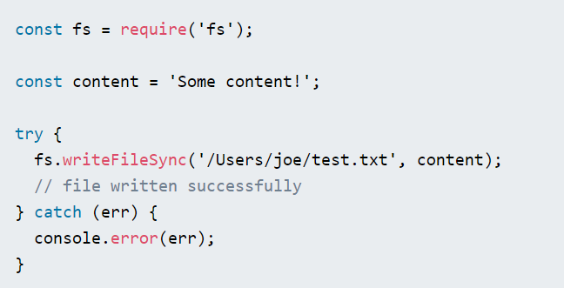
Alternatively, you can use the synchronous version fs.writeFileSync()

Slide 22
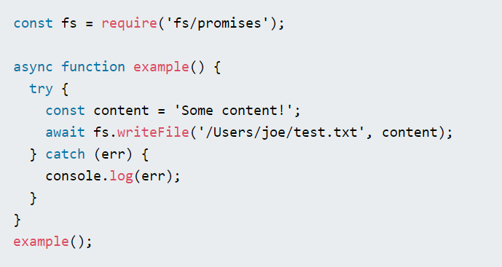
You can also use the promise-based fsPromises.writeFile() method offered by the fs/promises module

Slide 23
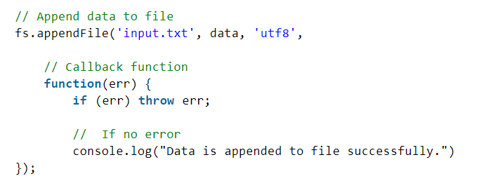
WRITING TO EXISTING FILES
The fs.appendFile() method is used to synchronously append the data to the file.

Slide 24
WORKING WITH FOLDERS
Use fs.access() (and its promise-based fsPromises.access() counterpart) to check if the folder exists and Node.js can access it with its permissions.
Use fs.mkdir() or fs.mkdirSync() or fsPromises.mkdir() to create a new folder.
Use fs.readdir() or fs.readdirSync() or fsPromises.readdir() to read the contents of a directory.
Use fs.rename() or fs.renameSync() or fsPromises.rename() to rename folder. The first parameter is the current path, the second the new path.

Slide 25
EXERCISE
Create a file named note.txt. It can have any content in it.
Add some more content to the existing files (without replacing the current content).
Read all the content from the file and log it in the console.

Slide 26
QUESTIONS?
You can find us at
Trainer's Facebook profile
Assistant's Facebook Profile
Demo code and Materials
Link to GitHub repository

