Slide 1

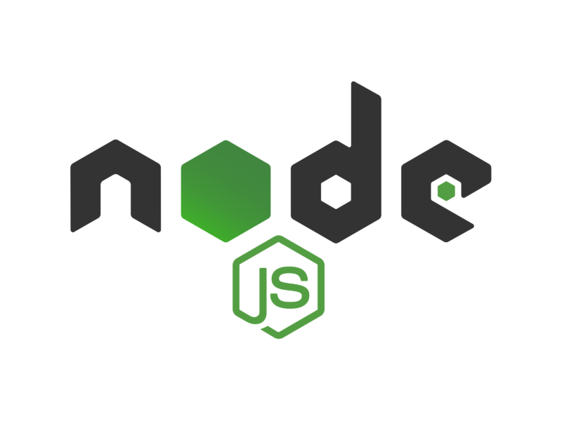
Introduction to
Trainer – dimitrov.gjorge@protonmail.com
Assistant – anetastankovskaane@gmail.com

Slide 2


HELLO THERE
George Dimitrov
Full Stack Web Developer @Symphony
Trainer @SEDC
Aneta Stankovska
Full Stack Web Developer @Sourcico
Assistant @SEDC

Slide 3
AIMS AND GOALS OF THIS COURSE
Understanding the basics of Node.js
Learning to use npm packages
Solving problems in Node.js by building applications
Writing a lot of JS code compiled in Node.js runtime environment

Slide 4
WHERE ARE WE NOW?
Just finished the front end part of the academy
Have a decent understanding of:
HTML
CSS
JavaScript
Have the ability to give a front end solution to a problem

Slide 5
A WEB SOLUTION
Front end
Design
UI
Responsiveness
Web-page
User see and interact with it. It is built for the user's convenience
HTML
CSS
JavaScript
JavaScript Frameworks
Security
Data base
Services
Server Application
Not seen by the users. It is the foundation of the application and the business logic required
C# / JAVA / JS / PYTHON / PHP
MVC / RestAPI / GraphQL
SQL / MySQL / MongoDB
.NET Framework / Nest.js Framework
Authentication and Authorisation
Back end

Slide 6
WHAT IS NODE.JS?
Node.js is an open-source and cross-platform JavaScript runtime environment. It is a popular tool for almost any kind of project!
Node.js runs the V8 JavaScript engine, the core of Google Chrome, outside of the browser. This allows Node.js to be very performant.

Slide 7
SINGLE-THREADED AND ASYNC
A Node.js app runs in a single process, without creating a new thread for every request. Node.js provides a set of asynchronous I/O primitives in its standard library that prevent JavaScript code from blocking.
When Node.js performs an I/O operation, like reading from the network, accessing a database or the filesystem, instead of blocking the thread and wasting CPU cycles waiting, Node.js will resume the operations when the response comes back.
This allows Node.js to handle thousands of concurrent connections with a single server.

Slide 8
SAME LANGUAGE… YAAY!
Node.js has a unique advantage because millions of frontend developers that write JavaScript for the browser are now able to write the server-side code in addition to the client-side code without the need to learn a completely different language.
In Node.js the new ECMAScript standards can be used without problems, as you don't have to wait for all your users to update their browsers - you are in charge of deciding which ECMAScript version to use by changing the Node.js version, and you can also enable specific experimental features by running Node.js with flags.

Slide 9
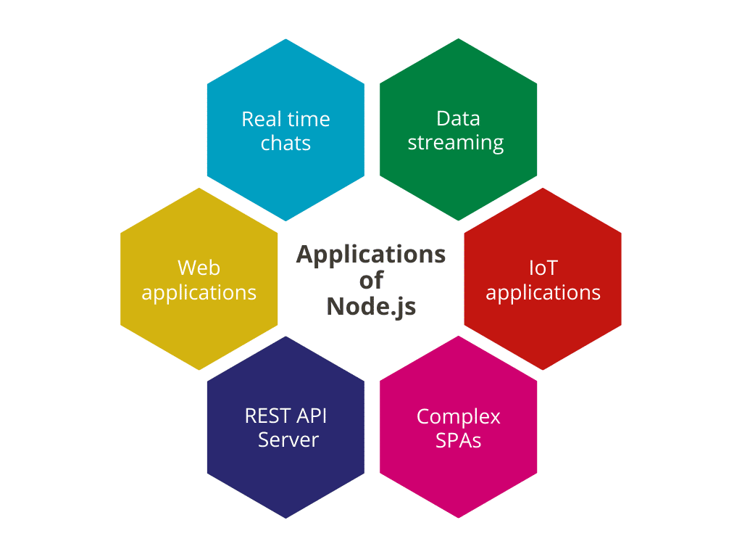




Slide 10
JS IN THE BROWSER & NODE.JS
Both the browser and Node.js use JavaScript as their programming language. Building apps that run in the browser is a completely different thing than building a Node.js application.
What changes is the ecosystem.

Slide 11
In the browser, most of the time what you are doing is interacting with the DOM, or other Web Platform APIs like Cookies. Those do not exist in Node.js, of course. You don't have the document, window and all the other objects that are provided by the browser.
And in the browser, we don't have all the nice APIs that Node.js provides through its modules, like the file-system access functionality.
Another big difference is that in Node.js you control the environment. Compared to the browser environment, where you don't get the luxury to choose what browser your visitors will use, this is very convenient.

Slide 12
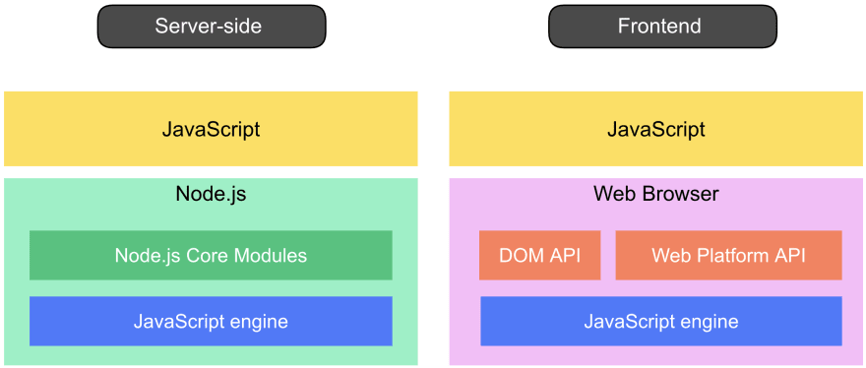

Slide 13
THE V8 JAVASCRIPT ENGINE
V8 is the name of the JavaScript engine that powers Google Chrome. It's the thing that takes our JavaScript and executes it while browsing with Chrome.
The cool thing is that the JavaScript engine is independent of the browser in which it's hosted. This key feature enabled the rise of Node.js. V8 was chosen to be the engine that powered Node.js back in 2009, and as the popularity of Node.js exploded.
V8 is written in C++, and it's continuously improved. It is portable and runs on Mac, Windows, Linux and several other systems.
JavaScript is internally compiled by V8 with just-in-time (JIT) compilation to speed up the execution.

Slide 14
NPM (Node Package Manager)
npm is the standard package manager for Node.js.
In September 2022 over 2.1 million packages were reported being listed in the npm registry, making it the biggest single language code repository on Earth, and you can be sure there is a package for (almost!) everything.
It started as a way to download and manage dependencies of Node.js packages, but it has since become a tool used also in frontend JavaScript.

Slide 15
NPM (Node Package Manager)
Now you can use NPM to:
Install and update dependencies of your project.
Control versioning of your app.
Run tasks using commands.

Slide 16

WHO IS USING NODE.JS?

Slide 17
EXERCISE
Create a folder with a .js file in it
It can have any content in it.
Open terminal in that folder
Run command ‘npm init’ and see what happens

Slide 18
QUESTIONS?
You can find us at
Trainer's Facebook profile
Assistant's Facebook Profile
Demo code and Materials
Link to GitHub repository

