Slide 1

MONGOOSE
Trainer – dimitrov.gjorge@protonmail.com
Assistant – anetastankovskaane@gmail.com

Slide 2
WHAT IS MONGOOSE?
Mongoose is an Object Data Modeling (ODM) library for MongoDB and Node.js. It manages relationships between data, provides schema validation, and is used to translate between objects in code and the representation of those objects in MongoDB.

Slide 3
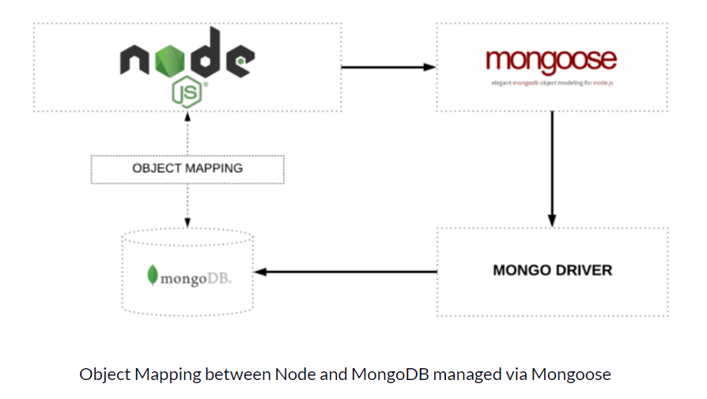

Slide 4
MongoDB is a schema-less NoSQL document database. It means you can store JSON documents in it, and the structure of these documents can vary as it is not enforced like SQL databases. This is one of the advantages of using NoSQL as it speeds up application development and reduces the complexity of deployments.

Slide 5
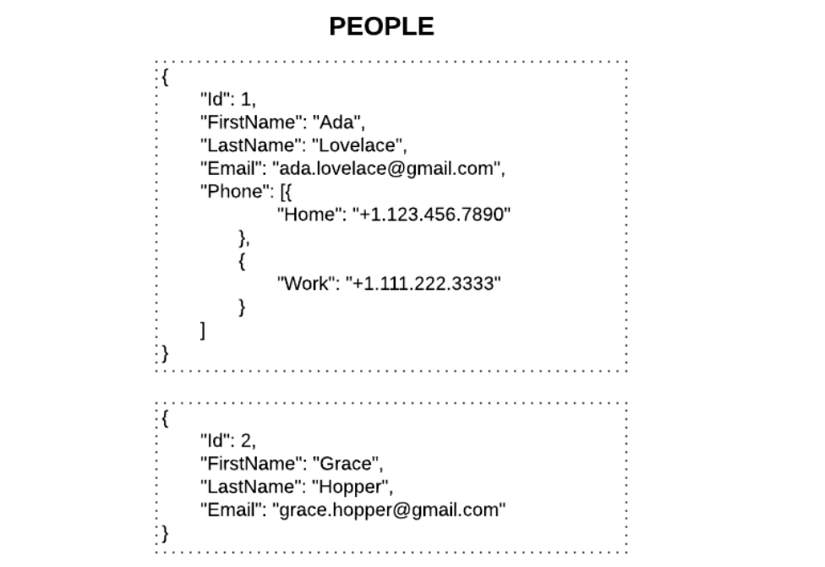
Below is an example of how data is stored in Mongo:

Slide 6
SCHEMA / SCHEMA TYPES
A Mongoose schema is a document data structure (or shape of the document) that is enforced via the application layer.
While Mongoose schemas define the overall structure or shape of a document, SchemaTypes define the expected data type for individual fields (String, Number, Boolean, and so on).
You can also pass in useful options like required to make a field non-optional, default to set a default value for the field, and many more.

Slide 7
MODELS / MONGOOSE MODELS
Models / Mongoose models are higher-order constructors that take a schema and create an instance of a document equivalent to records in a relational database.

Slide 8
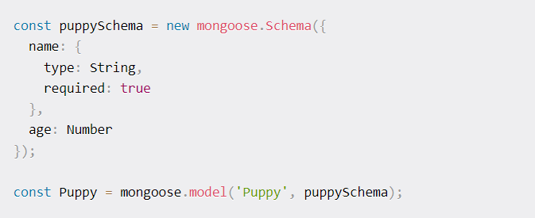
Here's a small code snippet to illustrate some of the terminology

Slide 9
In the code above, puppySchema defines the shape of the document which has two fields, name, and age
The SchemaType for name is String and for age is Number. Note that you can define the SchemaType for a field by using an object with a type property like with name. Or you can apply a SchemaType directly to the field like with age.
Also, notice that the SchemaType for name has the option required set to true. To use options like required and lowercase for a field, you need to use an object to set the SchemaType.
At the bottom of the snippet, puppySchema is compiled into a model named Puppy, which can then be used to construct documents in an application.

Slide 10
QUESTIONS?
You can find us at
Trainer's Facebook profile
Assistant's Facebook Profile
Demo code and Materials
Link to GitHub repository

