Slide 1

Databases - MongoDB
Trainer – dimitrov.gjorge@protonmail.com
Assistant – anetastankovskaane@gmail.com

Slide 2
AIMS AND GOALS OF THIS COURSE
Understanding the advanced concepts of Node.js
Learning about ORMs & DBs
Learning how to write type safe code with Typescript
Getting familiar with a BE framework – Nest.js and its consisting parts

Slide 3
WHAT ARE DATABASES?
A database is an organized collection of data, so that it can be easily accessed and managed.
The main purpose of the database is to operate a large amount of information by storing, retrieving, and managing data.
Databases are generally accessed electronically from a computer system and are usually controlled by a database management system (DBMS).

Slide 4
WHAT ARE DATABASES?
There are many databases available like:
MySQL
Oracle
MongoDB
PostgreSQL
SQL Server, etc.
SQL or Structured Query Language is used to operate on the data stored in a database.

Slide 5
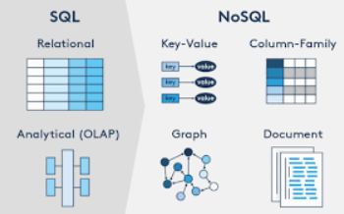
TYPES OF DATABASES
Databases are widely divided into two major types or categories, namely, Relational or Sequence Databases and Non-relational or Non-sequence databases or No SQL databases.

Slide 6
RELATIONAL DATABASE
A relational database is the most common type of database. It uses schema, which is a template used to dictate the data structure stored within the database.
Tables, which are also called entities, are all in relation to each other.
There are keys associated with tables in a relational database. They provide a quick database summary or access to the particular row or column you want to check.

Slide 7
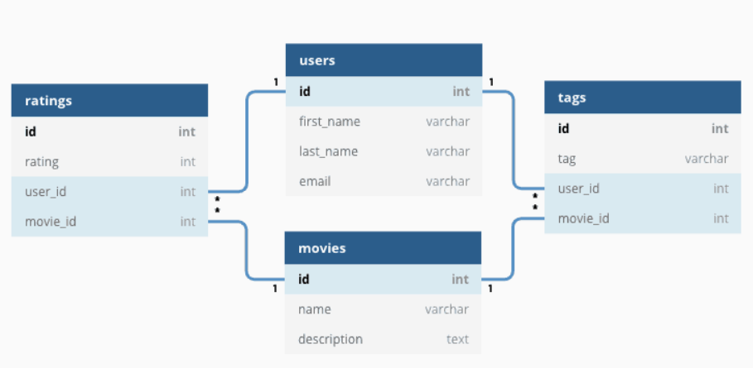

Slide 8
Some examples of SQL databases include:
Oracle
PostgreSQL (more info later in the course)
MySQL
SQL Server

Slide 9
Benefits of using SQL databases:
Relational databases follow a strict schema, meaning that each new entry must have different components that make it fit in that preformed template. It enables the data to be predictable and easily assessable.
They are well structured and significantly reduce the chances of errors.

Slide 10
NON-RELATIONAL DATABASE
Another common type of database is non-relational. The non-relational form of database organization is more forgiving in its structure and form than relational databases. Instead of tables with columns and rows, they have collections of different categories illustrated by documents. So, there can be multiple documents in one collection. Also, they may or may not follow any particular pattern or schema.

Slide 11
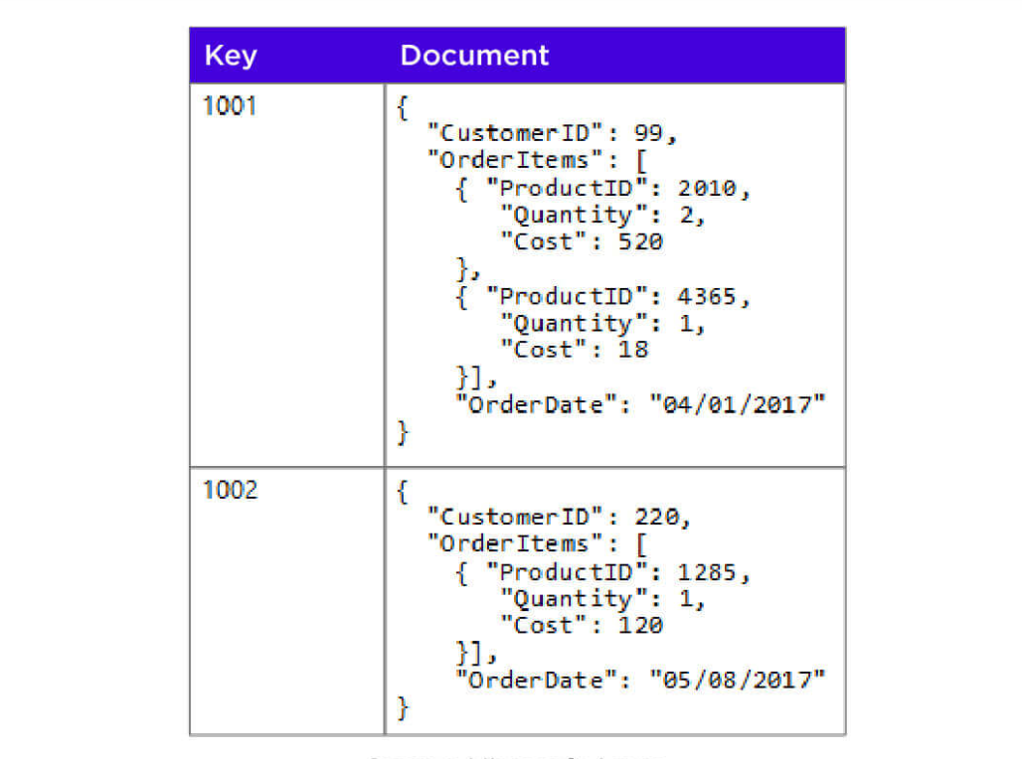

Slide 12
The different types of non-relational databases are:
Key-Value Stores - only stores and provides quick and simple knowledge regarding key-value pairs (Redis / Amazon DynamoDB)
Wide Column Stores - stores and manages humongous amounts of data in tables or multiple columns (CassandraDB)

Slide 13
Document Stores - Data gets stored in JSON documents, and these documents resemble those of key-value and wide-column. Some of the most famous NoSQL databases fall into this category, namely, Couchbase and MongoDB
Graph Databases - show the connections between different data points. They are used to analyze different types of data and their relationship with each other.

Slide 14

MongoDB
MongoDB is a source-available cross-platform document-oriented database program. Classified as a NoSQL database program, MongoDB uses JSON-like documents with optional schemas.

Slide 15
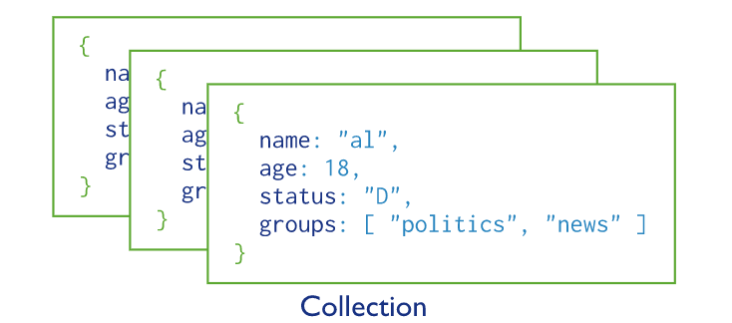
HOW MONGO STORES DATA?
MongoDB stores data records as documents (specifically BSON documents) which are gathered together in collections.
A database stores one or more collections of documents. Collections are analogous to tables in relational databases.

Slide 16
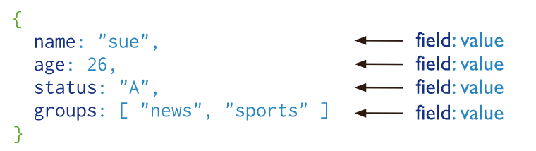
DOCUMENTS
MongoDB documents are composed of field-and-value pairs and have the following structure:

Slide 17
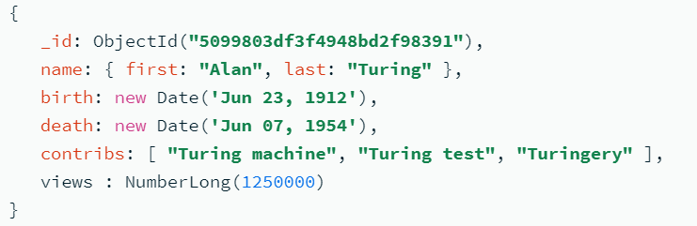
The value of a field can be any of the BSON data types, including other documents, arrays, and arrays of documents. For example, the following document contains values of varying types:

Slide 18
Documents have the following restrictions on field names:
The field name _id is reserved for use as a primary key; its value must be unique in the collection, is immutable, and may be of any type other than an array. If the _id contains subfields, the subfield names cannot begin with a ($) symbol.
Field names cannot contain the null character.
The server permits storage of field names that contain dots (.) and dollar signs ($).
MongodB 5.0 adds improved support for the use of ($) and (.) in field names. There are some restrictions.

Slide 19
QUESTIONS?
You can find us at
Trainer's Facebook profile
Assistant's Facebook Profile
Demo code and Materials
Link to GitHub repository

