Slide 1

CONTROLLERS & ROUTING
Trainer – dimitrov.gjorge@protonmail.com
Assistant – anetastankovskaane@gmail.com

Slide 2
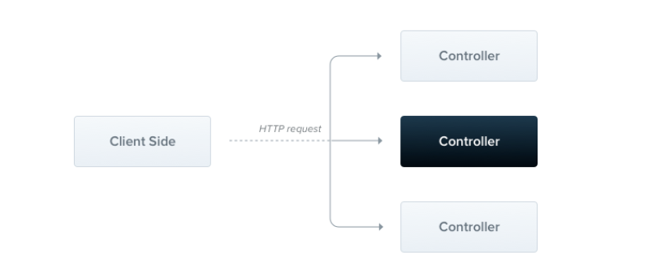
WHAT ARE CONTROLLERS?
Controllers are responsible for handling incoming requests and returning responses to the client.

Slide 3
A controller's purpose is to receive specific requests for the application. The routing mechanism controls which controller receives which requests. Frequently, each controller has more than one route, and different routes can perform different actions.
In order to create a basic controller, we use classes and decorators. Decorators associate classes with required metadata and enable Nest to create a routing map (tie requests to the corresponding controllers).
We use the @Controller() decorator, which is required to define a basic controller.

Slide 4
ROUTING
Using a path prefix in a @Controller() decorator allows us to easily group a set of related routes, and minimize repetitive code.
The @Get() HTTP request method decorator tells Nest to create a handler for a specific endpoint for HTTP requests. The endpoint corresponds to the HTTP request method (GET in this case) and the route path. What is the route path? The route path for a handler is determined by concatenating the (optional) prefix declared for the controller, and any path specified in the method's decorator.

Slide 5
e.q. http://localhost:3000/users/premium/
users -> controller
premium -> endpoint handler

Slide 6
REQUEST OBJECT
Handlers often need access to the client request details. Nest provides access to the request object of the underlying platform (Express by default). We can access the request object by instructing Nest to inject it by adding the @Req() decorator to the handler's signature.
The request object represents the HTTP request and has properties for the request query string, parameters, HTTP headers, and body (read more here). In most cases, it's not necessary to grab these properties manually. We can use dedicated decorators instead, such as @Body() or @Query(), which are available out of the box.

Slide 7
REDIRECTION
To redirect a response to a specific URL, you can either use a @Redirect() decorator or a library-specific response object (and call res.redirect() directly).
@Redirect() takes two arguments, url and statusCode, both are optional. The default value of statusCode is 302 (Found) if omitted.

Slide 8
ROUTE PARAMETERS
Routes with static paths won't work when you need to accept dynamic data as part of the request (e.g., GET /cats/1 to get cat with id 1). In order to define routes with parameters, we can add route parameter tokens in the path of the route to capture the dynamic value at that position in the request URL. The route parameter token in the @Get() decorator example below demonstrates this usage. Route parameters declared in this way can be accessed using the @Param() decorator, which should be added to the method signature.

Slide 9
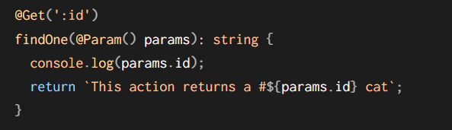
@Param() is used to decorate a method parameter (params in the example above), and makes the route parameters available as properties of that decorated method parameter inside the body of the method. As seen in the code above, we can access the id parameter by referencing params.id. You can also pass in a particular parameter token to the decorator, and then reference the route parameter directly by name in the method body.

Slide 10
QUESTIONS?
You can find us at
Trainer's Facebook profile
Assistant's Facebook Profile
Demo code and Materials
Link to GitHub repository

