Slide 1

TYPESCRIPT pt.2
Trainer – dimitrov.gjorge@protonmail.com
Assistant – anetastankovskaane@gmail.com

Slide 2
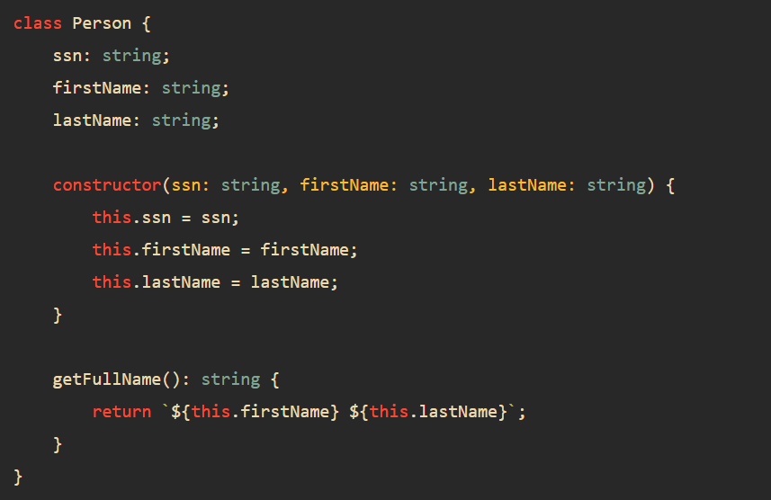
CLASSES IN TYPESCRIPT?
TypeScript class adds type annotations to the properties and methods of the class. The following shows the Person class in TypeScript

Slide 3
When you annotate types to properties, constructor, and method, TypeScript compiler will carry the corresponding type checks.
For example, you cannot initialize the ssn with a number. The following code will result in an error:

Slide 4
ACCESS MODIFIERS
Access modifiers change the visibility of the properties and methods of a class. TypeScript provides three access modifiers:
The private modifier allows access within the same class.
The protected modifier allows access within the same class and subclasses.
The public modifier allows access from any location.
Note that TypeScript controls the access logically during compilation time, not at runtime.

Slide 5
GETTERS & SETTERS
The getters and setters allow you to control the access to the properties of a class.
For each property:
A getter method returns the value of the property’s value. A getter is also called an accessor.
A setter method updates the property’s value. A setter is also known as a mutator.

Slide 6
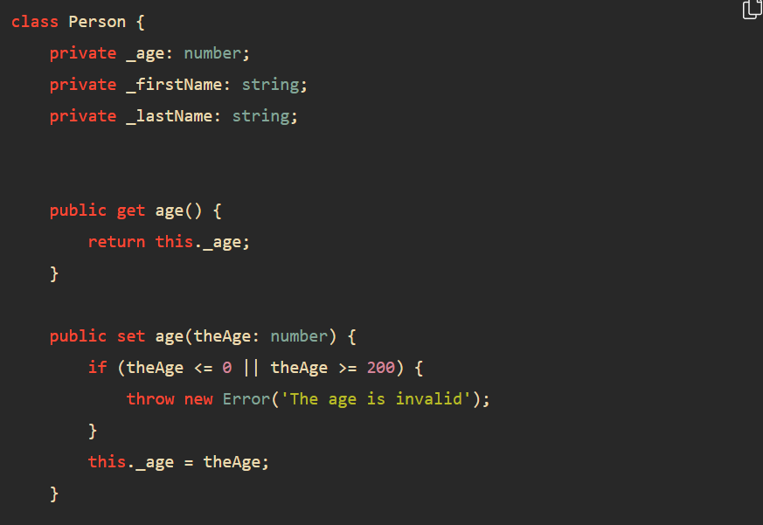
A getter method starts with the keyword get and a setter method starts with the keyword set.

Slide 7
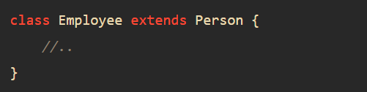
TYPESCRIPT INHERITANCE
To inherit a class, you use the extends keyword. For example the following Employee class inherits the Person class:
In this example, the Employee is a child class and the Person is the parent class.

Slide 8
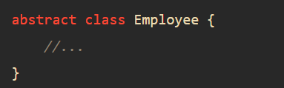
TYPESCRIPT ABSTRACT CLASSES
An abstract class is typically used to define common behaviors for derived classes to extend. Unlike a regular class, an abstract class cannot be instantiated directly.
To declare an abstract class, you use the abstract keyword:

Slide 9
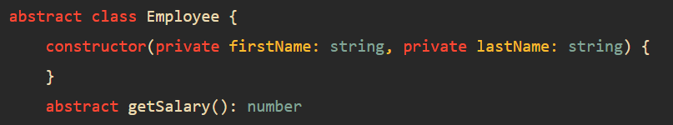
Typically, an abstract class contains one or more abstract methods.
An abstract method does not contain implementation. It only defines the signature of the method without including the method body. An abstract method must be implemented in the derived class.
The following shows the Employee abstract class that has the getSalary() abstract method:

Slide 10
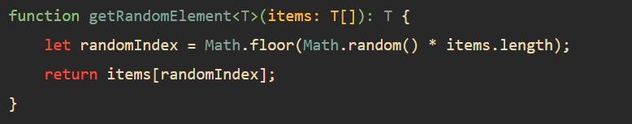
GENERICS
TypeScript generics allow you to write the reusable and generalized form of functions, classes, and interfaces.
The following shows a generic function that returns the random element from an array of type T:

Slide 11
This function uses type variable T. The T allows you to capture the type that is provided at the time of calling the function. Also, the function uses the T type variable as its return type.
This getRandomElement() function is generic because it can work with any data type including string, number, objects,…
By convention, we use the letter T as the type variable. However, you can freely use other letters such as A, B C, …

Slide 12
QUESTIONS?
You can find us at
Trainer's Facebook profile
Assistant's Facebook Profile
Demo code and Materials
Link to GitHub repository

