Slide 1

MIDDLEWARE & GUARDS
Trainer – dimitrov.gjorge@protonmail.com
Assistant – anetastankovskaane@gmail.com

Slide 2
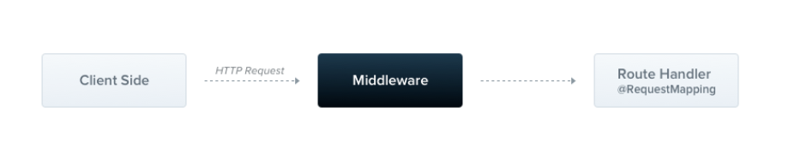
WHAT IS MIDDLEWARE?
Middleware is a function which is called before the route handler. Middleware functions have access to the request and response objects, and the next() middleware function in the application’s request-response cycle. The next middleware function is commonly denoted by a variable named next.

Slide 3
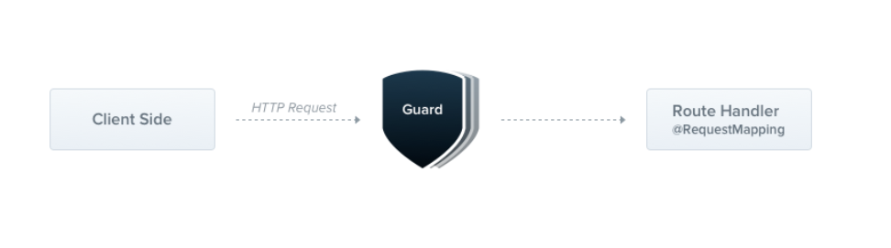
WHAT IS GUARD?
A guard is a class annotated with the @Injectable() decorator, which implements the CanActivate interface.

Slide 4
Guards have a single responsibility. They determine whether a given request will be handled by the route handler or not, depending on certain conditions (like permissions, roles, ACLs, etc.) present at run-time. This is often referred to as authorization.
Guards have access to the ExecutionContext instance, and thus know exactly what's going to be executed next. They're designed, much like exception filters, pipes, and interceptors, to let you interpose processing logic at exactly the right point in the request/response cycle, and to do so declaratively. This helps keep your code DRY and declarative.

Slide 5
Authorization guard
As mentioned, authorization is a great use case for Guards because specific routes should be available only when the caller (usually a specific authenticated user) has sufficient permissions. The AuthGuard that we'll build now assumes an authenticated user (and that, therefore, a token is attached to the request headers). It will extract and validate the token, and use the extracted information to determine whether the request can proceed or not.

Slide 6
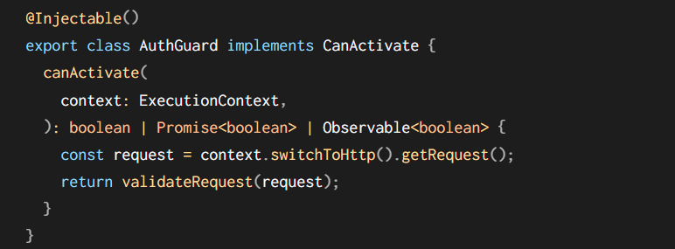

Slide 7
The logic inside the validateRequest() function can be as simple or sophisticated as needed. The main point of this example is to show how guards fit into the request/response cycle.
Every guard must implement a canActivate() function. This function should return a boolean, indicating whether the current request is allowed or not. It can return the response either synchronously or asynchronously (via a Promise or Observable). Nest uses the return value to control the next action:
if it returns true, the request will be processed.
if it returns false, Nest will deny the request.

Slide 8
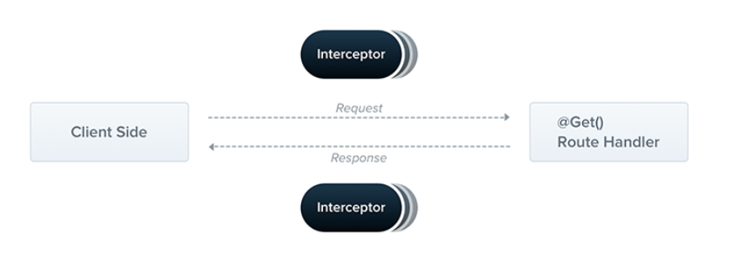
WHAT IS INTERCEPTOR?
An interceptor is a class annotated with the @Injectable() decorator and implements the NestInterceptor interface.

Slide 9
Interceptors have a set of useful capabilities which are inspired by the Aspect Oriented Programming (AOP) technique. They make it possible to:
bind extra logic before / after method execution
transform the result returned from a function
transform the exception thrown from a function
extend the basic function behavior
completely override a function depending on specific conditions (e.g., for caching purposes)

Slide 10
Basics
Each interceptor implements the intercept() method, which takes two arguments. The first one is the ExecutionContext instance (exactly the same object as for guards). The ExecutionContext inherits from ArgumentsHost. We saw ArgumentsHost before in the exception filters chapter. There, we saw that it's a wrapper around arguments that have been passed to the original handler, and contains different arguments arrays based on the type of the application. You can refer back to the exception filters for more on this topic.

Slide 11
Execution context
By extending ArgumentsHost, ExecutionContext also adds several new helper methods that provide additional details about the current execution process. These details can be helpful in building more generic interceptors that can work across a broad set of controllers, methods, and execution contexts. Learn more about ExecutionContexthere.

Slide 12
Call handler
The second argument is a CallHandler. The CallHandler interface implements the handle() method, which you can use to invoke the route handler method at some point in your interceptor. If you don't call the handle() method in your implementation of the intercept() method, the route handler method won't be executed at all.

Slide 13
QUESTIONS?
You can find us at
Trainer's Facebook profile
Assistant's Facebook Profile
Demo code and Materials
Link to GitHub repository

