Slide 1

Intro to NestJS & Modules
Trainer – dimitrov.gjorge@protonmail.com
Assistant – anetastankovskaane@gmail.com

Slide 2
WHAT IS NEST.JS?
Nest (NestJS) is a framework for building efficient, scalable Node.js server-side applications. It uses progressive JavaScript, is built with and fully supports TypeScript (yet still enables developers to code in pure JavaScript) and combines elements of OOP (Object Oriented Programming), FP (Functional Programming), and FRP (Functional Reactive Programming).
Under the hood, Nest makes use of robust HTTP Server frameworks like Express (the default) and optionally can be configured to use Fastify as well!

Slide 3
In recent years, thanks to Node.js, JavaScript has become the “lingua franca” of the web for both front and backend applications. This has given rise to awesome projects like Angular, React and Vue, which improve developer productivity and enable the creation of fast, testable, and extensible frontend applications. However, while plenty of superb libraries, helpers, and tools exist for Node (and server-side JavaScript), none of them effectively solve the main problem of - Architecture.
Nest provides an out-of-the-box application architecture which allows developers and teams to create highly testable, scalable, loosely coupled, and easily maintainable applications. The architecture is heavily inspired by Angular.

Slide 4

NEST CLI
The Nest CLI is a command-line interface tool that helps you to initialize, develop, and maintain your Nest applications. It assists in multiple ways, including scaffolding the project, serving it in development mode, and building and bundling the application for production distribution. It embodies best-practice architectural patterns to encourage well-structured apps.
Install the CLI globally using the npm install -g command.

Slide 5
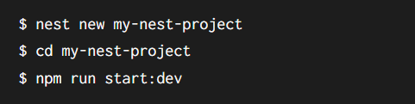
To create, build and run a new basic Nest project in development mode, go to the folder that should be the parent of your new project, and run the following commands:
In your browser, open http://localhost:3000 to see the new application running. The app will automatically recompile and reload when you change any of the source files.

Slide 6
Command overview
Run nest <command> --help for any of the following commands to see command-specific options.
See usage for detailed descriptions for each command.

Slide 7
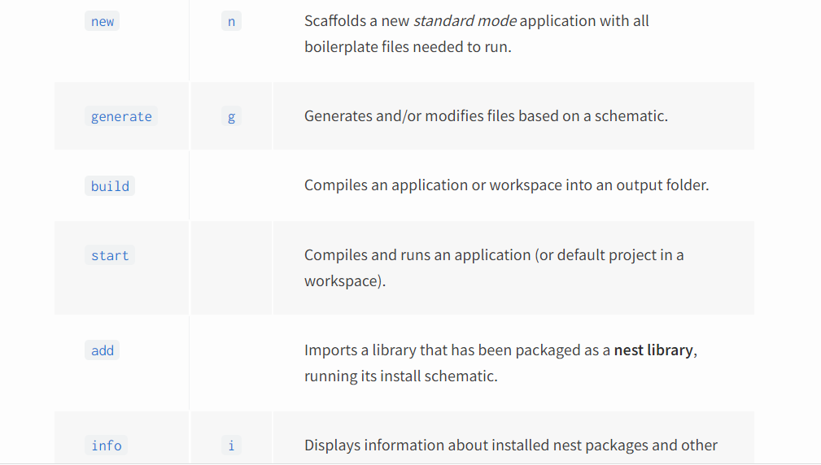

Slide 8
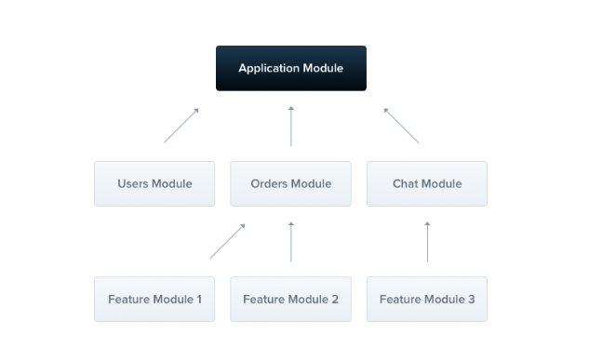
MODULES
A module is a class annotated with a @Module() decorator. The @Module() decorator provides metadata that Nest makes use of to organize the application structure.

Slide 9
Each application has at least one module, a root module. The root module is the starting point Nest uses to build the application graph - the internal data structure Nest uses to resolve module and provider relationships and dependencies. While very small applications may theoretically have just the root module, this is not the typical case. We want to emphasize that modules are strongly recommended as an effective way to organize your components. Thus, for most applications, the resulting architecture will employ multiple modules, each encapsulating a closely related set of capabilities.

Slide 10
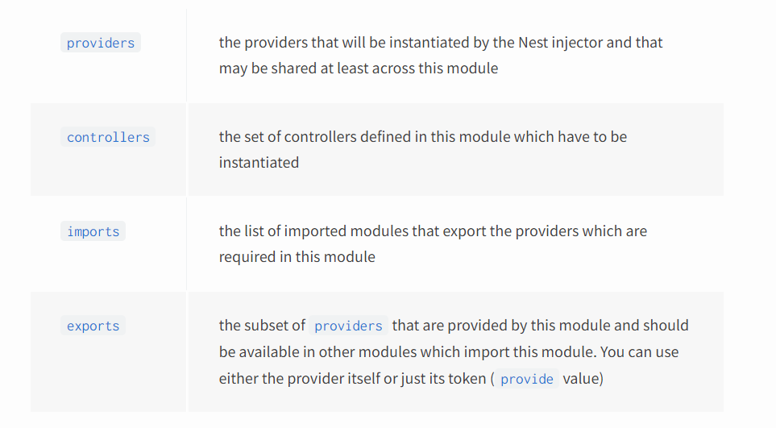
The @Module() decorator takes a single object whose properties describe the module:

Slide 11
FEATURES MODULES
A feature module simply organizes code relevant for a specific feature, keeping code organized and establishing clear boundaries. This helps us manage complexity and develop with SOLID principles, especially as the size of the application and/or team grow.

Slide 12
GLOBAL MODULES
When you want to provide a set of providers which should be available everywhere out-of-the-box (e.g., helpers, database connections, etc.), make the module global with the @Global() decorator.

Slide 13
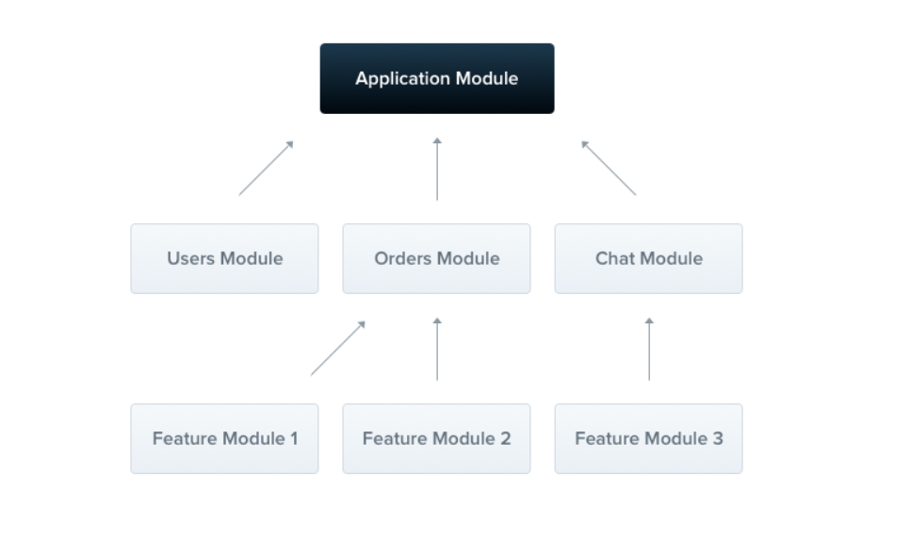

Slide 14
QUESTIONS?
You can find us at
Trainer's Facebook profile
Assistant's Facebook Profile
Demo code and Materials
Link to GitHub repository

