Slide 1

TYPESCRIPT pt.1
Trainer – dimitrov.gjorge@protonmail.com
Assistant – anetastankovskaane@gmail.com

Slide 2
WHAT IS TYPESCRIPT?
TypeScript is a super set of JavaScript
TypeScript builds on top of JavaScript. First, you write the TypeScript code. Then, you compile the TypeScript code into plain JavaScript code using a TypeScript compiler.
Once you have the plain JavaScript code, you can deploy it to any environments that JavaScript runs.
TypeScript files use the .ts extension rather than the .js extension of JavaScript files.

Slide 3
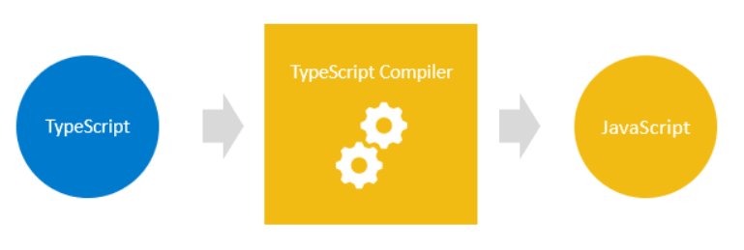

Slide 4
Why TypeScript
1) TypeScript improves your productivity while helping avoid bugs
Types increase productivity by helping you avoid many mistakes. By using types, you can catch bugs at the compile-time instead of having them occurring at runtime.
2) TypeScript brings the future JavaScript to today
TypeScript supports the upcoming features planned in the ES Next for the current JavaScript engines. It means that you can use the new JavaScript features before web browsers (or other environments) fully support them.

Slide 5
TYPES IN TYPESCRIPT
TypeScript inherits the built-in types from JavaScript. TypeScript types is categorized into:
Primitive types
Object types

Slide 6
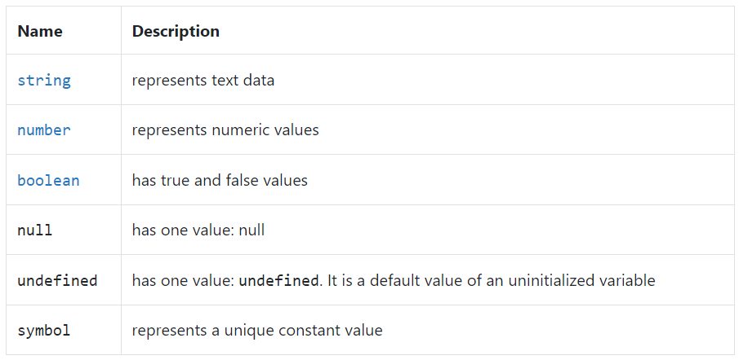
Primitive types
The following illustrates the primitive types in TypeScript:

Slide 7
Object types
Object types are functions, arrays, classes, etc.

Slide 8
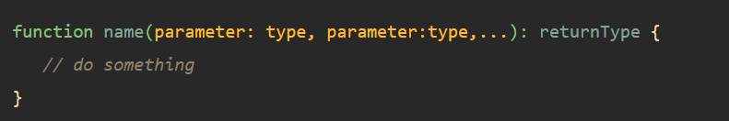
FUNCTIONS
TypeScript functions are the building blocks of readable, maintainable, and reusable code.
Like JavaScript, you use the function keyword to declare a function in TypeScript:
Unlike JavaScript, TypeScript allows you to use type annotations in parameters and return value of a function.

Slide 9
QUESTIONS?
You can find us at
Trainer's Facebook profile
Assistant's Facebook Profile
Demo code and Materials
Link to GitHub repository

