Slide 1

NestJS

Slide 2
NestJS
NestJS is a progressive Node.js framework for building efficient, reliable, and scalable server-side applications. By leveraging TypeScript, NestJS provides a level of abstraction above Node.js, enhancing developer productivity and application maintainability.

Slide 3
Core Concepts of NestJS
At its heart, NestJS introduces several core concepts that organize the application architecture, such as Modules, Controllers, Providers, Services, and Pipes. These concepts are crucial for understanding how to structure and develop applications using NestJS.

Slide 4
Why NestJS?
Type safety with TypeScript
Out-of-the-box application architecture
Extensive ecosystem and integrations
Embraces good programming practices and patterns like Dependency Injection

Slide 5
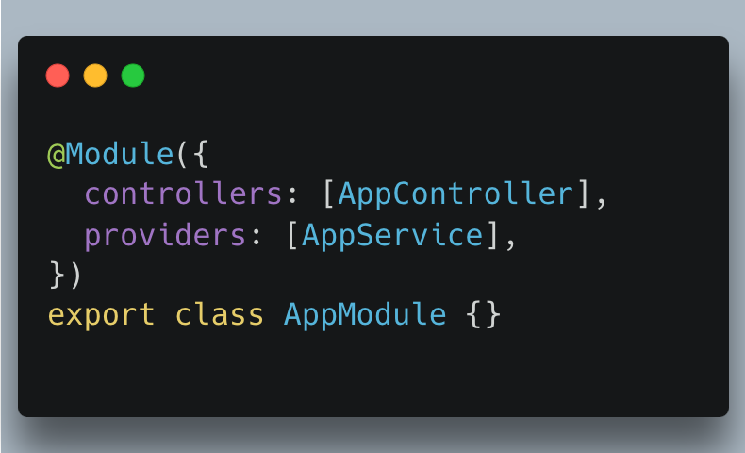
NestJS Modules
Modules are the fundamental building blocks of any NestJS application. They're used to organize related components such as controllers and services into cohesive blocks of functionality.

Slide 6
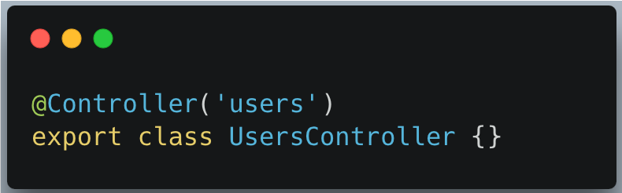
Understanding Controllers
Controllers are responsible for handling incoming requests and returning responses to the client. They define routes and can utilize services to perform business logic.

Slide 7
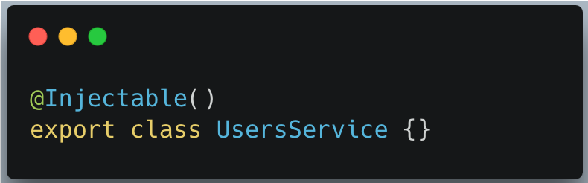
Providers and Services
Providers can be used to define services, repositories, factories, helpers, and more. Services are typically used to encapsulate business logic and data access.

Slide 8
NestJS Project Structure
A typical NestJS project has several directories and files, including modules, controllers, services (providers), DTOs (Data Transfer Objects), and more. Understanding this structure is key to developing applications with NestJS.

Slide 9
First Steps with NestJS
Creating a new NestJS project is straightforward with the Nest CLI. Use nest new project-name to bootstrap a new application.
nest new my-nest-app

Slide 10
Questions?
Trainer Name
Trainer
trainer@mail.com
Assistant Name
Assistant
asistant@mail.com

