Slide 1

TYPESCRIPT

Slide 2
TypeScript
TypeScript is a strongly typed programming language that builds on JavaScript, giving you better tooling at any scale.

Slide 3
WHAT IS TYPESCRIPT?
TypeScript is a super set of JavaScript
TypeScript builds on top of JavaScript. First, you write the TypeScript code. Then, you compile the TypeScript code into plain JavaScript code using a TypeScript compiler.
Once you have the plain JavaScript code, you can deploy it to any environments that JavaScript runs.
TypeScript files use the .ts extension rather than the .js extension of JavaScript files.

Slide 4
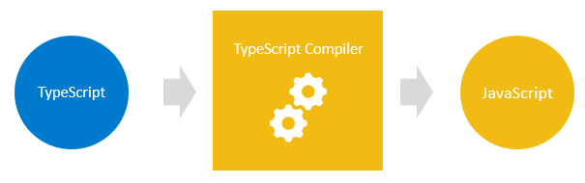
Compiling TypeScript

Slide 5
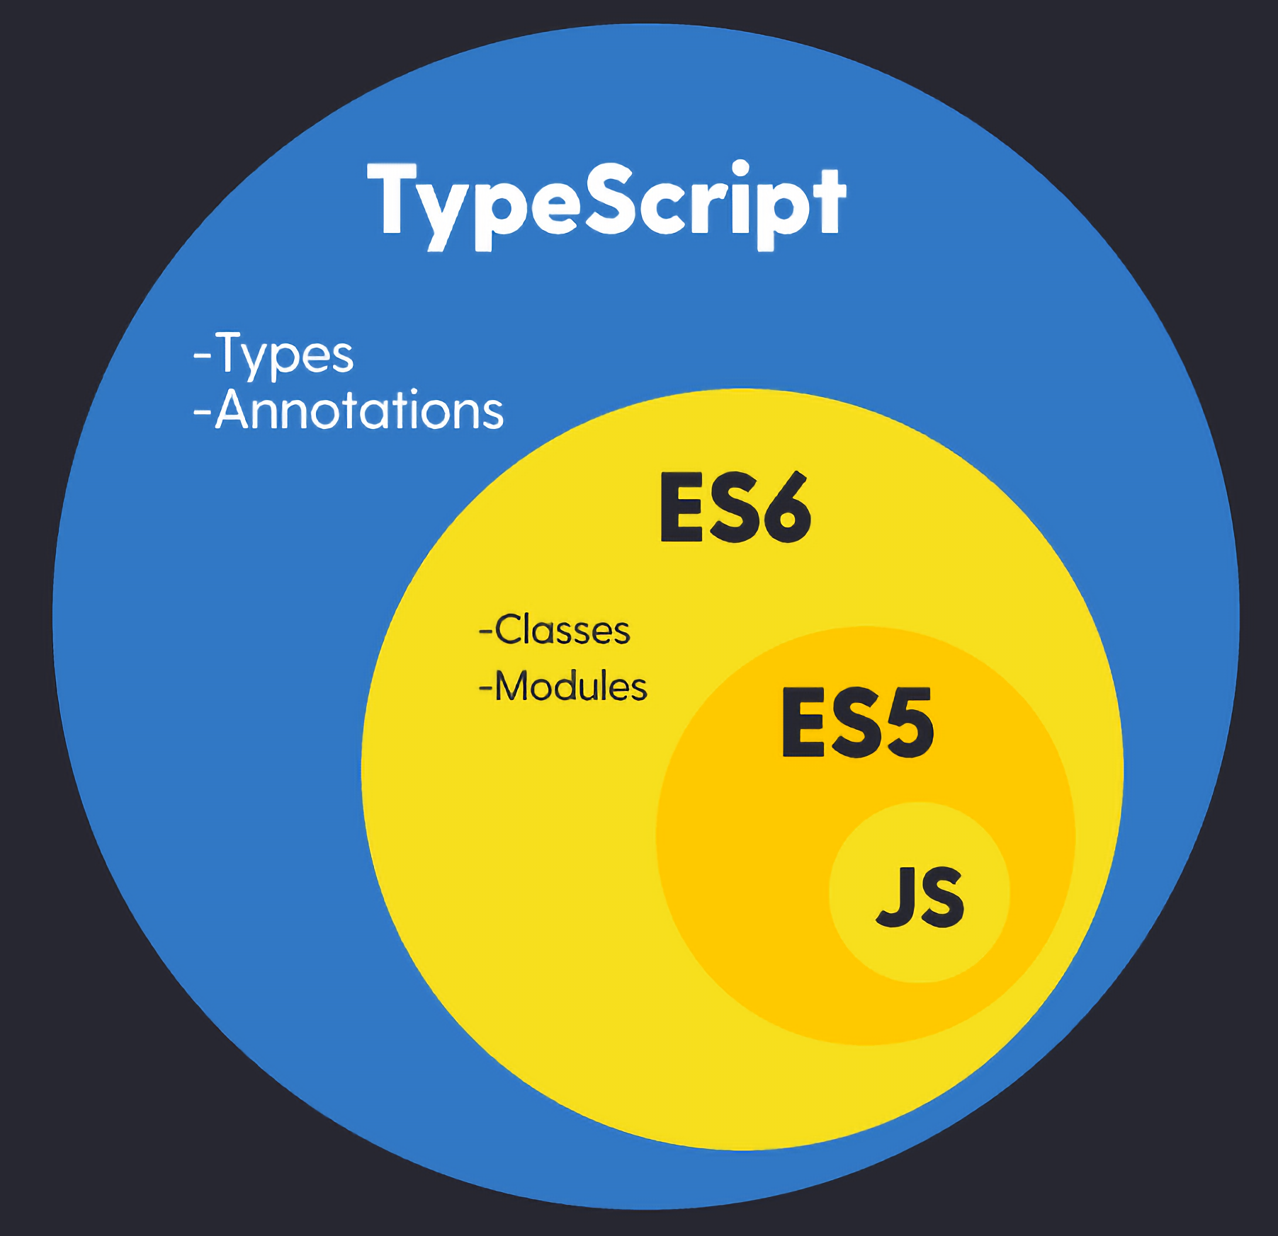
TypeScript adds types and annotations to JavaScript

Slide 6
Why TypeScript?
TypeScript improves your productivity while helping avoid bugs
Types increase productivity by helping you avoid many mistakes. By using types, you can catch bugs at the compile-time instead of having them occurring at runtime.
TypeScript brings the future JavaScript to today
TypeScript supports the upcoming features planned in the ES Next for the current JavaScript engines. It means that you can use the new JavaScript features before web browsers (or other environments) fully support them.

Slide 7
TYPES IN TYPESCRIPT
TypeScript inherits the built-in types from JavaScript. TypeScript types is categorized into:
Primitive types
Object types

Slide 8
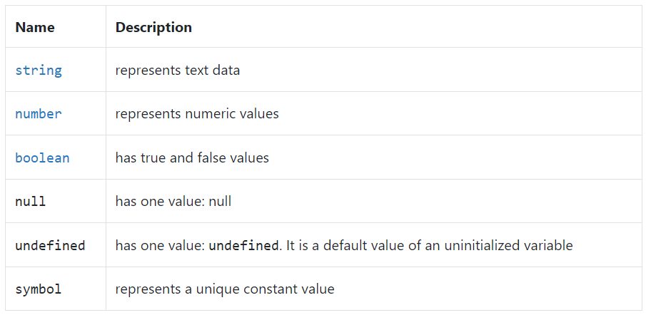
Primitive types
The following illustrates the primitive types in TypeScript

Slide 9
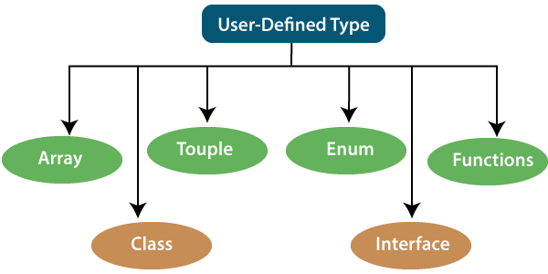
Object types
The following illustrates the object types in TypeScript

Slide 10
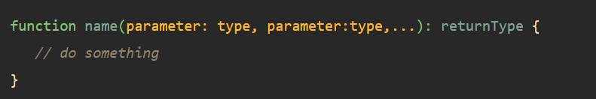
FUNCTIONS
TypeScript functions are the building blocks of readable, maintainable, and reusable code.
Like JavaScript, you use the function keyword to declare a function in TypeScript:
Unlike JavaScript, TypeScript allows you to use type annotations in parameters and return value of a function.

Slide 11
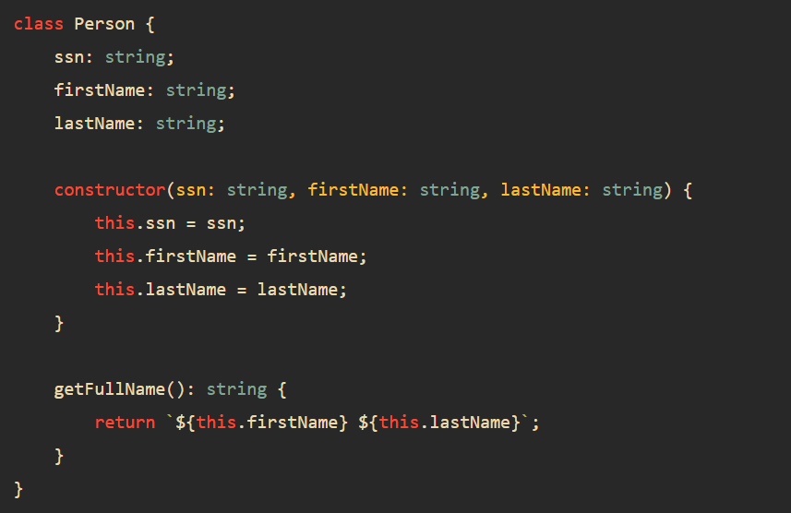
CLASSES IN TYPESCRIPT?
TypeScript class adds type annotations to the properties and methods of the class. The following shows the Person class in TypeScript

Slide 12
CLASSES IN TYPESCRIPT?
When you annotate types to properties, constructor, and method, TypeScript compiler will carry the corresponding type checks.
For example, you cannot initialize the ssn with a number. The following code will result in an error:

Slide 13
ACCESS MODIFIERS
Access modifiers change the visibility of the properties and methods of a class. TypeScript provides three access modifiers:
The private modifier allows access within the same class.
The protected modifier allows access within the same class and subclasses.
The public modifier allows access from any location.
Note that TypeScript controls the access logically during compilation time, not at runtime.

Slide 14
GETTERS & SETTERS
The getters and setters allow you to control the access to the properties of a class.
For each property:
A getter method returns the value of the property’s value. A getter is also called an accessor.
A setter method updates the property’s value. A setter is also known as a mutator.

Slide 15
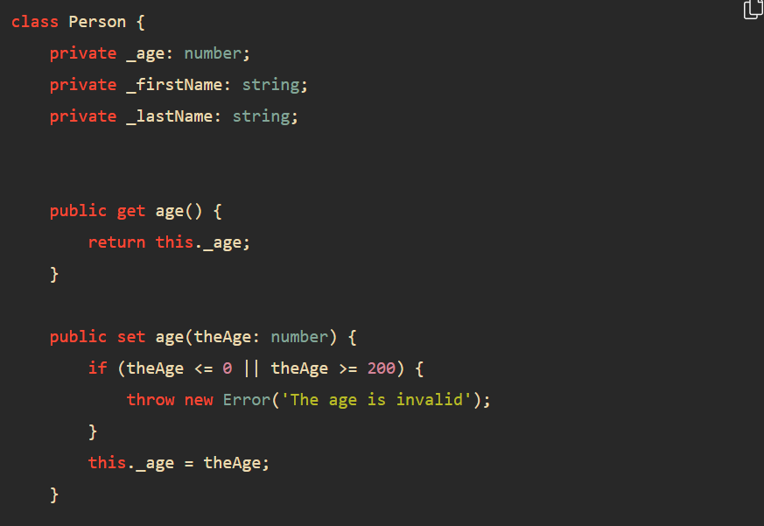
GETTERS & SETTERS
A getter method starts with the keyword get and a setter method starts with the keyword set.

Slide 16
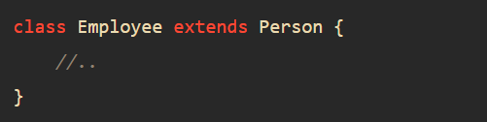
TYPESCRIPT INHERITANCE
To inherit a class, you use the extends keyword. For example the following Employee class inherits the Person class:
In this example, the Employee is a child class and the Person is the parent class.

Slide 17
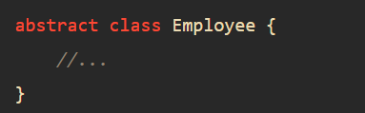
TYPESCRIPT ABSTRACT CLASSES
An abstract class is typically used to define common behaviors for derived classes to extend. Unlike a regular class, an abstract class cannot be instantiated directly.
To declare an abstract class, you use the abstract keyword:

Slide 18
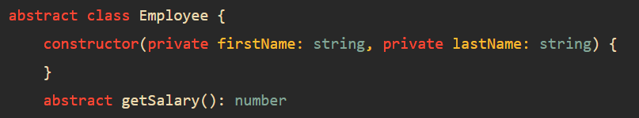
TYPESCRIPT ABSTRACT CLASSES
Typically, an abstract class contains one or more abstract methods.
An abstract method does not contain implementation. It only defines the signature of the method without including the method body. An abstract method must be implemented in the derived class.
The following shows the Employee abstract class that has the getSalary() abstract method:

Slide 19
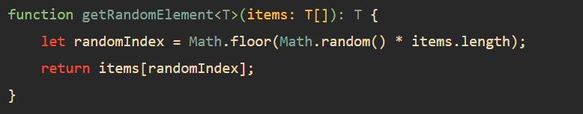
GENERICS
TypeScript generics allow you to write the reusable and generalized form of functions, classes, and interfaces.
The following shows a generic function that returns the random element from an array of type T:

Slide 20
GENERICS
This function uses type variable T. The T allows you to capture the type that is provided at the time of calling the function. Also, the function uses the T type variable as its return type.
This getRandomElement() function is generic because it can work with any data type including string, number, objects,…
By convention, we use the letter T as the type variable. However, you can freely use other letters such as A, B C, …

Slide 21
Questions?
Trainer Name
Trainer
trainer@mail.com
Assistant Name
Assistant
asistant@mail.com

