Slide 1

NodeJS
Backend with JS
Trainer: Trainer Name
Assistant: Assistant Name

Slide 2

Class plan
Introduction to nodejs and environment variables
Modules (MVC)
Express routing and middleware
JWT tokens and session handling
Definition of entities and CRUD
Definition of endpoints and API testing
Firebase integration & introduction to cloud (GCP)

Slide 3
Introduction to nodejs
Node.js is an an event-driven, non-blocking I/O server that makes it lightweight and efficient, perfect for data-intensive real-time applications that run across distributed devices.
Node.js is an open source, cross-platform runtime environment for developing server-side and networking applications.
It works as a cross platform and it is possible to be executed on all major platforms (OSs)
NPM (node package manager)
What is package.json
NPM Scripts

Slide 4
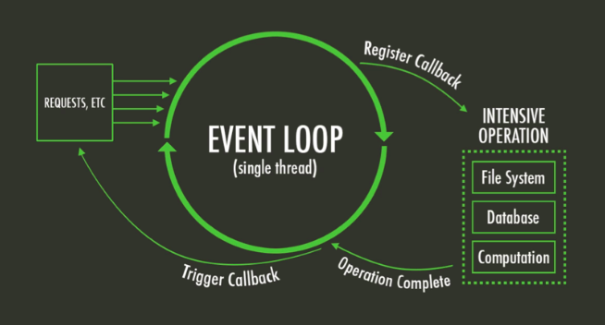
Event driven (event loop)
Process
EventEmitter
Require
Import
Export

Slide 5

Questions?

