Slide 1

ALM
Whole project flow and tools
Trainer: Trainer Name
Assistant: Assistant Name

Slide 2

Class plan
GIT
JIRA (Project management tool)
Project ownership

Slide 3
GIT
What is GIT?
Repository (bitbucket)
Default commands
GIT flow
Feature branches
Pull Requests (PR) & Code Review (CR)
Merging

Slide 4
Git is a free and open source distributed version control system designed to handle everything from small to very large projects with speed and efficiency.
Generically refers to a central place where data is stored and maintained. A repository can be a place where multiple databases or files are located for distribution over a network, or a repository can be a location that is directly accessible to the user without having to travel across a network.
Default commands:
clone
config
--- GIT team flow
pull
status
add
commit
push
The advantage of feature branching is that each developer can work on their own feature and be isolated from changes going on elsewhere. *master, *develop, *feature-branches

Slide 5
A pull request is a method of submitting contributions to an open development project. It is often the preferred way of submitting contributions to a project using a distributed version control system (DVCS) such as Git. A pull request occurs when a developer asks for changes committed to an external repository to be considered for inclusion in a project’s main repository.
Code review (sometimes referred to as peer review) is a software quality assurance activity in which one or several people check a program mainly by viewing and reading parts of its source code, and they do so after implementation or as an interruption of implementation. At least one of the persons must not be the code's author. The persons performing the checking, excluding the author, are called "reviewers".
Merge is the process of combining the various versions of a file or folder. This feature is typically found in version control software as a fundamental operation that is responsible for reconciliation of changes of data in a file. Merging software is able to combine changes in files placed in two different systems or used by different users.

Slide 6
Project management (JIRA)
Jira Software is part of a family of products designed to help teams of all types manage work.
Project
Stories
Epic
Methodologies (Agile, Scrum, Kanban)
Retrospective

Slide 7
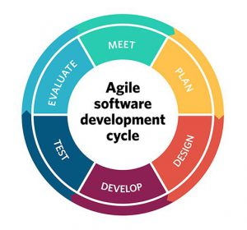
Agile
Meet and review requirements
Make a plan (Sprint planning)
Make a design
Start deveopment
Test the features
Evaluate the progress
All over again

Slide 8
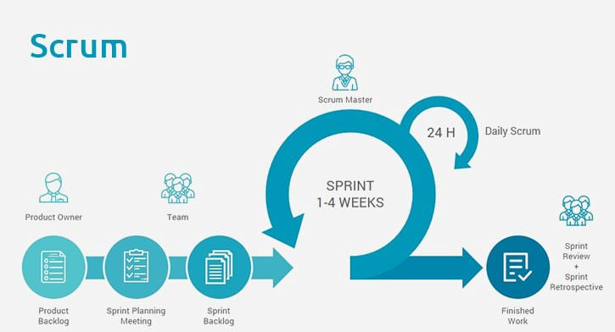
Scrum
Scrum is an agile project management methodology or framework used primarily for software development projects with the goal of delivering new software capability every 2–4 weeks.

Slide 9
Project ownership (flow)
Project Flow is an indicator of change planned for occurrence within a project over time. It shows the movement of project product from its conceptualization and design through delivery and deployment.
Project main parts (business logic, backend, frontend, database)
INIT the plan for the project.
“Restourant order platform”

Slide 10

Questions?

